Slide 1
WP5 Adaptation of community climate evaluation tools for CCI
A. Lauer, V. Eyring, B. Hassler, S. Zechlau (DLR), J. Vegas, K. Serradell (BSC), D. Hemming, R. King (Met Office), U. Willén, K. Zimmermann (SMHI)

Slide 2
Overview WP5
The aims of WP5 (WP5.1-5.4, 5.6, 5.7) are:
Exploit CCI and CCI+ data for evaluation of earth system models (ESMs)
Enhance the ESMValTool with additional diagnostics and performance metrics for the evaluation of models with ESA CCI and CCI+ data
Enhance use of ESA CCI and CCI+ data for climate model evaluation in the Climate Model Intercomparison Project (CMIP)
Make a substantial contribution to the CMIP Phase 6 (CMIP6)
Maintain and extend Climate Monitoring Facility (CMF) (database)
Support ECV projects in processing and uploading their data to the obs4MIPs database

Slide 3
Overview WP5
Scientific questions to be addresses in WP5
How well can state-of-the-art ESMs simulate climatological mean, variability and trends in selected ECVs?
What is the progress achieved in CMIP6 compared with CMIP5 in selected ECVs?
Are the new ESA CCI data complementing and changing global and regional model evaluation and benchmarking?

Slide 4

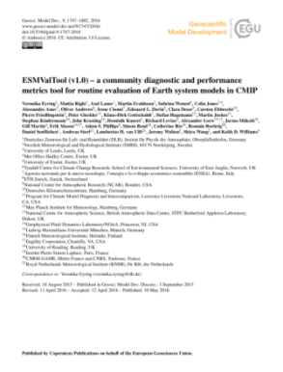
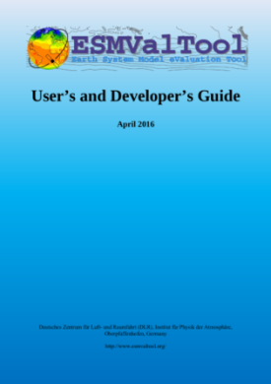
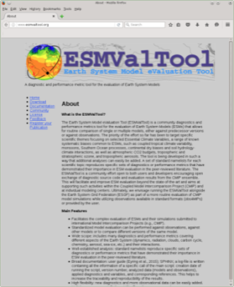
ESMValTool
http://www.esmvaltool.org/
Community diagnostics and performance metrics tool for the evaluation of Earth System
Standardized model evaluation can be performed against observations, against other models or to compare different versions of the same model
Many diagnostics and performance metrics covering different aspects of the Earth System (dynamics, radiation, clouds, carbon cycle, chemistry, aerosol, sea-ice, etc.) and their interactions
Well-established analysis based on peer-reviewed literature
Ensuring traceability and provenance (e.g. input data, metadata, diagnostics (incl. citation), tool version, doi)
Documentation and user guide
Currently ≈ 80 scientist from >30 institutions part of the development team and > 120 users
Development in several projects (e.g. APPLICATE, CMIP6-DICAD, CRESCENDO, C3S-MAGIC, ESA CMUG, PRIMAVERA)
Rapidly expanding
https://github.com/ESMValGroup/ESMValTool
Eyring et al., ESMValTool v1.0, GMD, 2016
v2.0 documentation paper for CMIP6 in prep.

Slide 5
ESMValTool and previous CMUG work
ESA CCI datasets implemented into ESMValTool v1.1.0
Dataset / Diagnostic | Variable(s) | Resolution | Years
Aerosol | od550aer, od870aer, od550lt1aer, abs550aer | 1°x1° | 1997-2011
Cloud | clt, clwvi, clivi | 0.5°x0.5° | 1982-2014
Fire | burntArea | 0.25°x0.25° | 2005-2011
Greenhouse Gases | xco2 | 5°x5° | 2003-2008
Ozone | tro3, tropoz, toz | 1°x1° | 1997-2010
Land Cover | lccs_class: grassNcropFrac, shrubNtreeFrac | 300 m | 2000, 2005, 2010
Sea Ice | sic | 25 km | 1992-2008
Sea Surface Temperature | tos | 0.05°x0.05° | 1992-2010
Soil Moisture | sm | 0.25°x0.25° | 1988-2005
Lauer et al., Remote Sensing of Environment, 2017

Slide 6
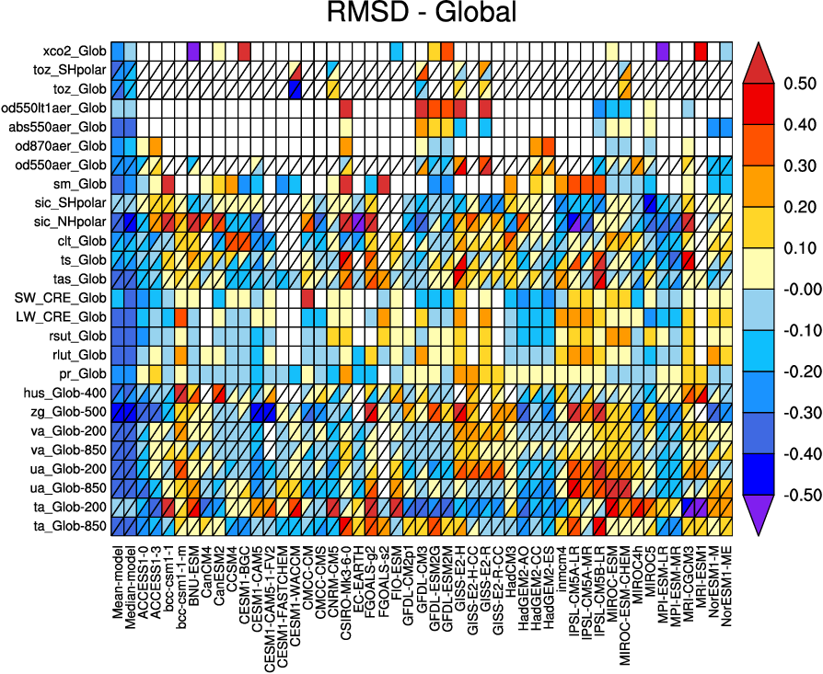
ESMValTool and previous CMUG work
Example: Model evaluation using CCI data (overview model performance)
Overview of CMIP5 model performance
RMSD of seasonal cycle calculated at each grid cell
starting point for further evaluation
blue shading = better performance than median RMSD
red shading = worse performance than median RMSD
ESA CCI datasets
greenhouse gases
ozone
aerosol
soil moisture
sea ice
cloud
SST

Slide 7
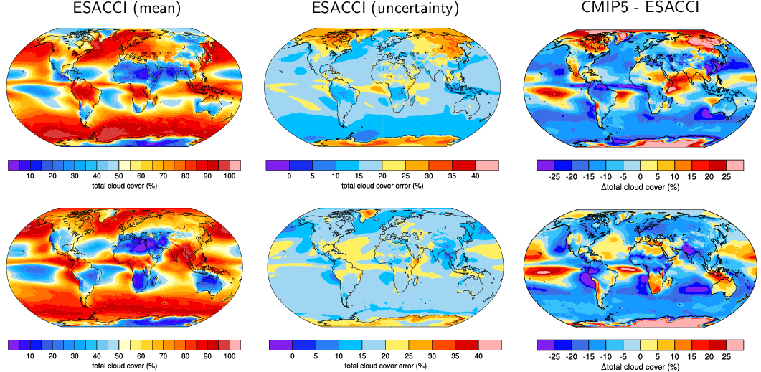
ESMValTool and previous CMUG work
Example: Model evaluation using CCI data including uncertainty information
(seasonal mean total cloud cover)
DJF
From: Lauer et al., Remote Sensing of Environment, 2017
JJA

Slide 8
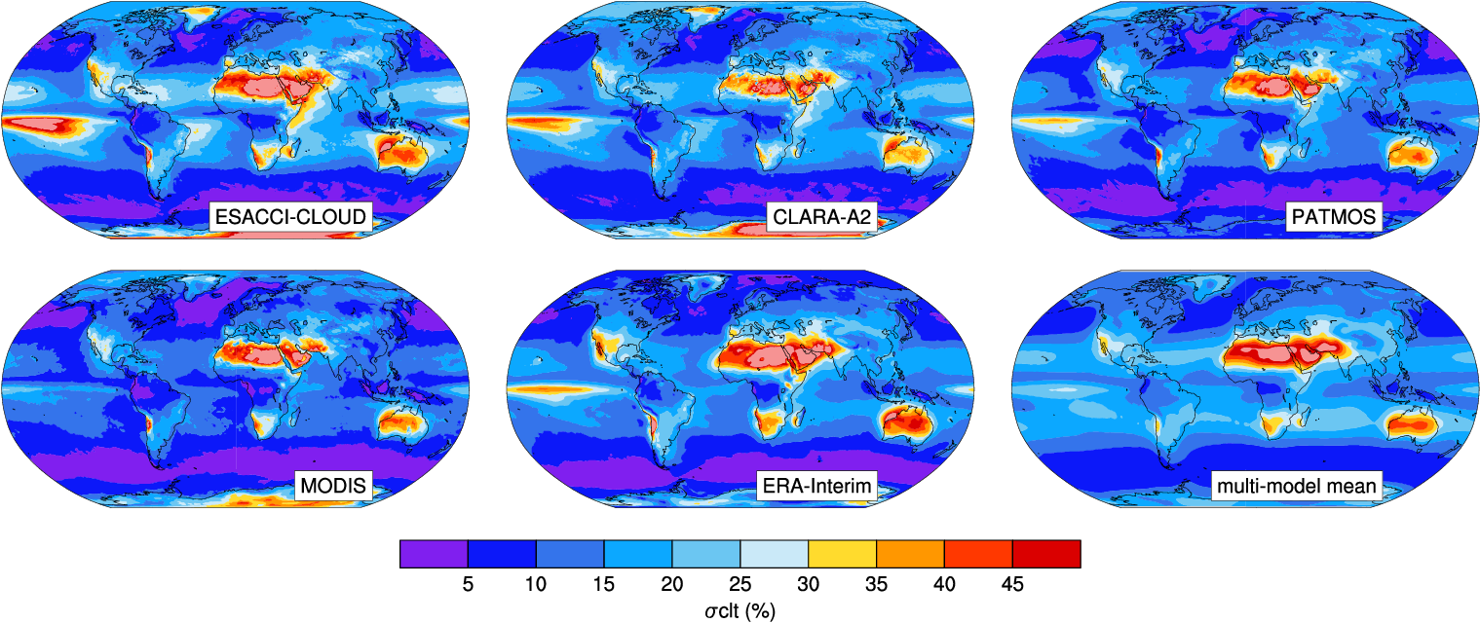
ESMValTool and previous CMUG work
Example: Comparison of CCI data with observations
(interannual variability of total cloud cover)
From: Lauer et al., Remote Sensing of Environment, 2017

Slide 9
WP5 tasks and WPs
Task 5.1 Coordination, support and documentation of ESMValTool CMUG activities
Task 5.3 Implemenation of CCI and CCI+ products into the ESMValTool
Task 5.4 Evaluating the CMIP6 ensemble with ESA CCI and CCI+ data using the ESMValTool
WP 5.6 Adaptation of the CMF and CMF database
WP 5.7 CCI Contribution to Obs4MIPs

Slide 10
Task 5.1 Coordination and support ESMValTool
Main aims
Coordination of ESMValTool activities with other projects
Release enhanced project version of ESMValTool as open source software
Tasks
Quality control of pull requests (GitHub) of new ESA CMUG contributions to the ESMValTool
Ensuring provenance in the output of the ESMValTool (netCDF, plots) including information on input data, metadata, diagnostics, tool version, etc.
Release enhanced ESMValTool and user’s guide at the end of the project
Maximize synergies with other relevant projects such as obs4MIPs, ESGF, CMIP, C3S-MAGIG, C3S-511, APPLICATE, CRESCENDO, PRIMAVERA

Slide 11
Task 5.3 Implementation of CCI(+) products
Main aims
Integration of new CCI+ data and CCI data that have not yet been implemented (e.g. methane) into the ESMValTool
Provide generic “recipe” as starting point for implementation of a specific ECV and ECV specific diagnostics by responsible CMUG partners
CCI/CCI+ data | CMUG partner
Land surface temperature | MetO
Long-lived GHGs (CH4) | DLR
Water vapor | DLR
Sea surface salinity | BSC
Ocean color | SMHI

Slide 12
Task 5.4 Evaluating CMIP6 models
Main aims
Running the enhanced ESMValTool on CMIP5 and CMIP6 ensembles
Address scientific questions as outlined in WP5 overview
Contribute to IPCC AR6 (peer reviewed publication on results submitted before IPCC AR6 WG I cut-off date)
Tasks
Application of the ESMValTool to CMIP6 model results
Assessment of CMIP6 model performance focusing on newly implemented variables
Assessment of progress in CMIP6 w.r.t. CMIP5

Slide 13
Task 5.7 CCI contribution to obs4MIPs
Main aims
Support to existing and new ECV projects in processing and uploading their data to the obs4MIPs database in the correct format and configuration
Tasks
Provide technical support to CCI teams
Reformatting (low spatial and temporal resolution) data to the obs4MIPs format (netCDF with CMOR-compliant metadata)
Publishing these datasets on the Earth System Federation Grid (ESGF)
Provide training material to assist CCI team preparing their datasets in obs4MIPs format

Slide 14
WP5 Adaptation of community climate evaluation tools for CCI
Interactions and links within CMUG and with ECV teams
Close collaboration with CMUG teams implementing ECVs into ESMValTool (MetO, DLR, BSC, SMHI)
Exchange with CCI teams providing ECVs for ESMValTool (e.g. additional information on possible applications and limitations of ECV products for model evaluation)
Support to and feedback from CCI teams for obs4MIPs preparation of datasets
Peer-reviewed publication on CMIP6 model evaluation with ESA CCI/CCI+ data (CMUG and one collaborator from ESA CCI teams)

Slide 15
WP5 Adaptation of community climate evaluation tools for CCI
Expected outcomes
Enhanced version of the ESMValTool including documentation with diagnostics and metrics for model evaluation with ESA CCI/CCI+ data
Report on CMIP6 global model evaluation with ESA CCI/CCI+ data and comparison with CMIP5 results in support of IPCC AR6
Updated CMF (database)
CCI obs4MIPs datasets

