Slide 1
Land Surface Temperature ECV
Darren Ghent & Lizzie Good

Slide 2
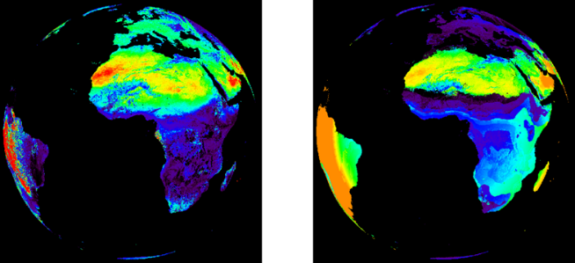
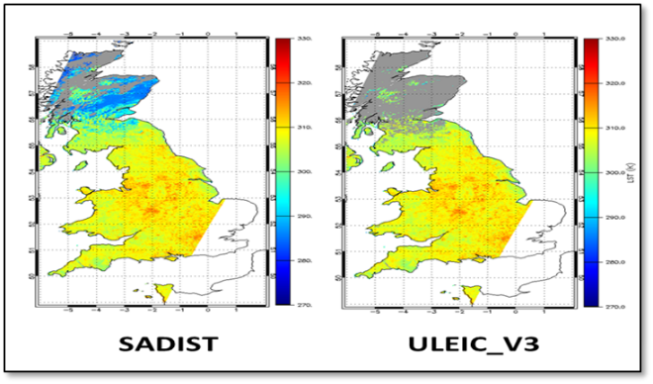
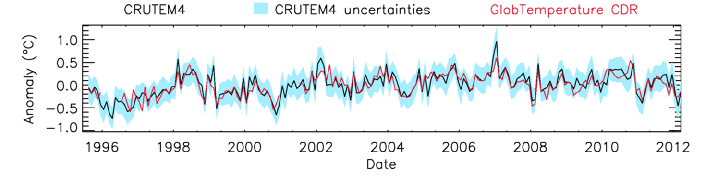
Overview
Algorithm development
  Retrieval algorithm consistency across LST ECV products
Ensure consistency of uncertainty approach
  Components separated according to correlation properties
Optimisation of best cloud clearing detection
  Best cloud clearing approaches for IR CDRs
Long-term CDRs
  25 years (1995 to 2020) from ATSR to Sentinel-3 IR CDR
  22 years (1998 to 2020) for Passive microwave time series
  10 years (2010 to 2020) for Merged IR CDR
Website: cci.esa.int/lst

Slide 3
Feedback from CMUG session
LST is a popular variable in the CMUG
  15 proposed CMUG experiments using LST
LST CCI CRG/Project Team will aim to liaise with experiment leads
Good to see some work considering uncertainties – this is a key aim for LST CCI

Slide 4
UR Consistency with Needs
Will your User Requirements be consistent with the needs of the Climate Research Groups (CRGs), CMUG needs, and GCOS requirements, including source traceability?
User Requirements Document produced from:
Background from GCOS & existing requirements (e.g. GlobTemp URD)
Survey at joint ISWG/LSA-SAF ‘Remote sensing and modelling’ workshop in Lisbon to guide further requirements gathering
Online survey – issued via Climlist, Twitter (ESA, Met Office, NCEO, …), emailed to CMUG & CM SAF, and via other lists (transferred list from GlobTemp)….
Interviews with CRG (6 UCS, 2 additional members, including one from CMUG)
Table in URD of requirements with source traceability

Slide 5
Product Specification Development
How will your product specifications develop to meet the needs of your individual Climate Research Group, how will the CRGs use the proposed products in their applications?
URD to inform v1 design of products
Issue v0 of data to CRG by M12 (by May 2019)
CRG will use data:
  6 UCS: Global & regional trends, Greenland ice sheet, surface urban heat islands, biosphere-atmosphere exchange, integrated use of data in urban areas, LST integration into surface energy balance model
  CMUG: LST-air temp as an indicator of vegetation stress
  MeteoSwiss: regional climate monitoring in Swizterland, focusing on drought, urban heat and frost monitoring
CRG feedback -> v2 URD -> v2 design of products

Slide 6
ECV Integrated Perspective
How will you address the integrated perspective for consistency between the ECVs, including identification of gaps?
Greenland IS CCI:
  Links through UCS #2
Lakes:
  Compare consistency of LSWT retrievals over Lakes
Permafrost:
  Input of LST CCI data into the Permafrost Project
Land Cover:
  Consistency in land-sea masking and gridded biome products
Soil Moisture:
  Assess consistency with CCI soil moisture products [UCS #5]
Consistent grids for different ECV products?

Slide 7
Uncertainties
How will you deal with uncertainties in products?
Have proposed an uncertainty model based on SST CCI, GlobTemperature & EUSTACE
  Based on user input & scientific capability
  Uncertainty components: random, locally correlated (surface and atmospheric components), systematic
  Enables appropriate propagation of uncertainties
Described and proposed this in online survey
  Most people interested in using uncertainty components
  Need good documentation on how to use uncertainties
URD will recommend adoption of this model in v1 of LST CCI products

Slide 8
Schedule of Data
V0: May 2019 CDRP V1: Oct 2019 CDRP V2: April 2021
Instrument | Satellite(s) | Time Window | Comments
AVHRR/3 | NOAA 15-19 | 1998 – 2016 | Global area coverage (4km)
 | Metop A-C | 2007 – 2020 | FRAC (1km)
ATSR-2 | ERS-2 | 1995 – 2003
AATSR | Envisat | 2002 – 2012
SLSTR | Sentinel 3A+B | 2016 – 2020
MODIS | Terra | 1999 – 2020
 | Aqua | 2002 – 2020
SEVIRI | MSG 1-4 | 2004 – 2020 | Geostationary ↓
Imager | GOES 12-16 | 2004 – 2020
JAMI | MTSAT-2 | 2009 – 2015
SSM/I | DMSP F-8, 11, 13, 17 | 1993 – 2020 | Microwave, near polar orbiting
ATSR-MODIS-SLSTR CDR | ATSR-2, AATSR, MODIS, SLSTR | 1995 – 2020 | Merged products ↓ ATSR-2 to SLSTR
Merged IR CDR | GEO + LEO IR | 2009 – 2020 | 3 hourly merged GEO + LEO
Experimental IR + MW | Select IR + MW | 1 year (2010) | Global diurnal cycle, clear + cloudy

Slide 9
Needs for ECMWF Reanalysis Data in LST CCI
What are your data needs for ECMWF reanalysis data?
As atmospheric profiles and surface data for the generation of retrieval coefficients via radiative transfer modelling
As atmospheric profiles and surface data for the generation of clear sky probabilities via radiative transfer modelling in conjunction with satellite brightness temperature observations
As input fields for LST retrievals (water vapour)
As auxiliary fields in LST products (interpolated onto the satellite tie-point grids)
For radiance-based validation of LST
For inter-comparison of LST with skin temperature fields

Slide 10
CRG Work Complementary to CMUG
How will you know if your CRG work is complementary with CMUG research?
Attendance by Science Lead & CRG Lead at Integration, collocation meetings
Regular interaction with CMUG:
  LST CRG lead & CMUG lead both based at Met Office Hadley Centre
  CMUG representative on LST CCI CRG
Lessons learnt from existing CCI – CMUG interactions

Slide 11
Future Meetings & Workshops
What meetings do you plan to attend over the next 12 months? Colocation, Living Planet
CCI Colocation Meeting:
  Science Lead
  CRG Lead
  Data Engineering Lead
GCOS Joint Panel Meeting
  Science Lead attending as member of TOPC
ESA Living Planet Symposium 2019:
  Science Lead chairing session
  Participation in 'Observations for supporting the UNFCCC Paris Agreement’ session
  Representation from most core partners
EGU 2019:
  Prime attending (and chairing session)
3rd International Surface Working Group (ISWG):
  Science Lead + representatives from other core partners
Joint EUMETSAT/AMS/NOAA Conference 2019
  Science Lead + expected representatives from other core partners

