Slide 1
CMUG meeting: Fire_cci project
M. Lucrecia Pettinari
University of Alcala - Spain

Slide 2
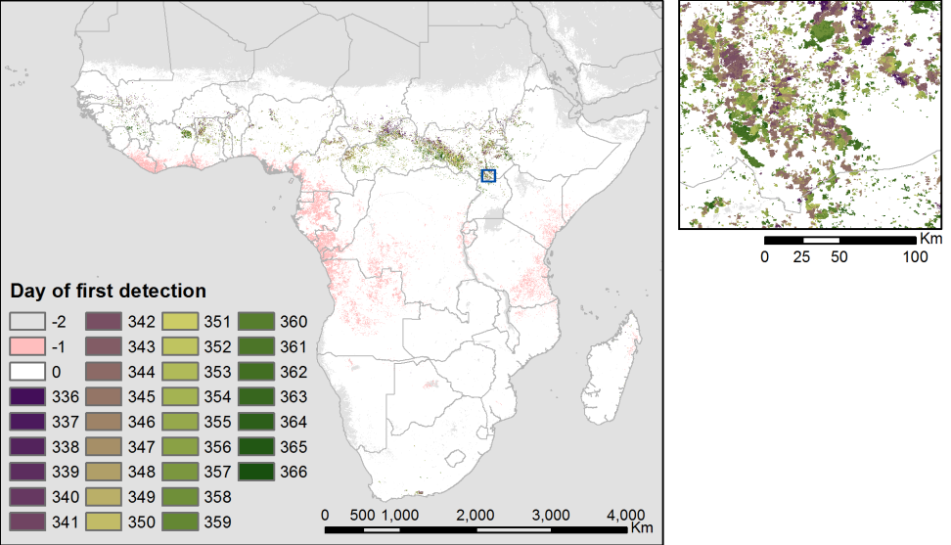
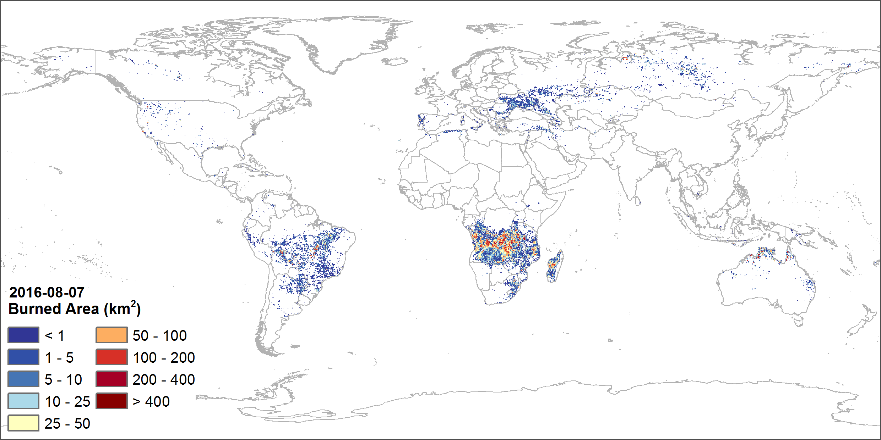
User requirements and product specifications
User requirements at the basis of the development of the products
Different types of products developed for different applications: pixel and grid
  Two kind of users:
    Climate, emissions and GDVM modellers
    Terrestrial and fire ecology, fire management, change detection, regional studies

Slide 3
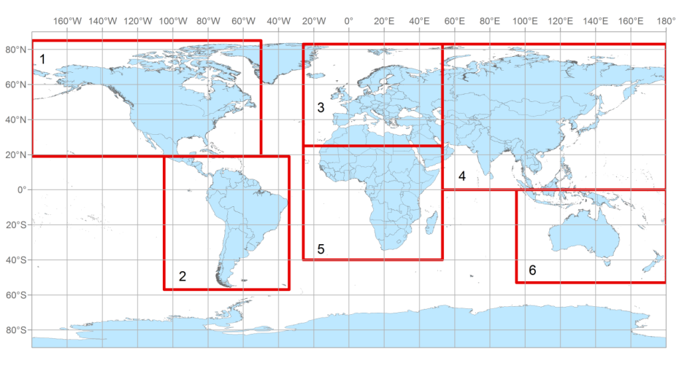
Fire_cci products
Fire_cci burned area products
Pixel products:
Spatial resolution: the one corresponding to the sensor
Layers: Day of first detection (JD), confidence level (CL), land cover of burned areas (LC).
Continental subsets, GeoTIF files.
Monthly products
Grid products:
Spatial resolution: 0.25 degrees
Layers: total burned area, standard error, fraction of burnable area, fraction of observed area, number of patches, burned area per land cover (18 layers)
Global NetCDF files.
Fortnightly or monthly products

Slide 4
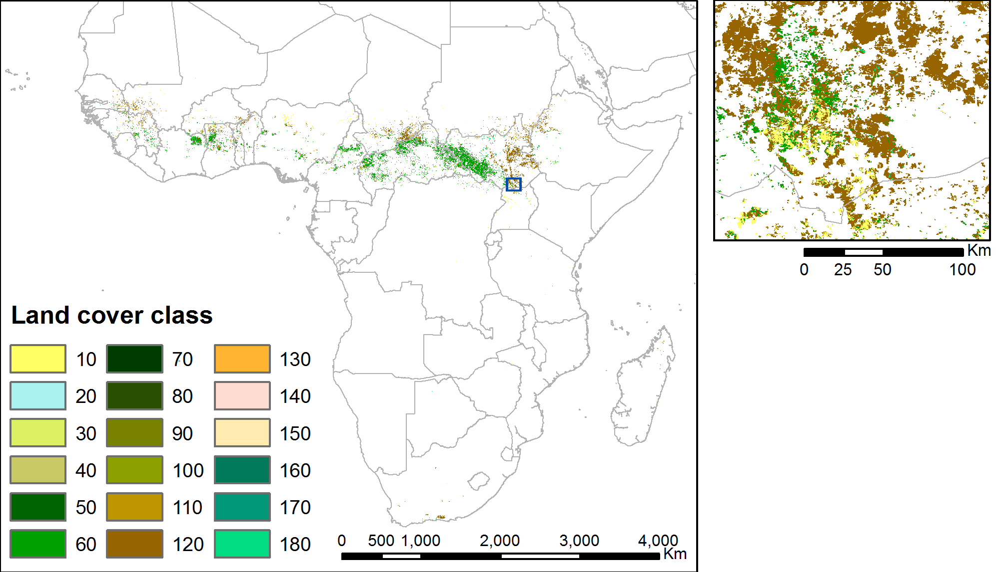
User requirements and product specifications
User requirements at the basis of the development of the products
Product specifications have evolved based on the requests of the users.
E.g.:
  Subsetting of pixel datasets to make them manageable for the users
  Spatial resolution of the grid product (from 0.5 to 0.25 degrees)
  Temporal resolution of the grid product (from fortnightly to monthly)
  Product layers (fraction of burnable area & fraction of observed area)
ECV consistency: using LC_cci for masking burnable land cover and providing burned land cover.

Slide 5
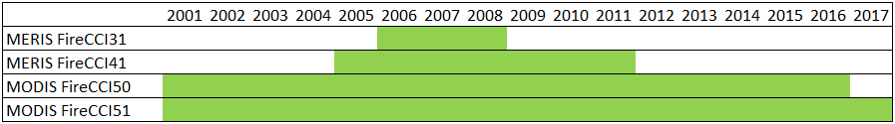
Global products
 | FireCCI41 | FireCCI50 | FireCCI51 | FireCCILT10
Sensor | MERIS | MODIS | MODIS | AVHRR-LTDR
Resolution | 300m | 250m | 250m | 0.05º (~5km)
Pixel product | Monthly | Monthly | Monthly | -
Grid product | Biweekly | Biweekly | Monthly | Monthly
Time span | 2005-2011 | 2001-2016 | 2001-2017 | 1982-2017

Slide 6
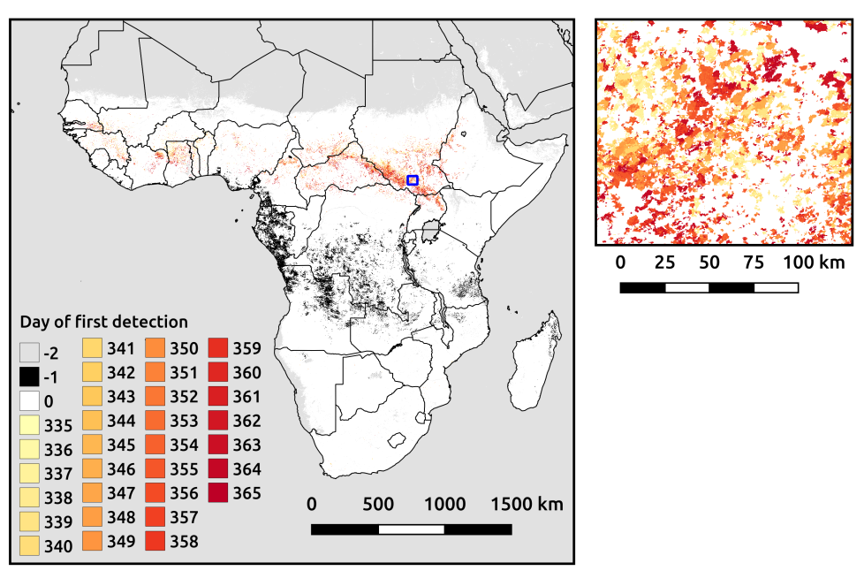
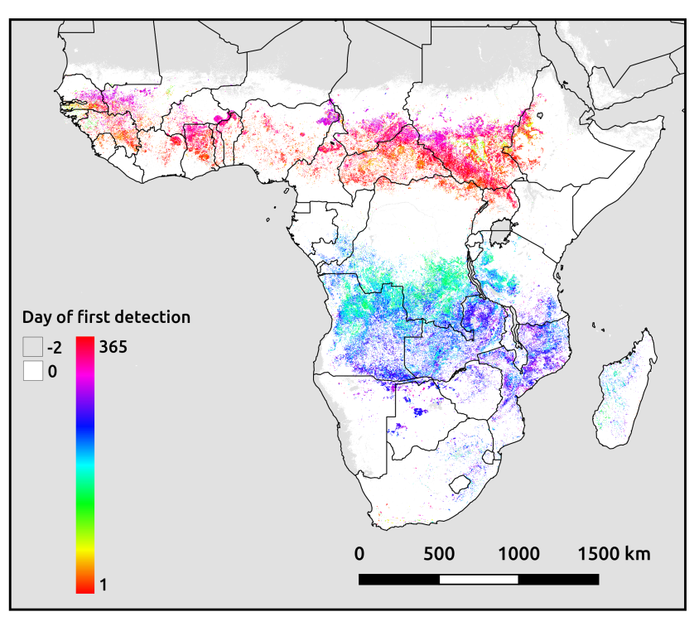
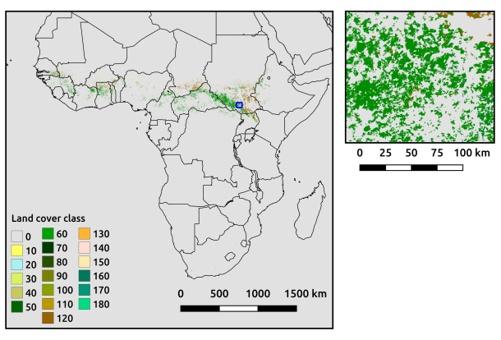
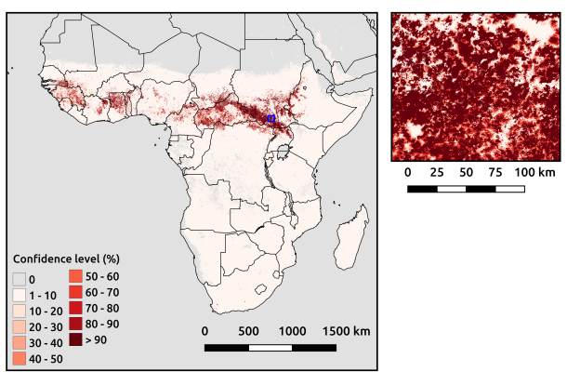
Global products – pixel
Example of pixel product
FireCCI51, 2017 (12)

Slide 7

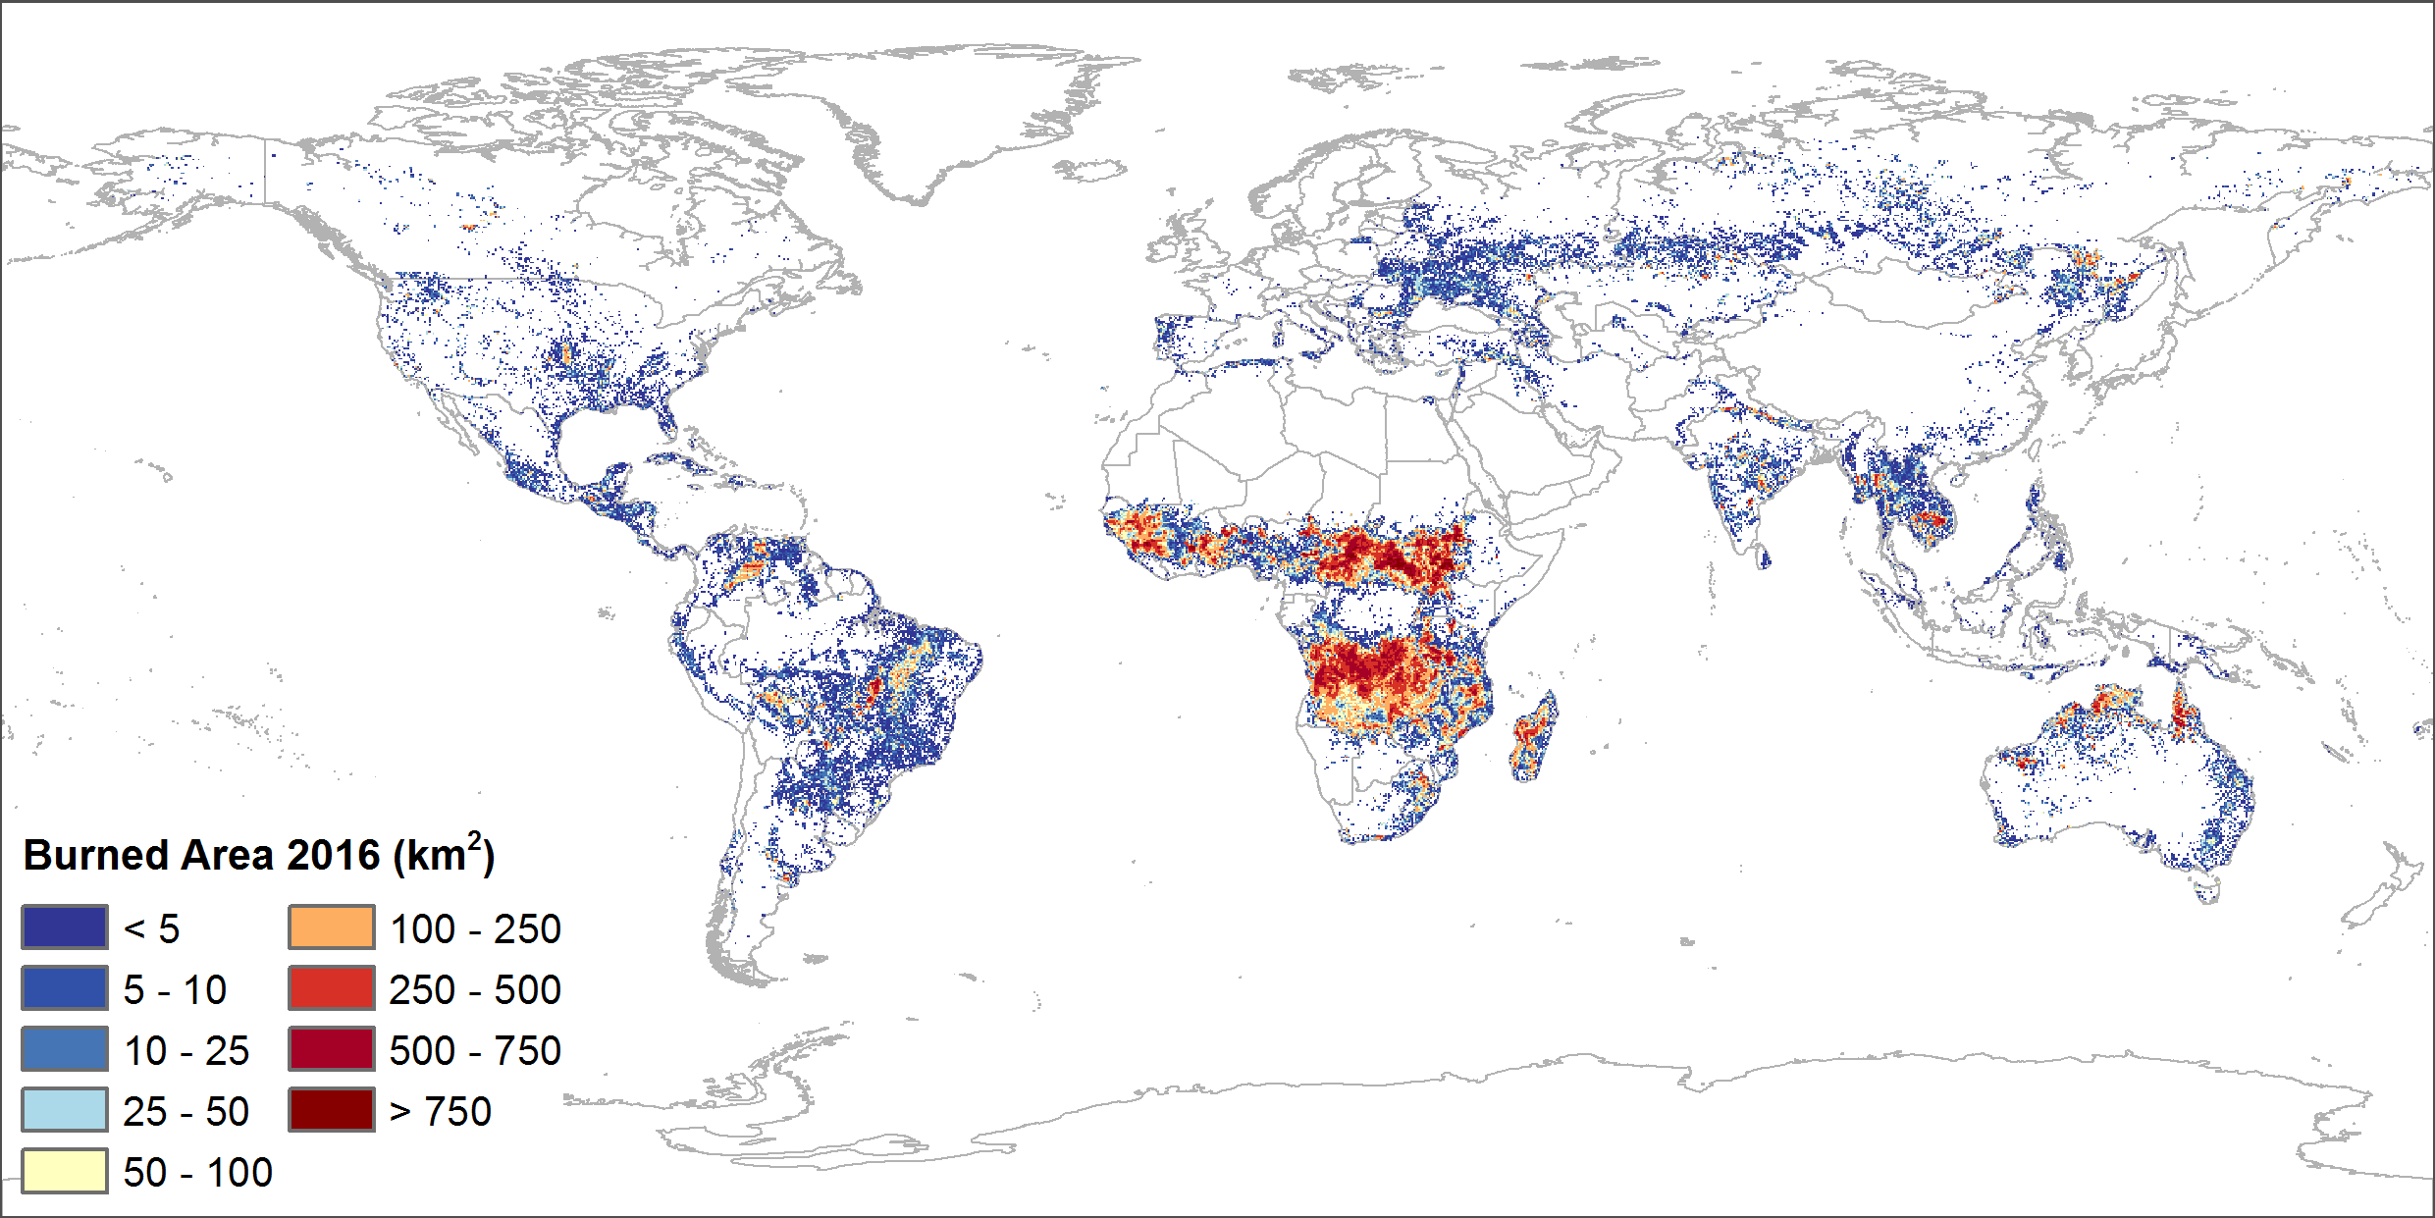
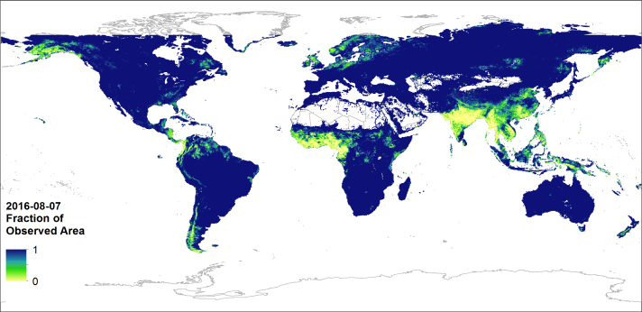
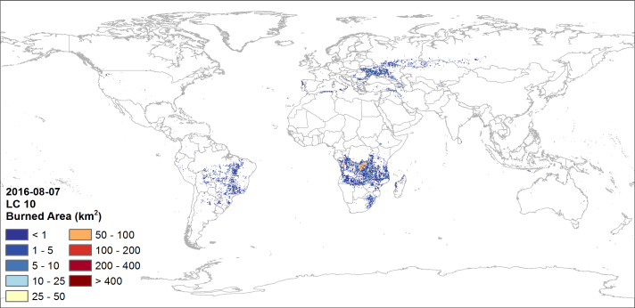
Global products – grid
Example of grid product
FireCCI50, 2016 (08-1F)

Slide 8
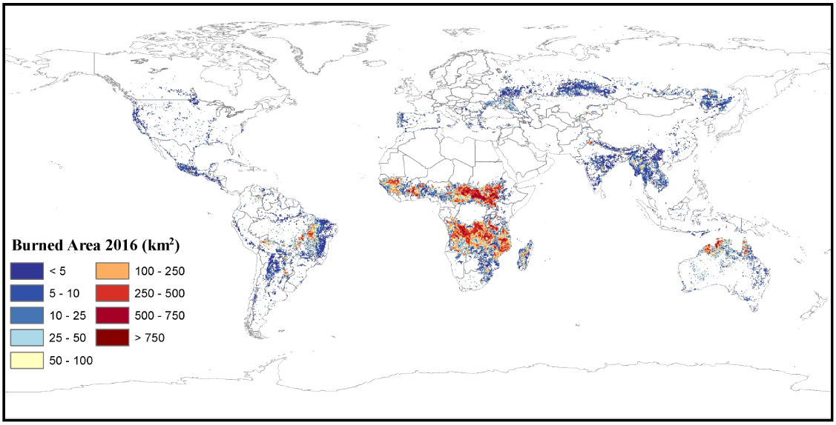
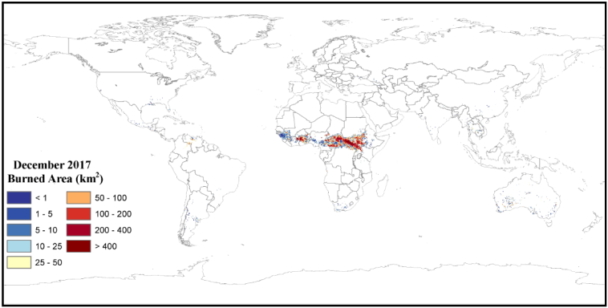
Global products – FireCCILT10
FireCCITL10 – only grid
Time span: 1982 – 2017 (1994 incomplete)

Slide 9
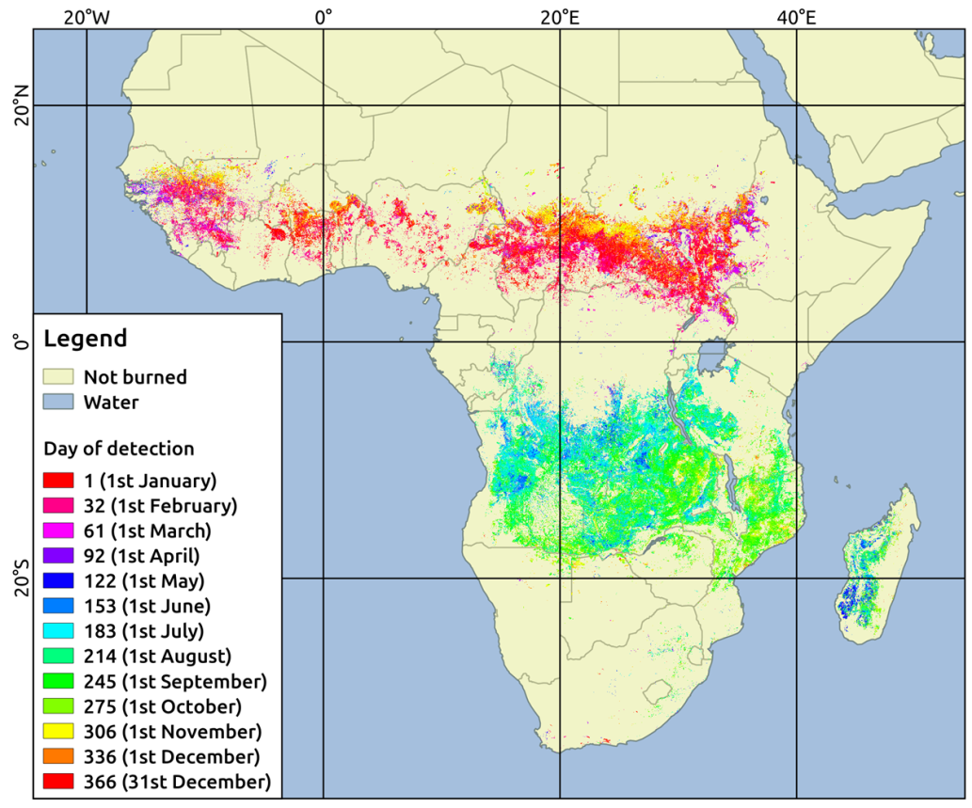
High resolution product: FireCCISDF11
Sub-Saharan Africa for 2016 based on Sentinel-2
Spatial resolution: ~ 20 m
Subsetting to 5x5 degree files
Land cover extracted from the LC_cci HR Sentinel-2 2016 product

Slide 10
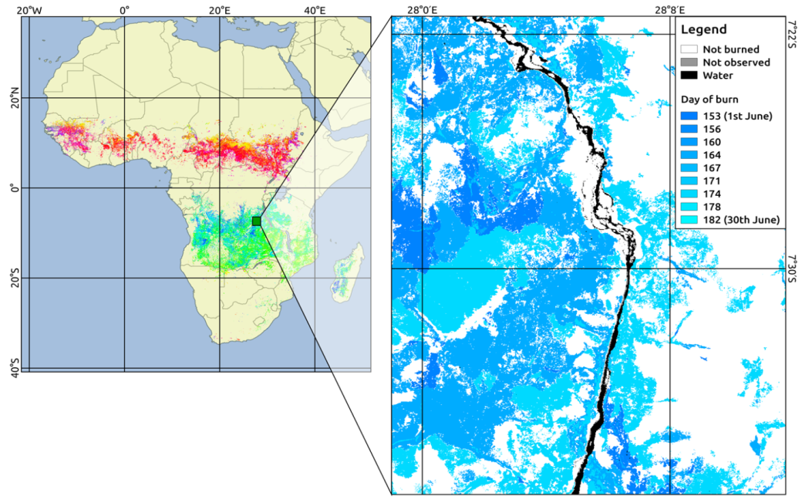
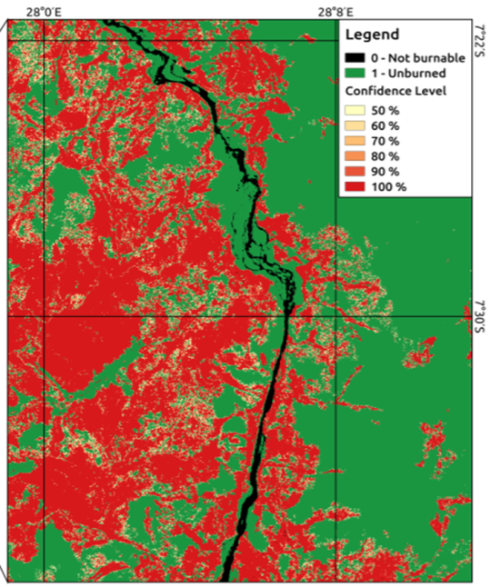
High resolution product: FireCCISDF11
Sub-Saharan Africa for 2016 based on Sentinel-2
Spatial resolution: ~ 20 m
Subsetting to 5x5 degree files
Land cover extracted from the LC_cci HR Sentinel-2 2016 product

Slide 11
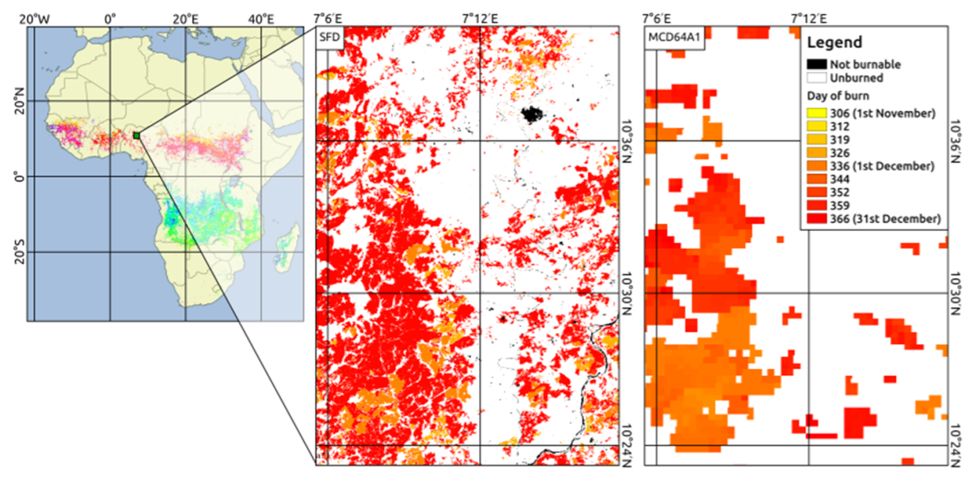
Much more detailed information

Slide 12
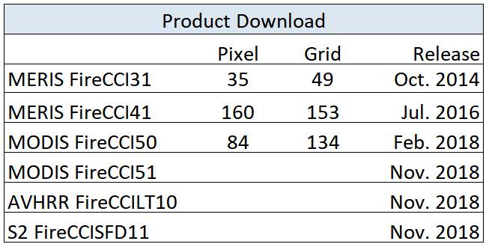
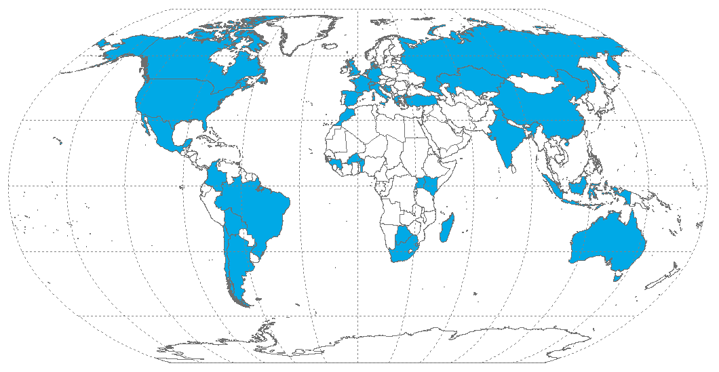
Product Use
CRG
IRD-LSCE: refinement of fire modules in GDVM – fire patch analysis, relationship between climatic variables and fire morphological features
MPIC: inter-comparison of BA products, participation in FireMIP
VUA: emissions estimations – integrating FireCCI products into GFED
Notes:
37 countries 5.0. Almost 40 countries.

Slide 13
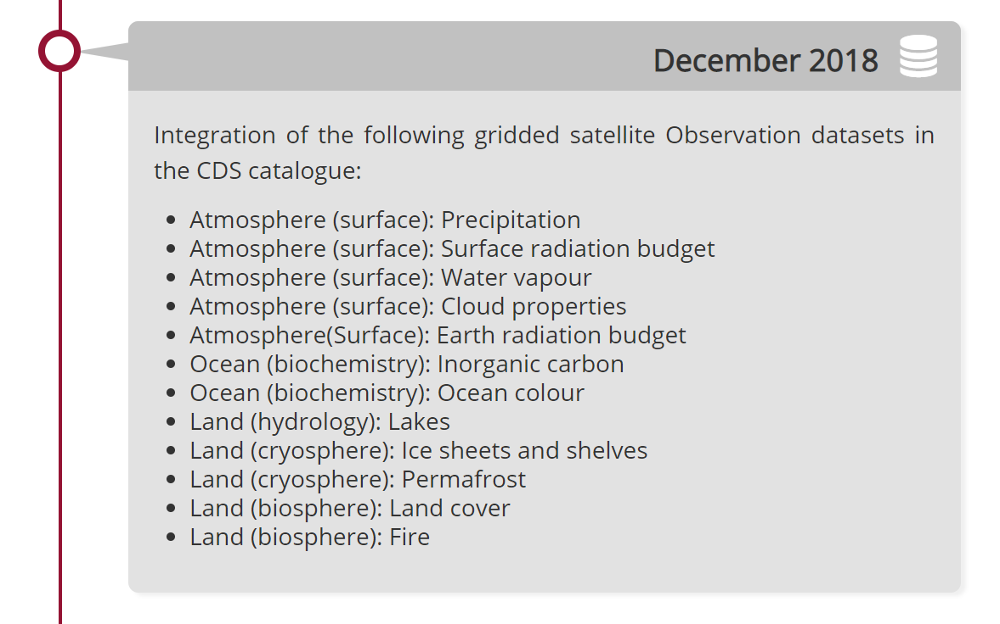
Burned area data to Copernicus
Outputs from Fire_cci to C3S (ECMWF)
Contract with ECMWF for C3S_321b_Lot5
Brokered and newly generated datasets:
  Brokered FireCCI50 (2001-2016)
  Brokered FireCCI51 (2001-2017)
  Production of S3 OLCI BA (2017-2020) using an adaptation of the FireCCI51 algorithm.
To be found starting Dec. 2018 at your nearest store
https://cds.climate.copernicus.eu/roadmap

Slide 14
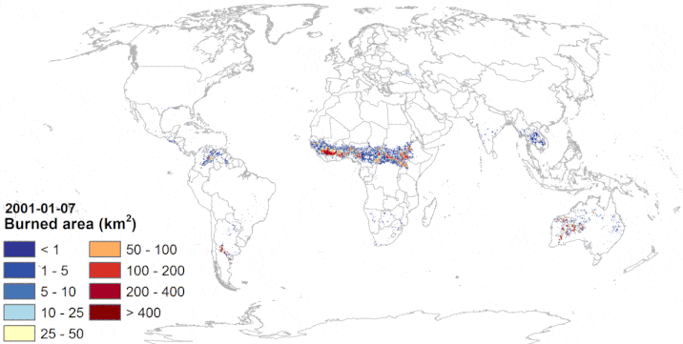
Thank you
https://esa-fire-cci.org

