Slide 1
Cloud_cci
Rainer Hollmann, Martin Stengel
Deutscher Wetterdienst

Slide 2
Content
Cloud_cci recent developments and available data sets
Intercomparison of latest versions
Application examples

Slide 3
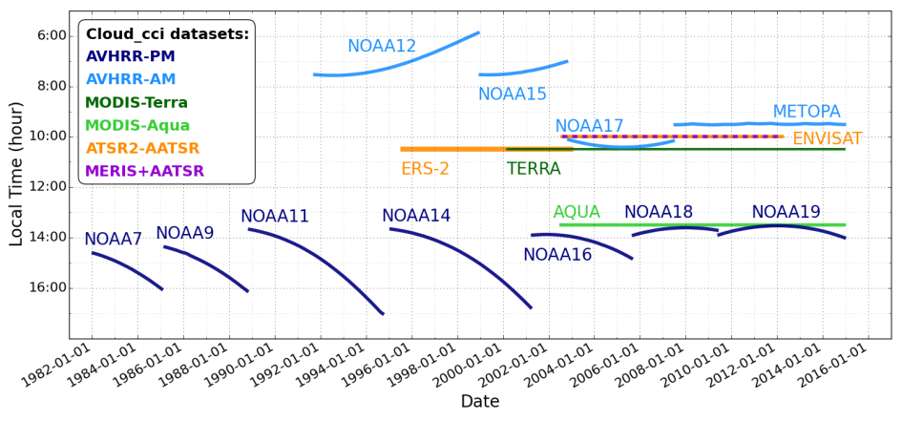
Cloud_cci v2 datasets
Time periods and local observation times (equator crossing times) of each satellite sensor considered in Cloud_cci.
Figure is taken from Stengel et al. (2017).

Slide 4
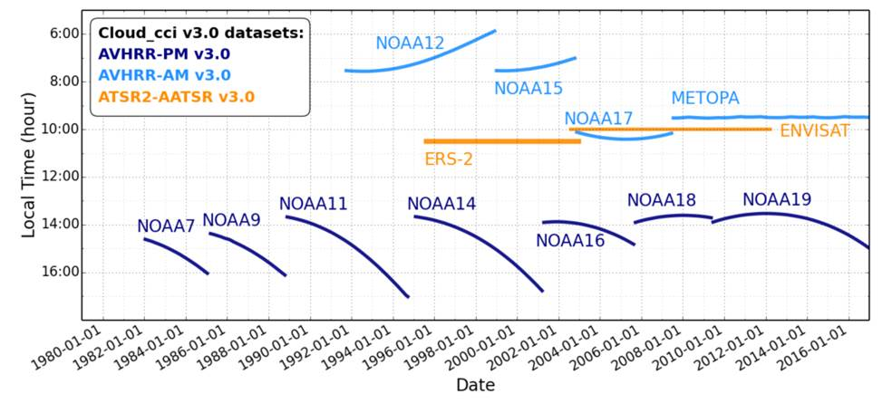
Cloud_cci v3 datasets
Time periods and local observation times (equator crossing times) of each satellite sensor considered in Cloud_cci. Figure is taken from Stengel et al. (2018b).

Slide 5
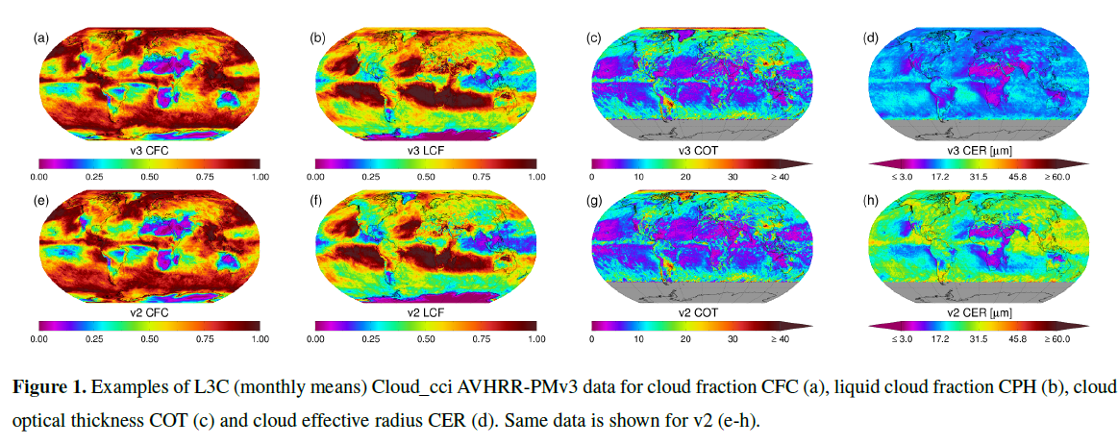
Cloud_cci AVHRR-PMv3 vs. v2
Examples (monthly means)
Significant changes for CER (in particular for ice clouds)

Slide 6
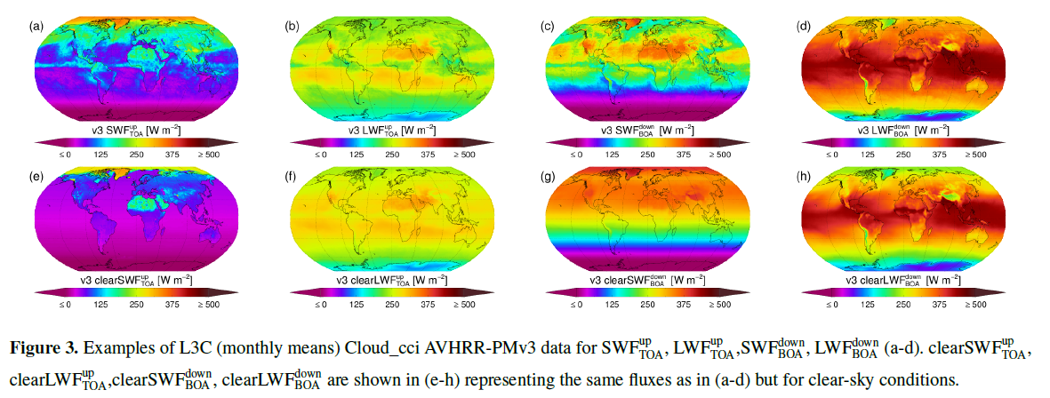
Cloud_cci AVHRR-PM v3 vs. v2
Broadband (SW & LW) flux examples (monthly means). New in v3!

Slide 7
Comparisons v3 vs v2

Slide 8
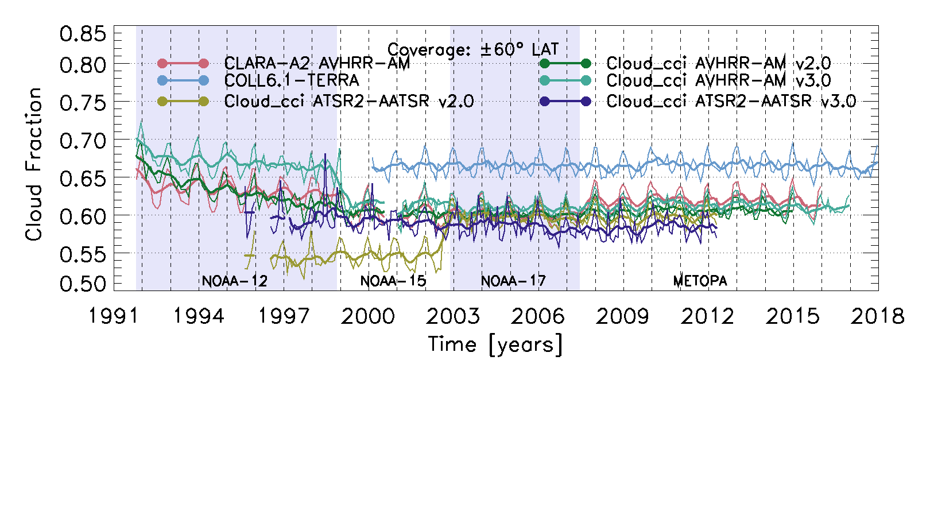
Comparisons v3 vs v2 (2)
Comparison of Cloud_cci AVHRR-AM v3 and ATSR2-AATSR v3 with other datasets

Slide 9
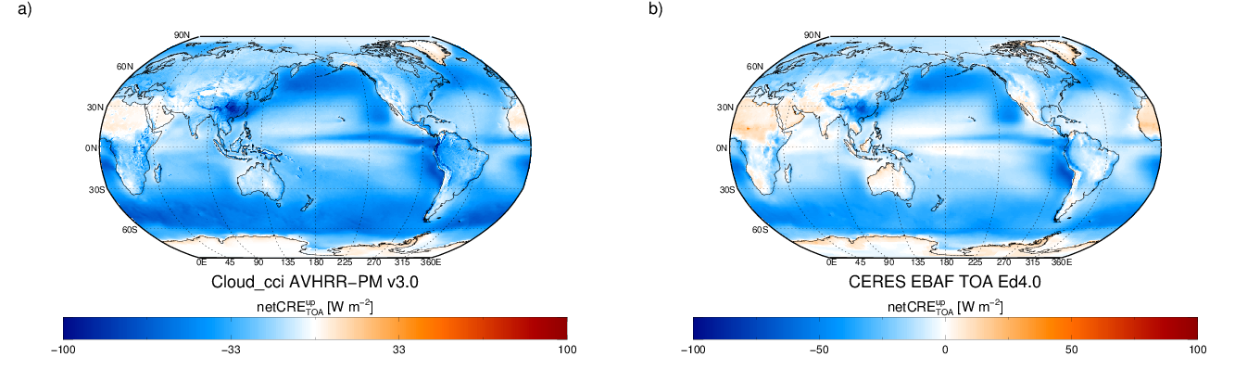
Linking cloud and radiation properties
Cloud radiative effect at TOA (2003-2016)
Very good agreement between Cloud_cci AVHRR-PMv3 and CERES EBAF TOA Ed4.0. cloud radiative effect. Cloud_cci AVHRR-PMv3 covers 1982 to 2016 and includes a large variety of cloud and radiative flux properties at AVHRR GAC spatial resolution (~4km).

Slide 10
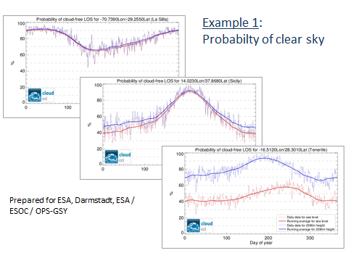
Application Examples (1)
Probability of Clear sky (during night)
Blue: all clouds
Red: all clouds higher than location

Slide 11
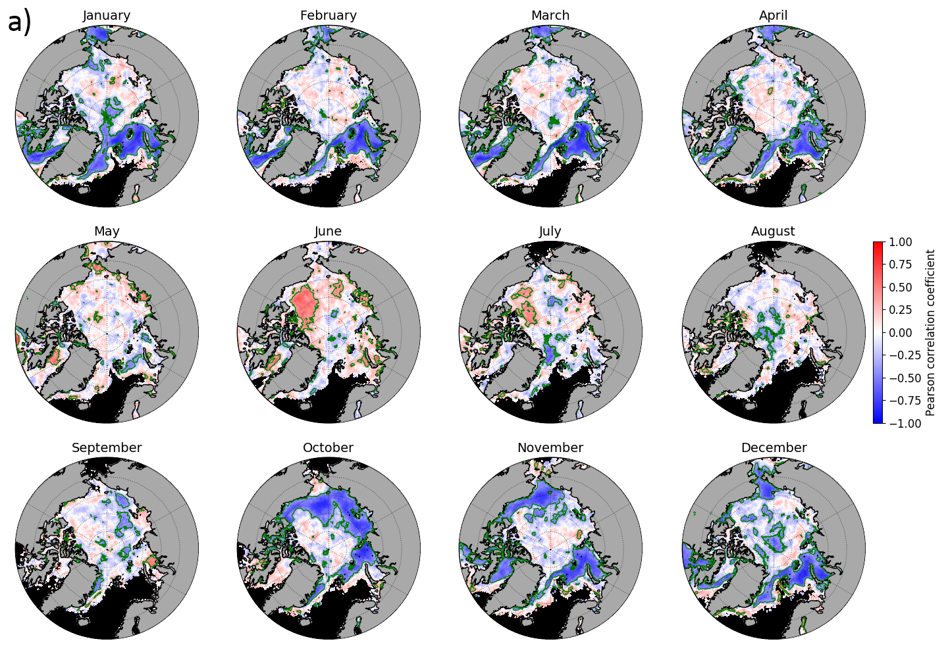
Assessing the relationship between artic sea ice and
low level clouds
artic sea ice decline leads to an increase in low level cloudiness
positive feedback since in return the increase in low level cloudiness supports the sea ice decline (through an increase in downwelling LW flux at BOA).
Pearson correlation coefficients for low-level cloud fraction with sea ice concentration (1984-2015). Green contour line indicates significance at 95% level of confidence. Grey: Continent; Black: Ocean. Courtesy of Daniel Philipp (DWD).

Slide 12
Cloud_cci Summary
Two multi-decadal global data sets for the GCOS cloud property ECVs including uncertainty estimates are available.
  multi-decadal multi-instrument product from (A)ATSR – AVHRR – MODIS (1982 - 2016)
  decadal product that uses complimentary information from AATSR and MERIS on-board of ENVISAT (2002 - 2012)
V3 is now available, now ToA and BoA radiation fluxes are consistently derived and included in the products
Key strengths:
  Spectral consistency of derived parameters, which is achieved by an optimal estimation (OE) approach based on fitting a physically consistent cloud model to satellite observations simultaneously from the visible to the mid-infrared.
  Uncertainty characterization, which is inferred from OE theory on pixel level, physically consistent, propagated into L3 data with uncertainties of the input data (e.g. measurements, a-priori) among the retrieved variables.

