Slide 1
Recent Advances in the Field of Satellite Data Uncertainties
Claire Bulgin¹, Chris Merchant¹, Darren Ghent²
¹University of Reading, UK
²University of Leicester, UK

Slide 2
Why do we need to provide uncertainties?
All measurements (in-situ and remote sensing) have an associated uncertainty:
Every measurement we make deviates from the ‘true’ surface temperature due imperfections in the instrumentation and measurement process.
We need to understand this uncertainty in the measurement in order to use the data properly.
Error and uncertainty are two different concepts…
Error: How different is the measured value from the true value?
Uncertainty: To what degree is the measured value in doubt?
Measurement error is often unknown (and if we did know what it was we would correct for it). We therefore provide an uncertainty, a measure of the dispersion of the error distribution.

Slide 3
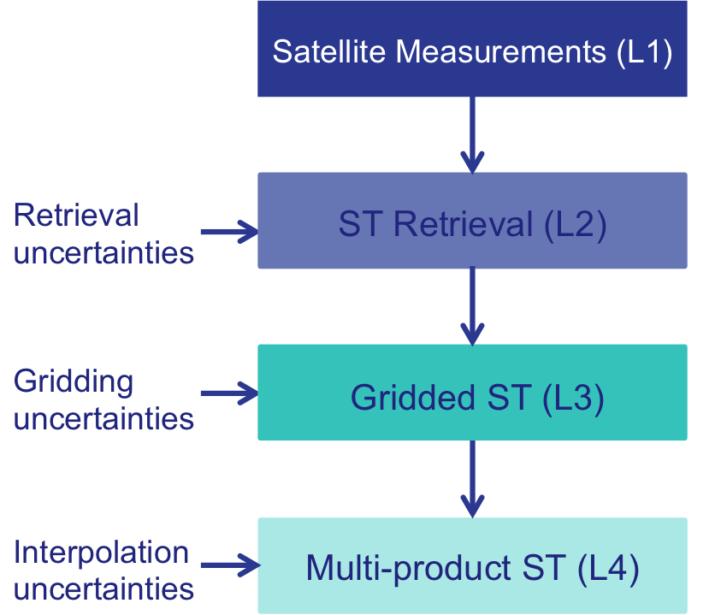
How do uncertainties propagate?
Uncertainties arise at each step of the measurement process:
Uncertainties arising early in the process need to be propagated through each stage of the processing.
New uncertainties will be introduced at each stage of the processing.

Slide 4
How do uncertainties propagate?
Uncertainties arise at each step of the measurement process:
Uncertainties arising early in the process need to be propagated through each stage of the processing.
New uncertainties will be introduced at each stage of the processing.

Slide 5

How can we understand and quantify the uncertainties for a given processing step?
We start from the measurement equation. Lets consider first a LST retrieval in the form:
z=g(y,β)+0
y = observations β = retrieval parameters +0 = process

Slide 6
How can we understand and quantify the uncertainties for a given processing step?
We start from the measurement equation. Lets consider first a LST retrieval in the form:
z=g(y,β)+0
y = observations β = retrieval parameters +0 = process
LST=a_{f,i,pw}+b_{f,i}(T₁₁-T₁₂)^{n}+(b_{f,i}+c_{f,i})T₁₂ + 0

Slide 7
How can we understand and quantify the uncertainties for a given processing step?
We start from the measurement equation. Lets consider first a LST retrieval in the form:
z=g(y,β)+0
y = observations β = retrieval parameters +0 = process
{T₁₁, T₁₂} {a, b, c} {+0}
LST=a_{f,i,pw}+b_{f,i}(T₁₁-T₁₂)^{n}+(b_{f,i}+c_{f,i})T₁₂ + 0

Slide 8
How to construct an uncertainty budget
Measurement Term | Normal Notation | Effect | Effects expected | Correlation length scale | Attributed uncertainties | Sensitivity
β | a | 1 | Fractional vegetation error | s | FCOVER uncertainty
 |  | 2 | Fitting error (atmospheric and emissivity) | s | Fitting residual | *
 |  | 3 | Precipitable water error | s | Not attributed
 | b | 4
 |  | 5
 | c | 6
 |  | 7

Slide 9
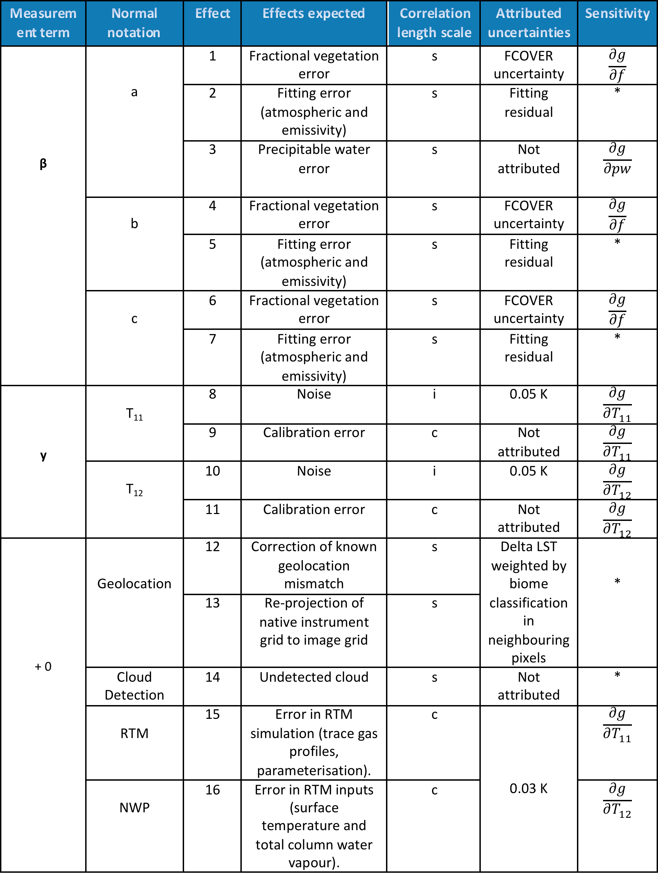
The complete uncertainty budget

Slide 10
The complete uncertainty budget
Uncertainties introduced directly in the retrieval

Slide 11
The complete uncertainty budget
Uncertainties propagated through from the satellite measurements

Slide 12
The complete uncertainty budget
What is included in the ‘+0’ term?

Slide 13
The +0 Term
Measurement Term | Normal Notation | Effect | Effects expected
+0 | Geolocation | 12 | Correction of known geolocation mismatch
 |  | 13 | Re-projection of native instrument grid to image grid
 | Cloud Detection | 14 | Undetected cloud
 | RTM | 15 | Error in RTM simulation
 | NWP | 16 | Error in RTM inputs

Slide 14
Why do we use this approach?
Starting from the measurement equation as illustrated on the previous slides has a number of benefits:
It is methodological considering each component in turn
It is rooted in metrology
It is transparent for both data users and data producers
It is a mean to identify gaps

Slide 15

What do we provide to data users?
Our objective for uncertainty information provision is:
To provide uncertainties for every LST retrieval made.
To provide uncertainties for products at different levels (L2, L3).
To provide uncertainties for data re-gridded at different resolutions.
To derive these uncertainties independently of in-situ data.
One key benefit of deriving uncertainties independently of in-situ data is that we can then use in-situ data to validate both the retrieved LST and the associated uncertainty.

Slide 16
What do we provide to data users?
In our data products we provide:
Total uncertainty
Three additional categories of uncertainty information:
  Uncertainties arising from random error effects (uncorrelated between observations)
  Uncertainties arising from locally systematic error effects
    For LST products there are typically two components in this category – uncertainties from surface processes and uncertainties from atmospheric processes
  Uncertainties arising from large-scale error effects
The reason for providing the breakdown of uncertainty components is to allow the uncertainties to be correctly propagated in any further processing or generation of derived products.

Slide 17
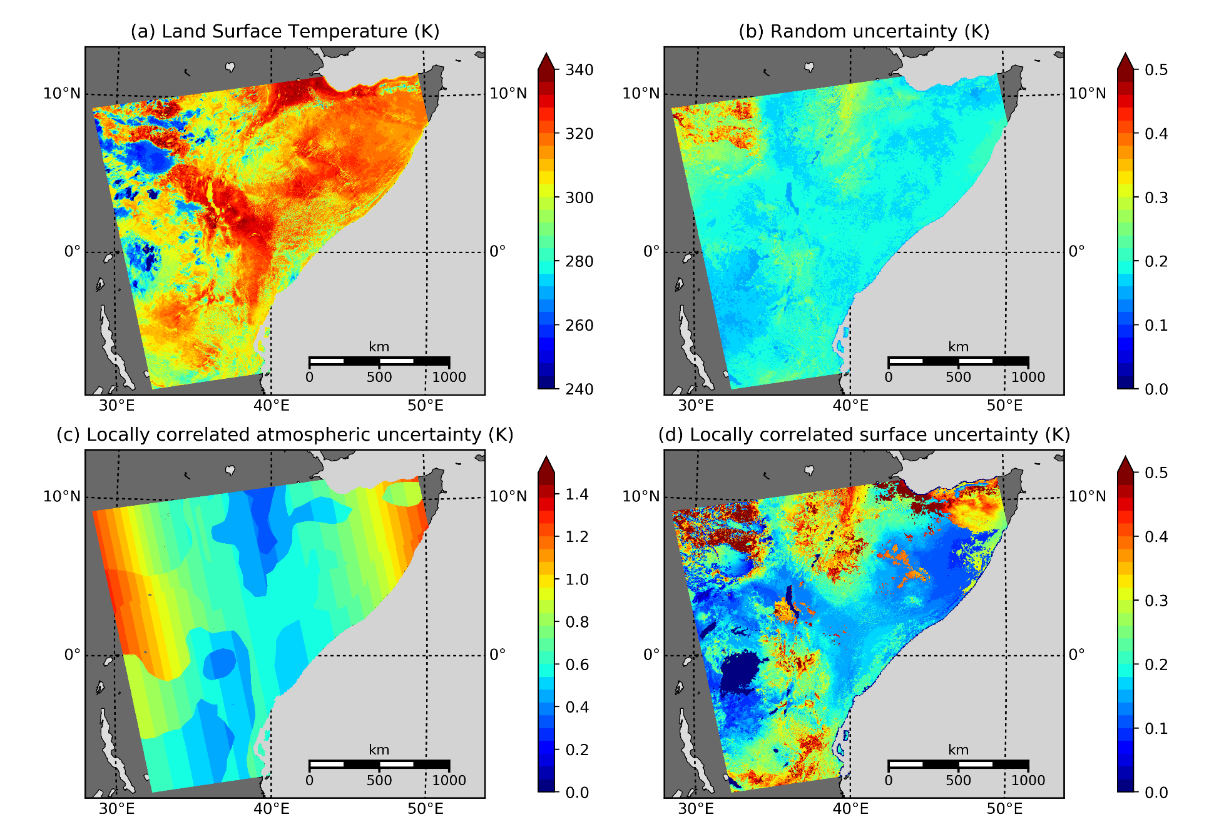
Some Example products
MODIS TERRA LST and breakdown of uncertainties components

Slide 18
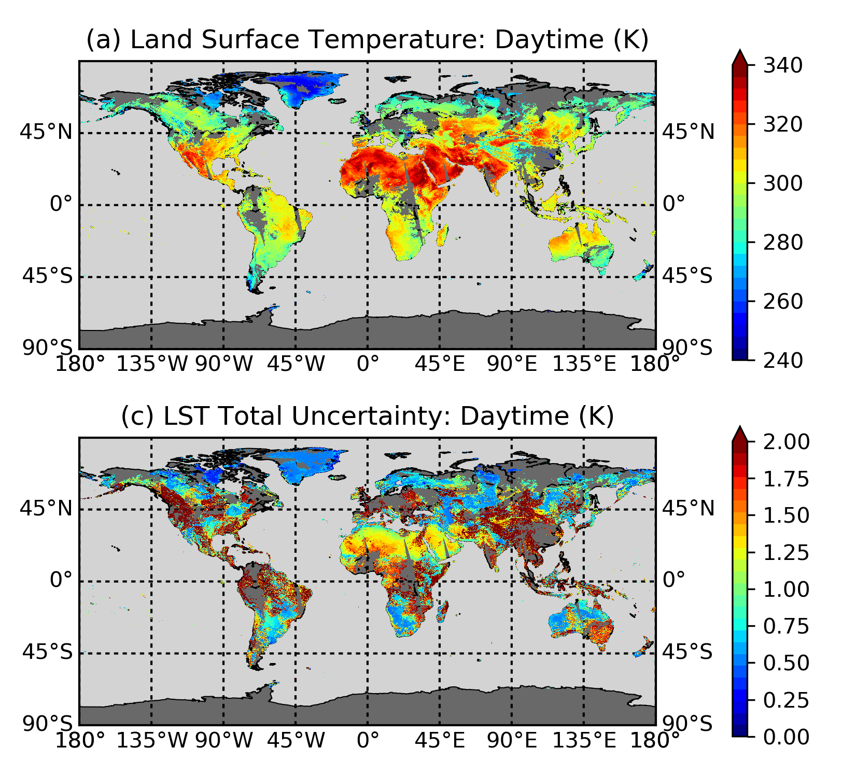
Some example products
MODIS TERRA L3C Daily LST and total uncertainty

Slide 19
Validation of uncertainties
Validation of uncertainties tests the goodness of fit between:
The uncertainty calculated from the difference between the satellite and in-situ measurements (σ_{diff})
The total satellite product uncertainty

Slide 20
Validation of uncertainties
Validation of uncertainties tests the goodness of fit between:
The uncertainty calculated from the difference between the satellite and in-situ measurements (σ_{diff})
The total satellite product uncertainty
σ_{sat} = the total uncertainty in the satellite observation

Slide 21
Validation of uncertainties
Validation of uncertainties tests the goodness of fit between:
The uncertainty calculated from the difference between the satellite and in-situ measurements (σ_{diff})
The total satellite product uncertainty
σ_{sat} = the total uncertainty in the satellite observation
σ_{ground} = the total uncertainty in the in-situ observation

Slide 22
Validation of uncertainties
Validation of uncertainties tests the goodness of fit between:
The uncertainty calculated from the difference between the satellite and in-situ measurements (σ_{diff})
The total satellite product uncertainty
σ_{sat} = the total uncertainty in the satellite observation
σ_{ground} = the total uncertainty in the in-situ observation
σ_{space} = the geophysical uncertainty associated with comparing a point measurement with an area average

Slide 23
Validation of uncertainties
Validation of uncertainties tests the goodness of fit between:
The uncertainty calculated from the difference between the satellite and in-situ measurements (σ_{diff})
The total satellite product uncertainty
σ_{sat} = the total uncertainty in the satellite observation
σ_{ground} = the total uncertainty in the in-situ observation
σ_{space} = the geophysical uncertainty associated with comparing a point measurement with an area average
σ_{time} = the geophysical uncertainty from comparing observations at different times

Slide 24
Validation of uncertainties
Validation of uncertainties tests the goodness of fit between:
The uncertainty calculated from the difference between the satellite and in-situ measurements (σ_{diff})
The total satellite product uncertainty
σ_{sat} = the total uncertainty in the satellite observation
σ_{ground} = the total uncertainty in the in-situ observation
σ_{space} = the geophysical uncertainty associated with comparing a point measurement with an area average
σ_{time} = the geophysical uncertainty from comparing observations at different times
σ_{time} = the geophysical uncertainty due to the difference in measurement depth (MW only)

Slide 25
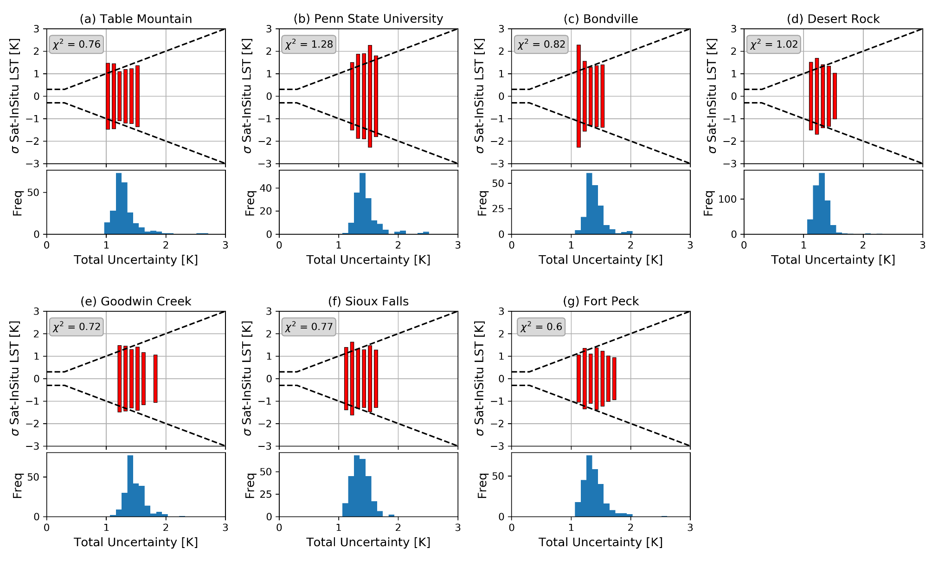
Validating uncertainties
Uncertainty from satellite and in-situ differences
Expected uncertainty model:
This doesn’t tend to zero due to uncertainties in the in-situ data and data matching process
Retrieval Uncertainty

Slide 26
Summary
In summary:
We derive our uncertainties independently of in-situ data, based on the measurement equation for the retrieval process.
We provide to the user both total uncertainty, and a breakdown of the uncertainty components by correlation length scale to enable correct propagation of these to derived products.
We validate the uncertainties in addition to the LST using in-situ observations.

