Slide 1
Land Surface Temperature Monitoring
LSTM Mission
A Copernicus Mission for Agricultural Monitoring
Mike Perry and Darren Ghent

Slide 2
Copernicus for Agricultural Monitoring
Sentinel-3 (MODIS)
Observational Gap: TIR for Evapotranspiration
^{Source:} CEOS ACQUISITION STRATEGY FOR GEOGLAM PHASE 1
Sentinel-2 (Landsat)
Sentinel-2 (Landsat)
Sentinel-1 (PalSAR)

Slide 3

Global & EU relevant Policies
EU Common Agriculture Policy
  Greening Element e.g. Ecological Focus Areas,
  Crop diversification
  Yield predictions at EU and Global scale
EU Water Framework Directive & Nitrate Directive
  Water resource management
  Water pollution
Sustainable Development Goals
  SDG 6.4 Water Efficiency & 6.3 Water Quality
UN Convention for Combating Desertification & Land Degradation
UN Framework Convention of Climate Change

Slide 4
Land Surface Temperature Mission (LSTM)
LSTM Main Mission Objective:
“To complement Sentinel observation capabilities with high spatio-temporal resolution Thermal Infra-Red observations over land and coastal regions in support of agriculture management services, and possibly a range of additional applications and services”
Mission Status:
Mission Advisory Group (MAG) shaping the mission requirements
  Consolidated High Level Requirements (HLR)
  Mission Requirement Document Version 2.0 approved in April 2019
Mission Phase A/B1 completed
Evaluation of bids for Mission Phase B2/C/D/E1
On-going Scientific Studies, End-to-End Simulator, Airborne Campaigns and LWIR Detectors pre-development

Slide 5
Land Surface Temperature Mission (LSTM)
Domain | Level - 2 |  |  |  |  |  |  | Level -1
 | Application | Geophysical variable | Spatial resolution | Coverage | Temporal resolution | Uncertainty | Supporting Data | NEdT (@300 K) | Minimum TIR Spectral Resolution | Other Spectral ranges
Hydrology | Detection of water stress in crops | Level-3 Classifications | 2-7 m | Local | Daily | <1.0 K | Met Data | <0.2 K | 2 bands (10-12 µm) | VNIR
 |  |  | 40-100 m
 | Detection of water stress in forest | Land cover | 100 m | Local to Regional | Daily-Monthly | <1.0 K | Met Data | <0.2 K | 2 bands (10-12 µm) | VNIR
 | Detection of evapotranspiration in crops | Level-3 Classifications | 1-2 m | Local | Daily-Monthly | <1.0 K | Met Data | <0.2 K | 2 bands (10-12 µm) | VNIR
 |  |  | 40-100 m
 | Detection of evapotranspiration in river basin | Level-3 Classifications | 100 m | Local to Regional | Daily-Monthly | <1.0 K | Met Data | <0.2 K | 2 bands (10-12 µm) | VNIR
 | Detection of evapotranspiration in continents | Level-3 Classifications | 1 km | Continental to Global | Daily-Monthly | <1.0 K | Met Data | <0.2 K | 2 bands (10-12 µm) | VNIR
 | Growing Degree Day estimations | Level-3 LST + NDVI | 20-1000 m | Local | Daily/Sub-Daily | <1.0 K | Met Data + land cover map | <0.2 K | 2 bands (10-12 µm) | VNIR
 | Growing Degree Day mapping | Level-3 LST + Land Cover | 20-1000 m | Regional to Local | Daily/Sub-Daily | <1.0 K | Met Data + land cover map | <0.2 K | 2 bands (10-12 µm) | VNIR
 | Cooling Degree Day estimations | Level-3 LST + Land Cover | 20-1000 m | Regional to Local | Daily/Sub-Daily | <2.0 K | Met Data + land cover map | <0.2 K | 2 bands (10-12 µm) | VNIR
 | Predictions of floods | Level-3 Classifications | 500 – 1000 m | Regional | Daily |  |  | <0.4 K | 2 bands (10-12 µm) | VNIR
 | Monitoring floods | Level-3 thresholds | 1 m – 1 km | Local to Regional | Daily (noon-midnight) | <1.0 K |  | <0.4 K | Multispectral (≥3 bands in 8-12 µm)
 | Mapping irrigated land | Level-3 maps | 100 m | Global | Monthly (local morning overpass) | <2.0 K | Agriculture classification + vegetation indices | <0.4 K | Multispectral (≥3 bands in 8-12 µm)

Slide 6
LSTM – Mission Objectives
Primary objective: to enable monitoring evapotranspiration (ET) rate at European field scale by capturing the variability of Land Surface Temperature (LST) (and hence ET) allowing more robust estimates of field-scale water productivity.
LST goal: accuracy 1.0 K at 300 K
LST & LSE threshold: LST accuracy 1.5 K at 300 K, LSE accuracy 2%
ET goal: accuracy 15% [mm/day], precision 5%, field scale MFU [0.5 ha], daily
ET threshold: accuracy 20% [mm/day], precision 10%, field scale MFU [1 ha], 3 days
Complementary objectives: to support a range of additional services benefitting from TIR observations – in particular:
soil composition
urban heat islands
coastal zone management
High‐Temperature Events.

Slide 7
LSTM System Design
Observation Requirements:
Spatial resolution: 30-50 m to match European field scale variability
LST observations should optimally be acquired daily (goal), with a minimum threshold of 3 days
Minimum 3 bands in TIR range for ET rate estimation – recommended additional narrow thermal bands for improved LST/emissivity separation
Simultaneous VIS/NIR/SWIR observations are required for atmospheric correction, cloud detection and emissivity estimations
Collocation of S-2 & S-3 observations within +/-3 days for ancillary parameters
Optimal LST observations early afternoon (goal around 13:00 hrs)
Key requirement | Design Concept
Geometrical revisit | 1 day/4 sats (2d/2s)
Local time | 13:00 (Europe) & night observations
SSD | 50 m (37m at nadir)
Spectral Bands | 5 TIR, 4 VNIR, 2 SWIR
Swath | 700 km, at 640 km altitude
Acquisition system | Whiskbroom scanner
Geo-location L1c | 1 SSD
MTF | 0.2-0.3
Data latency (L2) | 6-12 hours
NeDT | < 0.1 K
ARA | < 0.5 K
Satellite mass | about 1.1 ton

Slide 8
Spectral Requirements
3 (threshold) to 5 (goal) spectral bands in the TIR spectral range (8 ‐ 12.5 μm)
6 (threshold) spectral bands in the VNIR-SWIR spectral range (0.4 ‐ 2.5 μm)
TIR spectral bands for the primary mission objectives:
Band # | Goal / Threshold | Centre λ_{centre} (μm) | Spectral width Δλ (μm) | Tolerance λ_{centre} (± nm) | Tolerance Δλ (± nm) | Knowledge λ_{centre} (± nm) | Knowledge Δλ (± nm)
TIR-1 | G | 8.6 | 0.18 (G)/0.30 (T) | 10 | 10 | 5 | 5
TIR-2 | G | 8.9 | 0.18 (G)/0.30 (T) | 10 | 10 | 5 | 5
TIR-3 | T | 9.15 | 0.18 (G)/0.30 (T) | 10 | 10 | 5 | 5
TIR-4 | T | 10.9 | 0.40 (T) | 1o | 10 | 5 | 5
TIR-5 | T | 12.0 | 0.47 (T) | 10 | 10 | 5 | 5

Slide 9
LSTM Scientific Study (TRP)
Objectives of the activity
To deliver essential input information for the system studies and related technical support activities.
To quantify the impact of different instrument performances on the LST retrieval models.
Analysis of user requirements to translate them into mission requirements
To quantify the impact of different LST observational assumptions on the performance of evapotranspiration (ET) retrieval models.
To consider leading ET models and benchmark their performance, taking into account model parameterisation and available ancillary inputs
Trade-offs in the Industrial system studies between possibly conflicting requirements might be necessary

Slide 10
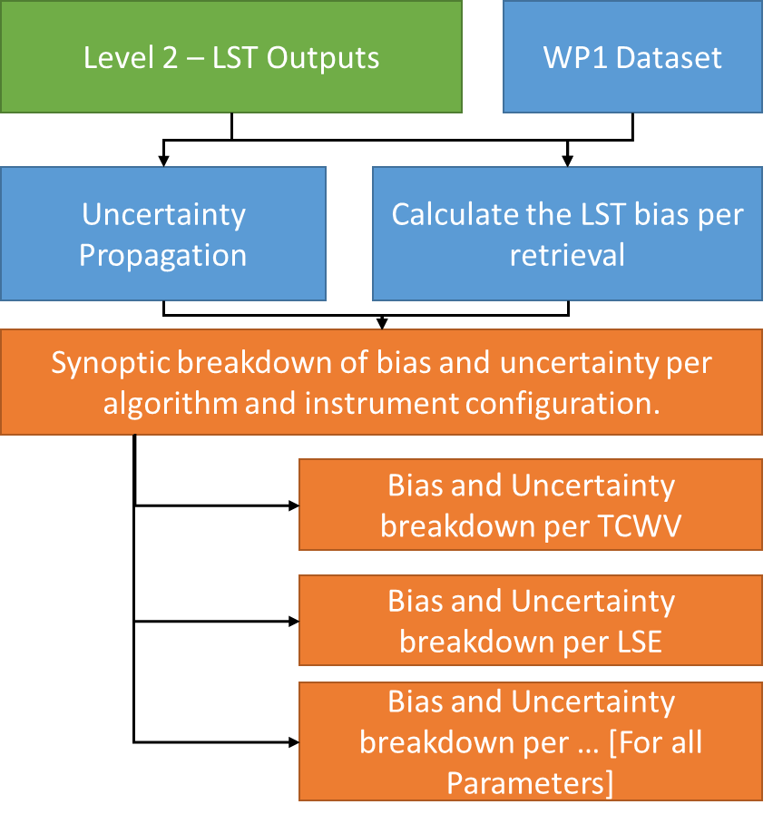
LSTM Scientific Study (TRP)
The first Stage involved using a purely synthetic database constructed using DART by partners at CESBIO.
The results can be investigated as a whole set over all variable parameters, but are also broken down by the significantly the influencing variables such as:
  Water vapour
  Land surface emissivity
  Solar angle (viewing time analogy)
  Satellite view angle
  Crop Type

Slide 11
TIR-TRP Algorithm Assessment
 | Accuracy (K) |  |  | Precision (K)
 | GSW | OE | TES | GSW | OE | TES
Maize | 1.17 | 1.97 | 2.19 | 1.48 | 2.00 | 3.75
Wheat | 2.07 | 1.19 | 3.58 | 1.48 | 2.35 | 0.98
Orange Grove | 0.55 | 1.04 | 1.92 | 0.60 | 1.87 | 3.05
All algorithms can benefit from the VNIR/SWIR channels for good quality LSE and TCWV a priori data to optimise the performance
Both OE and TES capitalise on the use of all the TIR channels to retrieve both LST and LSEs per channel. These maximise the value of the instrument design for LSTM
Overall the OE shows the most stable performance to instrument errors, and is primarily influenced by the quality of the a priori data. If the a priori data is of good quality then the OE would meet the accuracy requirements in the MRD

Slide 12
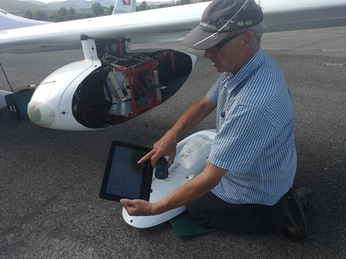
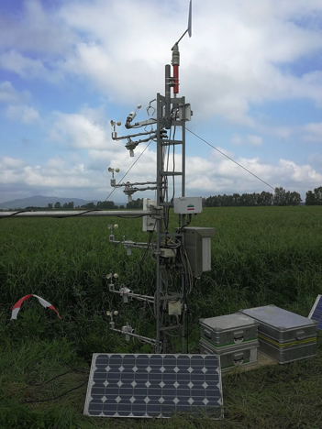
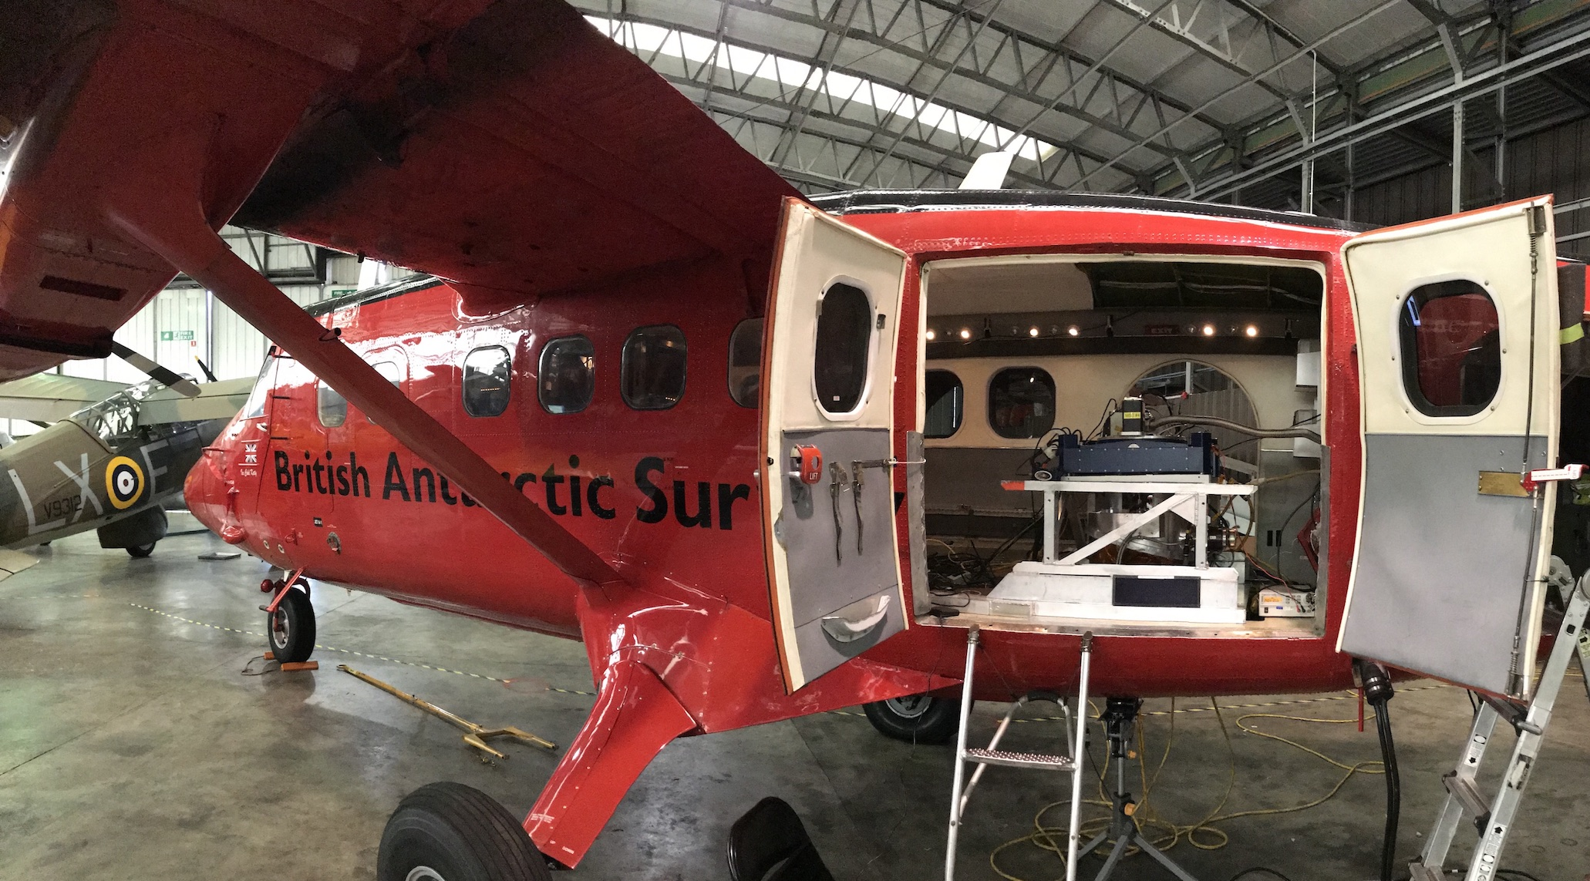
Airborne Campaigns
SurfSense 2018:
  Sensors: TASI & HyPlant
  Test site: close to Grosseto, Italy
    Irrigated / non- irrigated corn
  Flights 17th - 24th July
  Field validation data
2019 HyTES Joint Campaign
  ESA, NASA, NCEO-KCL, NERC, BAS aircraft
  Sensors: HyTES
  Test site: Grosseto area, Italy
  Flights 17th - 25th June
  Field validation data
2020 Campaign in planning

Slide 13
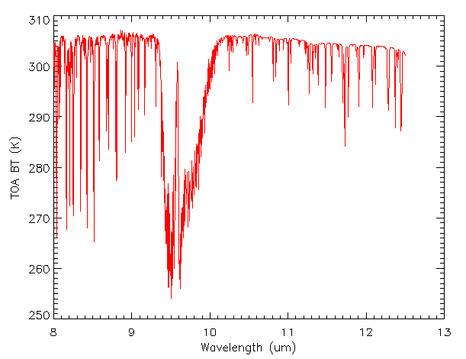
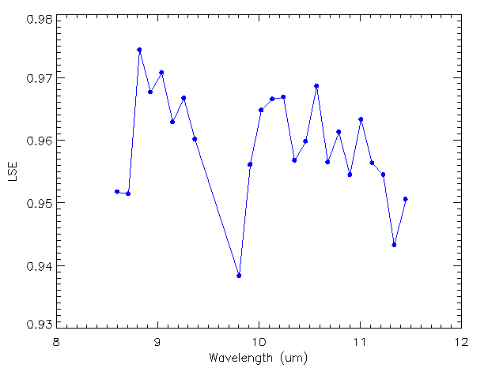
Campaign Data: Grosseto
TASI data was propagated to TOA BTs:
The TASI data contains 24 spectral LSE point in the range 8.6 to 11.6 microns.
The LST and LSE data as assimilated into the Line-By-Line Radiative transfer model RFM.
RFM generates TOA BTs for 1200 spectral samples between the range of 8-12.6 Microns.

Slide 14
Summary of Statistics
 |  | GSW NI | GSW WI | OE NI | OE WI
Bias | Median: | -0.42 | -0.49 | -0.25 | -0.43
 | Standard deviation: | 1.24 | 2.20 | 0.72 | 0.76
Uncertainty | Median: | 0.73 | 1.57 | 1.23 | 1.35
 | Standard deviation: | 0.02 | 0.09 | 0.10 | 0.26
*NI = No Instrument Artefacts
*WI = With Instrument Artefacts:

Slide 15
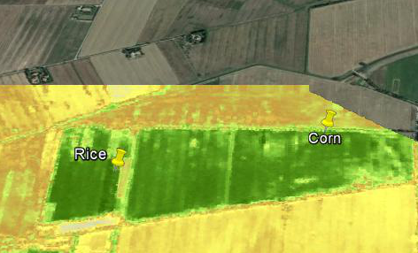

Campaign Data: Grosseto – 11:47:30
Region contains measurement points from the Insitu dataset.
RICE
 |  | In-Situ | Uveg LST | GSW NI | GSW WI | OE NI | OE WI
Bias | Median: | 305.19 | 303.50 | 303.68 | 303.82 | 303.96 | 303.83
 | Standard deviation: | 0.22 | 1.60 | 1.80 | 1.98 | 1.83 | 1.84
NDVI

Slide 16
NCEO and LSTM
Phase A/B1 for technology readiness for LSTM mission implementation [NCEO-Leicester, subcontractor to one of the parallel studies]
Mission Advisory Group [D. Ghent, NCEO-Leicester]
Scientific Study (TIR-TRP) to support MRD requirements consolidation for spectral resolution, retrieval algorithms up to Level 3 [NCEO-Leicester, Project Lead]
TIRI-SIM Study to consolidate existing users requirements for high resolution thermal infrared [NCEO-Leicester, Project Lead]
End-to-End Simulator activities for performance modelling in order to support the verification of the observation and performance requirements [NCEO-Leicester, Lead Science Advisor]
Airborne Campaigns to support MRD requirements consolidation to support local time & ground resolution choices up to Level 3 [NCEO-KCL, aircraft / instrument coordination]

