Slide 1
TAKING THE PULSE OF THE PLANET
Secondary
11–14
Seeing in colour
Notes:
This slide deck supports the education resource pack teacher guide and student worksheets of the same name.
It includes:
Learning objectives for each activity. The objectives have been rewritten in language more appropriate for students and are separated into knowledge (‘Learning outcomes’) and skills (‘Skills development’).
An extended key words list for each activity.
Where the teacher guide lists images, animations or videos to support the material on Information sheet 1, these have been included here. Animations and videos are linked to (playing in slide where possible) in order to keep file size reasonable.
Abbreviated versions of key questions and tables from worksheets.
Answers for most closed questions.
Abbreviated instructions or/and images showing how to set up some practical activities.
Visual instructions for accessing the appropriate screen(s) of Climate from Space for the final activity, together with a screenshot of the key screen required.
Notes beneath each slide give:
credit for images (along with caption, where relevant)
a description of any animation on the slide
url for any links or embedded material.
Some also provide additional information.

Slide 2
Activity 1: TAKING THE PULSE OF THE PLANET
Learning outcomes
List the regions of the electromagnetic spectrum.
Describe what type of radiation satellites use to monitor different parts of the Earth system.
Explain why it is useful to collect information about these parts of the Earth system.
Key words
electromagnetic spectrum
radiation
wavelength
infrared (IR)
ultraviolet (UV)

Slide 3
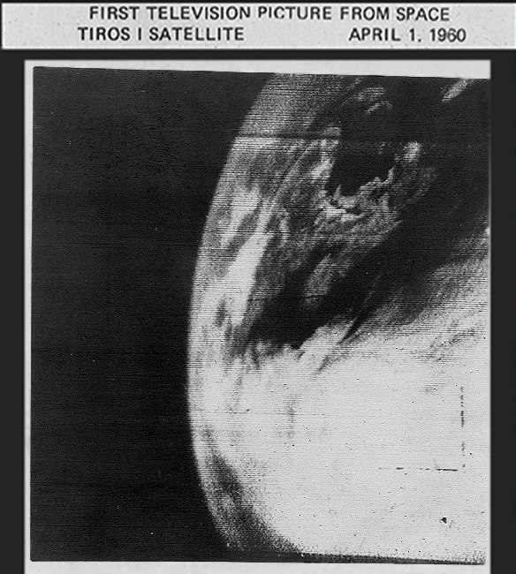
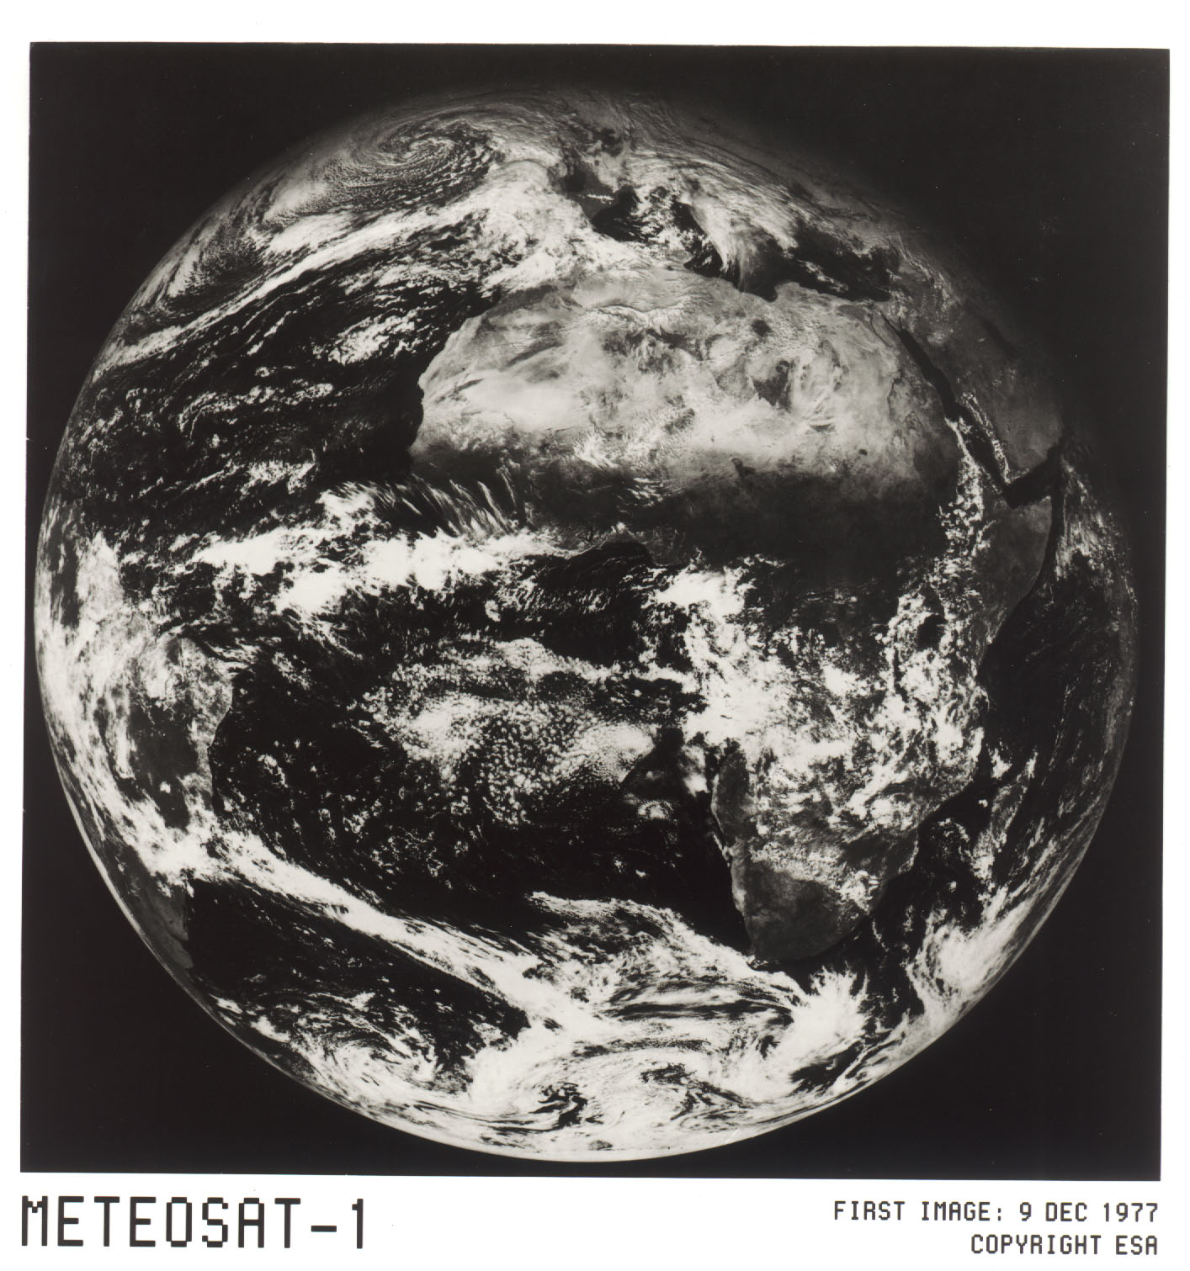
Early pictures of the Earth from space
Notes:
The first image taken by the experimental weather satellite TIROS-1 in April 1960 (NASA)
Europe's first weather satellite, Meteosat-1, was launched in November 1977 (ESA)

Slide 4
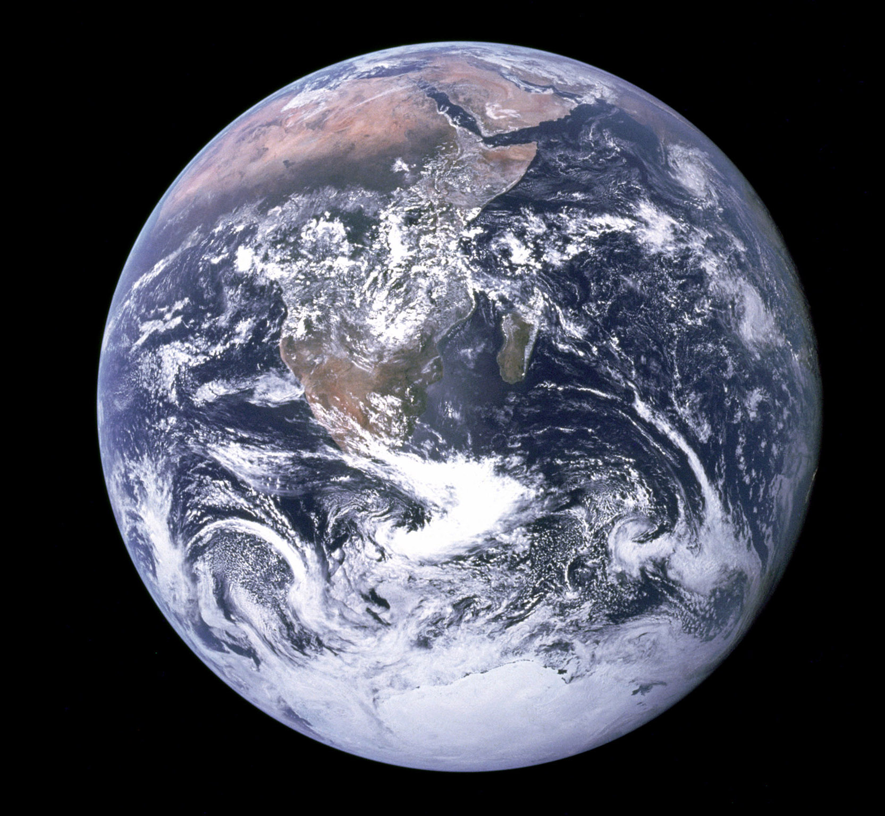
The Blue Marble
Notes:
Photograph of the Earth taken by the Apollo 17 crew in 1972 (NASA)

Slide 5
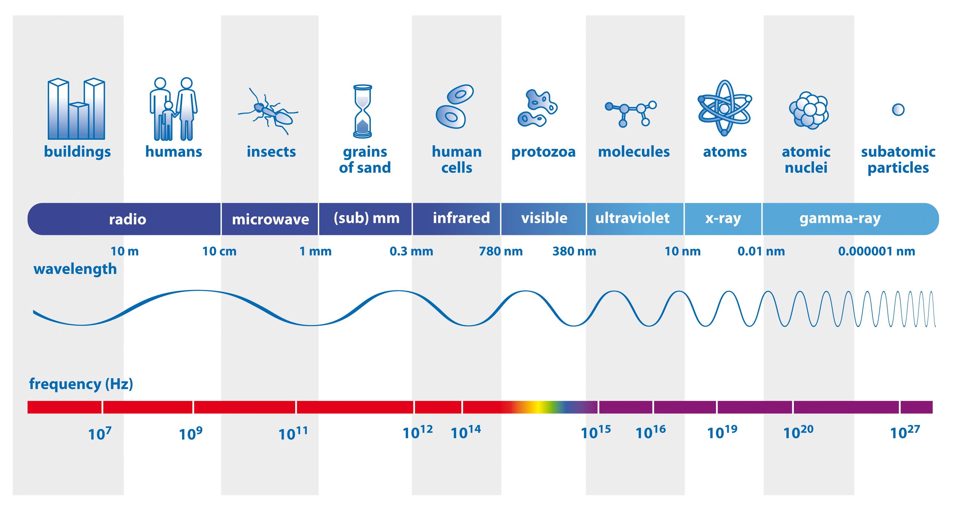
The electromagnetic spectrum
Notes:
The parts of the electromagnetic spectrum by wavelength.
The top row shows objects that are about the same size as one wavelength of the radiation.
The bottom row shows the frequency – that is, the number of vibrations of the wave each second.
(Source: ESA/AOES Medialab – adapted ESA CCI)

Slide 6
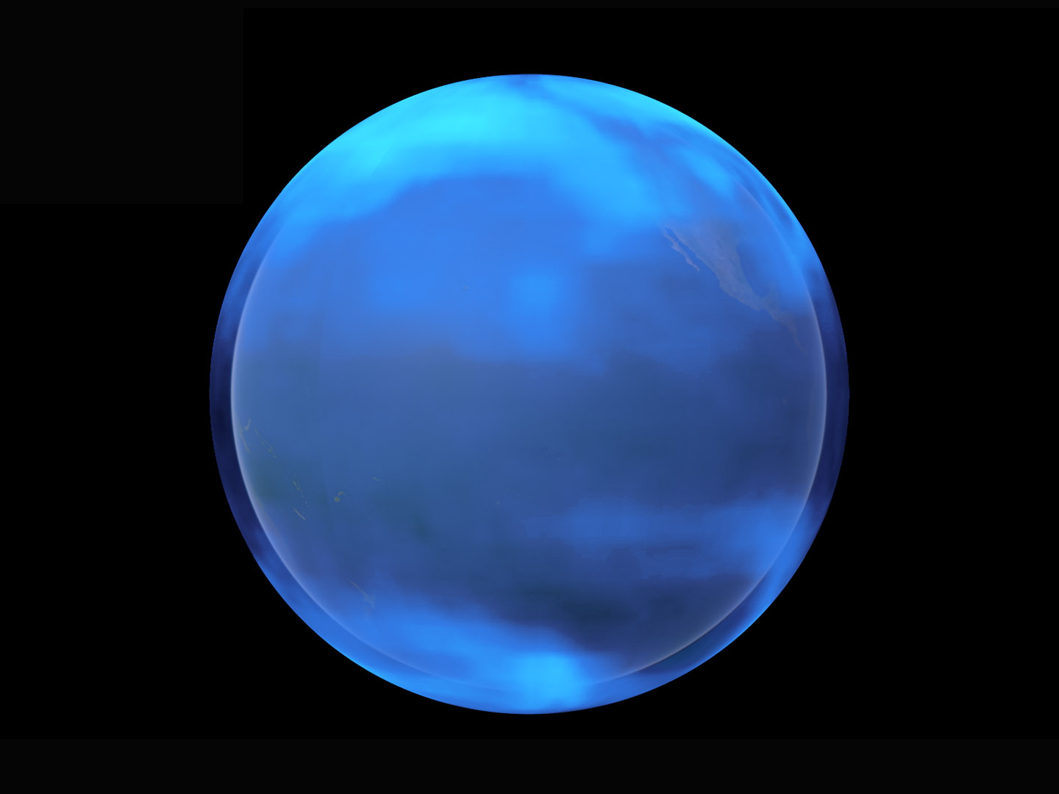
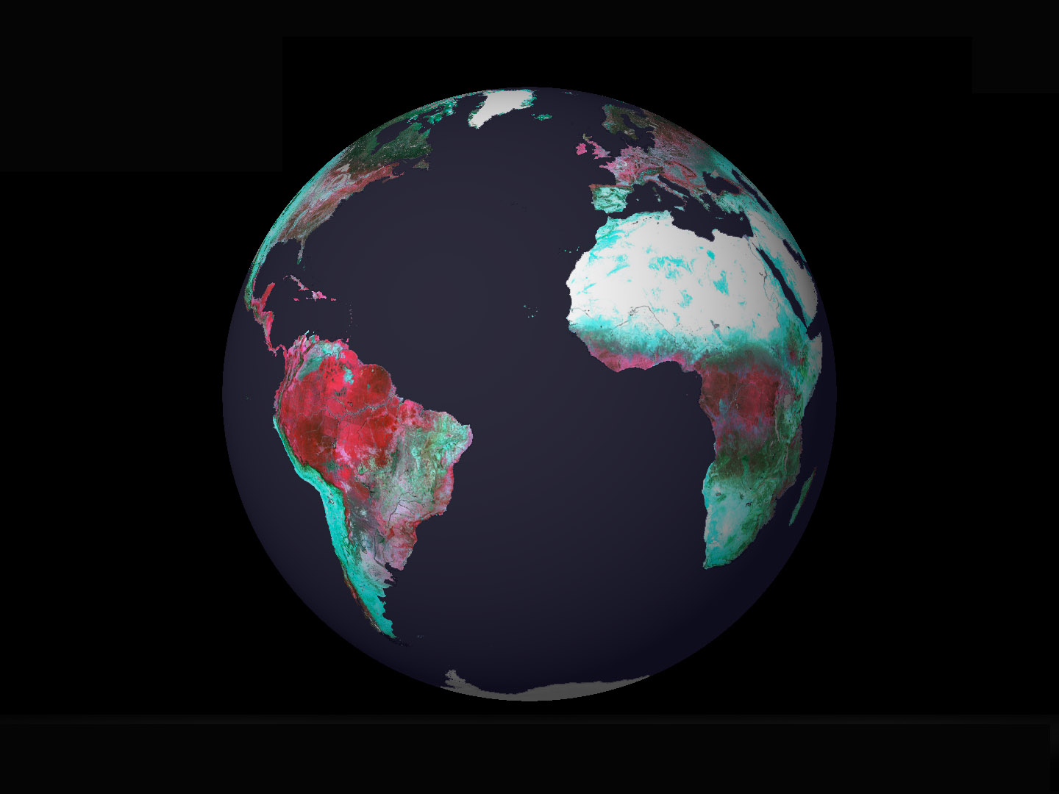
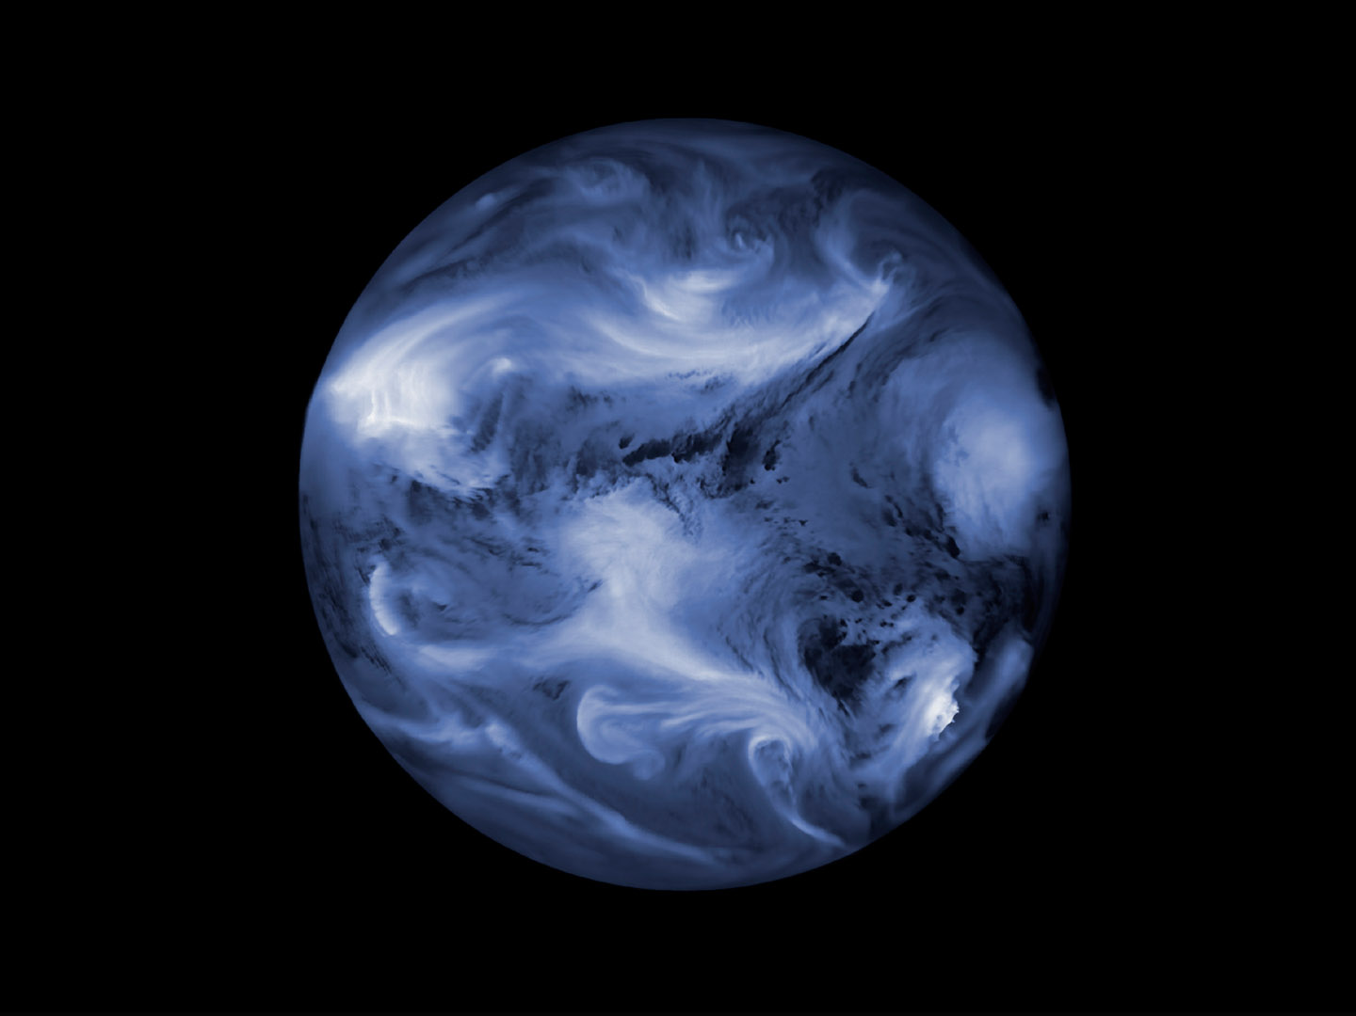
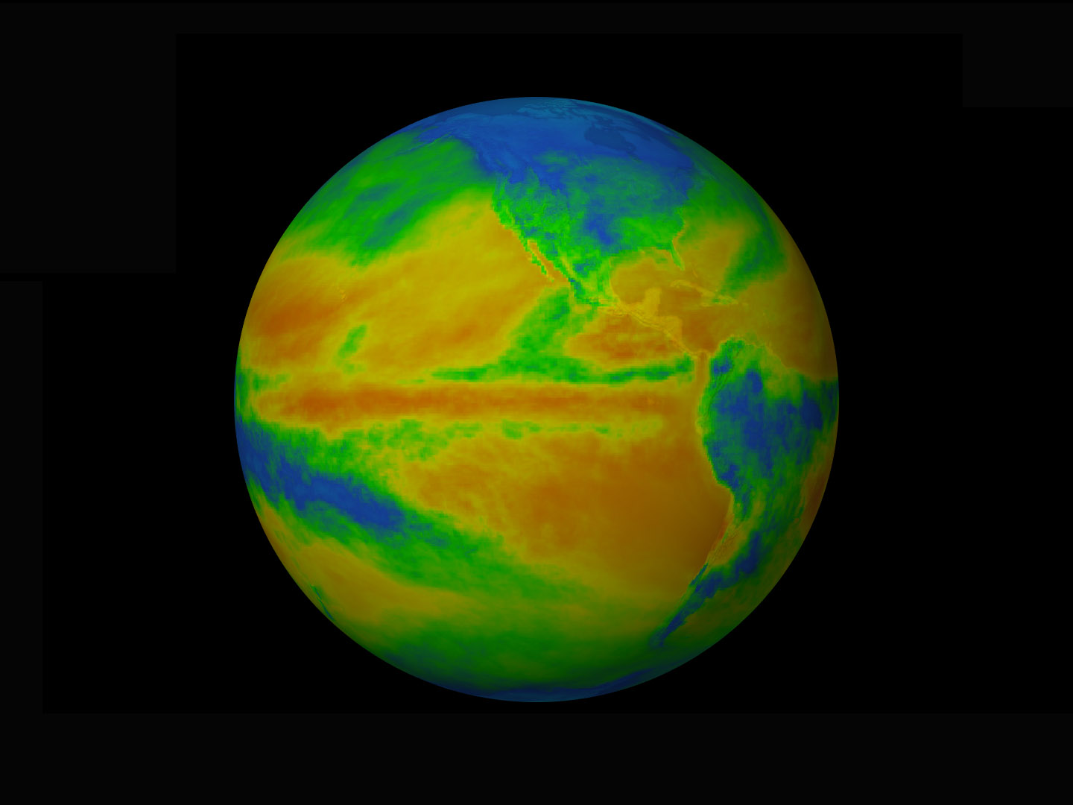
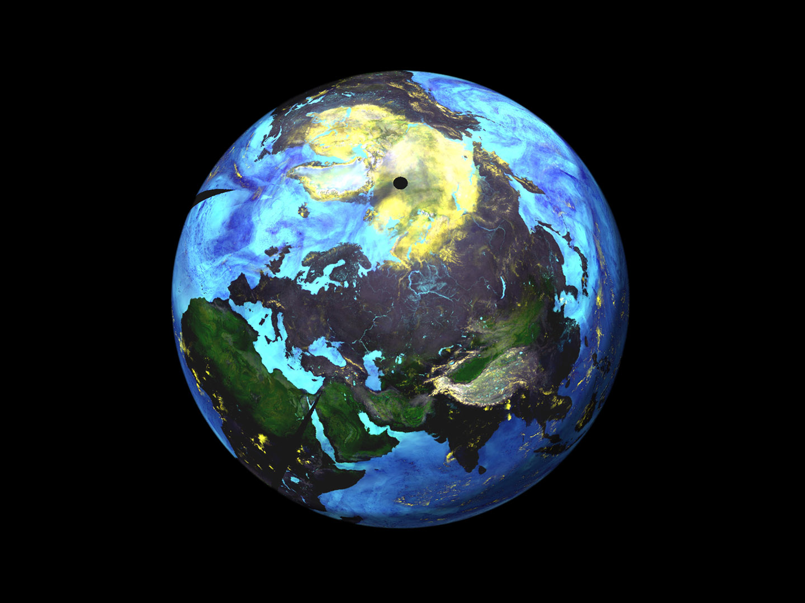
The Earth at different wavelengths
Notes:
Ultraviolet light reveals the concentration of atmospheric ozone (ESA-CCI Ozone)
Pictures below appear in sequence with each click
Multispectral surface reflectance at visible and near-infrared wavelengths shows the vigour of plant life on land (ESA-CCI CCI Land Cover)
Atmospheric water vapour revealed at mid-infrared wavelengths by the Meteosat weather satellite (ESA/Eumetsat/DLR)
Thermal infrared wavelengths show the temperature of the Earth’s surface and cloud tops (ESA-CCI Cloud)
Microwave emissions are used to track soil moisture, sea ice, snow and atmospheric water. Brightness temperature at 89 GHz and 23.8 GHz from AMSR-E. (National Space Development Agency of Japan)

Slide 7
Monitoring the Earth across the spectrum – 1
Type of electromagnetic radiation | Wavelengths | What we can monitor using it
visible light | 380–780 nm | land cover ocean colour (phytoplankton)
X-rays gamma rays | <10 nm | no Earth observation applications, although many medical uses
ultraviolet light | 10–380 nm | ozone
near infrared | ~1 μm | plant health (agricultural productivity, impact of droughts)
thermal infrared | ~10 μm | temperature of land, ocean, cloud tops
microwaves | in cm | water (soil moisture, ice and snow, atmospheric water vapour)
Type of electromagnetic radiation | Wavelengths | What we can monitor using it
Notes:
Table content appears on click

Slide 8
Monitoring the Earth across the spectrum – 2
2. Why are microwaves particularly useful for monitoring the Earth?
Microwaves pass through clouds, so can get data in the dark and poor weather.
3. Electromagnetic radiation with very long wavelengths – metres or even kilometres – is not used for monitoring the Earth. What is it used for?
Communications (radio and TV).
4. Most satellite instruments detect radiation in the same way as a camera detects light. They are known as passive sensors. However, many microwave satellites use active sensors. What is different about how these work?
Active sensors send out a pulse of radiation then detect when it returns and how it has changed. Radar and sonar are active sensors.
Passive sensors, like our eyes, depend on reflected or emitted radiation.
Notes:
Answers appear one at a time on click.

Slide 9
Activity 2: SEEING IN NEW COLOURS
Learning outcomes
Describe how colour images are created by combining sets of data.
Evaluate the usefulness of various false-colour images.
Skills development
Use satellite data to explore
changes in a region.
Key words
channel
pixel
true-colour image
sensor
false-colour image
band

Slide 10
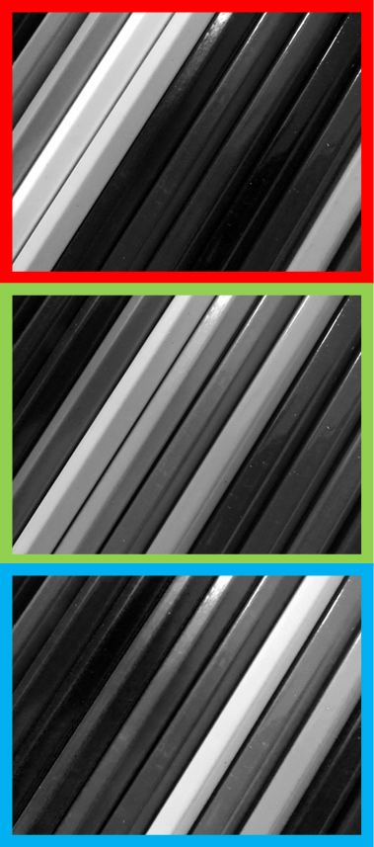

Building a true-colour image
How much red light is reflected | How much green light is reflected | How much blue light is reflected
Information from the red channel,
green channel and blue channel
combine to make a full-colour image.
Notes:
Photographs by Catherine Fitzsimons, NCEO

Slide 11
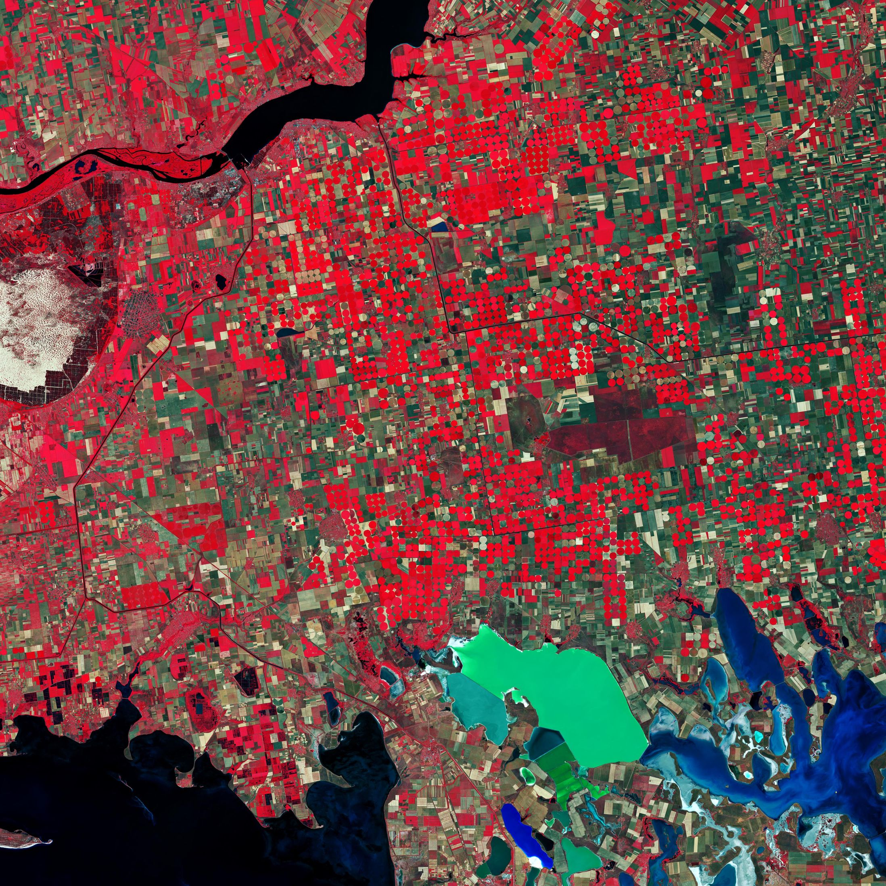
Seeing invisible light
Data from an infrared sensor is shown in the red channel.
Data about red light is
shown in the green channel.
Data about green light is shown in the blue channel.
Notes:
A false-colour image of Southern Ukraine (contains modified Copernicus Sentinel data (2019), processed by ESA)

Slide 12
Understanding false-colour images
1. What colour would the bright green area be in real life?
Red.
2. What do you think the bright blue swirls near the bottom right are?
Green algae or weed in a greenish lake.
3. Vegetation shows as red in this type of image. What does this tell us about plants and infrared radiation?
Plants reflect infrared light well.
infrared
red
green
Notes:
A false-colour image of Southern Ukraine (contains modified Copernicus Sentinel data (2019), processed by ESA)

Slide 13
Copernicus Sentinel-2 bands
Band number | Band name | Resolution / m | Minimum wavelength / nm | Maximum wavelength / nm
B1 | Aerosol | 60 | 443.9 | 442.3
B2 | Blue | 10 | 496.6 | 492.1
B3 | Green | 10 | 560 | 559
B4 | Red | 10 | 664.5 | 665
B5 | Red Edge 1 | 20 | 703.9 | 703.8
B6 | Red Edge 2 | 20 | 740.2 | 739.1
B7 | Red Edge 3 | 20 | 782.5 | 779.7
B8 | NIR | 10 | 835.1 | 833
B8A | Red Edge 4 | 20 | 864.8 | 864
B9 | Water vapour | 60 | 945 | 943.2
B11 | SWIR 1 | 20 | 1613.7 | 1610.4
B12 | SWIR 2 | 20 | 2202.4 | 2185.7
Notes:
NIR = near infrared
SWIR = shortwave infrared

Slide 14
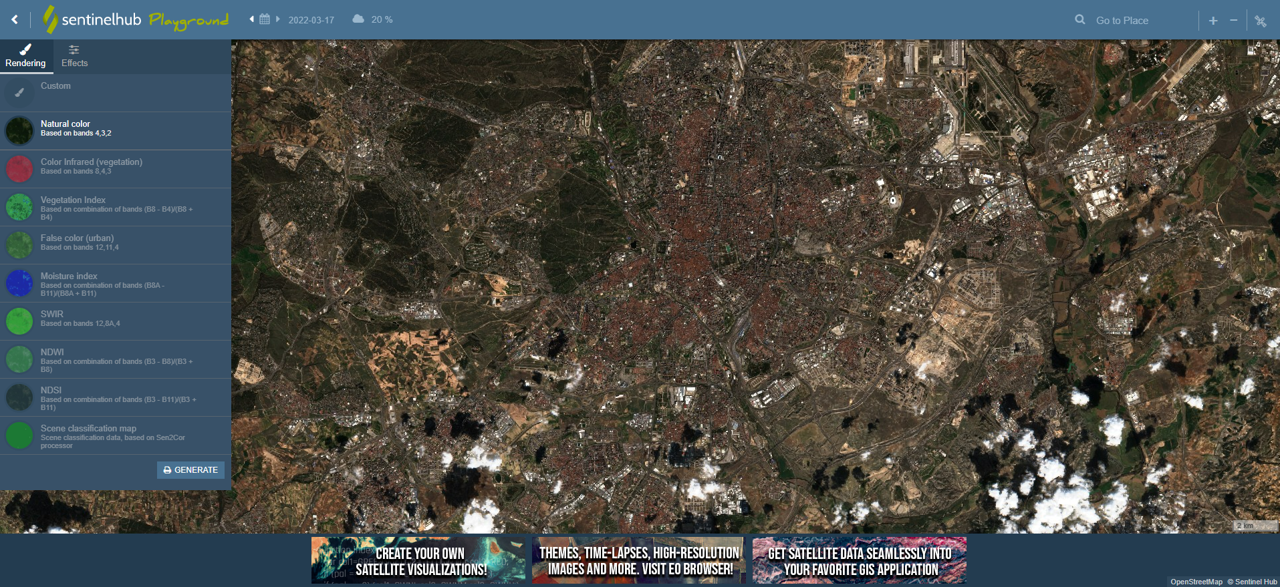
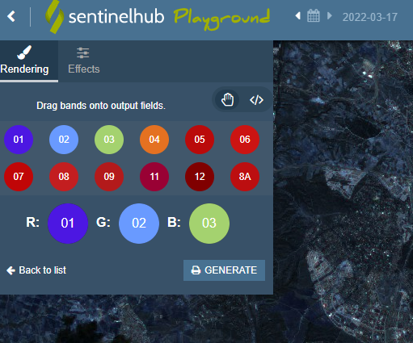
Using Sentinelhub Playground
4
1 apps.sentinel-hub.com/sentinel-playground
2
3 Drag a band onto a channel
Notes:
Opens with screenshot and address.
Box 1 will open the Playground in a browser window if you prefer to demonstrate.
Other elements appear on clicks as follows:
‘2’ highlighting ‘Custom’
Inset showing the Custom dialogue box
‘3’ showing how to choose bands for each channel
‘4’ highlighting controls for zooming, searching for a location, and turning off the Sentinel 2 layer in order to view the underlying map and navigate using it.

Slide 15
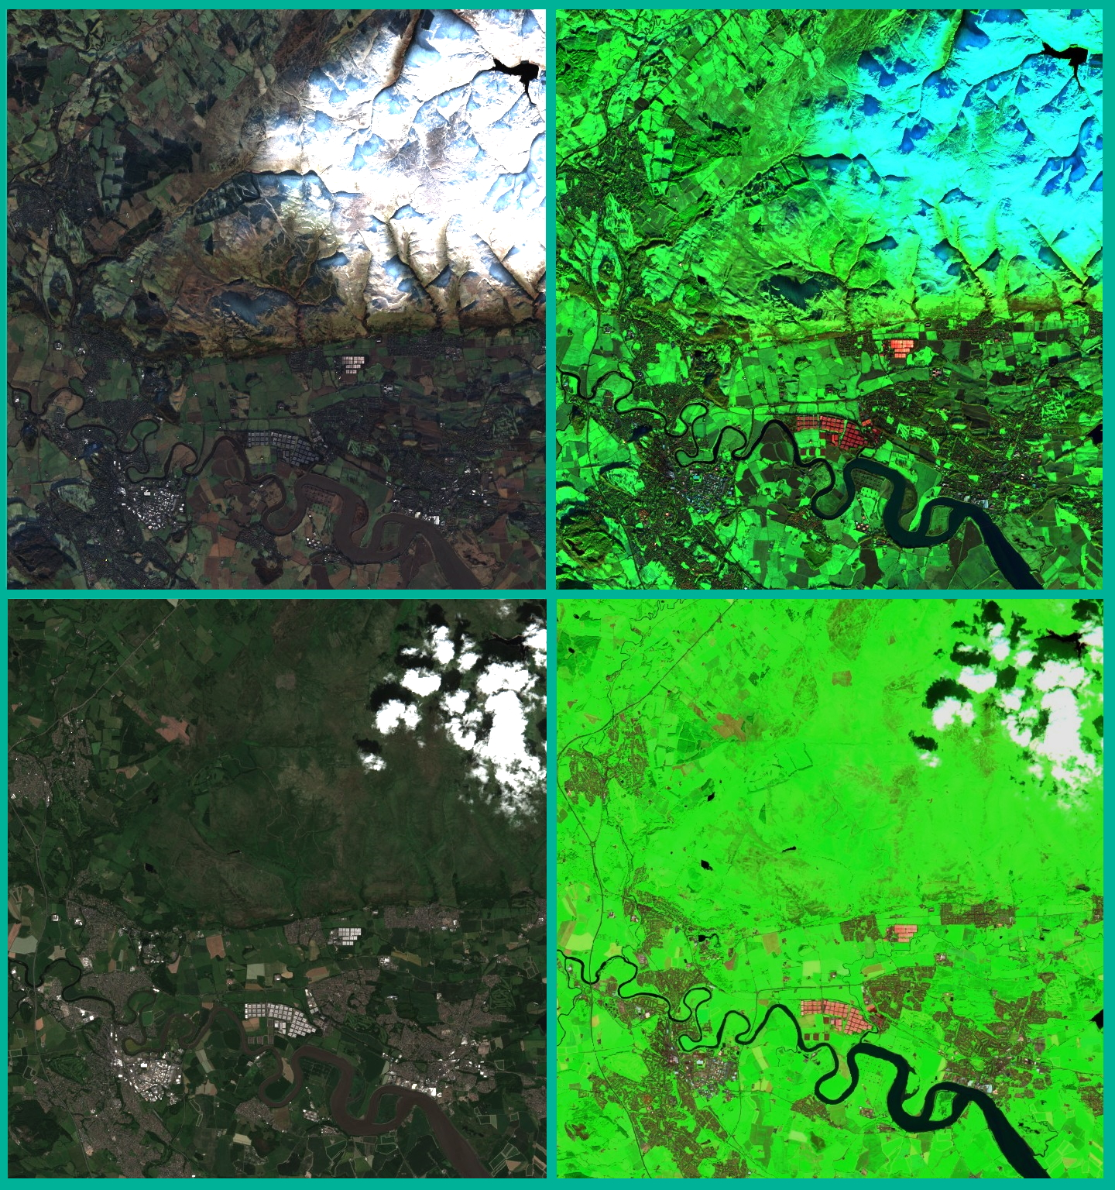
Exploring band combinations
Choose a feature to investigate.
Find:
  a suitable location
  the most recent cloud-free date
  three useful band combinations
  an older cloud-free date.
For each date, download or take a screenshot of:
  a true-colour image
  an image made using the best band combination.
Notes:
Real and false-colour (bands 12|8|3) images of Stirling, Scotland in January and July
(contains modified Copernicus Sentinel data (2021), processed using Sentinelhub Playground)

Slide 16
Using satellites to monitor change
Use your four images to make a poster showing the location you chose.
Add text to point out how it has changed over time.
You might also include:
More images of the same place at different times.
Images of a similar place that has not changed in the same way.
An explanation of the band combination you have used.
Information about the causes or/and effects of the changes.

Slide 17
Activity 3: EXPLORING CLIMATE FROM SPACE
Skills development
Use the Climate from Space web application to explore changes in soil moisture and other variables.
Combine information from a range of sources to create a report on a recent natural event that has affected many people.
Key words
satellite
sensor
pixel
resolution
soil moisture
anomaly

Slide 18
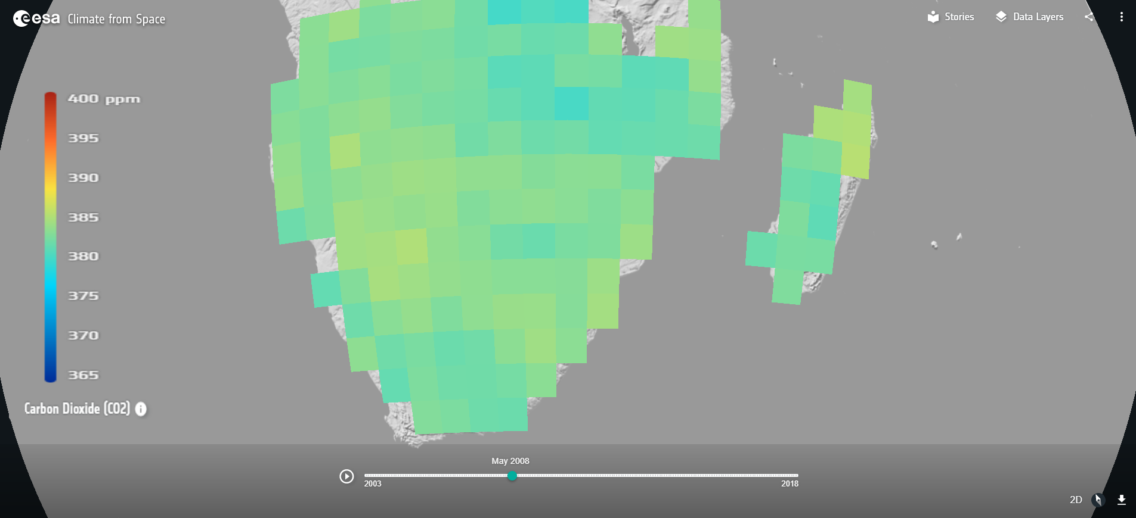
Carbon dioxide in Climate from Space
Notes:
Image included here to enable initial discussion (see teacher guide page 12, step 1) to take place before students move to/switch on computers if you preferred.

Slide 19
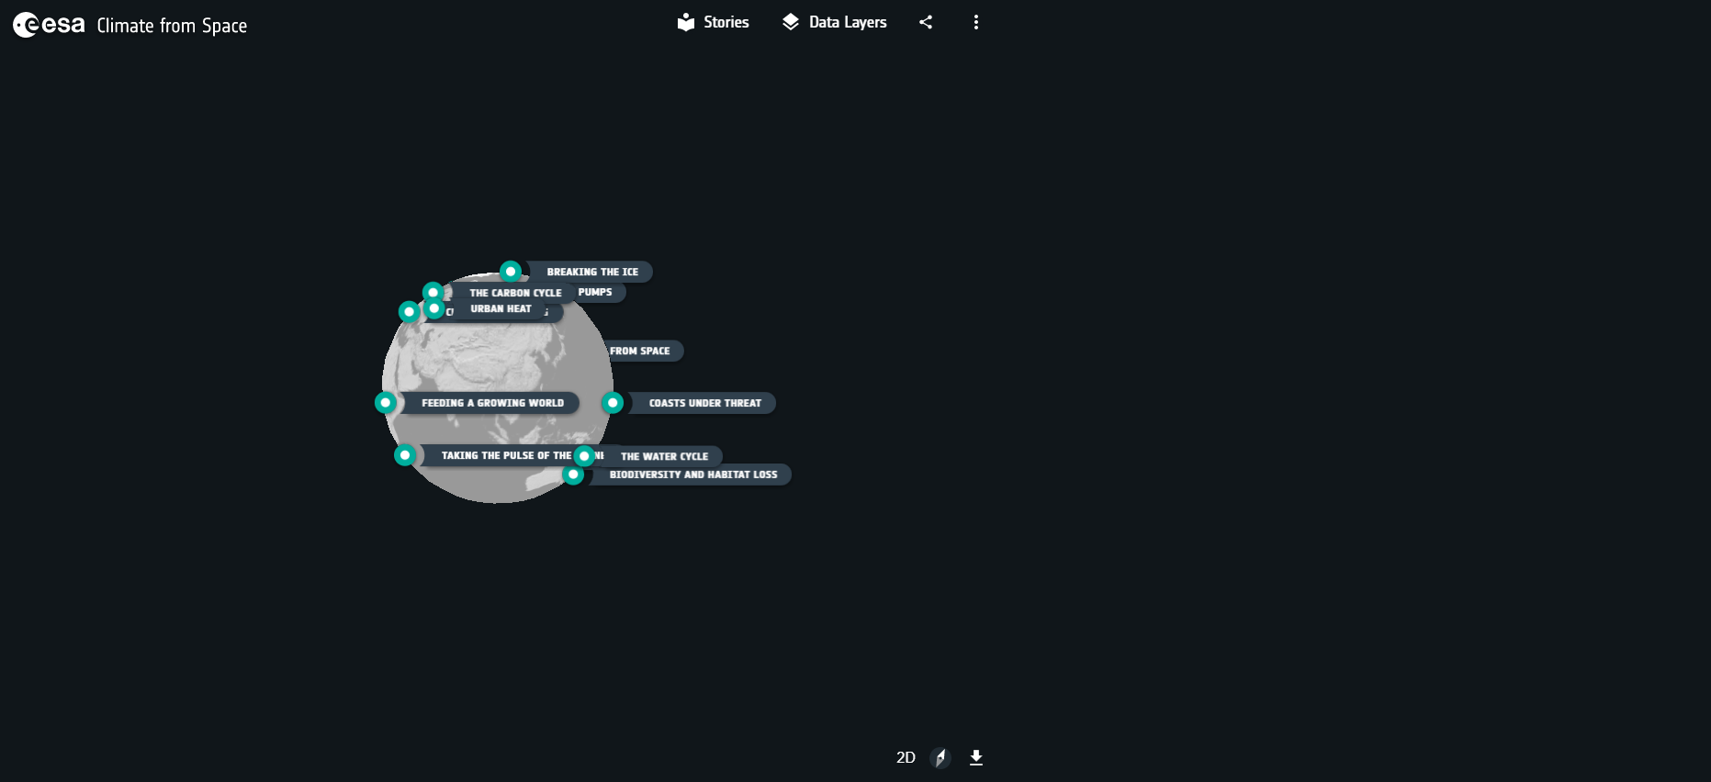
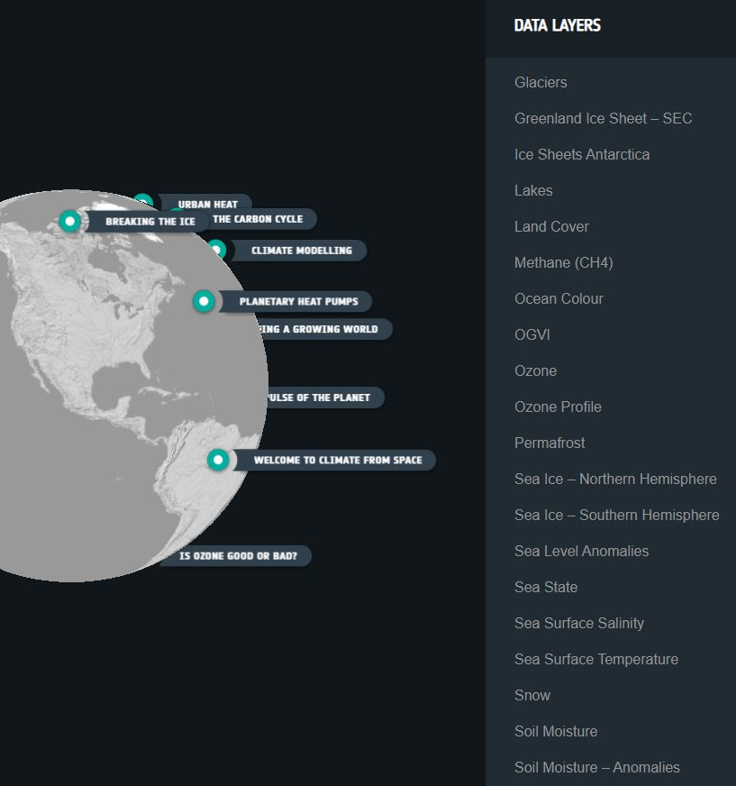
Using Climate from Space
3 scroll down
2
1
cfs.climate.esa.int
4
Notes:
Button 1 will open Climate from Space in a browser window if you prefer to demonstrate.
Image of globe and button/arrow 2 appear on first click.
Inset appears on second click.

Slide 20
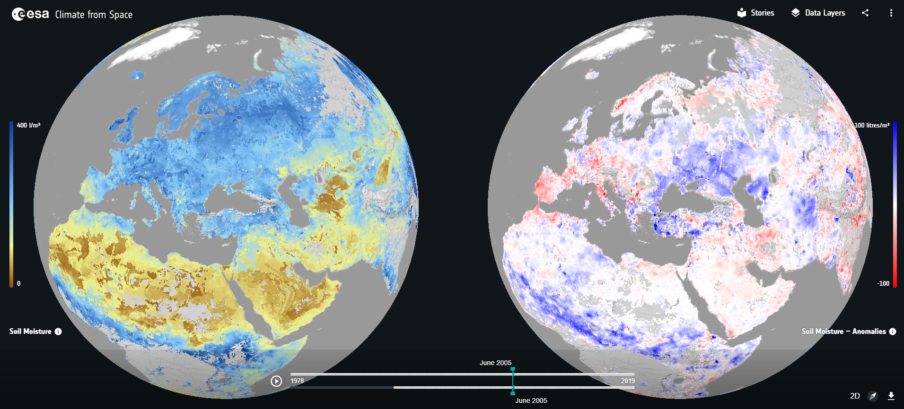
Two ways of looking at soil moisture – 1

Slide 21
Two ways of looking at soil moisture – 2
What extra information might we get from looking at these differences?
Plants, farming methods (and even building designs) are adapted to the normal levels and cycles of soil moisture. However, if a place is wetter than usual, it may be flooded; if it is drier than usual it may be experiencing a drought.
Soil moisture anomaly
is how much water is in the soil compared to the usual value for the time of year.
Why is the phrase in bold important?
Soil moisture may vary from month to month in a similar way each year. Comparing with annual averages may only show this regular variation. Comparing a normally wet month with a normally dry month gives no useful information.
Location:
Date | Estimated soil moisture / m³/m³ | Wetter or drier than usual? | Estimated soil moisture anomaly / l/m³
Notes:
Slide opens with definition.
Questions (Q3a and Q3b on student worksheet 3.1) appear together on first click.
Answers appear individually.
Table (combining Q2 & Q4 on student worksheet 3.1) appears after questions.

Slide 22
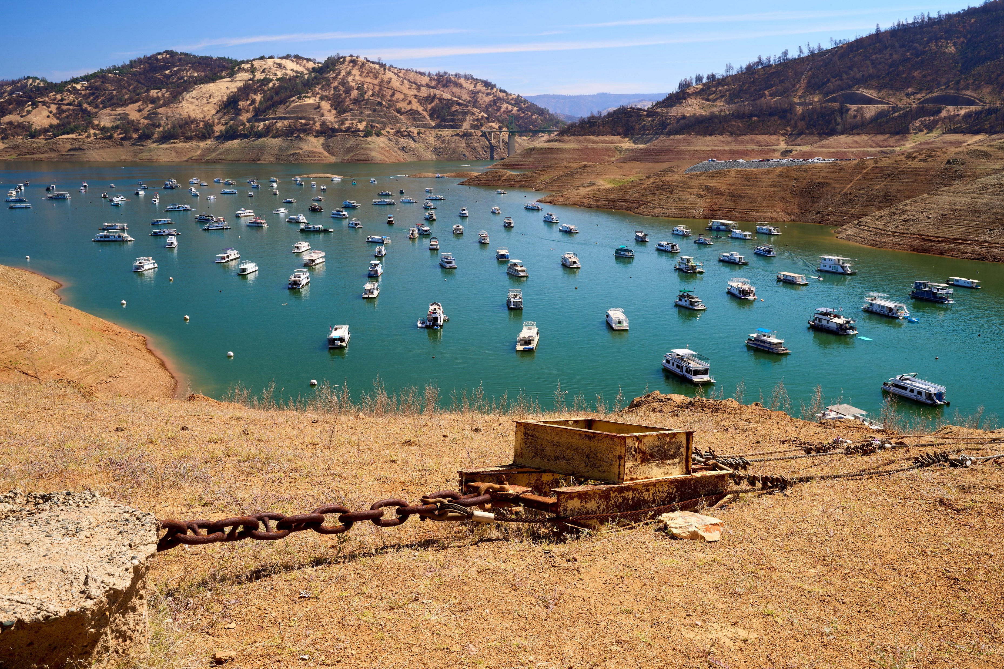
Notes:
Additional image as discussion prompt for effects of droughts Activity 3 (see teacher guide page 12, step 3)
Frank Schulenburg on flickr https://flic.kr/p/2m2Tpom used under Creative commons Attribution-ShareAlike 2.0 Generic (CC BY-SA 2.0) license
Headed into the next drought | Lake Oroville on the morning of Memorial Day 2021. In May 2021, water levels of Lake Oroville dropped to 38% of capacity. The boats are dwarfed by the exposed banks while California is headed into another drought year.

Slide 23
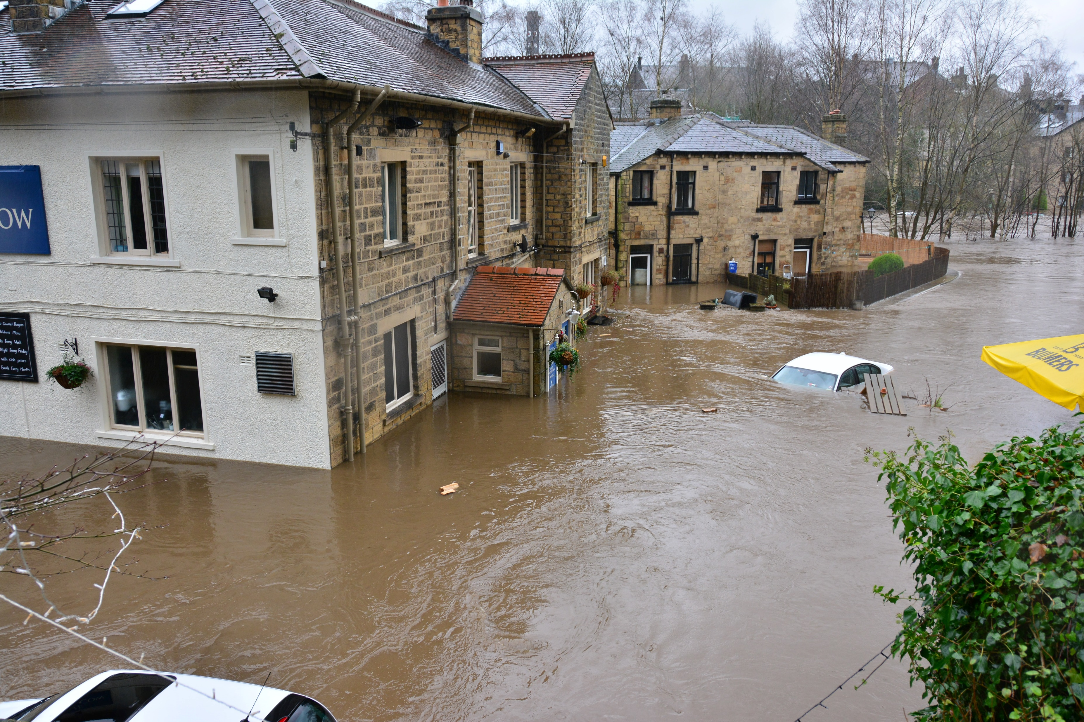
Notes:
Additional image as discussion prompt for effects of floods Activity 3 (see teacher guide page 12, step 3)
Photo by Chris Gallagher on Unsplash Free to use under the Unsplash License
River Aire floods Boxing Day 2015, Ireland Bridge, Bingley, UK

Slide 24
Investigating a drought or flood
Find out more about the event, its causes and impacts using:
The Climate from Space web app.
  Start with soil moisture levels and how they differed from their usual values.
  Then look at other things that might be relevant.
  (Cloud? Land cover? Fire? Snow? Permafrost?)
Sentinelhub Playground. Think about which band combinations are most useful.
The Internet for information such as annual climate data, economic data, population data, news reports …
Remember to assess the reliability of your sources.

Slide 25
Reporting on a drought or flood
You must include:
Details of the event: what? when? where?
At least one relevant image from satellite data.
You should include at least some of these:
What caused the event? How certain can we be about this?
What impact did the event have on the area?
How did the event affect people? How many?
Over what time scales? What was done to help them?
Is it likely to happen again?
If so, what is being done to reduce the impact the next time?
Does climate change make this type of event in this place more or less likely?

Slide 26
TAKING THE PULSE OF THE PLANET--

