Slide 1
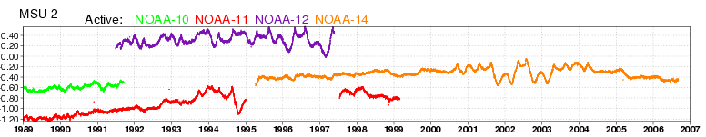
Reanalysis:
When observations meet models
Dick Dee, ECMWF
Paul Berrisford, Roger Brugge, Hans Hersbach, Carole Peuby, Paul Poli, Hitoshi Sato, David Tan
Adrian Simmons, Sakari Uppala
MSU Ch2 radiance bias [K], estimated by reanalysis

Slide 2
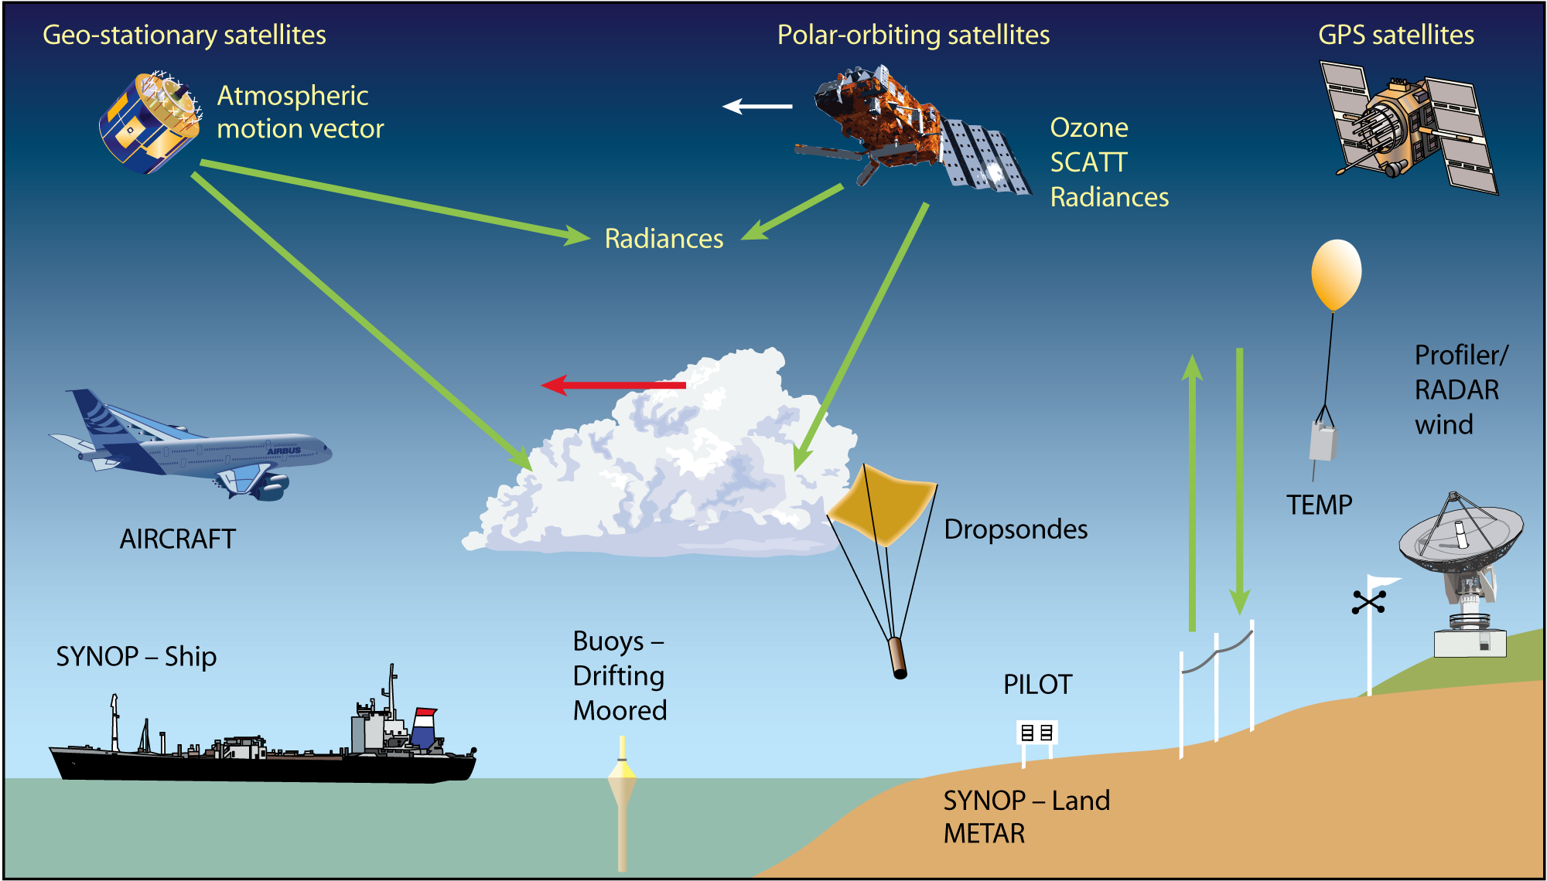
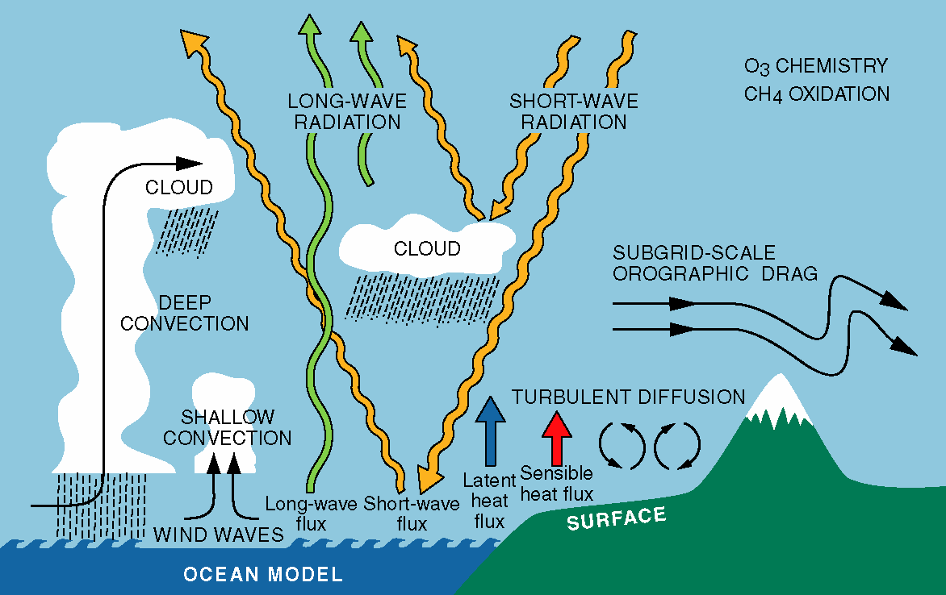
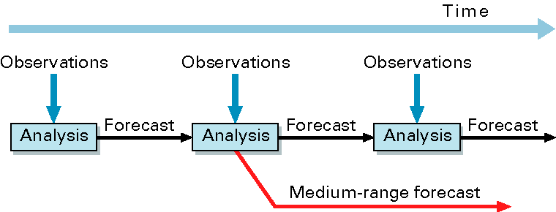
Data assimilation for numerical weather prediction
Observations
Forecast model
Data assimilation

Slide 3
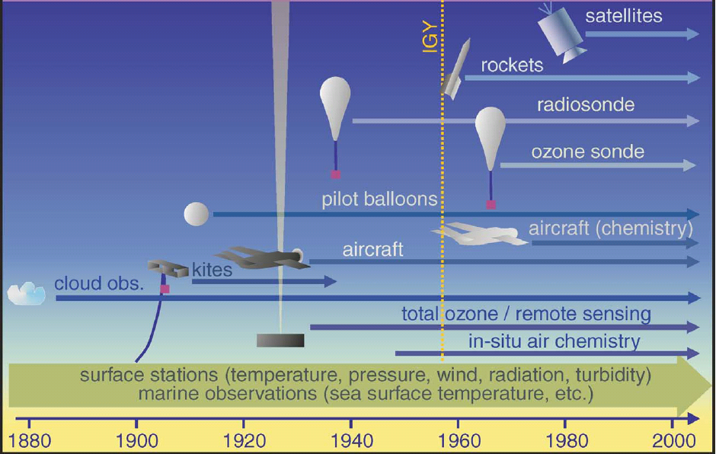
From weather analyses to climate reanalysis
Reanalysis uses a modern forecasting/data assimilation system to
reprocess (re-analyse) past observations.
(The observations themselves may have been re-processed.)

Slide 4
From weather analyses to climate reanalysis
Reanalysis uses a modern forecasting/data assimilation system to
reprocess (re-analyse) past observations.
(The observations themselves may have been re-processed.)
Example: Consistent representation of the Hadley circulation
From ECMWF weather analyses:
From reanalysis (ERA-15):

Slide 5

Reanalysis at ECMWF
ERA-15: 1979 – 1993
ERA-40: 1957 – 2001
ERA-Interim: 1989 onwards
ORA-S3: 1959 onwards
MACC: 2003 – 2010
ERA-CLIM:
European Reanalysis of Global Climate Observations
An EU FP7 project to prepare the next ECMWF reanalysis
ERA-20C: 1900 onwards

Slide 6
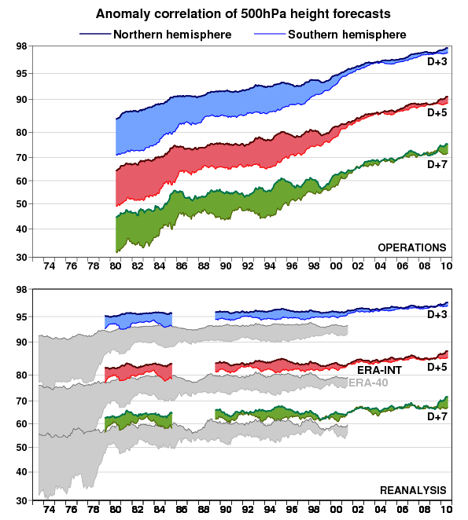
Atmospheric reanalysis: ERA-Interim
ECMWF forecasts: 1980 – 2010
Changes in skill are due to:
improvements in modelling
and data assimilation
evolution of the observing system
atmospheric predictability
ERA-Interim: 1979 – 2010
uses a 2006 forecast system
ERA-40 used a 2001 system
re-forecasts more uniform quality
improvements in modelling and
data assimilation outweigh
improvements in the observing
system
Notes:
Flatness of curves: (1) uniform quality over time and space -> good for applications
But also: (2) increase in forecast skill has more to do with improvements in data assimilation methods than with improvements in the observing system

Slide 7
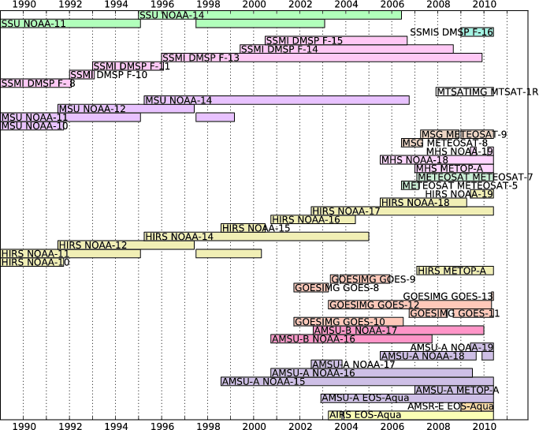
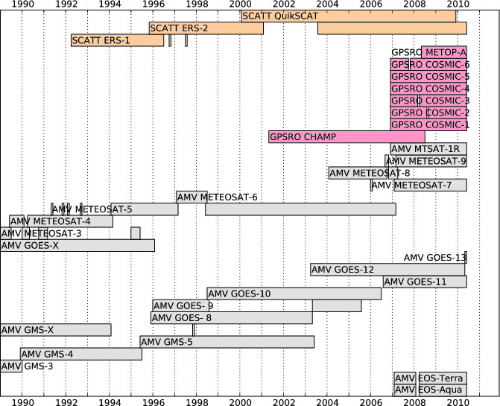
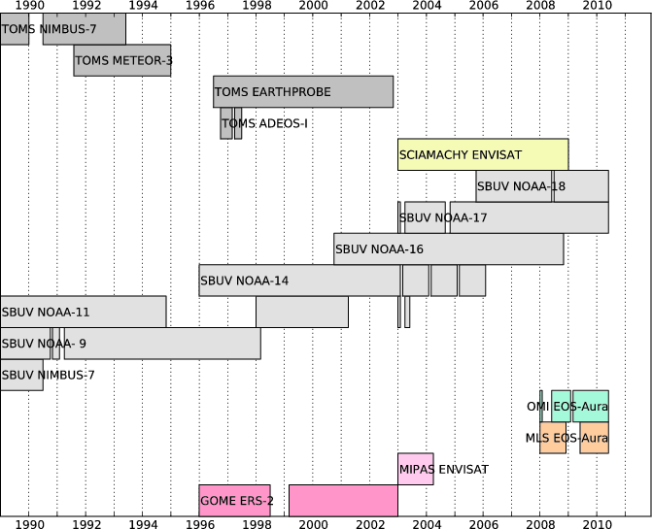
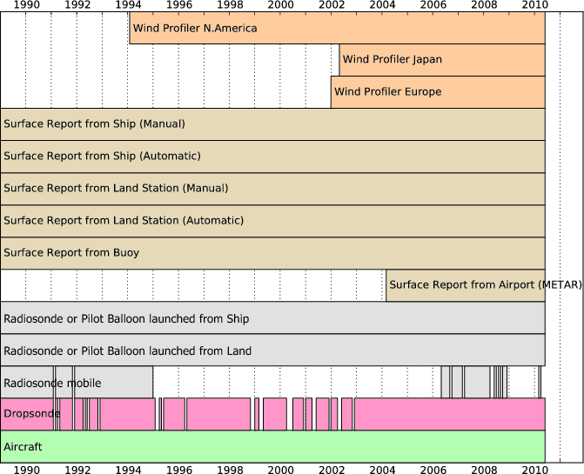
Observations used in ERA-Interim: Instruments
Radiances from satellites
Backscatter, GPSRO, AMVs from satellites
Ozone from satellites
Sondes, profilers, stations, ships, buoys, aircraft

Slide 8
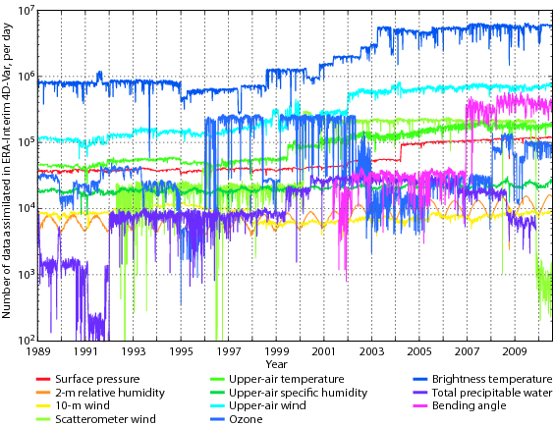
Observations used in ERA-Interim: Data counts

Slide 9
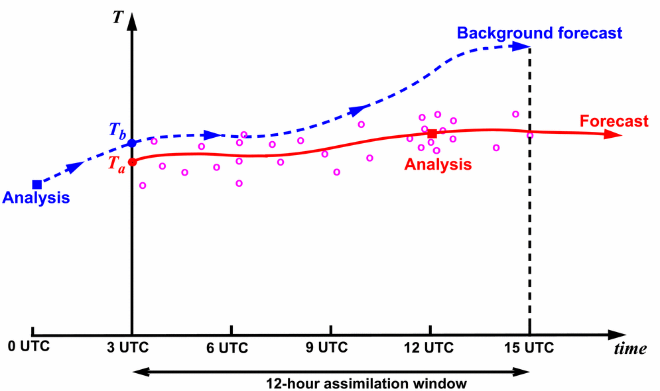
Variational analysis of observations
The model equations are used to fill gaps and to propagate information forward in time
Observations are used to constrain the model state
Additional parameters may be used to adjust for data biases
prior state constraints
prior parameter constraints
observational constraints

Slide 10
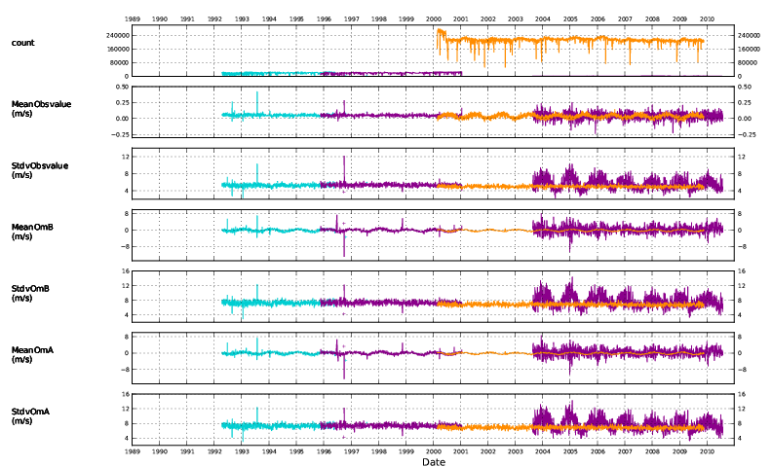
Input data monitoring: Scatterometers
ERA-Interim daily assimilation statistics for scatterometer data (U-wind)
Data counts
ERS-1
ERS-2
QuikSCAT
stdv mean
Observed
values
stdv mean
Background departures
stdv mean
Analysis departures

Slide 11
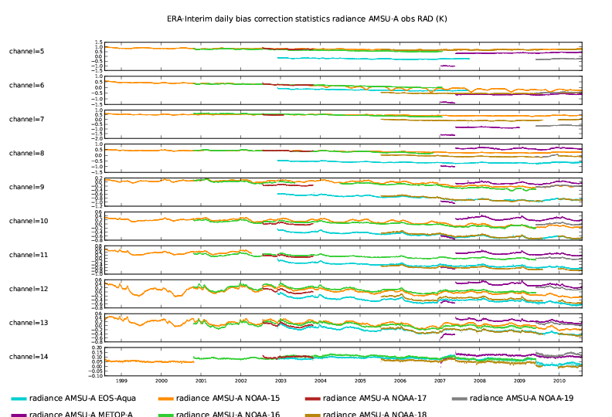
Variational bias adjustments for satellite radiances
Globally averaged bias estimates, for all AMSU-A channels used
Ch 5
Ch 6
Ch 7
Ch 8
Ch 9
Ch 10
Ch 11
Ch 12
Ch 13
Ch 15

Slide 12
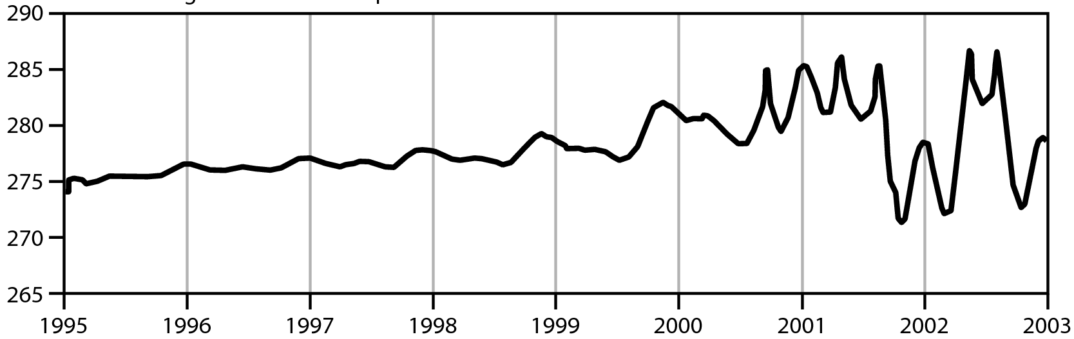
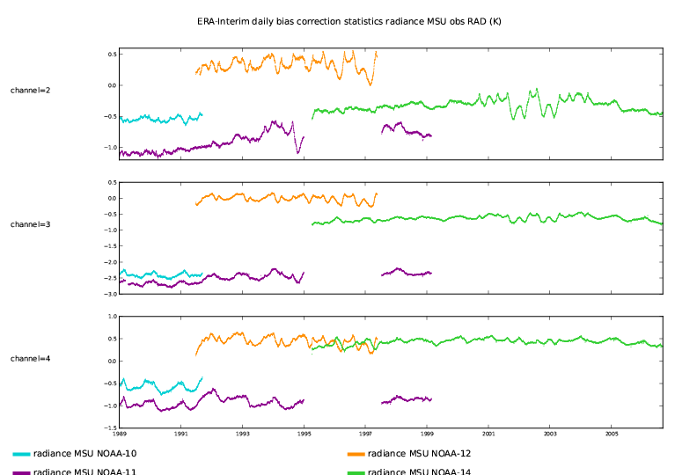
Independent verification of MSU bias estimates
Recorded on-board warm target temperature changes due to orbital drift for NOAA-14 (Grody et al. 2004)
Ch 2
Ch 3
Ch 4

Slide 13
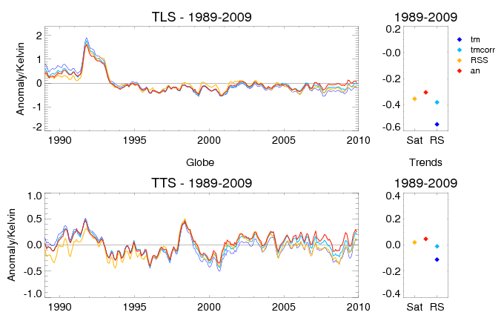
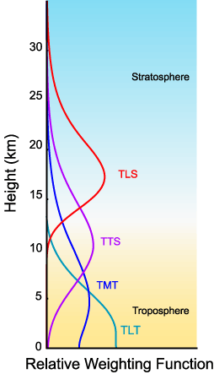
How accurate are trend estimates from reanalysis?
Global mean temperatures, for MSU-equivalent vertical averages:
ERA-Interim
Radiosondes only (corrected)
MSU only, from RSS

Slide 14
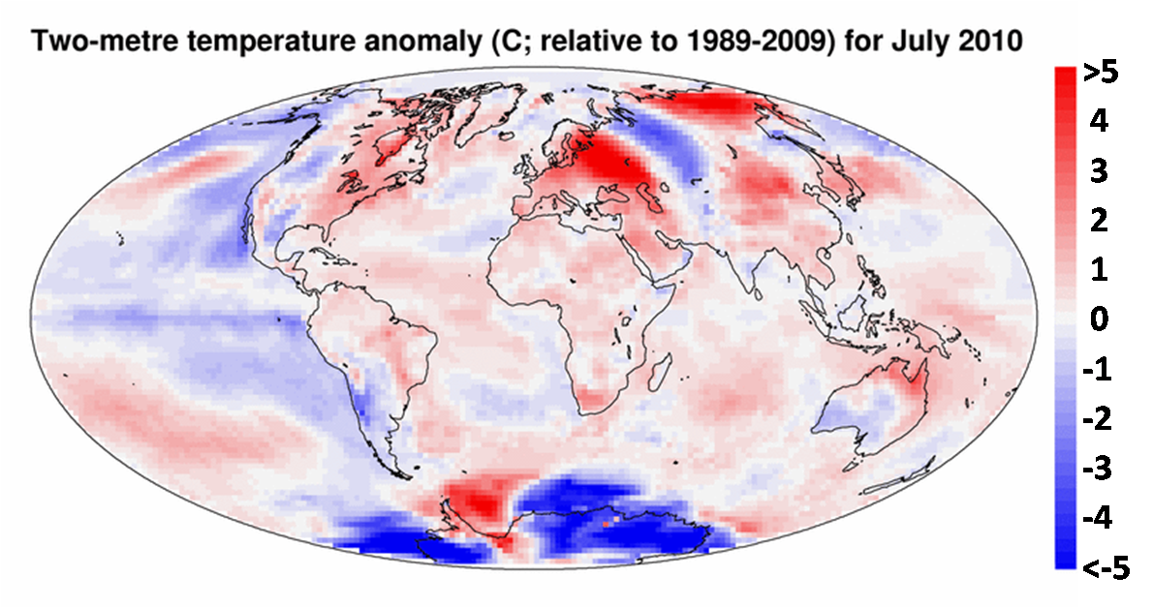
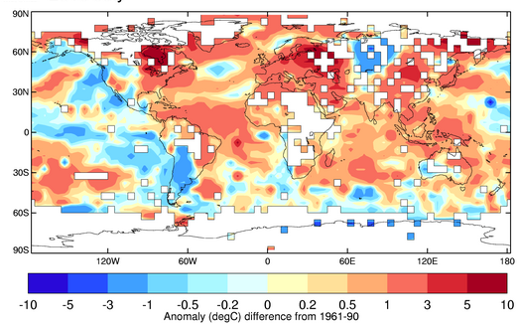
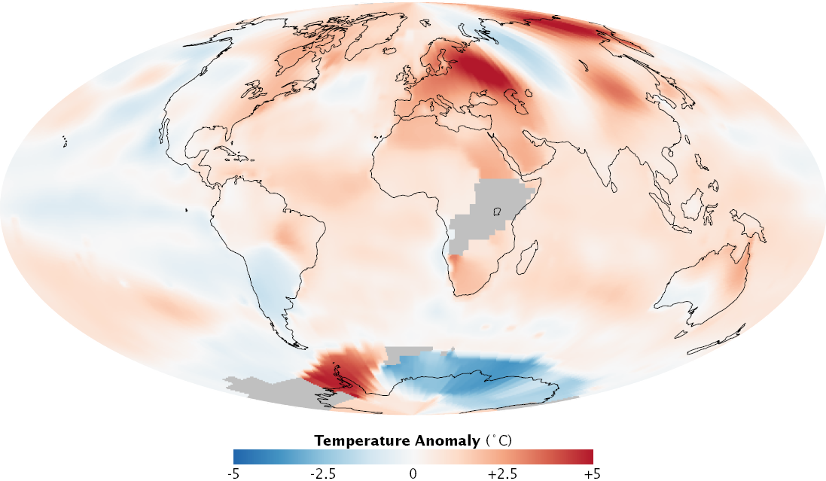
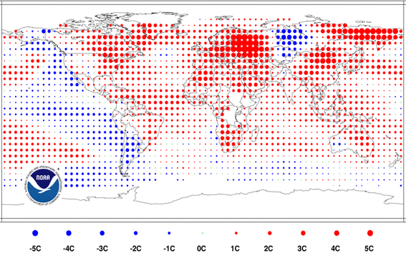
Surface temperature anomalies for July 2010
ERA-Interim
Hadley Centre
NASA/GISS
NOAA/NCDC

Slide 15
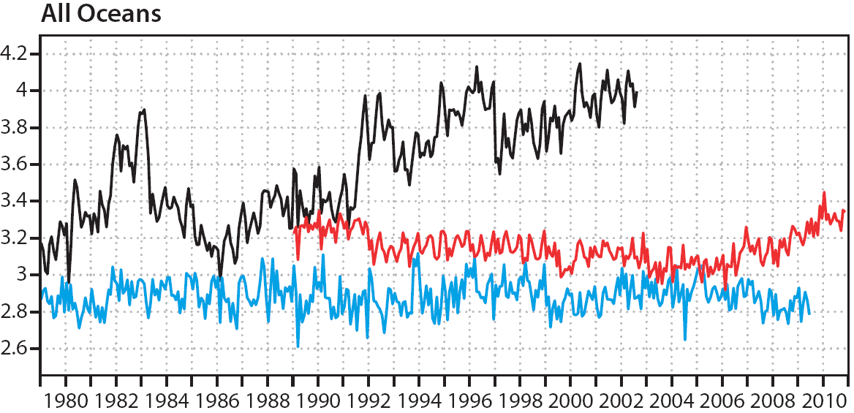
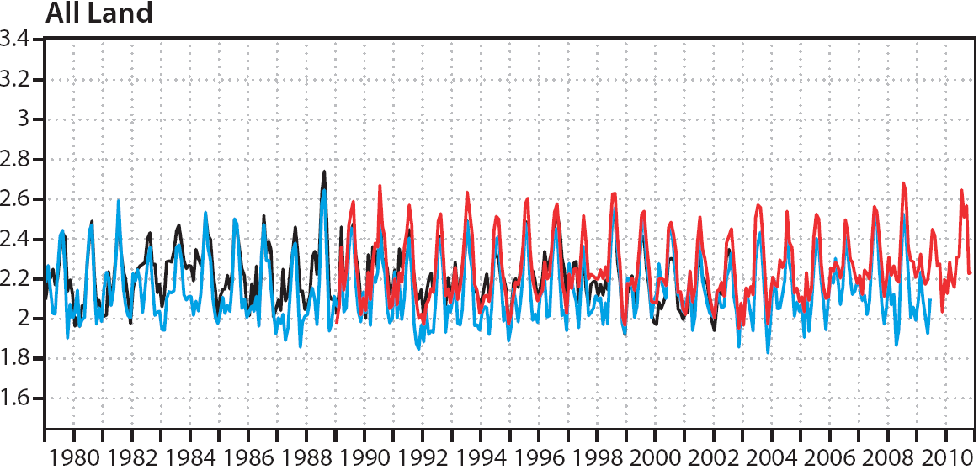
Larger uncertainties in precipitation trends
Comparison of monthly averaged rainfall with combined rain gauge and satellite products (GPCP)
Reanalysis estimates of rainfall over ocean are still problematic
Results over land are much better

Slide 16
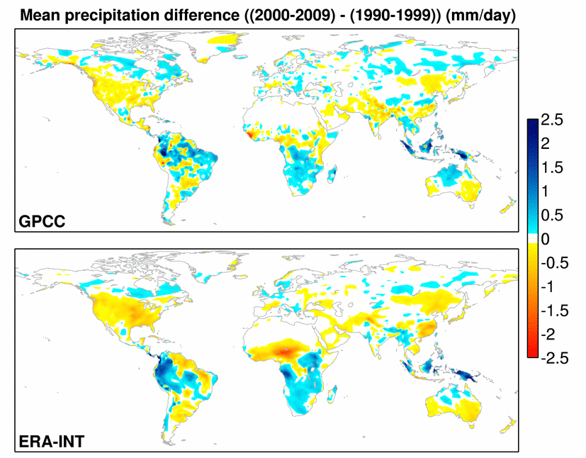
Larger uncertainties in precipitation trends
Decadal trends in precipitation, from GPCC data and from ERA-Interim:

Slide 17
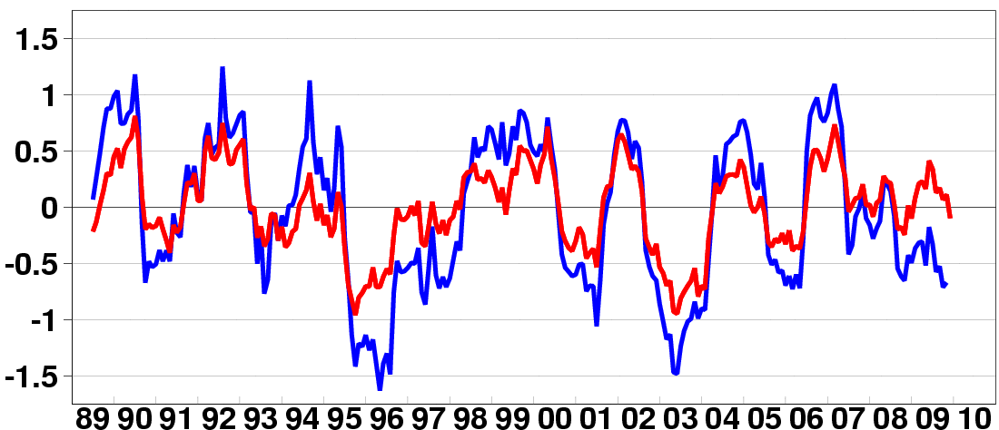
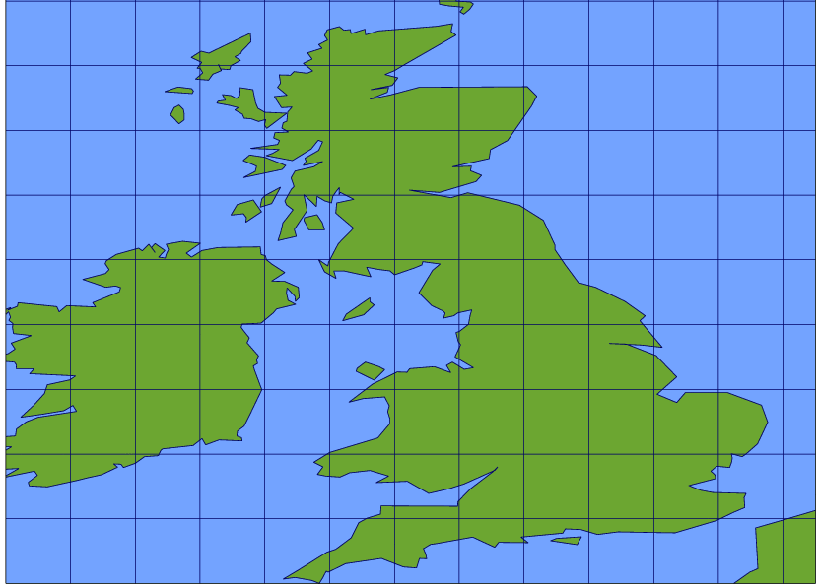
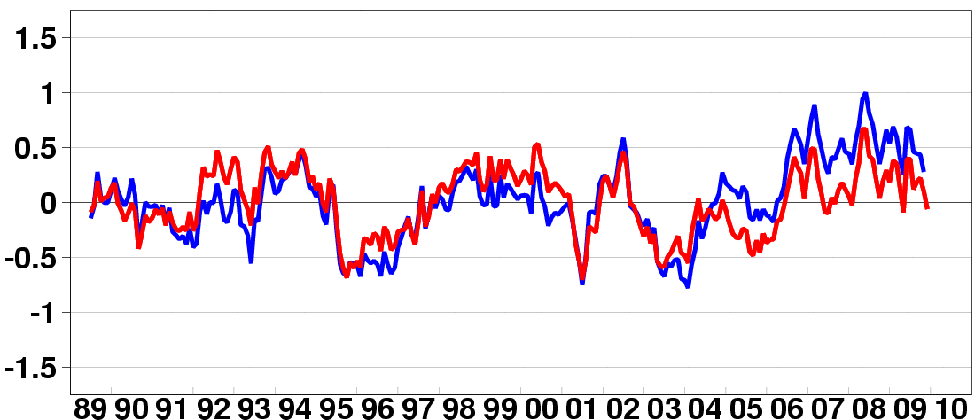
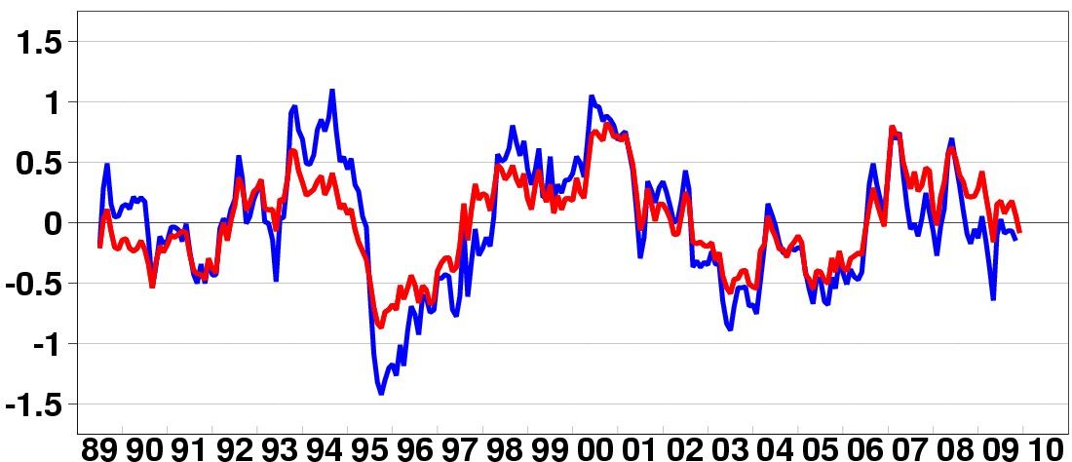
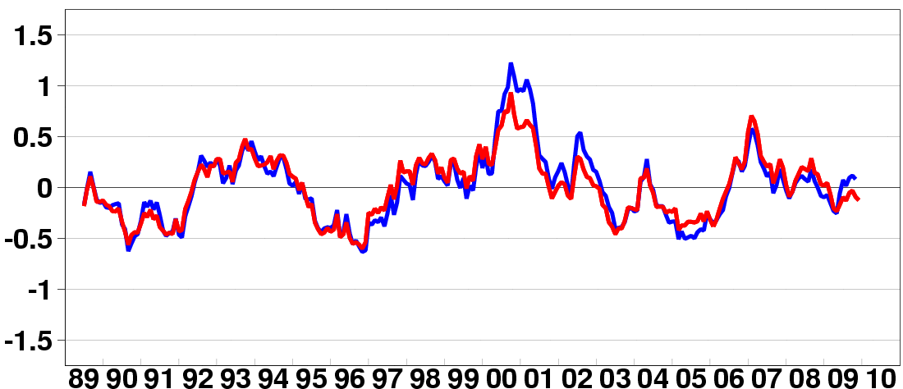
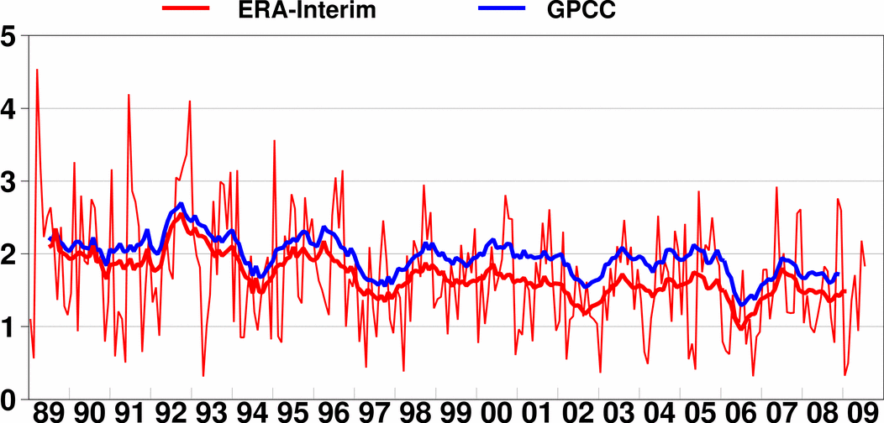
Precipitation anomalies for 1^{O}x1^{O} grid boxes
Anomalies are computed relative to (1989-2009) means for each month from ERA and GPCC respectively.
Time series of 12-month running means are shown here.

Slide 18
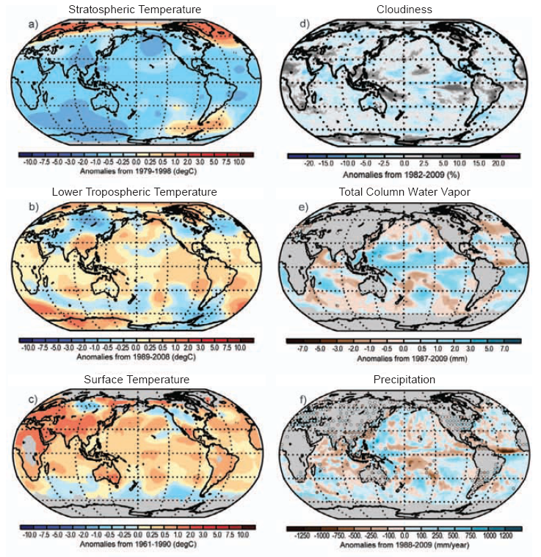
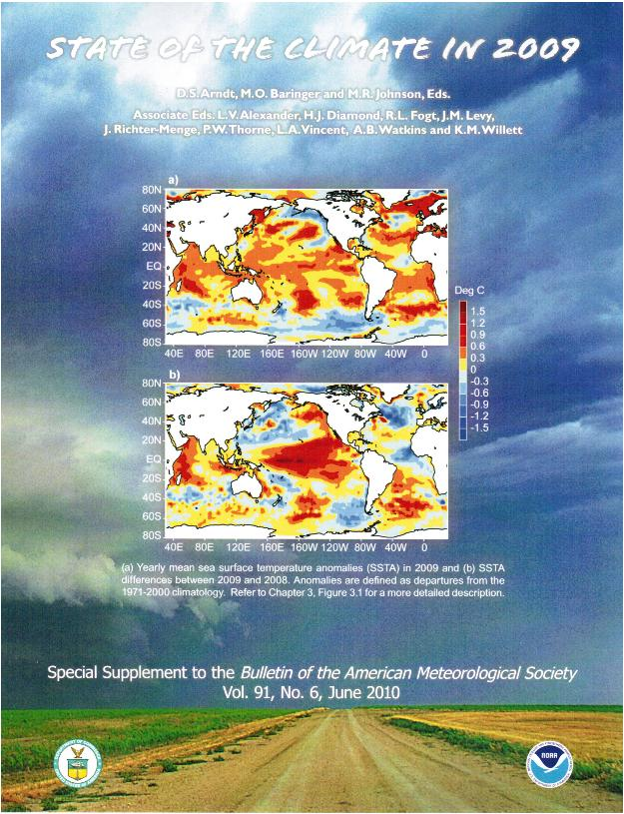
BAMS State of the Climate
Growing use of reanalysis for climate monitoring
Caution is still advised!

Slide 19
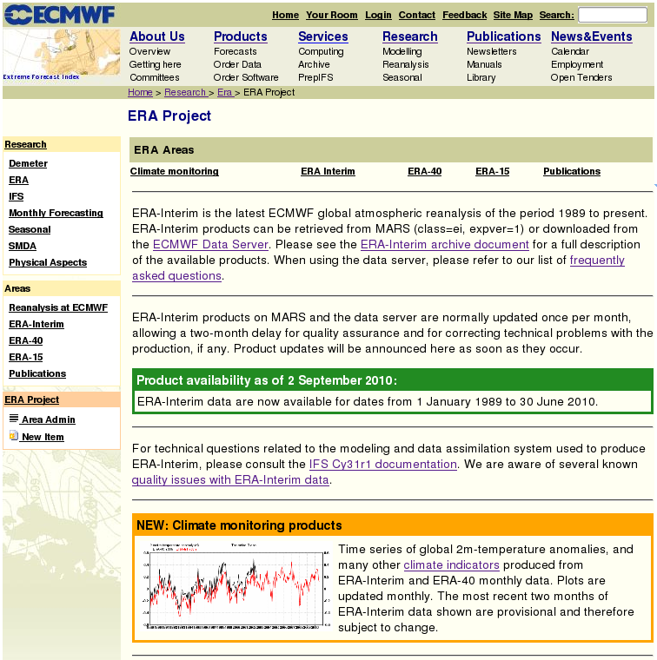
Access to reanalysis data at www.ecmwf.int/research/era
Public data server:
~6000 registered users
Data products are updated monthly
Full resolution data expected June 2011
Climate change monitoring tools in development
Compares ECVs from reanalyses and other observational products

Slide 20
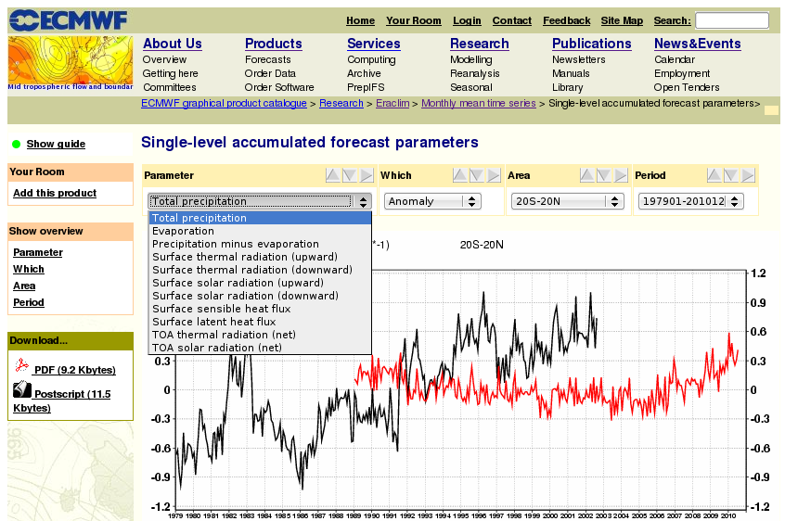
Time series of monthly averaged products

Slide 21
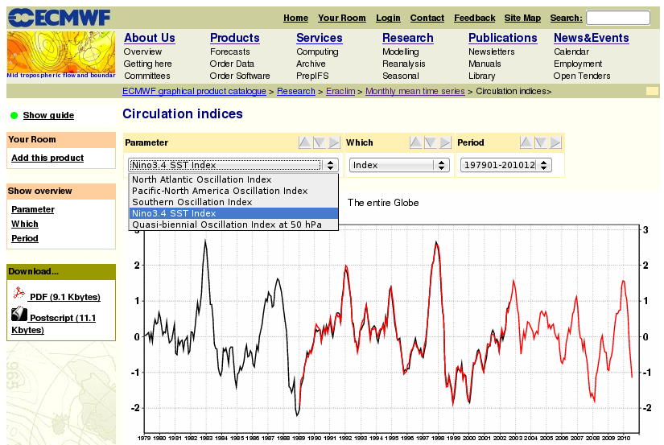
Large-scale circulation indices

Slide 22
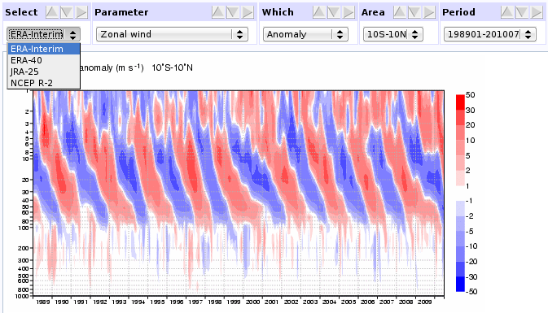
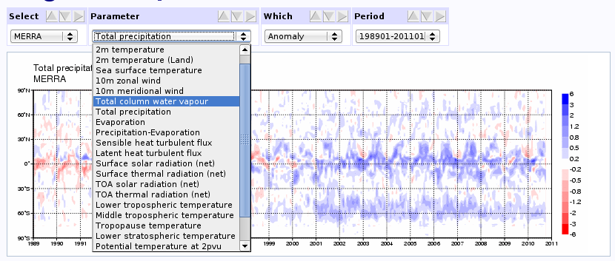
Additional climate monitoring products in development
Two-dimensional time series (height/latitude/longitude)
Global maps of Essential Climate Variables and climate anomalies
Comparisons with other available reanalyses (JMA, NCEP, …)
Comparisons with other observational products (GPCP, CCI, …)

Slide 23
ERA data and visualisation services
We will generate 2 Pb data products by 2017 (ERA-Interim: 50 Tb)
We expect a large number of users for these products
  ERA-40 public data server had 12000 registered users
  ERA-Interim data server has ~6000 registered users – adding 300 per month
We will provide web access to full-resolution reanalysis data
  ECMWF is no longer required to apply an information charge
  Cost of data services is substantial (but not yet funded)
We will provide web access to observation feedback
  Analysis and background departures; error estimates for observations
We will provide web access to data visualisation tools
  Includes climate monitoring facilities
  Need separate funding to do this right

Slide 24
Summary and conclusions
Various roles for reanalysis within the CCI:
Source of input data for ECV retrievals
Source of alternative ECV estimates
Tools for confronting models with observations
  Assessments of ECV products, singly and combined
  Assessments of input observations used in ECV production
  Assimilation of input observations?
Reanalysis provides a unifying framework for integrating climate information from many sources
Progress requires sustained long-term research and development
Expansion of web services for data and visualisation requires some additional resources
Better models
Better observations
Better reanalysis

