Slide 1
Facilitating the Use of Satellite Observations for Evaluating CMIP5/IPCC Simulations
“Confronting Models with Observations”
Robert Ferraro, Duane Waliser, Joao Teixeira
Jet Propulsion Laboratory, California Institute of Technology, Pasadena, CA
Peter Gleckler, Karl Taylor
Program on Climate Modeling Diagnostics and Intercomparison (PCMDI), Livermore, CA
First Interaction meeting of the Climate Modelling User Group
ECMWF
Reading, UK
March 14 - 16
Copyright 2011 California Institute of Technology. All rights reserved.

Slide 2
MOTIVATION: Examples of Where Satellite Data Have
Helped and Where They Have Been Missing
IPCC Models: Global Average Precipitation
IPCC Models: Global Average Precipitable Water
IPCC Models: Global Average Cloud Fraction
NASA/NOAA/DOD have produced observations of Precipitation (e.g., TRMM-NASA), Column Water Vapor (e.g. SSM/I - DOD), and Cloud Frequency (ISCCP-NASA/NOAA) that have led to RELATIVELY good model-model and model-obs (not shown) agreement.
IPCC Models: Global Average Ice Water Path
BUT look at Cloud Ice –
No Robust Satellite Measurements (Until Very Recently). This leads to poor model-model agreement and thus implicitly model-obs agreement.
&
uncertainty in climate projections
Factor of ~20
Factor of ~6
Waliser et al. (2009)
Notes:
Fairly well explained on slide.

Slide 3
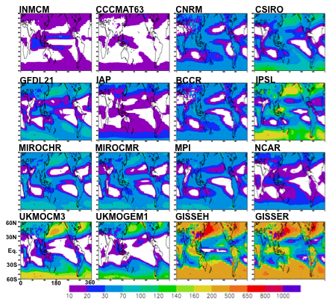
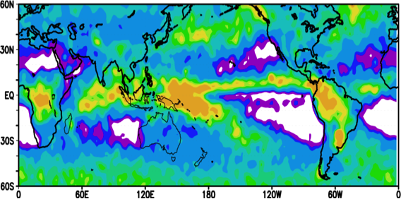
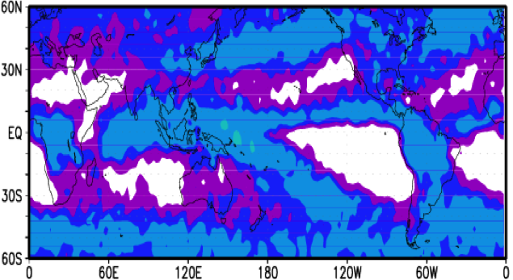

MOTIVATION: Examples of Where Satellite Data Have
Helped and Where They Have Been Missing
CloudSat Total IWP
CloudSat IWP Conditionally Filtered to better Approximate/Validate GCM-modeled Cloud IWP
Mean Cloud IWP from 16 IPCC Contributions of 20th Century Climate : Color scale ~ log10:
We need to use our observations to reduce this uncertainty.
Waliser et al. 2009
Notes:
Left Panel – cloud ice water path (IWP) from 16 IPCC contributions to AR4. Note – color bar: 1-2 orders of magnitude uncertainty.
Upper right – total IWP estimated from cloudsat – this includes “clouds” and falling hydrometeors such as snow and graupel and thus cannot be directly compared to the left side.
Lower right – IWP filtered in an attempt to just illustrate the IWP that is associated with the clouds. This can be used to help constrain IPCC AR5 model development (e.g., GISS, GFDL).
Waliser et al. (2009) – cloudsat special issue.

Slide 4


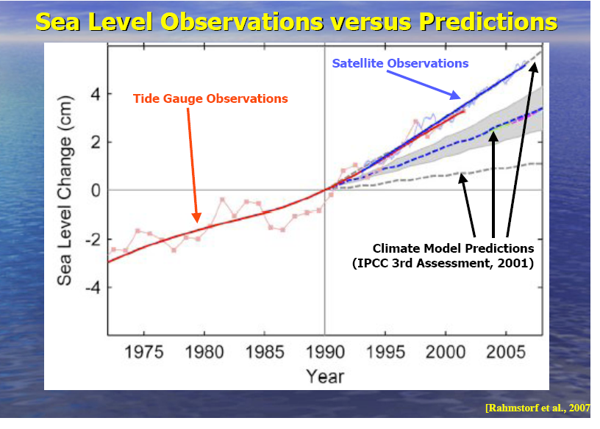
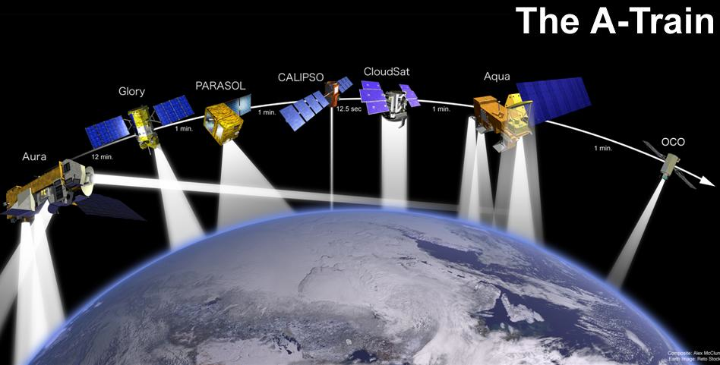
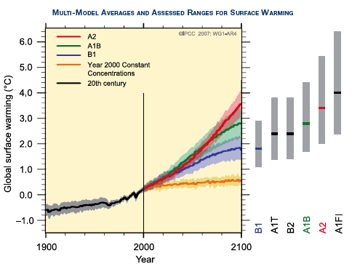
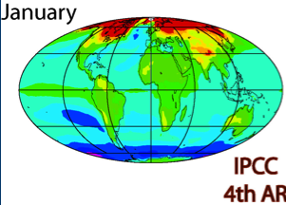
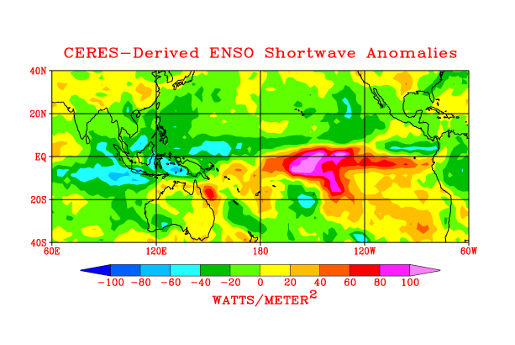
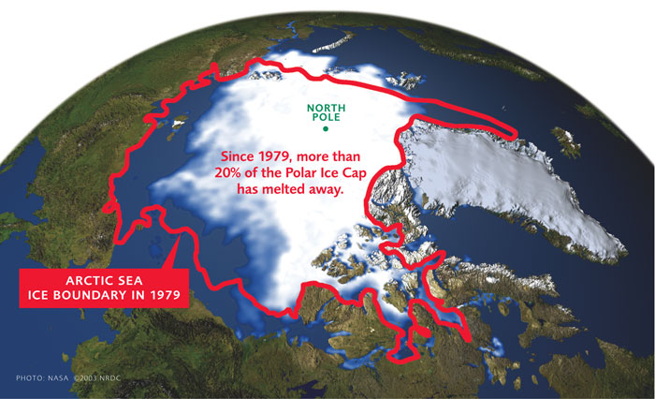
NASA and CMIP/IPCC: Better Linkage
How to bring as much observational scrutiny as possible to the IPCC process?
How to best utilize the wealth of NASA Earth observations for the IPCC process?

Slide 5
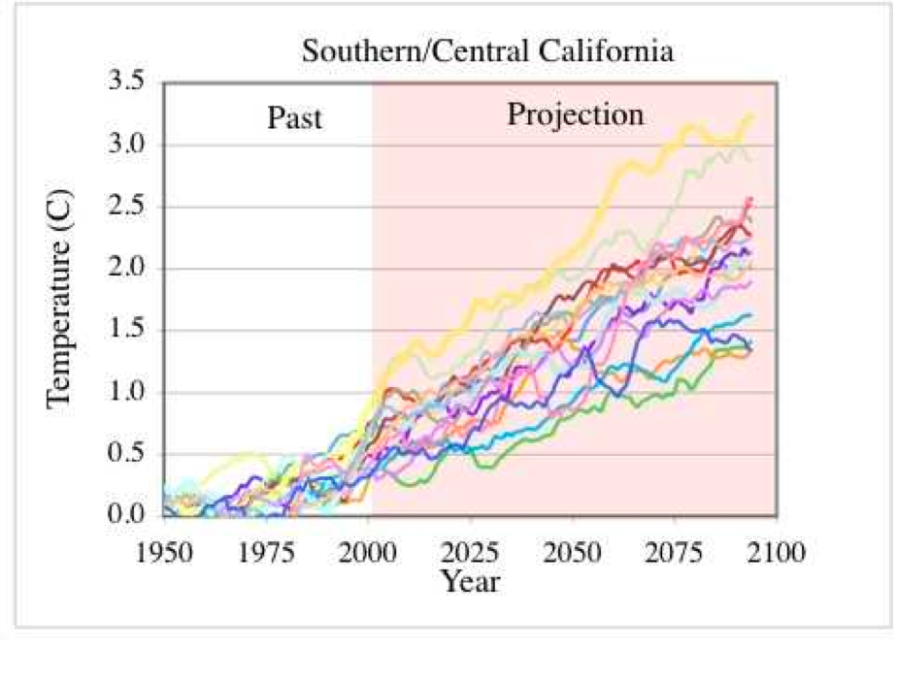
Modelers, PCMDI, JPL/NASA, Community
Who does what?
Produce Simulations & Projections
(HUGE job; focus on model development – not analysis or observations)
Model output archived in a uniform fashion to facilitate access and analysis. (Far from trivial – see below)
Sophisticated development and application of model diagnostics for evaluation (Observations needed here, but which ones?)
Identify and deliver/archive observations in form useful for model analysis (Requires model, obs and IT expertise)
Develop global observations relevant to climate change research (Focus on hardware, retrievals, delivery)
Modeling
Centers
NASA
& JPL
PCMDI
Weak
Link
Enormous Model Output/Complexity
To quantify and reduce uncertainty, this chain has to work.
Waliser et al. 2009, Climatic Change, Submitted.

Slide 6
What to do about the weak link?
Taylor et al (2009) have defined the protocol for the CMIP5 simulations that will be used for the next IPCC Assessment Report, AR5.
The protocol defines the scope of simulations that will be undertaken by the participating modeling groups.
For several of the prescribed retrospective simulations (e.g, decadal hindcasts, AMIP and 20th Century coupled simulations) observational data sets can be used to evaluate and diagnose the simulation outputs.
However, to date, the pertinent observational data sets to perform these particular evaluations have not been optimally identified and coordinated to readily enable their use in the context of CMIP5.
Observations may match model variables
but usually differ in file format, metadata standard, and may have subtle characteristics that are not obvious to the non-expert
Observational Scientists make datasets for process studies – not for model evaluation

Slide 7
Satellite Observations for CMIP5 Simulations
Some Basic Tenets of this Activity
To provide the community of researchers that will access and evaluate the CMIP5 model results access to analogous sets (in terms periods, variables, temporal/spatial frequency, dissemination) of satellite data.
To be carried out in close coordination with the corresponding CMIP5 modeling entities and activities – in this case PCMDI and WGCM.
To directly engage the observational (e.g. mission and instrument) science teams to facilitate production of the corresponding data sets and documentation.
Modelers
Satellite
Experts
Target Quantities
Model Output
Variables
Analysis
Community
Satellite Retrieval
Variables
Main Target Community

Slide 8
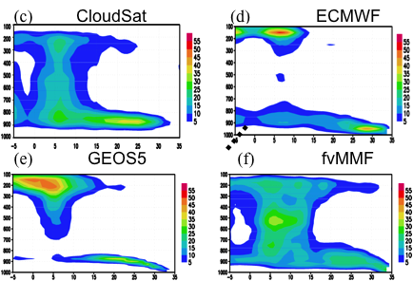
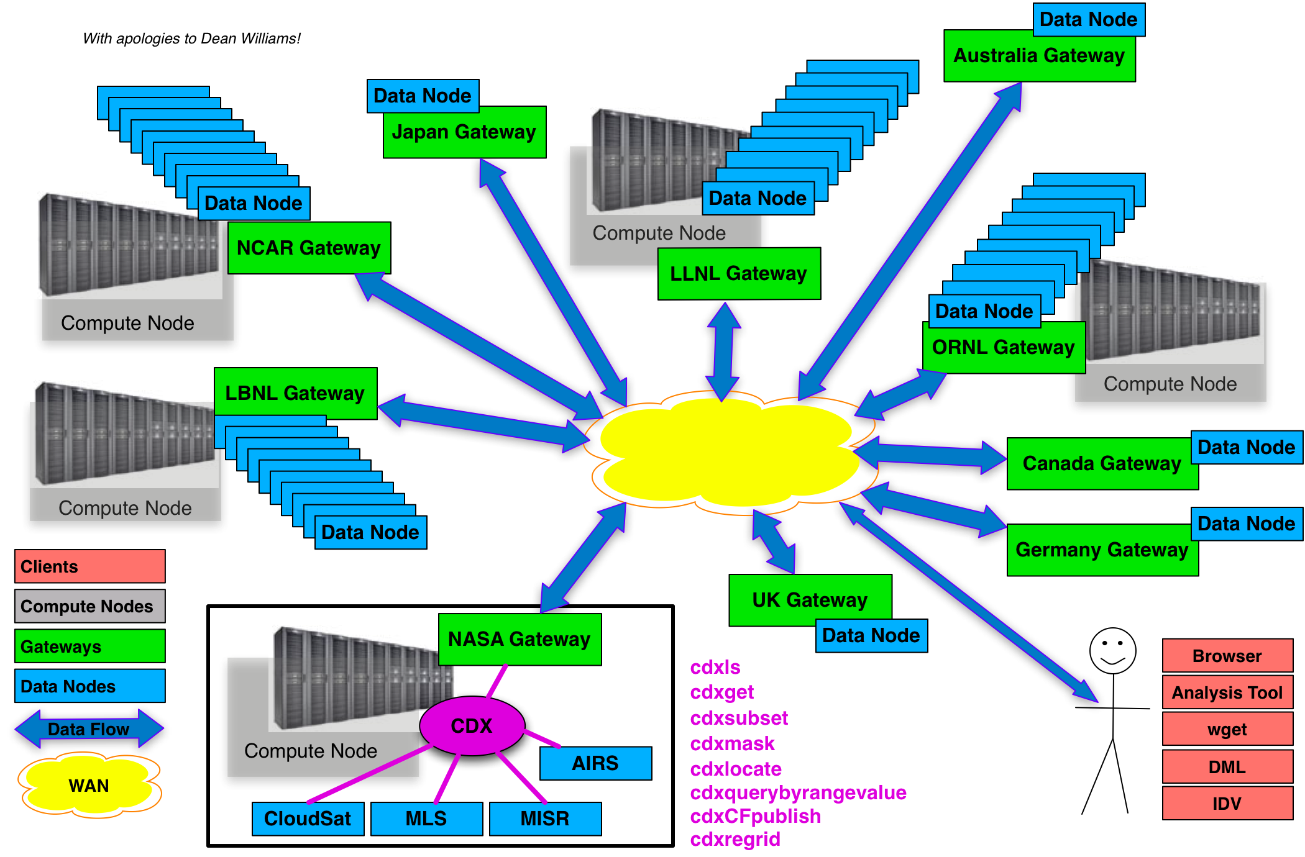
IPCC AR5 – Making Better Use of Observations
Characterizing and Reducing Uncertainties
JPL/NASA is leading an effort with PCMDI/DOE to identify and deliver a number of NASA satellite datasets tailored for IPCC model-data comparison.
Community to have simultaneous access to model output and satellite observations similarly formatted to facilitate model evaluation.
Use observation-based “metrics” to assess model capabilities of representing past climate -> use to weight models’ climate projections.
Need by Spring/Summer 2011 for model evaluations and timely submission of research articles –> IPCC AR5 to be published in 2013.
NASA funded JPL pilot project to
identify & deliver selected satellite data.
JPL led organization of two workshops
1) Mission/Science -> Data Sets
2) Mission/IT -> Infrastructure
Hoping for future NASA Program
Science + Observations + IT

Slide 9
Satellite Observations for CMIP5 Simulations
Main Tasks for CMIP5
Use the CMIP5 simulation protocol (Taylor et al. 2009) as guideline for deciding which observations to stage in parallel to model simulations.
  Target is monthly averaged (CMON, AMON) products on 1 x 1 degree grid
Work with satellite community to identify data sets [e.g., AIRS, MLS, TES, QuikSCAT, CloudSat, Topex/Jason, CERES, TRMM, AMSR-E, TRMM]
Work with observational teams to produce 4-5 page Technical Note describing strengths/weaknesses, uncertainties, dos/don’ts regarding interpretations comparisons with models. (at graduate student level)
Transform satellite observations into CMIP5 compliant format (to the greatest extent possible – should look like model output)
  Not new products, but reformatted existing products, with perhaps some interpolation
Provide a strategy for accessing them that has close parallels to the model data archive (e.g. ESG).
Advertise availability of observations for use in CMIP5 analysis.

Slide 10
NASA Recommended Datasets for CMIP5
Match up of available NASA datasets to PCMDI priority list

Slide 11
Satellite Observations for CMIP5 Simulations
“Technical Note”
Target audience is modeling community members who have little experience with NASA datasets
Content
Intent of the Document/POC
Data Field Description
Data Origin
Validation and Uncertainty Estimate
Considerations for Model – Observation Intercomparison
Instrument Overview
References
Revision History
Guidance documents (and project related stuff) posted at
http://oodt.jpl.nasa.gov/wiki/display/CLIMATE

Slide 12
Satellite Observations for CMIP5 Simulations
Example Technical Note – AIRS

Slide 13
Satellite Observations for CMIP5 Simulations
Example Technical Note – AIRS

Slide 14
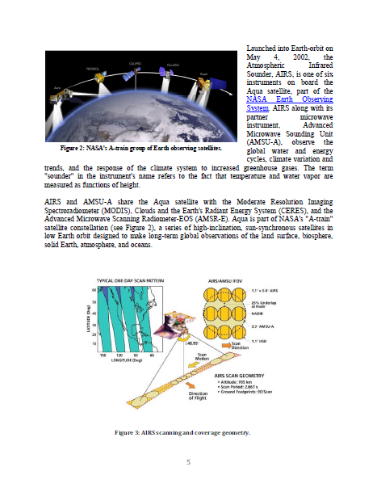
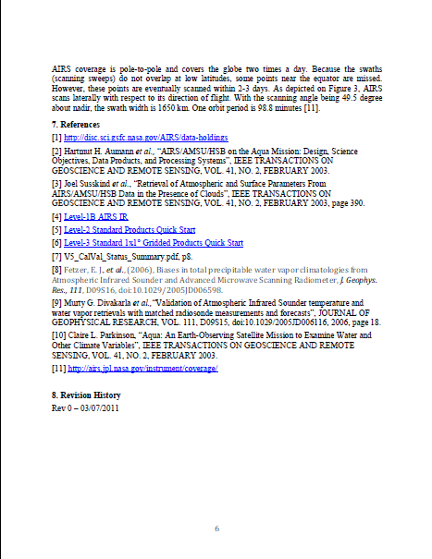
Satellite Observations for CMIP5 Simulations
Example Technical Note – AIRS

Slide 15
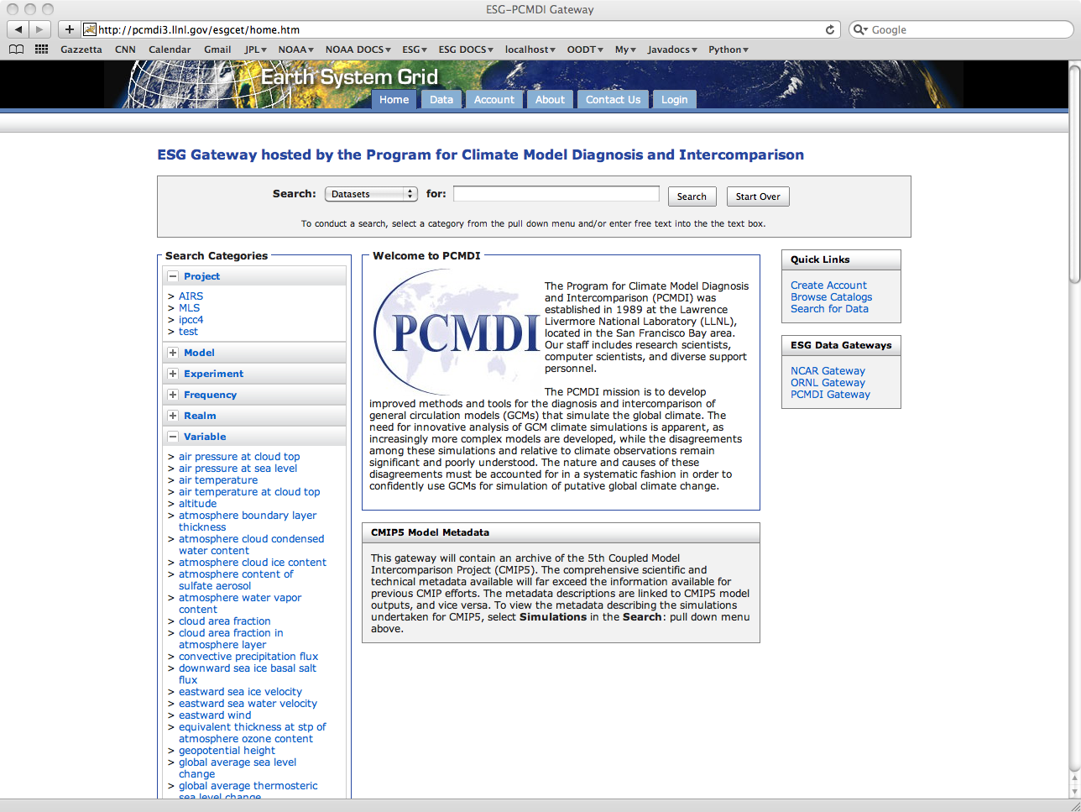
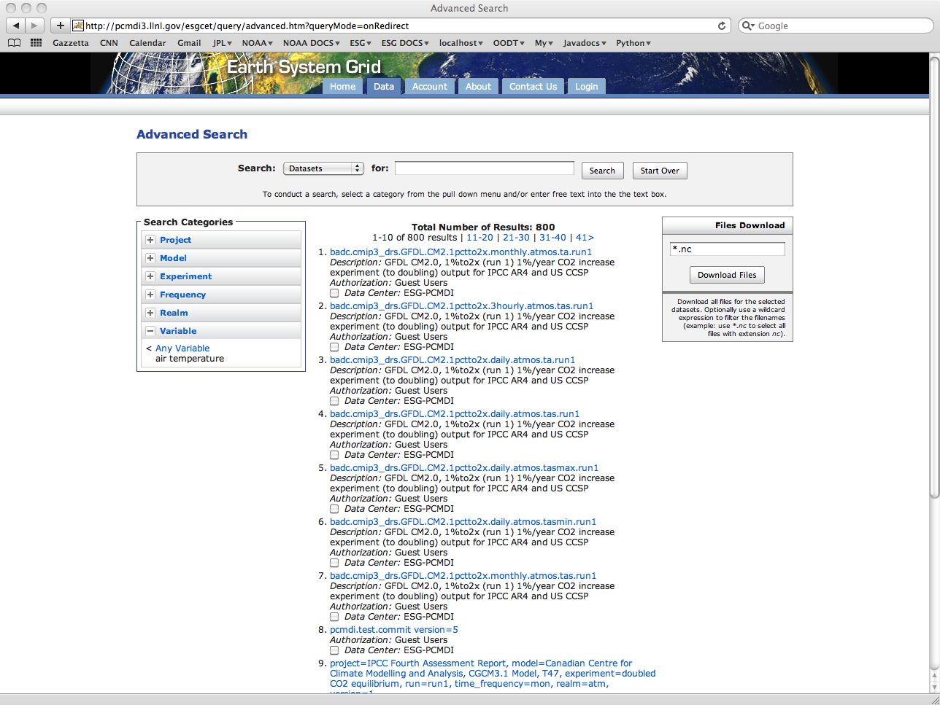
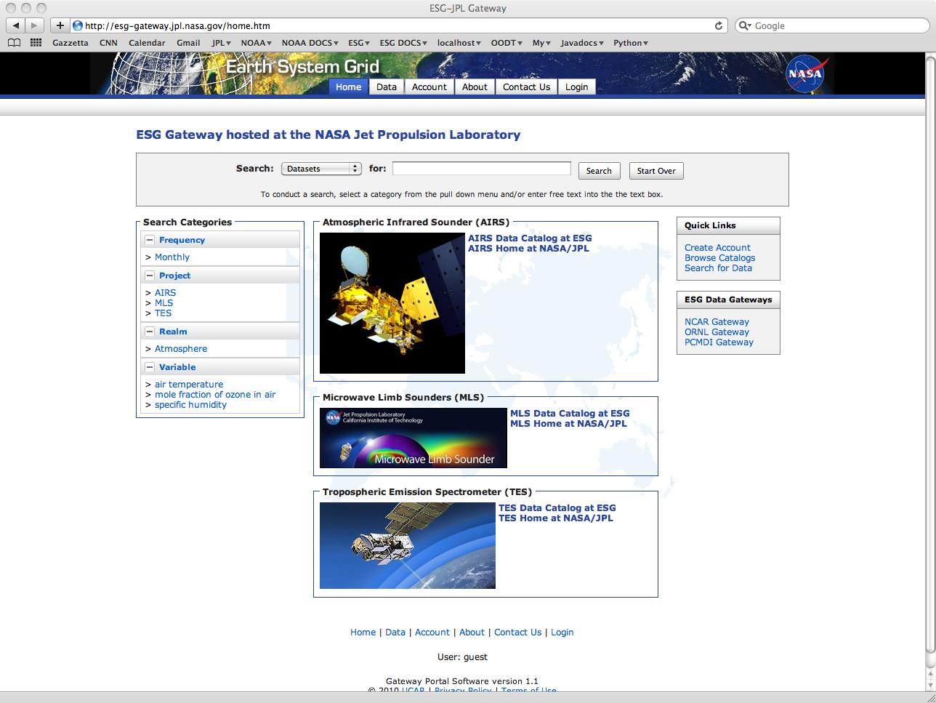
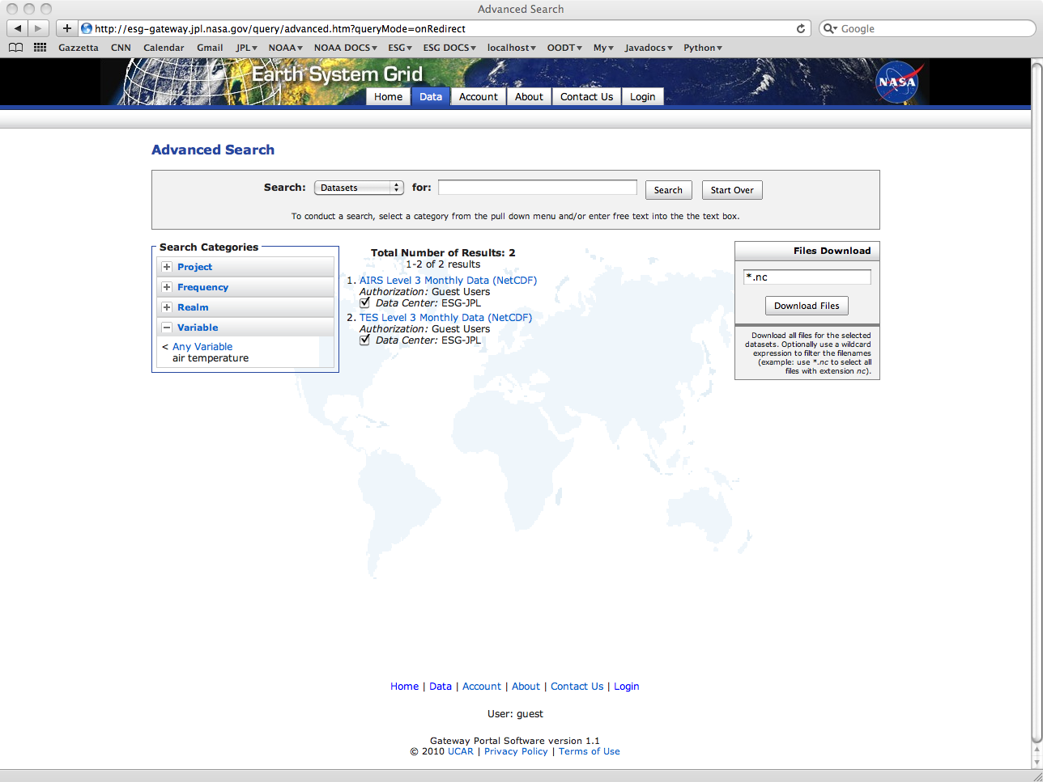
Satellite Observations for CMIP5 Simulations
ESG-JPL Gateway : Side by Side Archive

Slide 16
IPCC AR5
New Emphases, Opportunities, & Needs
Model Scoring against Observations:
“one model – one vote” to weighting of projections based on metrics.
(e.g. WGCM/WGNE Metrics Panel)
Earth System Modeling (e.g. Coupled Carbon-Climate models):
added complexity, more degrees of freedom, greater need for
observational constraints (e.g. CO₂, carbon).
Decadal Predictions:
more directly related to societal decisions and investment needs
typically augmented with regional models that provide downscaling with added processes/realism.
such models need observational scrutiny too.

Slide 17
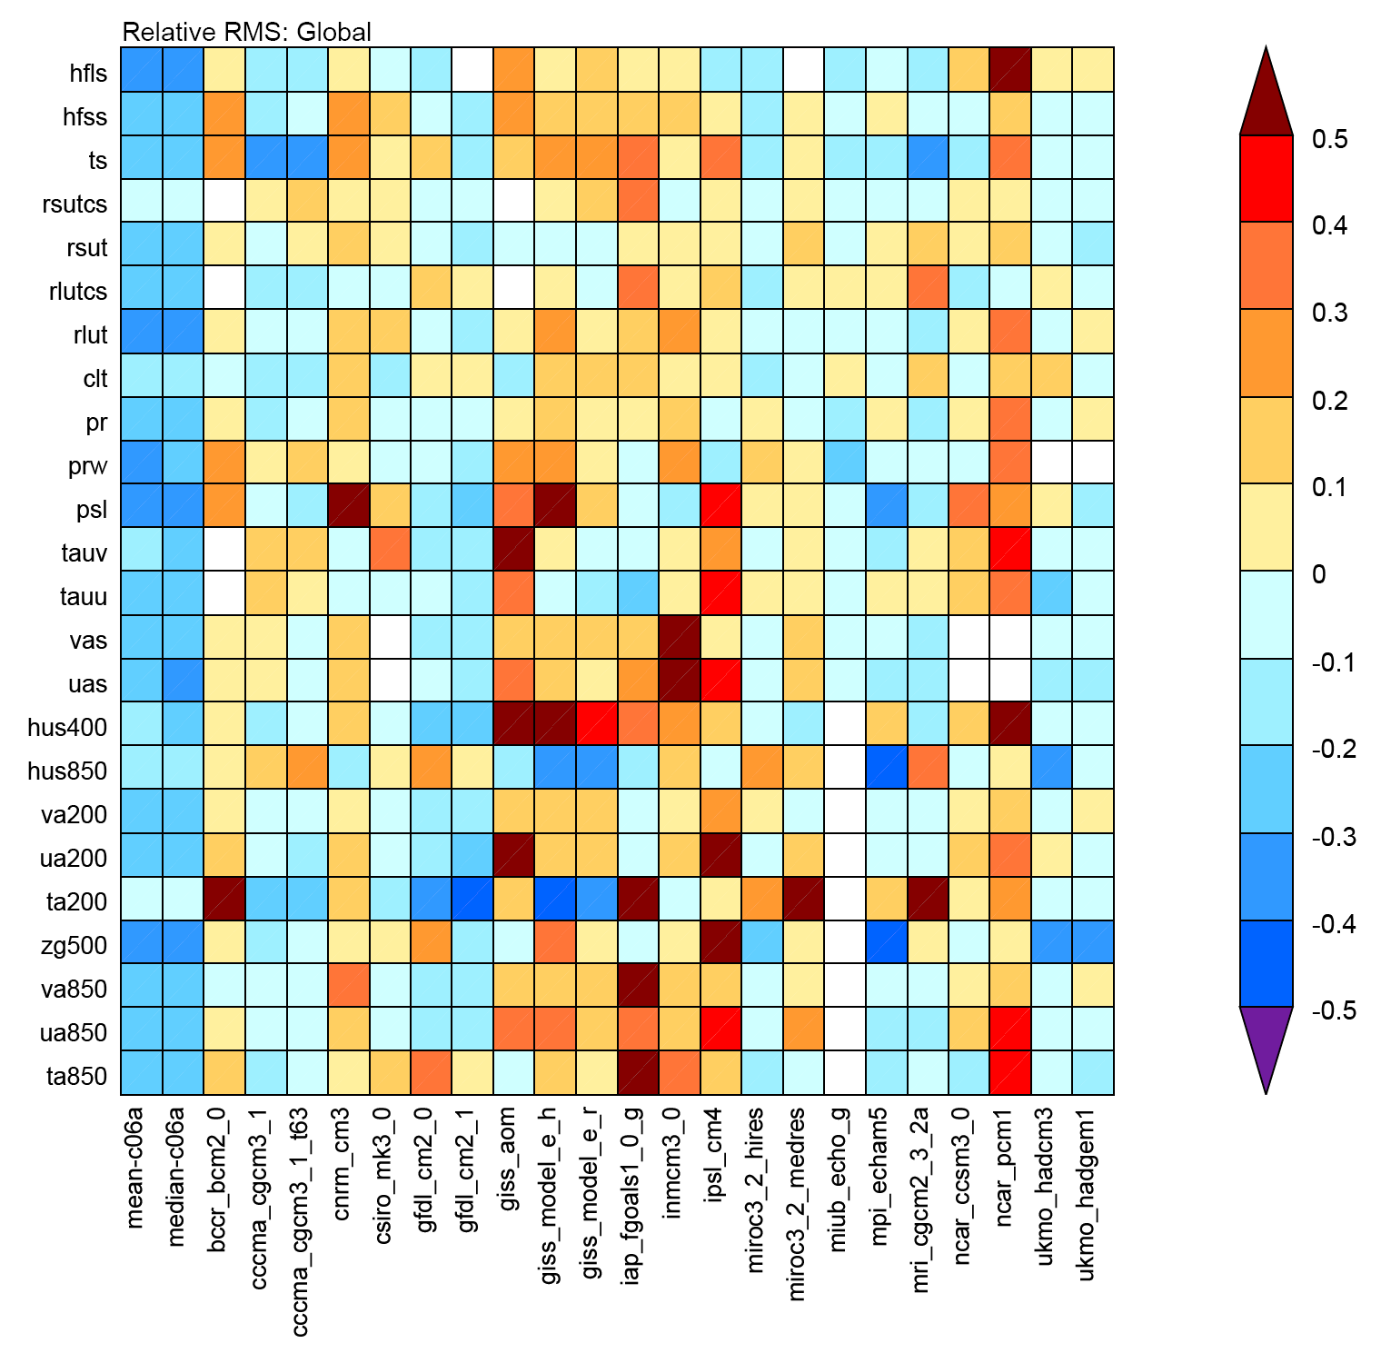











IPCC AR5 - New Emphases, Opportunities, & Needs: Model “Scoring” Based on Measures of Model Quality
CMIP3 GCM Performance
Latent heat flux at surface
Sensible heat flux at surface
Surface temperature
Reflected SW radiation (clear sky)
Reflected SW radiation
Outgoing LW radiation (clear sky)
Outgoing LW radiation
Total cloud cover
Precipitation
Total column water vapor
Sea-level pressure
Meridional wind stress
Zonal wind stress
Meridional wind at surface
Zonal wind at surface
Specific humidity at 400 mb
Specific humidity at 850 mb
Meridional wind at 200 mb
Zonal wind at 200 mb
Temperature at 200 mb
Geopotential height at 500 mb
Meridional wind at 850 mb
Zonal wind at 850 mb
Temperature at 850 mb
“Worst”
Climate variable
Median
“Best”
Mean Median
Gleckler, P. et al. (2008)
Model used in IPCC Fourth Assessment
New WGCM & WGEN Metrics Subpanel: Use observation-based “metrics” to assess model representations of past climate -> use to weight models’ climate projections

Slide 18
Satellite Observations for Climate Modeling
SUMMARY
Pilot Project to establish a NASA-wide capability for the climate modeling community to support model-to-data intercomparison. This involves IT, satellite retrieval, data set, modeling and science expertise.
Longer Term
Provide a science “bridge” between models and satellite observations to facilitate model improvement and reduce projection uncertainty. This is also a focus of the new JPL Center for Climate Science.
Ultimately
Utilize feedback/community collaboration to develop future climate-critical satellite missions. The modeling community has yet to be galvanized to provide feedback to the satellite-development community.
This project is on course to deliver NASA satellite data sets by the end of May for the evaluation of CMIP5 climate model archive and impact the IPCC AR5.

