Slide 1
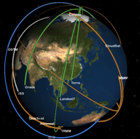
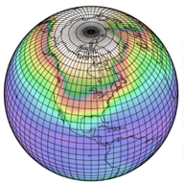



Datasets for evaluating climate models and their projections: Obs4MIPs
Obs4MIPs
Robert Ferraro
Jet Propulsion Laboratory
Presented at the
CCI CMUG Fourth Integration Meeting
Met Office, Exeter, 2-3 June 2014
Jet Propulsion Laboratory
California Institute of Technology
Notes:
Heavy emphasis and acknowledgement given to speaker - *Stephens :)

Slide 2

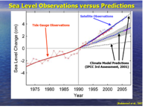

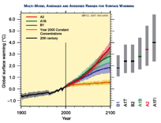
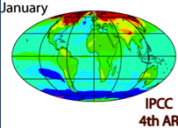
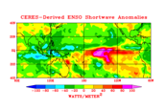
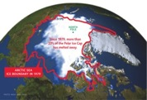
Initial Sentiments Behind obs4MIPS
Under-Exploited Observations for Model Evaluation
How to bring as much observational scrutiny as possible to the CMIP/IPCC process?
How to best utilize the wealth of satellite observations for the CMIP/IPCC process?

Slide 3
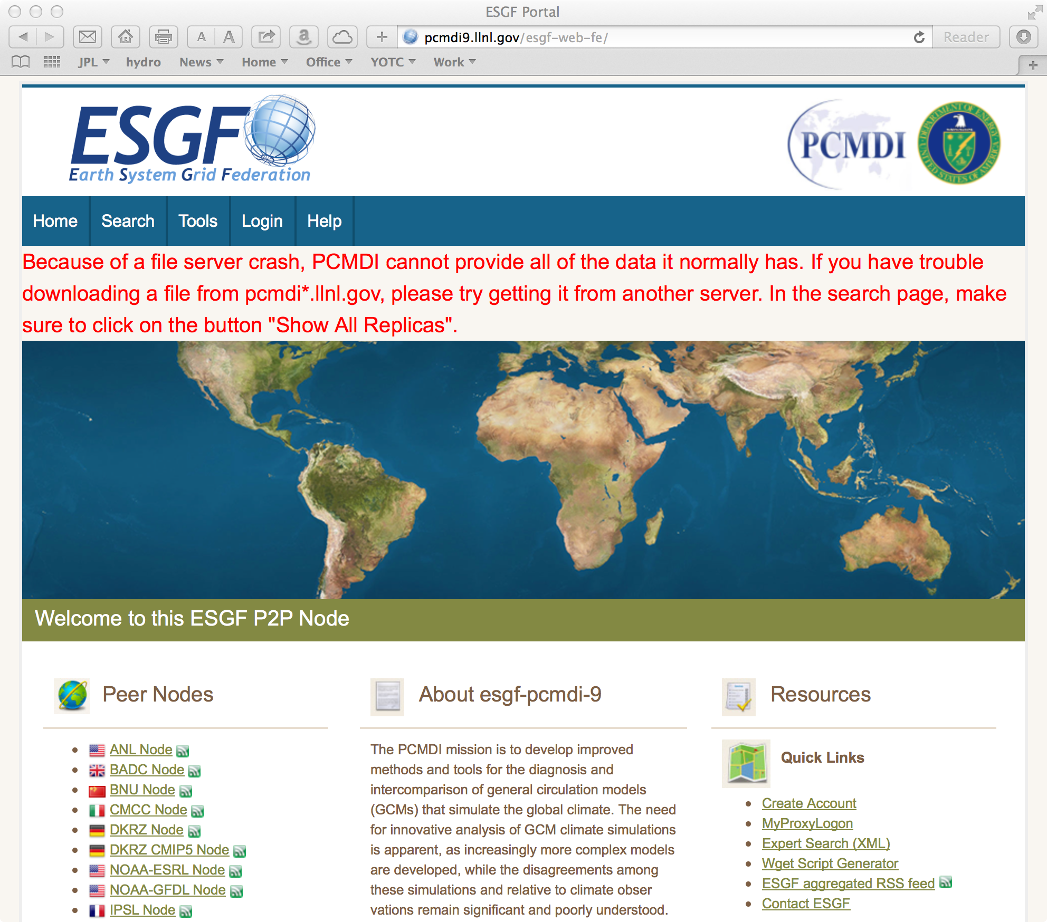
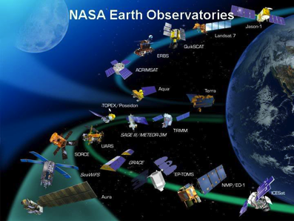

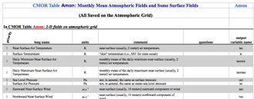
Model and Observation Overlap
Where to Start? For what quantities are comparisons viable?
Taylor et al. 2008
Example: NASA – Current Missions ~14
Total Missions Flown ~ 60
Many with multiple instruments
Most with multiple products (e.g. 10-100s)
Many cases with the same products
Over 1000 satellite-
derived quantities
~120 ocean
~60 land
~90 atmos
~50 cryosphere
Over 300 Variables in
(monthly) CMIP Database

Slide 4
obs4MIPs: The 4 Commandments
Target Quantities
Use the CMIP5 simulation protocol (Taylor et al. 2009) as guideline for selecting observations.
Observations to be formatted the same as CMIP Model output (e.g. NetCDF files, CF Convention)
Include a Technical Note for each variable describing observation and use for model evaluation (at graduate student level).
Hosted side by side on the ESGF with CMIP model output.
Model Output
Variables
Satellite Retrieval
Variables
Modelers
Observation
Experts
Analysis
Community
Initial Target
Community

Slide 5
obs4MIPs “Technical Note”
Content
Intent of the Document
Data Field Description
Data Origin
Validation and Uncertainty Estimate
Considerations for use in Model Evaluation
Instrument Overview
References
Revision History
POC

Slide 6
Evolution and Status of obs4MIPs
Pilot Phase - CMIP5
  Initial protocols – variables, sources & documentation
  Compatibility with CMIP file formats and ESGF
  PCMDI Science & GSFC IT Workshops
  Identified and provided ~ 15 variables
Expanding the Pilot
Additional data types, sources, variables (e.g., CFMIP, CMUG, CEOS, reanalysis)
Reconsidering the initial guidelines/boundaries
Some partial oversight & governance: NASA+ Working Group
Planning Ahead – CMIP6
Identify additional data sources / remaining variable gap across Earth System
Judicious/expanded model output considerations, including satellite simulators
Increasing community input on objectives and on implementation contributions
Broadening awareness & governance: WDAC obs4MIPs Task Team
Notes:
Heavy emphasis and acknowledgement given to speaker - *Stephens :)

Slide 7
obs4MIPs: Current Set of Observations
https://www.earthsystemcog.org/projects/obs4mips/satellite_products
CMIP Protocol Variables | Data Source | Time Period | Comments
ta, hus - Atm Temp, Specific Humidity | AIRS (≥ 300 hPa) | 9/02 – 5/11 | AIRS +MLS needed to cover all required pressure levels
ta, hus - Atm Temp, Specific Humidity | MLS ( < 300 hPa) | 8/04 - 12/10 | 2 x 5 degrees Lat-Lon AIRS +MLS needed to cover all required pressure levels
tos - Sea Surface Temperature | AMSR-E | 6/02 - 12/10
rlut, rlutcs, rsdt, rsut, rsutcs - TOA outgoing LW & SW Radiation, Incident SW Radiation | CERES | 3/00 - 6/11
rlds, rldscs, rlus, rsds, rsdscs, rsus, rsuscs - Surface down- and upwelling LW & SW Radiation | CERES | 3/00 - 2/10 | Some isolated inconsistent data values. An update is in progress.
clt – Total Cloud Fraction | MODIS | 3/00 - 9/11
zos - Sea Surface Height Above Geoid | TOPEX/JASON series | 10/92 - 12/10 | AVISO Product
pr - Precip flux | TRMM | 1/98 - 10/12 | .25 x 2.5 degree, 50 N - 50 S Monthly Ave & 3 Hourly snapshots
pr - Precip flux | GPCP | 1Oct96 - 30Jul11 | Daily Ave
pr - Precip flux | GPCP | 01/79 - 7/11 | 2.5 x 2.5 degree
sfcWind, uas, vas - near surface winds | QuikSCAT | 8/99 –10/09 | Oceans only, excluding sea ice regions.
fpar - Fract Abs Photo Active Radiation | MODIS | 2/00 - 12/09 | .5 x .5 degree, Not a CMIP5 variable
lai - Leaf Area Index | MODIS | 2/00 - 12/09 | .5 x .5 degree
tro3 – Mole Fract of Ozone | TES (standard pressure levels) | 7/05 - 12/09 | 2 x 2.5 degree Lat-Lon Some unresolved issues
od550aer - AOD 550 nm | MISR | 3/00 - 12/12 | Over Land only some isolated inconsistent data values.
od550aer - AOD 550 nm | MODIS | 3/00 - 12/12 | Over Ocean only some isolated inconsistent data values
ua, va - near surface winds | ECMWF Reanalysis | 1/79 - 3/13 | .75 x .75 degrees
tos - Sea Surface Temperature | ARC SST (ATSR, AATSR) | 1/97 - 12/11
clisccp ; albisccp ; cltisccp ; cttisccp ; pctisccp | ISCCP | 7/83 - 6/08
cfad2Lidarsr532 ; cfad2Lidarsr532 ; cfadLidarsr532 ; clrcalipso ; uncalipso ; clcalipso ; clccalipso ; clhcalipso ; cllcalipso ; clmcalipso ; cltcalipso | CALIPSO | 6/06 - 12/10 | mon & day/night
parasolRefl ; parasolRefl ; sza | PARASOL | 3/05 - 12/08 | mon & day
overpasses ; missingdatafraction ; cfadDbze94 ; cltcloudsat | CloudSat | 6/06 - 10/12

Slide 8
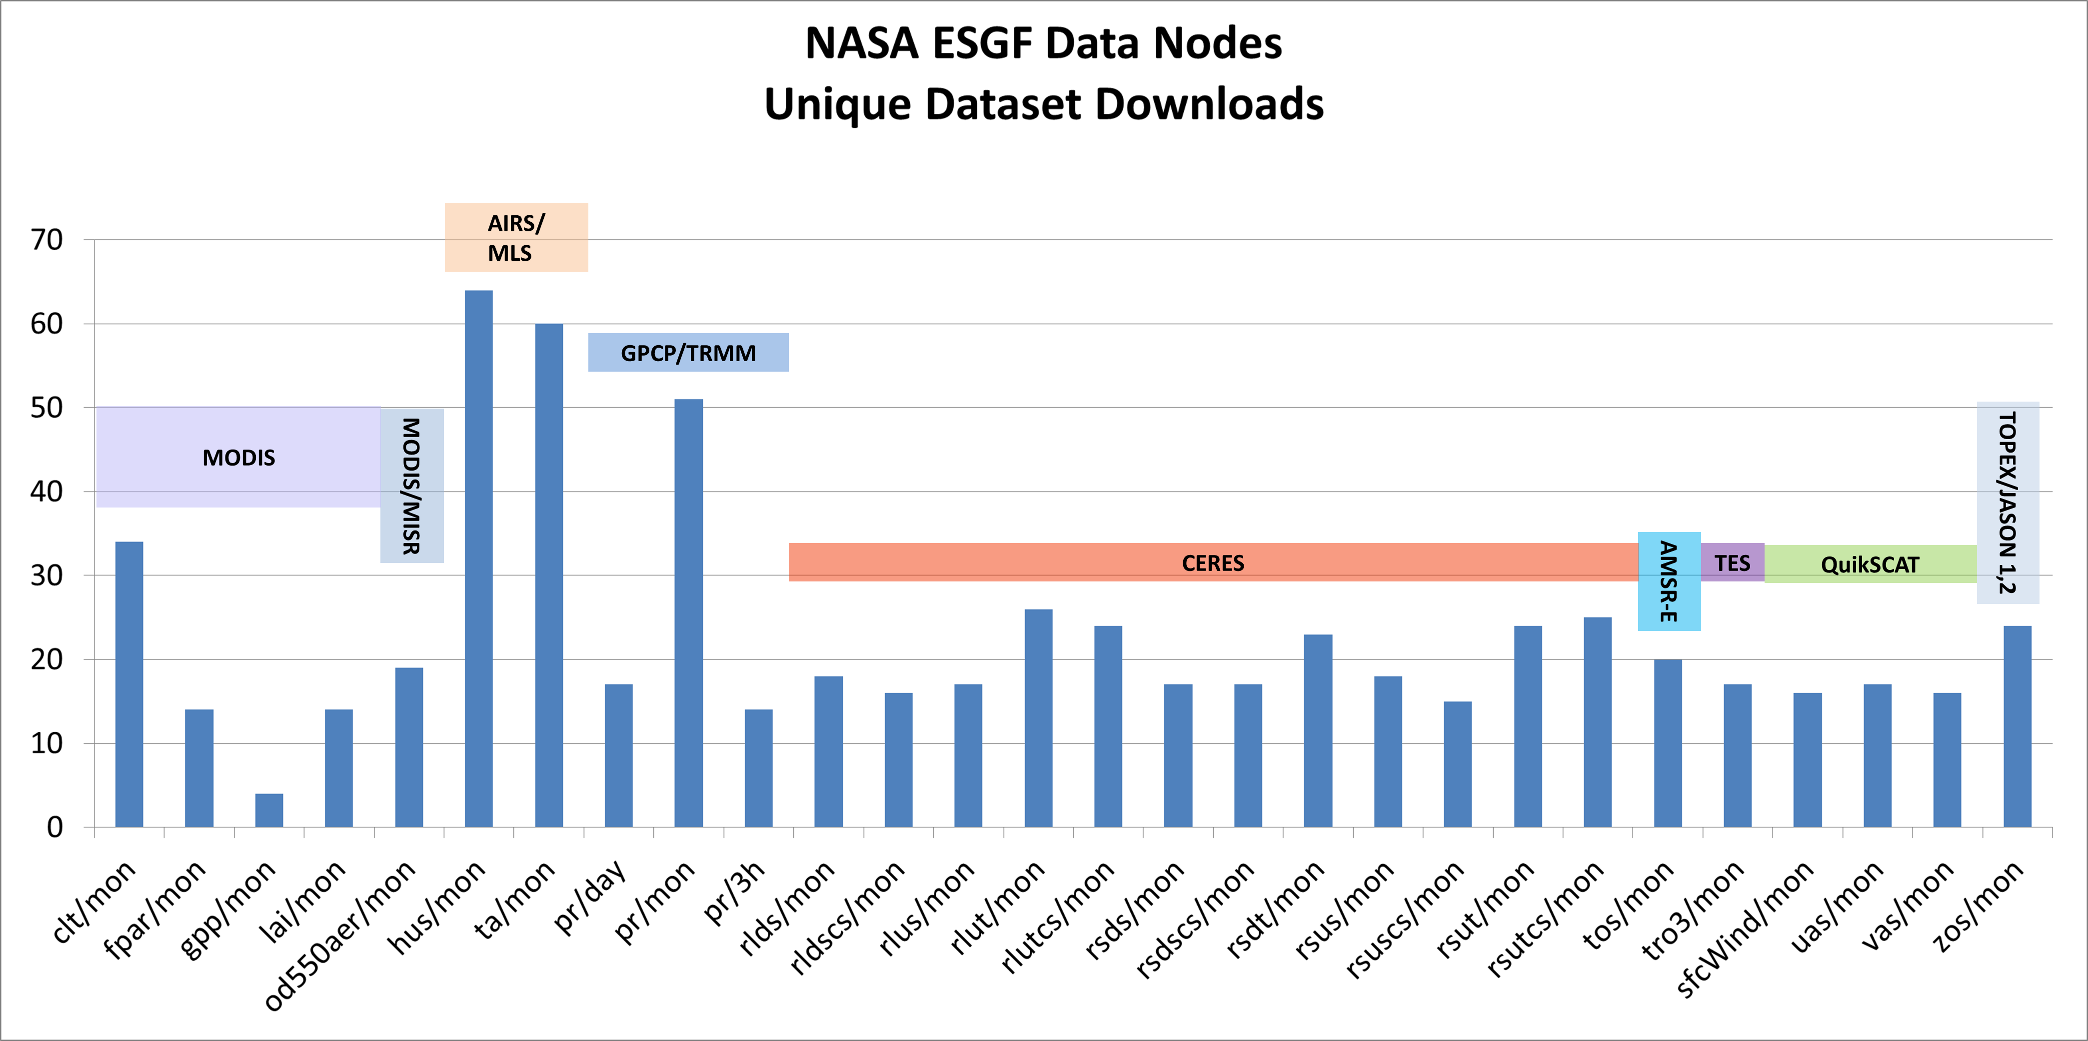
obs4MIPs: Access Statistics
(NASA Datasets Only)
119 unique* users from 16 countries
641 dataset downloads in 2012-13
As of Nov 2013
(NASA datasets only)
* “Unique” counts unique user ID downloads of a complete dataset, not individual files. Repeat downloads of the same dataset by the same user were counted only once.
Notes:
Download data was only available for datasets available from the JPL and GSFC data nodes on the ESGF at the time this chart was produced.

Slide 9
Evolution and Plans of obs4MIPs
Pilot Phase - CMIP5
  Initial protocols – variables, sources & documentation
  Compatibility with CMIP file formats and ESGF
  PCMDI Science & GSFC IT Workshops
  Identified and provided ~ 15 variables
Expanding the Pilot
Additional data types, sources, variables (e.g., CFMIP, CMUG, CEOS, reanalysis)
Reconsidering the initial guidelines/boundaries
Some partial oversight & governance: NASA+ Working Group
Present: Planning Ahead – CMIP6
Identify additional data sources / remaining variable gap across Earth System
Judicious/expanded model output considerations, including satellite simulators
Increasing community input on objectives and on implementation contributions
Broadening awareness & governance: WDAC obs4MIPs Task Team
Future
More synergistic feedbacks between model development/improvements and new mission/observation definitions and prioritization
Notes:
Heavy emphasis and acknowledgement given to speaker - *Stephens :)

Slide 10
WDAC Obs4MIPs Task Team
Constituted under the auspices of the WCRP Data Advisory Council (WDAC)
Established to “internationalize” NASA & DOE initiatives (obs4MIPS, ana4MIPS, etc.)
Potential contributions from within and outside WCRP
Users: from weather to climate, global to regional
Challenge for obs4MIPs (and ESGF in general): adding flexibility beyond the “global climate model/data” initial standard
Challenge for the Task Team – sort through the competing interests in the future direction of obs4MIPs, and provide guidance …

Slide 11
obs4MIPs - CMIP6 Planning Meeting
April 29 - May 1, 2014
NASA Headquarters, 300 E Street SW, Washington, DC
Obs4MIPs
Meeting Organizers
Robert Ferraro, Duane Waliser – NASA Jet Propulsion Laboratory
Peter Gleckler, Karl Taylor – Lawrence Livermore National Laboratory
Veronika Eyring – German Aerospace Center
Jet Propulsion Laboratory
California Institute of Technology
Notes:
Heavy emphasis and acknowledgement given to speaker - *Stephens :)

Slide 12
Obs4MIPs – CMIP6 Planning Meeting
An opportune moment to consider how to coordinate osb4MIPs with the CMIP6 planning activities
Over 90 experts in modeling or data products invited – 60 attended
Meeting objectives:
  What’s working well so far?
  What’s not working?
  What’s missing (or can be done better)?
Sessions covered the major elements of Earth System Models
  Atmospheric Composition & Radiation
  Atmospheric Physics
  Terrestrial Water & Energy Exchange, Land Cover/Use
  Carbon Cycle
  Oceanography & Cryosphere
  Special Topics

Slide 13
Obs4MIPs – CMIP6 Planning Meeting
Report to be published on the obs4MIPs CoG site (soon ..)
Major findings –
  Expand the inventory
  Include higher frequency datasets, and higher frequency model output.
  Reliable and defendable error characterization/estimation of observations
  Include datasets in support of off-line simulators (aka observation proxies).
  Reanalysis serves many useful purposes, but reanalysis fields should not be used when observations are available. Inclusion of reanalysis fields in obs4MIPs should be done with considerable care and forethought.
  Collocated observations are particularly valuable for diagnosing certain processes. Consideration should be given to arranging for collocated datasets, including sparser in situ data, of known value to specific evaluations.
  Precise definitions of data products, including biases, and precise definitions of the model output variables are required.

Slide 14
Obs4MIPs – CMIP6 Planning Meeting
Additional Recommendations (not consensus) –
  Relax the “model-equivalent” criteria for inclusion in obs4MIPs.
  Requiring averaging kernels for the retrieval observations.
  Evolve to address process diagnostics and model development, in addition to evaluation.
  Sparse In-Situ datasets – where to start, how far to go?
  Inclusion of more Satellite Simulators (aka Observation Proxies) in the CMIP experiments.
  No gatekeeping … Just format enforcement ….

Slide 15
Obs4MIPs – CMIP6 Planning Meeting
Alignment with CMIP Model Output (& Used for Evaluation) | No Requirement / No obvious near-term use for Evaluation | Indirect or via complex processing steps | Alignment via simulator or operational operator | Alignment via simple steps e.g. ratio, column average | Strict Alignment
Evidence for Data Quality? | None | Significant <-> No Influence from models
 |  | Demonstrated via robust cal/val activity
 |  | Subjective <-> Objective error estimates
 |  | Large <-> Small error/uncertainties
 |  | Demonstrated via N? uses in peer-reviewed literature
WDAC Task Team to be charged with sorting this out ….

Slide 16
Conclusion
Obs4MIPs is evolving under the guidance of the WDAC Task Team
Looking forward to adding CCI datasets as they become available
Many issues to sort out going forward …
Find obs4MIPs at its new digs …
https://www.earthsystemcog.org/projects/obs4mips/
Or Google “obs4MIPs”

