Slide 1
CMUG ocean colour assessment
David Ford and Rosa Barciela
CCI-CMUG 5th Integration Meeting, 27th May 2015

Slide 2
Contents
Work to date
  Marine biogeochemical reanalysis
Results
Future plans
  Integrated assessment of marine ECVs

Slide 3
Work to date
Compare OC-CCI V1 and GlobColour chlorophyll products
Assimilate into coupled physical-biogeochemical ocean model
Create 15-year biogeochemical reanalyses
Perform assessment and write up for publication

Slide 4
Experiments
Assimilate chlorophyll into FOAM-HadOCC
Global reanalysis for Sept 1997 – July 2012
Compare:
  Control run
  Assimilation of OC-CCI chlorophyll
  Assimilation of GlobColour chlorophyll
Assess:
  Impact of assimilation on biology and carbon cycle
  Differences between OC-CCI and GlobColour runs
  Seasonal and inter-annual variability

Slide 5

FOAM
Forecasting Ocean Assimilation Model
Based on
For this project:
  Global
  1°resolution
  ERA-Interim fluxes
  Physical data assimilation not used

Slide 6
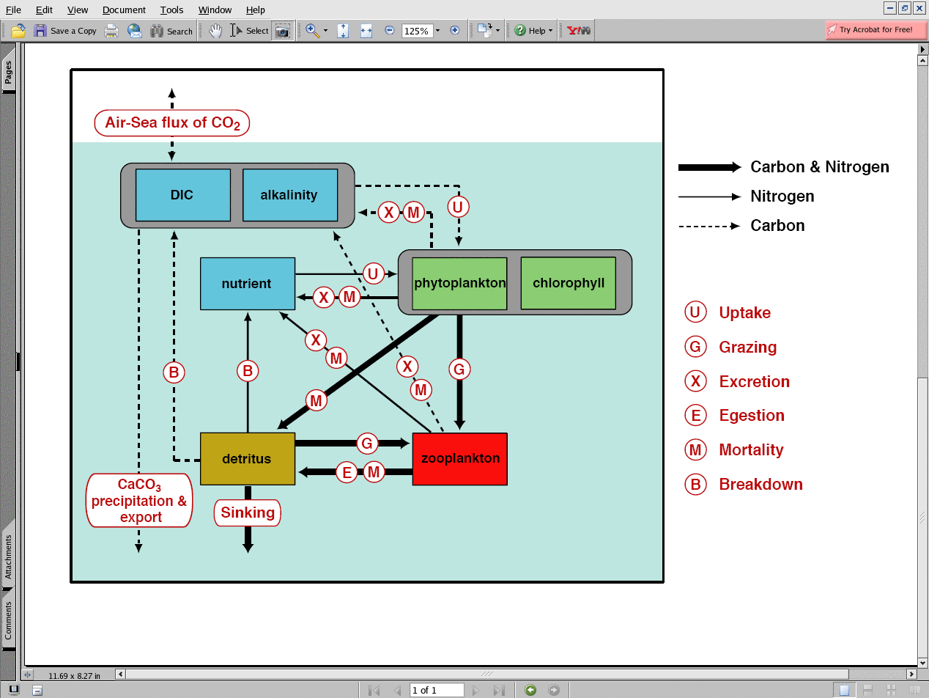
HadOCC
Hadley Centre Ocean Carbon Cycle Model
Palmer and Totterdell (2001)

Slide 7
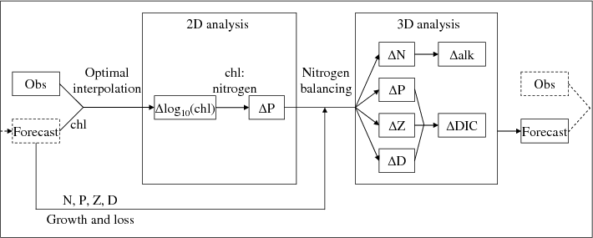
Chlorophyll data assimilation
Surface log₁₀(chlorophyll) increments produced by optimal interpolation
All 3D biogeochemical state variables updated by nitrogen balancing (Hemmings et al., 2008)
Ford et al. (2012, Ocean Science)

Slide 8
Results

Slide 9
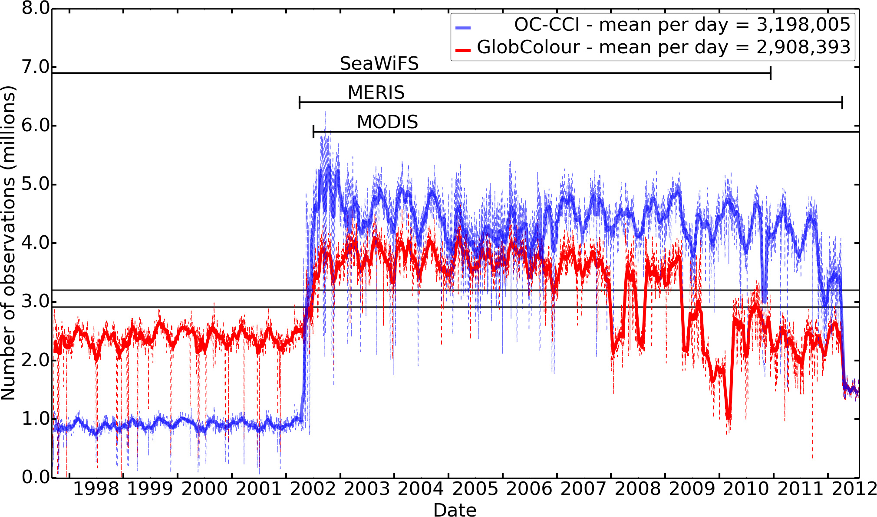
Number of observations
OC-CCI
GlobColour

Slide 10
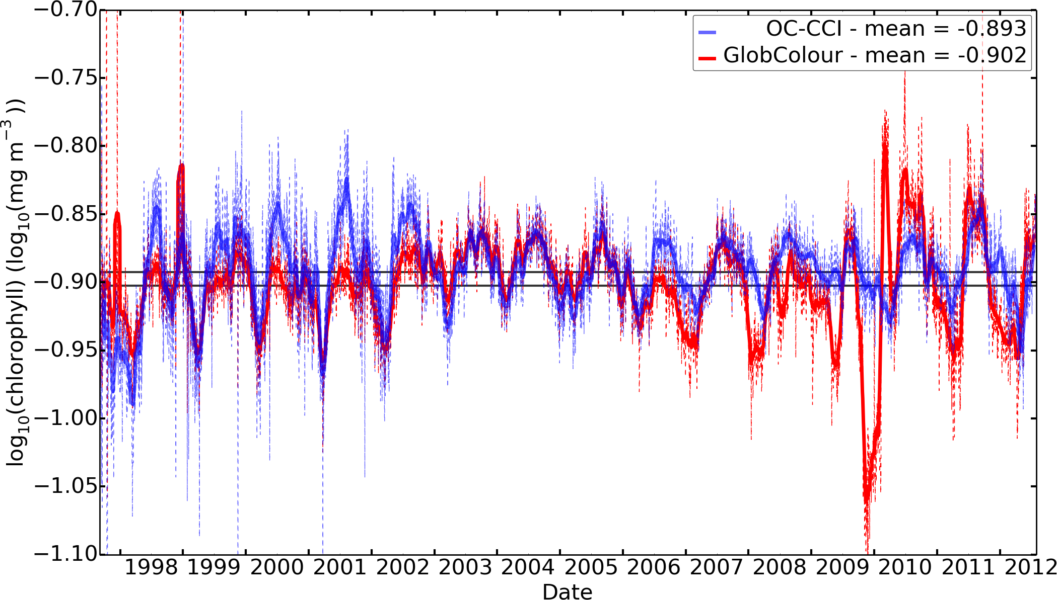
Global mean log₁₀(chlorophyll)
OC-CCI
GlobColour

Slide 11
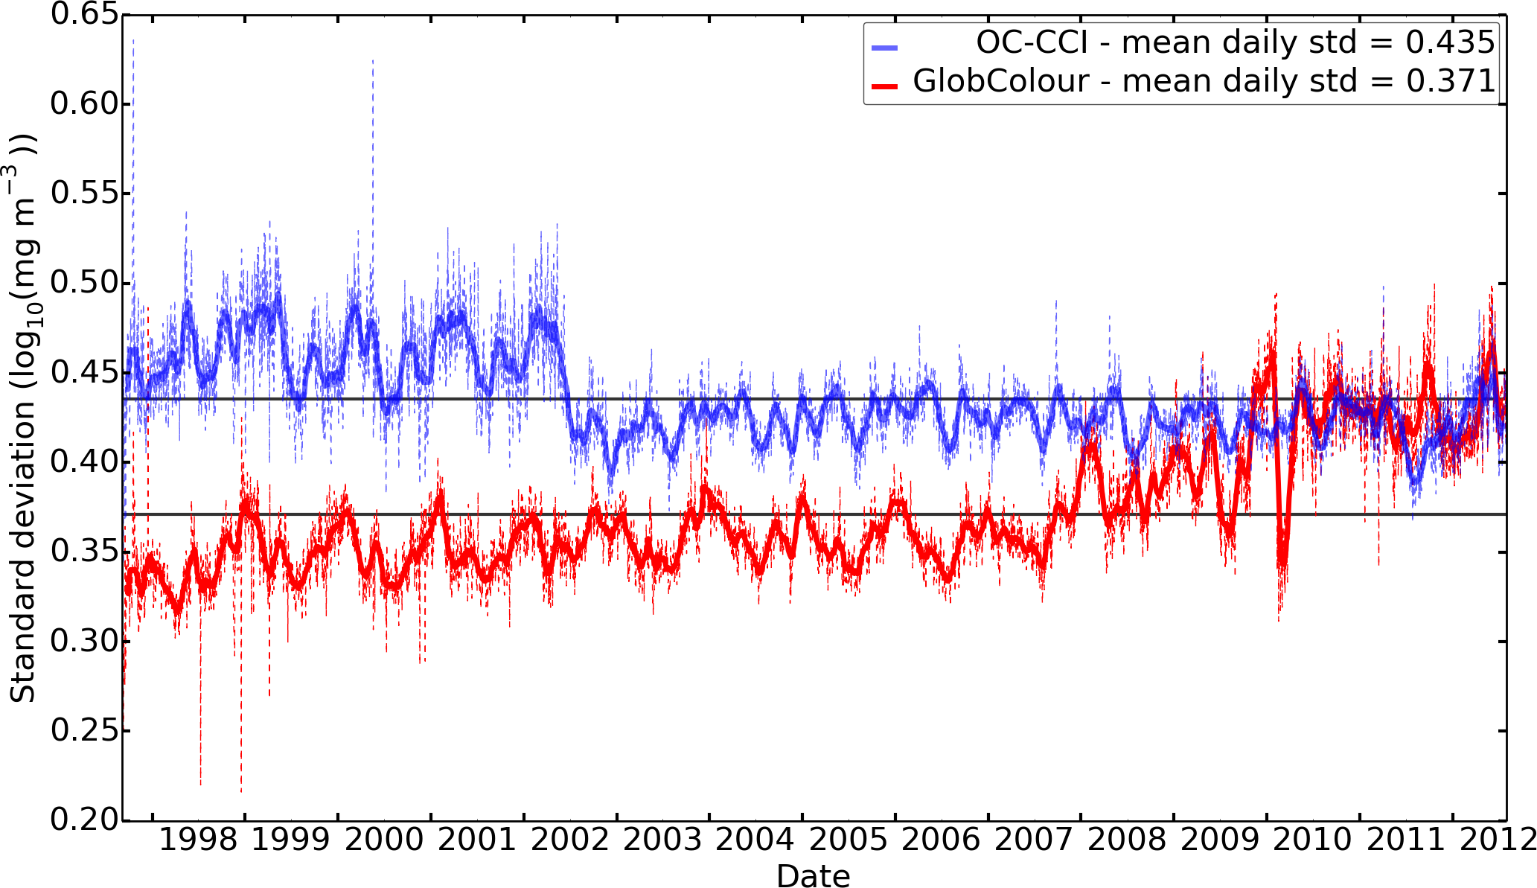
Global standard deviation log₁₀(chlorophyll)
OC-CCI
GlobColour

Slide 12
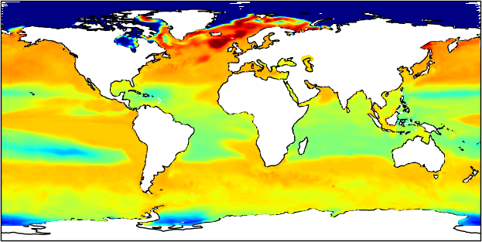
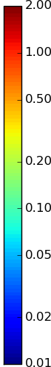
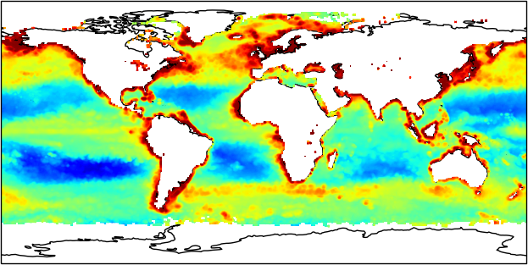
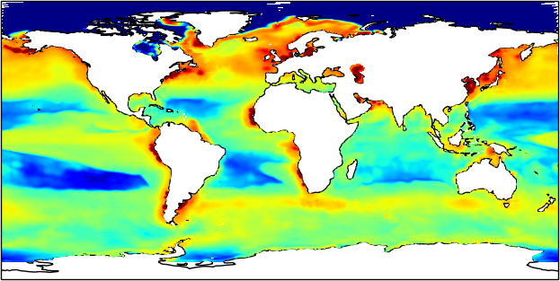
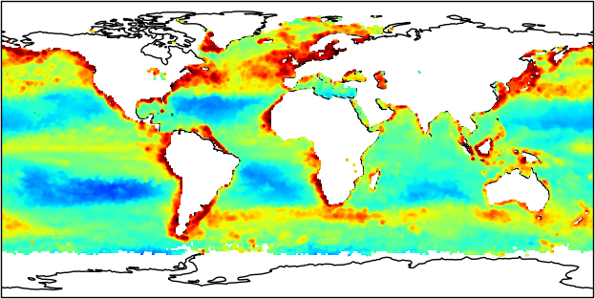
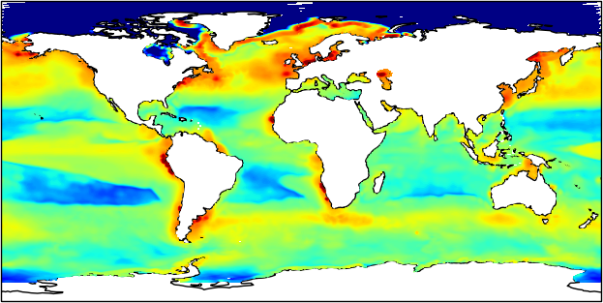
Chlorophyll
April 2003
mg m⁻³
Control run
OC-CCI observations
OC-CCI assimilation
GlobColour observations
GlobColour assimilation

Slide 13
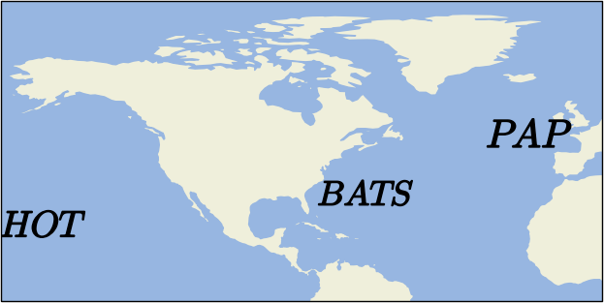
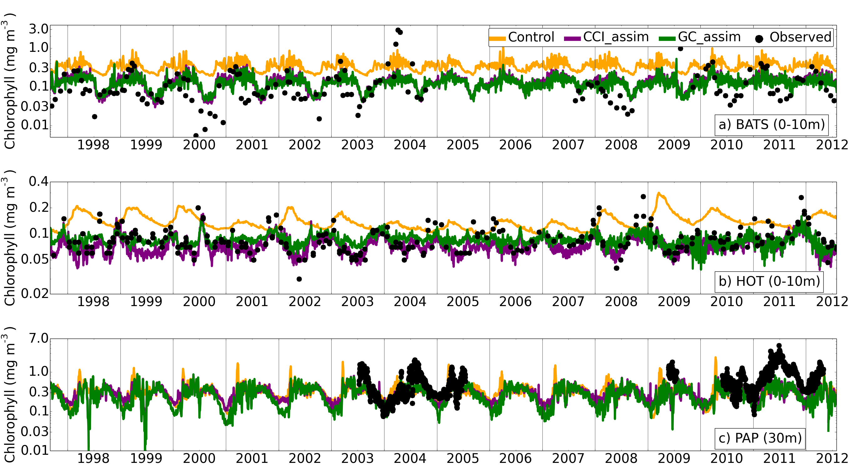
Chlorophyll time series

Slide 14
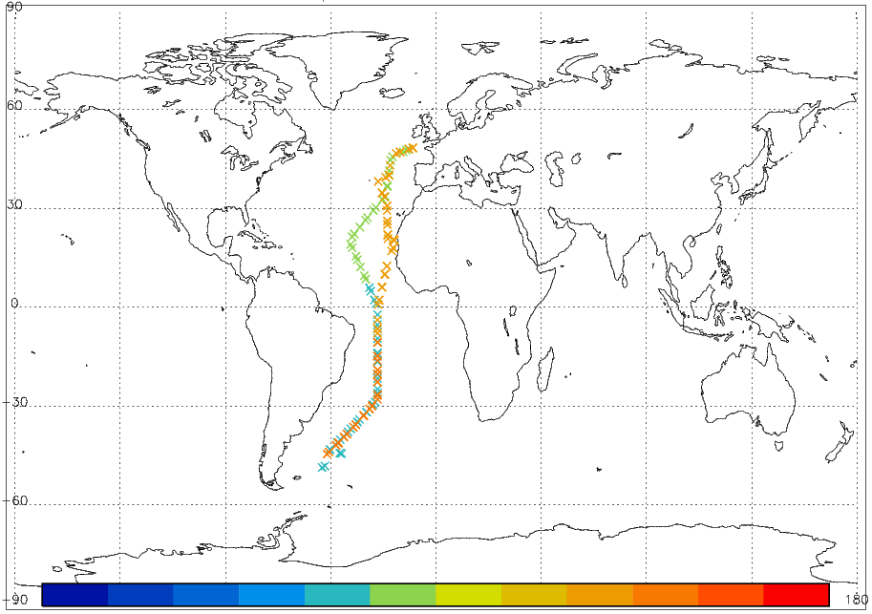
Validation against in situ obs
AMT 2003
 | log₁₀(chlorophyll)
 | RMSE | r
Control | 0.98 | 0.42
GlobColour assim | 0.63 | 0.77
OC-CCI assim | 0.63 | 0.77
(vs. observations taken in surface 10 m)

Slide 15
Validation against in situ obs
AMT 2003
 | log₁₀(chlorophyll) |  | Nitrate (mmol N m⁻³)
 | RMSE | r | RMSE | r
Control | 0.98 | 0.42 | 4.42 | 0.83
GlobColour assim | 0.63 | 0.77 | 4.34 | 0.83
OC-CCI assim | 0.63 | 0.77 | 4.34 | 0.83
(vs. observations taken in surface 10 m)

Slide 16
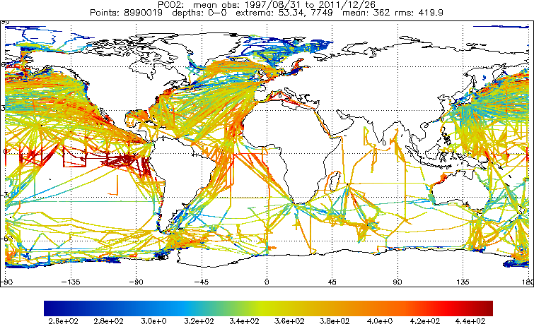
Validation against in situ obs
SOCAT v2 (1997-2011)
 | Surface fCO₂ (μatm)
 | RMSE | r
Control | 37.53 | 0.60
GlobColour assim | 37.52 | 0.61
OC-CCI assim | 37.65 | 0.60
n.b. Observations where bottom depth < 150 m excluded

Slide 17
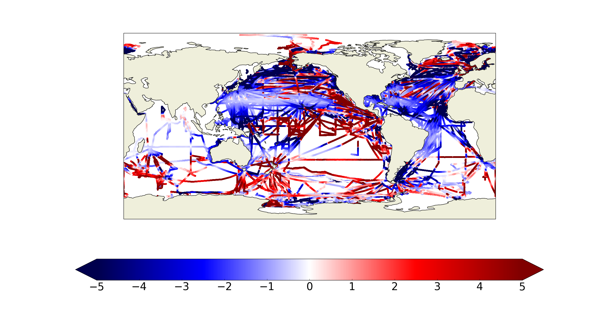
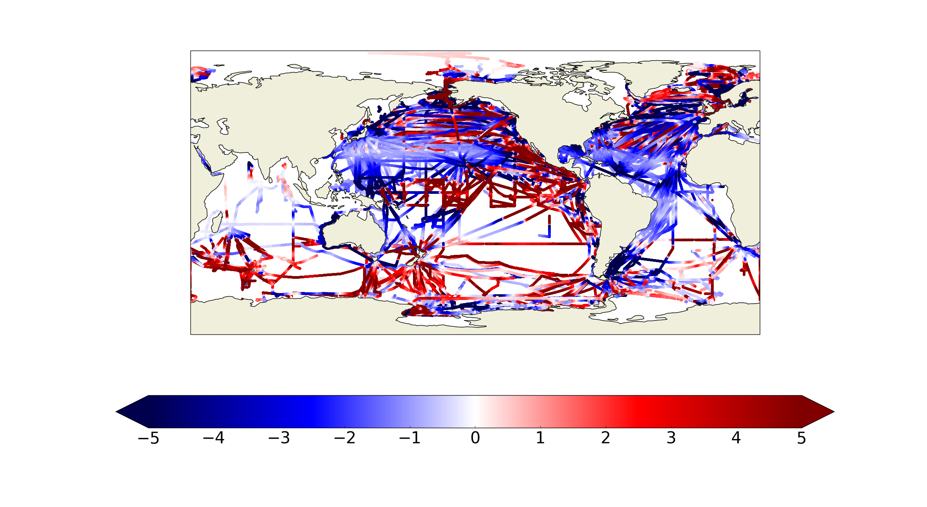
Impact on fCO₂ vs. SOCAT
OC-CCI
GlobColour
Assim better | Control better
μatm

Slide 18
Impact on fCO₂ vs. SOCAT
OC-CCI
GlobColour
Better: 5,856,471 (66%)
Worse: 3,053,868 (34%)
Better: 5,607,541 (63%)
Worse: 3,302,818 (37%)
Assim better | Control better
μatm

Slide 19
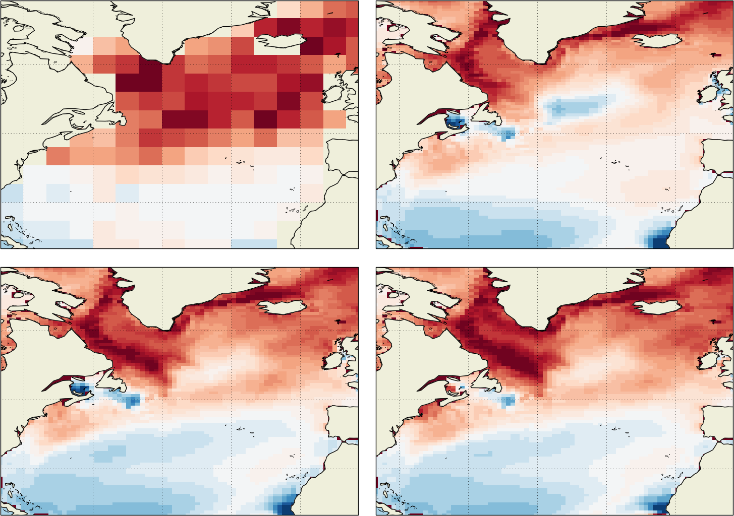
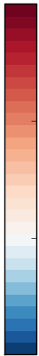
Air-sea CO₂ flux – June (1998-2012 mean)
Climatology
Control run
4 molC/m²/yr
2
Into
ocean
0 ----------
Out of
ocean
-2
GlobColour assim
OC-CCI assim

Slide 20
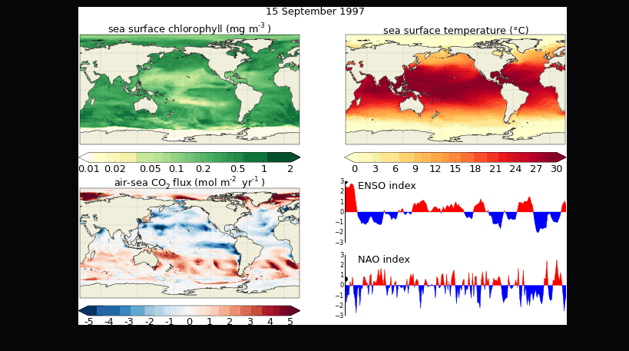
Fields from OC-CCI-assim reanalysis

Slide 21
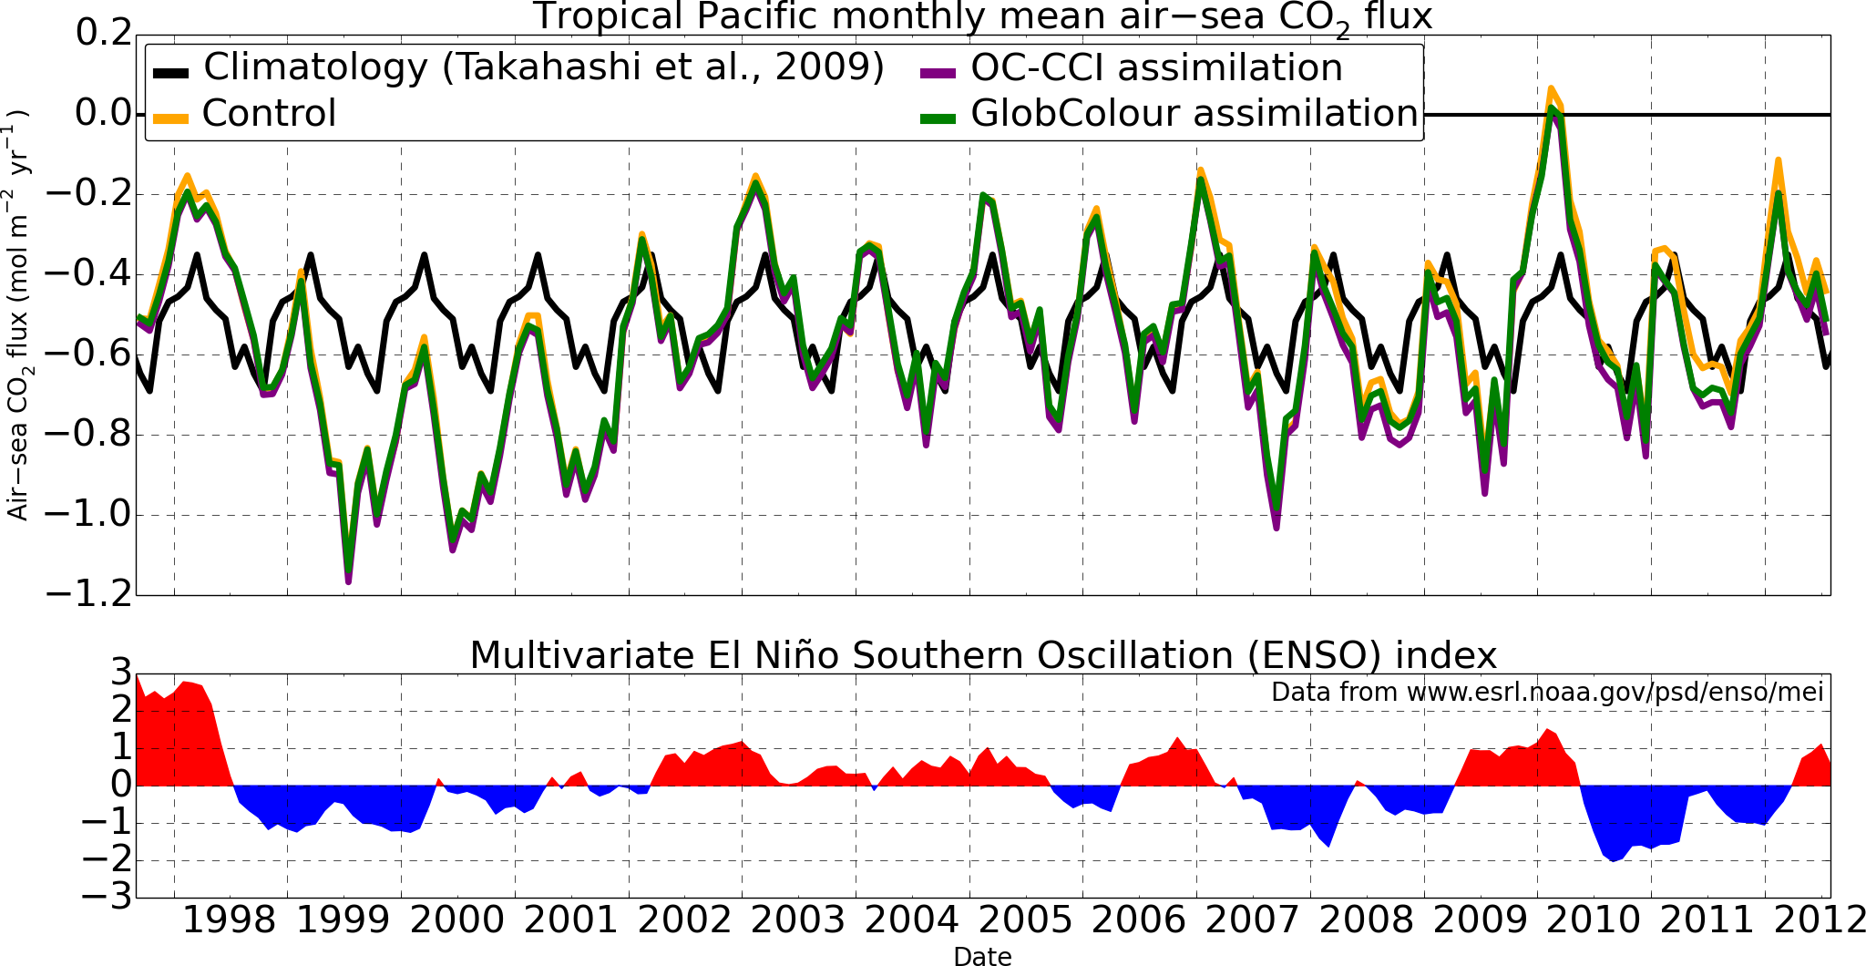

Slide 22
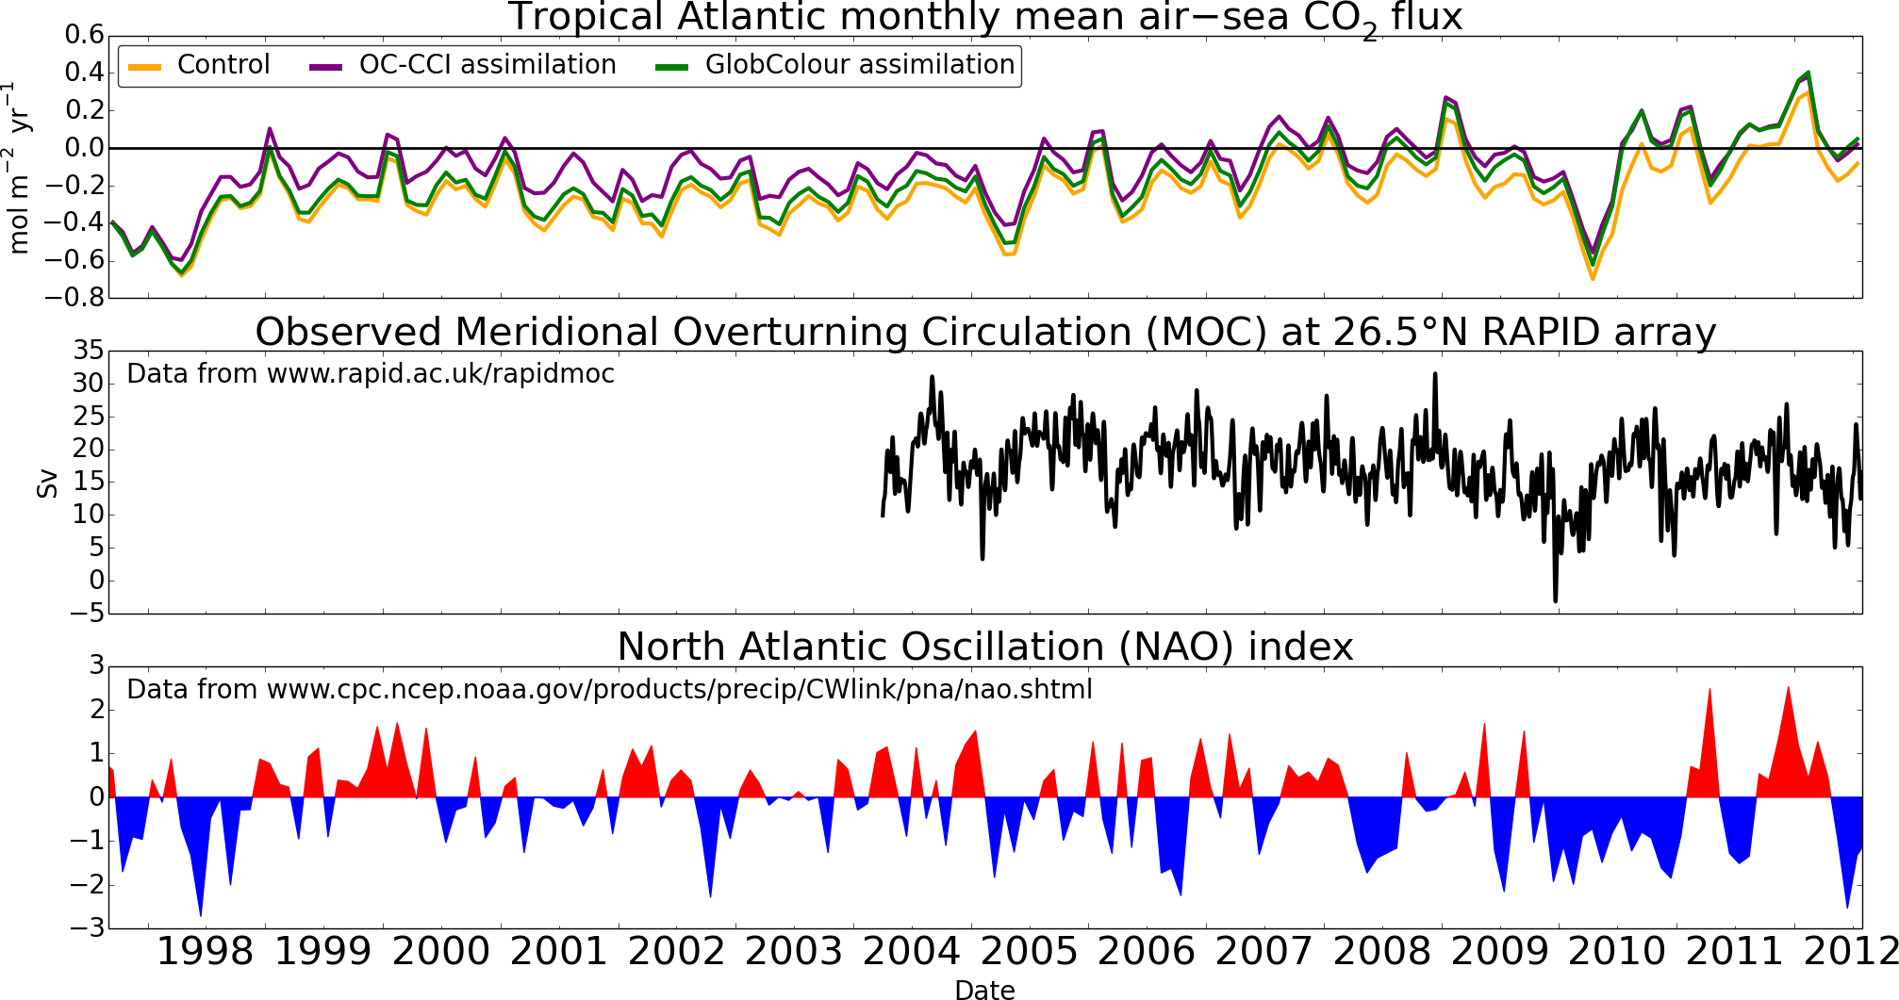

Slide 23
Conclusions and future plans

Slide 24
Summary of work so far
Reanalyses assimilating OC-CCI and GlobColour chlorophyll products
Assimilation improves model results
Reanalyses capture real-world variability
OC-CCI and GlobColour both fit for purpose
Some improved coverage and stability with OC-CCI

Slide 25
Next steps
Complete assessment of reanalyses
Submit paper(s) for publication
Integrated assessment of marine ECVs

Slide 26
Integrated assessment of ECVs
Ocean colour, SST, SSH, sea ice
Statistical assessment at different time scales
Multivariate assimilation to create global ocean physical-biogeochemical reanalyses
Experiments assimilating different ECVs
Assess consistency of features
Assess climate-relevant variables

Slide 27
Questions and answers

Slide 28
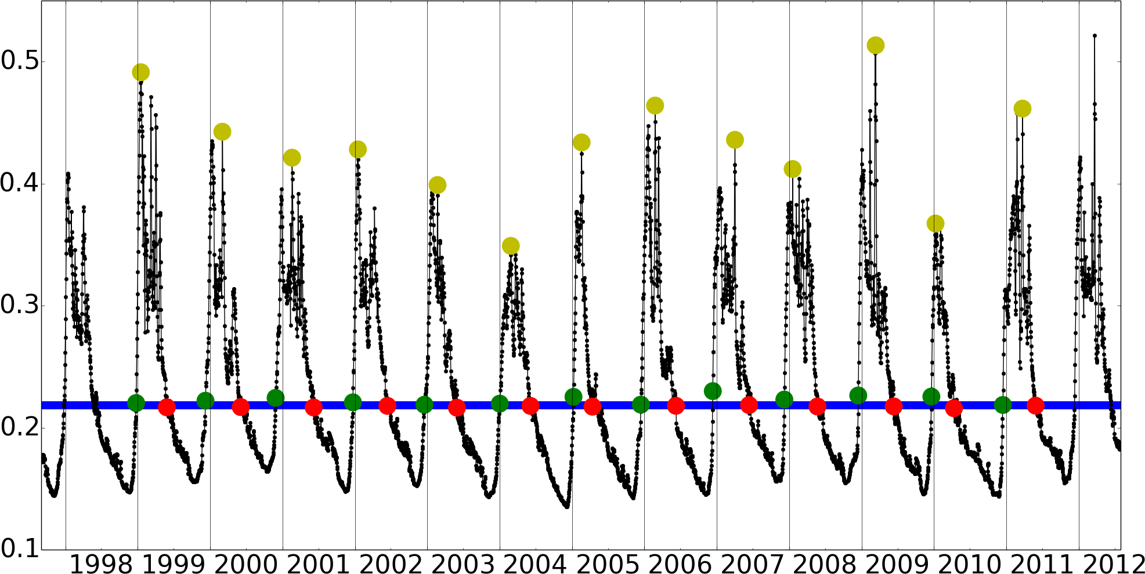
Chlorophyll phenology
Bloom start
Bloom peak
Bloom end
Median + 5%

Slide 29
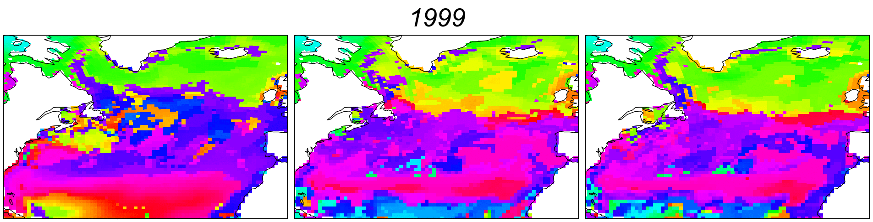
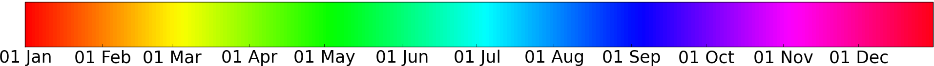
Bloom start date
OC-CCI
assimilation
GlobColour
assimilation
Control

Slide 30
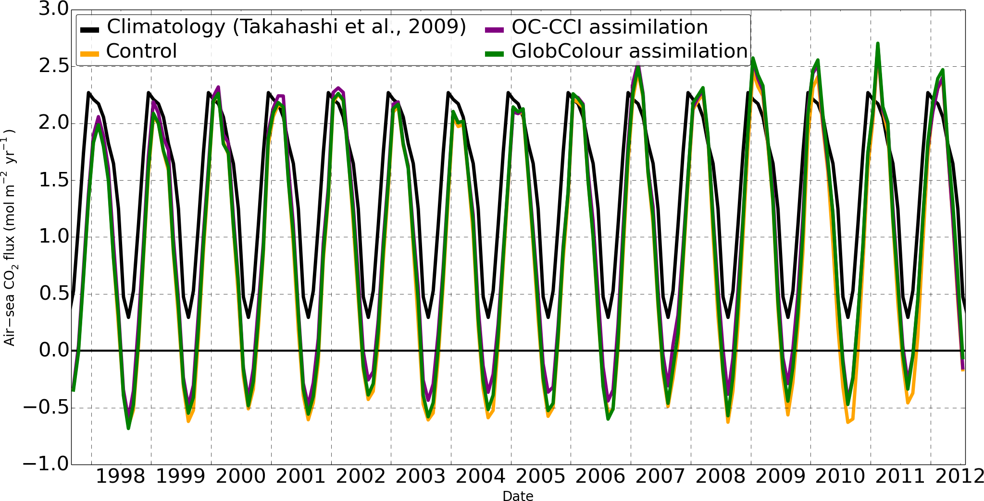
Air-sea CO₂ flux
North Atlantic monthly mean

Slide 31
Phase II: Integrated assessment of multiple CCI datasets (Met Office & ECMWF?)
Evaluation of quality in marine CCI products (SST, SSH, sea ice, ocean colour)
  Statistical assessment at different time scales (e.g. mean state, inter-annual variability and long-term trends)
  Detection of climate signal.
Global, ocean-only, model reanalyses (2000-2012)
  Multivariate assimilation of physical products (i.e. CCI L3 SST & precursor L2 SSH and sea-ice).
  Multivariate assimilation of physical products as above plus CCI OC.
  Impact assessment of climate-relevant variables (e.g. ocean heat content, salinity, mixed layer depth, AMO) and the carbon and biogeochemical cycles.

