Slide 1
Atmosphere ECV assessment: Aerosol, clouds (WP3.7)
Axel Lauer, Mattia Righi, Veronika Eyring, and Johannes Hendricks
Deutsches Zentrum für Luft- und Raumfahrt e.V. (DLR), Oberpfaffenhofen, Germany
27 May 2015

Slide 2
Scientific Questions
What is the interrelation between different aerosols, cloud and radiation ECVs in CCI data and Earth System Models?
How do the CMIP5 models perform in comparison to a more detailed aerosol global model (EMAC-MADE) in the representation of processes related to aerosol-radiation and aerosol-clouds interactions?
Tasks to be performed
Perform a transient simulation with the EMAC-MADE global aerosol model, using the same boundary conditions as the CMIP5 models.
Cross-assessment of aerosols, clouds, and radiation in the ESA CCI data compared to CMIP5 models and EMAC/MADE.
Expected added value
To improve process-level understanding of aerosol-radiation and aerosol-cloud interactions through the ESA CCI data.
To assess consistency of aerosols, clouds, and radiation ESA CCI data in comparison to other available observations.

Slide 3
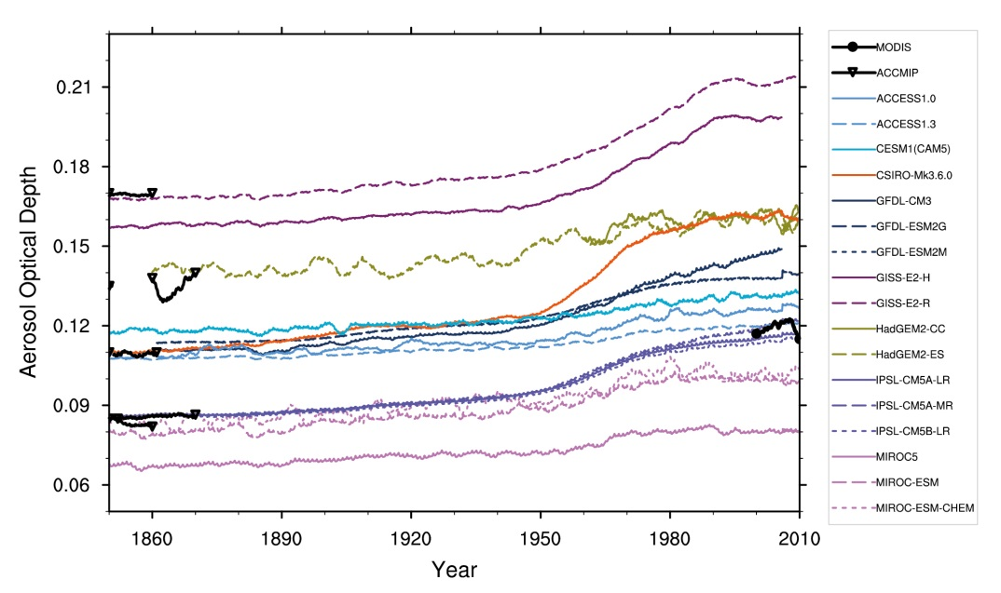
Cross-assessment of aerosol, cloud and radiation
Aerosol Optical Depth (AOD)
Top-of-the-atmosphere all-sky radiation (shortwave and longwave)
Top-of-the-atmosphere cloud-radiative-effects (CRE)
Characterization of the role of aerosol in the atmospheric and climate system and performing a cross-assessment of these ECVs in the ESA CCI data and the CMIP5 models
One goal is to update related evaluation assessments from IPCC Chapter 9 with the ESA CCI data.

Slide 4
ESA-CCI aerosol dataset
First aerosol data from ESA-CCI now available
Long term climate data record based on 2 data sets
  ERS2-ATSR2 (1996-2003)
  ENVISAT-AATSR (2002-2012)
Satellite data processed with different algorithms
Data provided as Level 3 daily data.
The dataset includes the following variables:
  AOD at 550, 555, 659, 865, 1610 nm (mean, uncertainty and std. dev.)
  Angstrom exponent 555/659 and 555/865 (mean, uncertainty and std. dev.)
  Fine mode AOD, absorbing AOD, dust AOD (mean and std. dev.)
  Surface reflectance at 555, 659, 865, 1610 nm (mean and std. dev.)
  Cloud fraction (mean and std. dev.)
  Land area fraction (mean and std. dev.)
  Solar and satellite zenith angle (mean and std. dev.)
  Relative azimuth angle (mean and std. dev.)

Slide 5
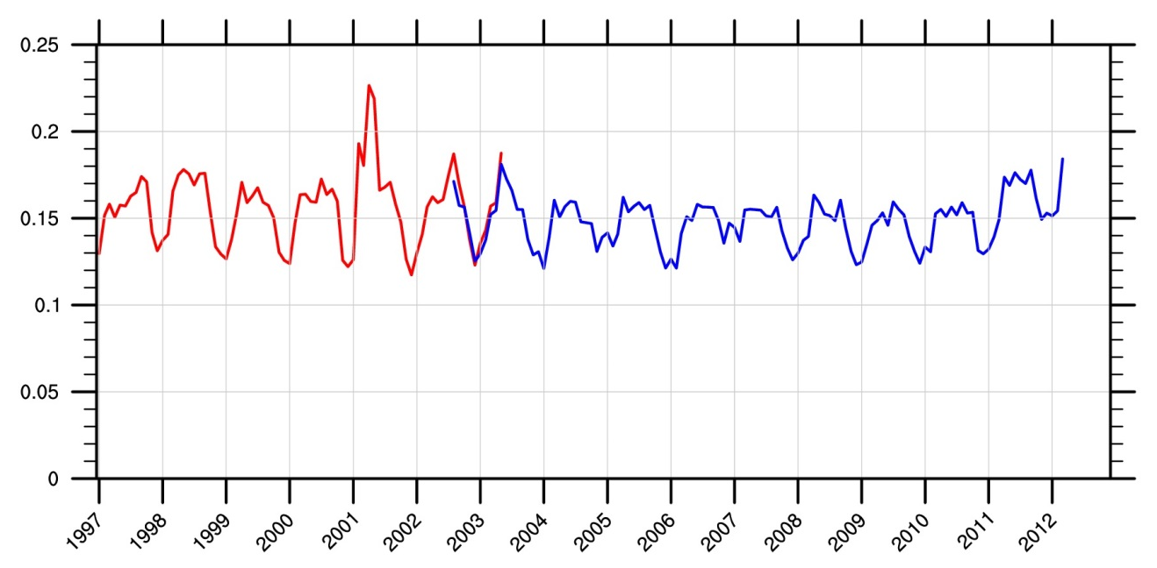
Combining the 2 data sets
ATSR2: Jun 1995 to May 2003
AATSR: Aug 2002 to Mar 2012
Data missing in the period Jan-Jun 1996 → we consider ATSR2 data starting from Jan 1997 (we need complete years for our analysis)
Overlapping period Aug 2002-May 2003
Minor differences between the two data sets, due to the different spatial coverage of the two instruments.
We generated the complete dataset using ATSR2 until 2002 and AATSR from 2003.
AATSR
ATSR2

Slide 6
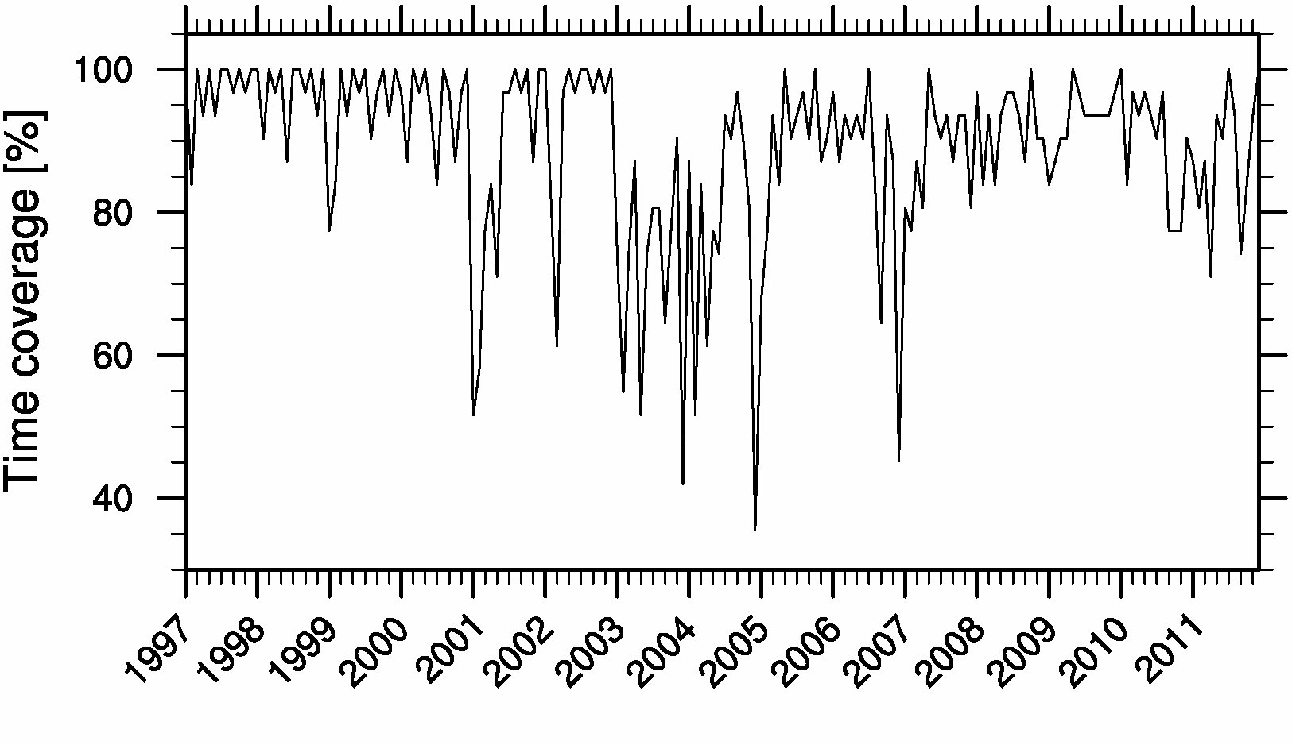
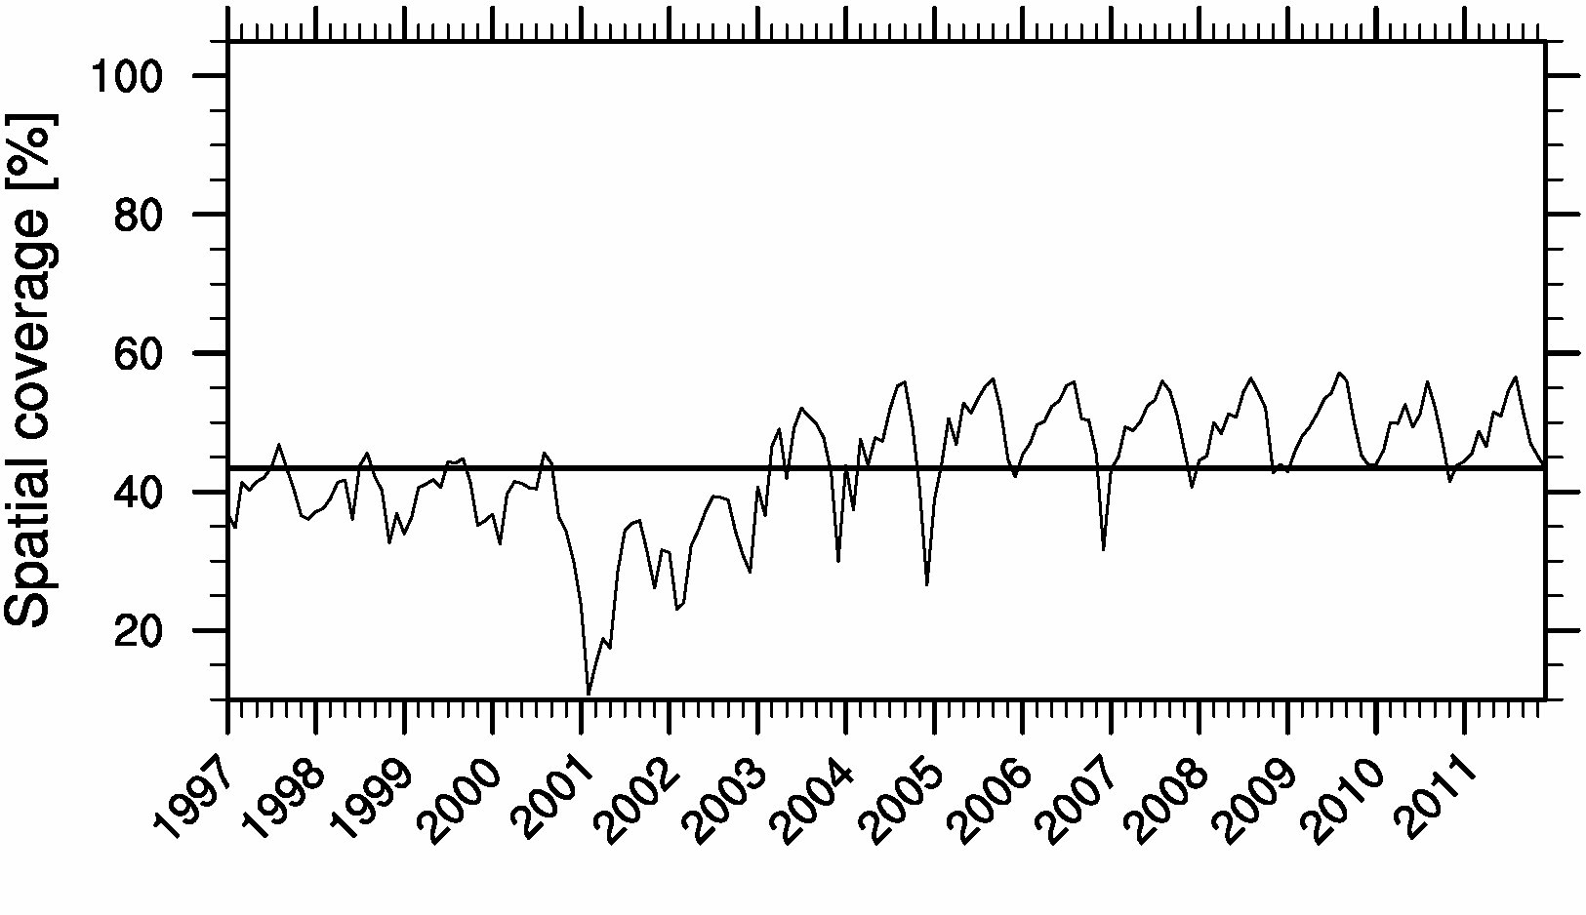
Spatial and temporal coverage
Temporal coverage is good
# of days-per-month with available measurements (1997-2011):
> 90% for 64% of the months
> 80% for 84% of the months
> 70% for 93% of the months
Similar coverage in ATSR2 and AATSR
Average spatial coverage is 43.4%
(on a monthly-mean basis)
Significant improvement in AATSR (wider observing swath):
ATSR2 (1997-2002): 36.1%
AATSR (2003-2011): 48.2%
AATSR
ATSR2

Slide 7
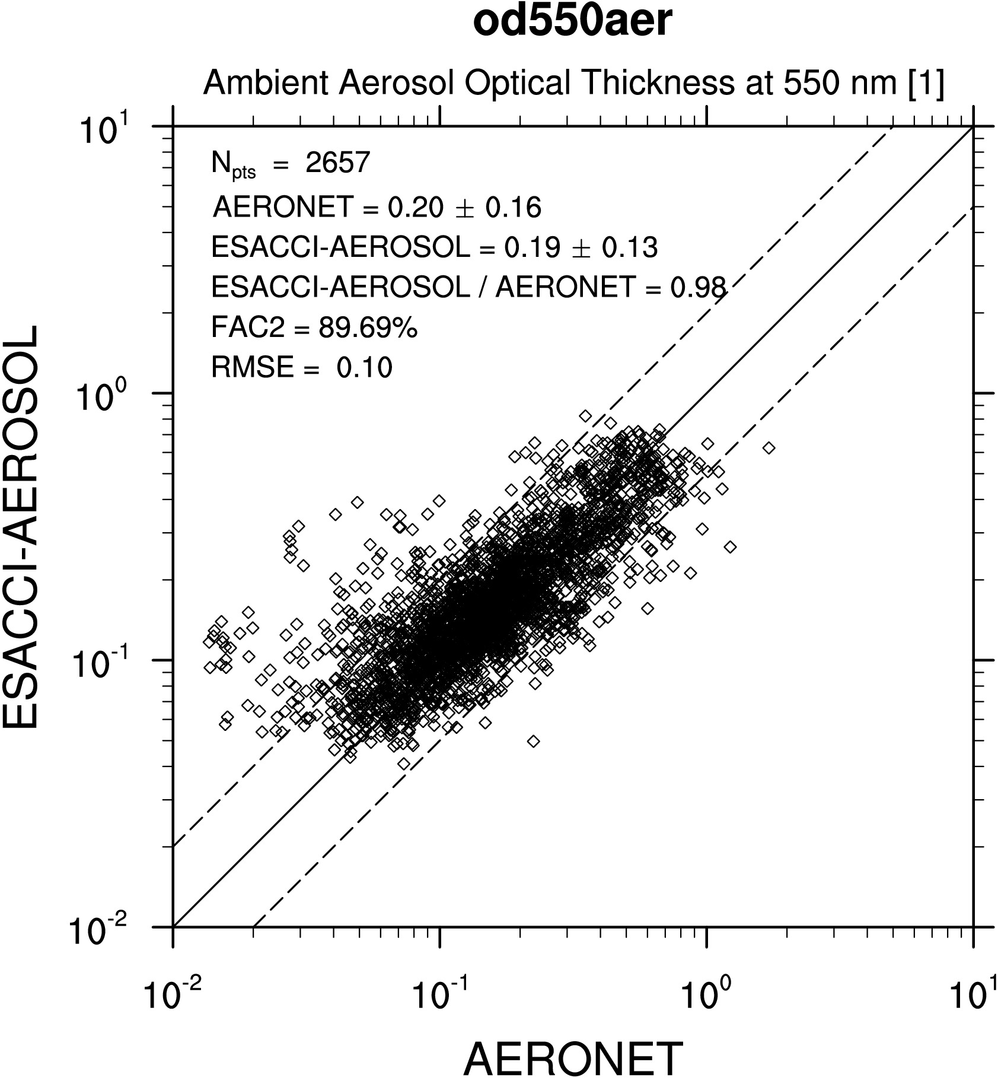
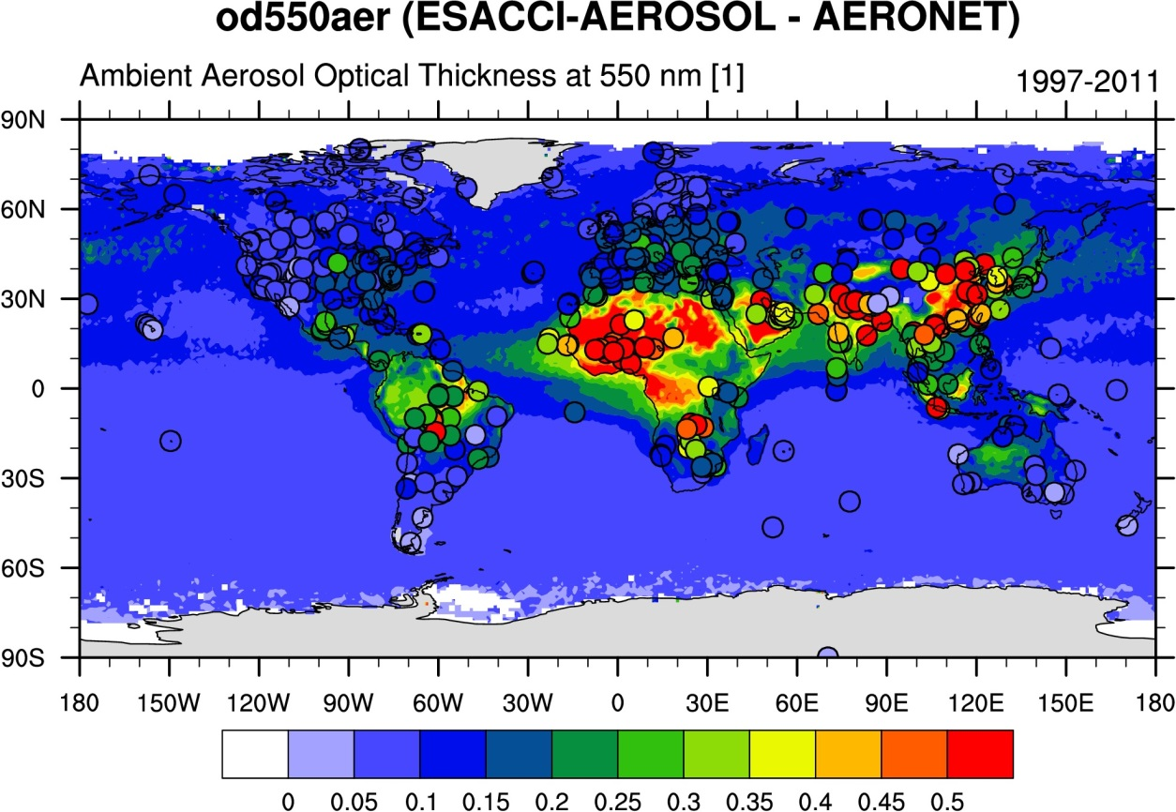
Comparison against AERONET ground network
Overall good agreement between ESA-CCI and AERONET
Overestimate of AOD at some stations (Sahara, Arabia, South America).
Good agreement in marine stations.

Slide 8
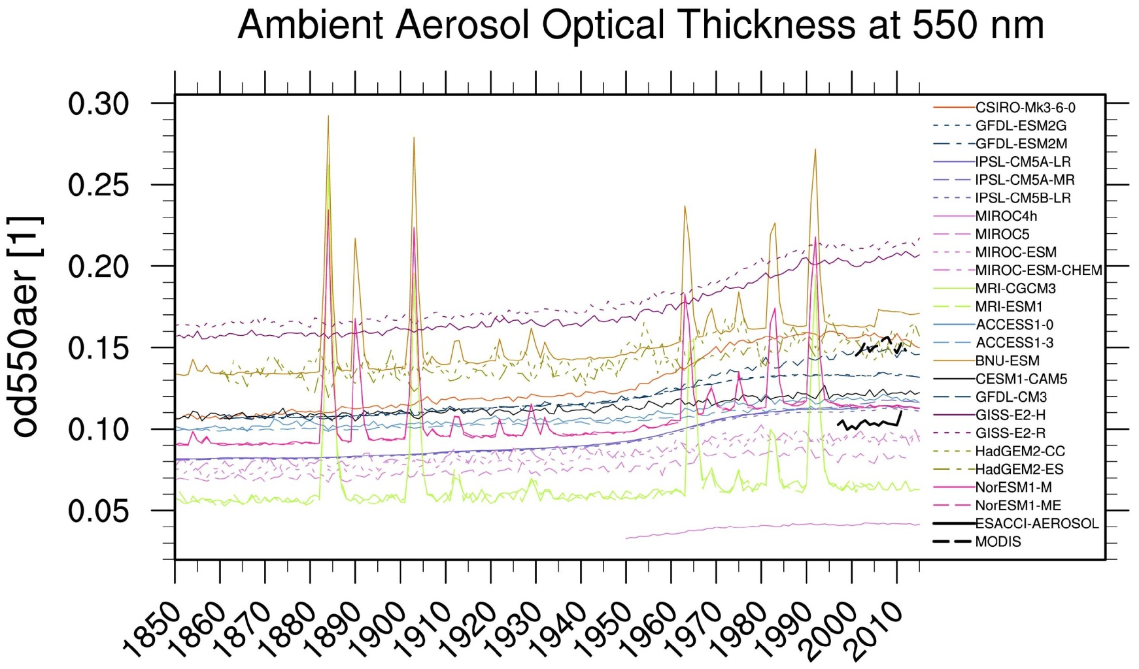
Assessment of CMIP5 models with new data
As in Fig. 9.29 of IPCC Chapter 9.
AOD integrated over the oceans for CMIP5 models, MODIS and ESA-CCI

Slide 9
Next steps
Strengths and weaknesses of the CMIP multi-model ensemble will be further investigated, by means of dedicated sensitivity experiments with the EMAC-MADE global aerosol model.
EMAC-MADE is able to track the aerosol dynamical processes in much more detail than most of the CMIP5 models and can also simulate the aerosol-cloud and aerosol-radiation interactions, using specific parameterizations of the involved processes.
Comparing the performances of the CMIP5 ensemble versus the results obtained with different configurations of EMAC-MADE will provide insights on the key processes driving the aerosol and related quantities in the climate system.
We provide a comparison of the new ESA CCI products with previous datasets (e.g., MODIS, MISR, CERES, and ERBE) to characterize uncertainties in the observations.
The analysis will distinguish between land and ocean (different relevant sources and processes).

Slide 10
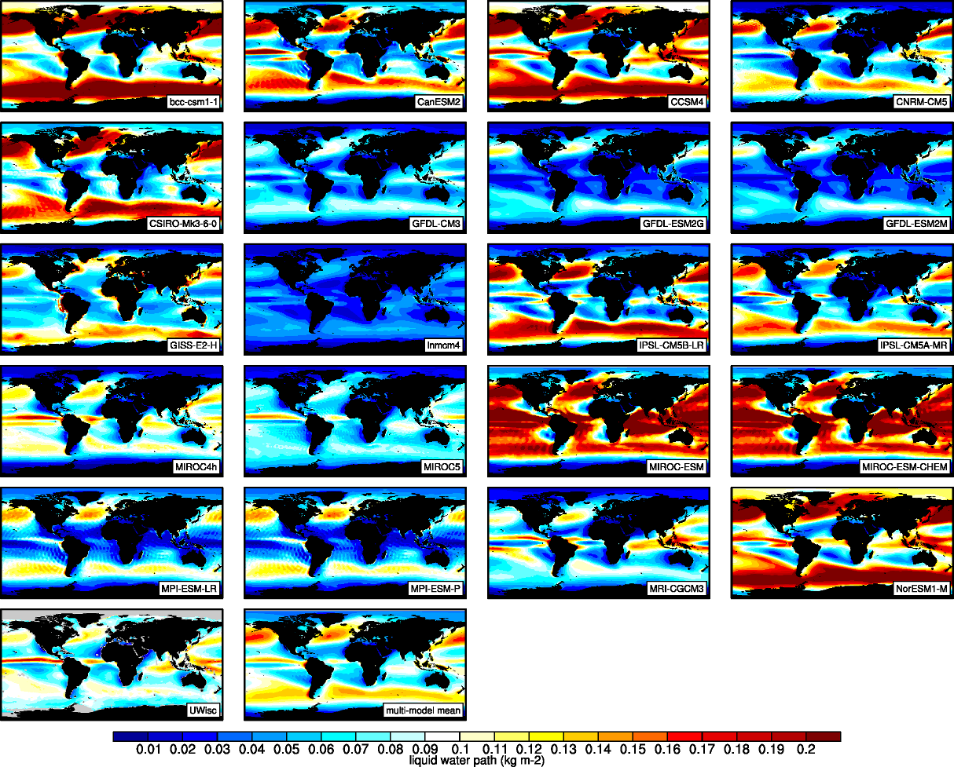
Next steps
Example
20-yr average LWP (1986-2005) CMIP5 in comparison with Uwisc satellite climatology

Slide 11
Thank you!

