Slide 1
CORE CLIMAX Results Overview
Bob Su, Jörg Schulz, Yijan Zeng, David Tan, Hilppa Gregow, Wim Timmermans
& the CORE-CLIMAX team
ITC, University of Twente
z.su@utwente.nl
joerg.schulz@eumetsat.int

Slide 2
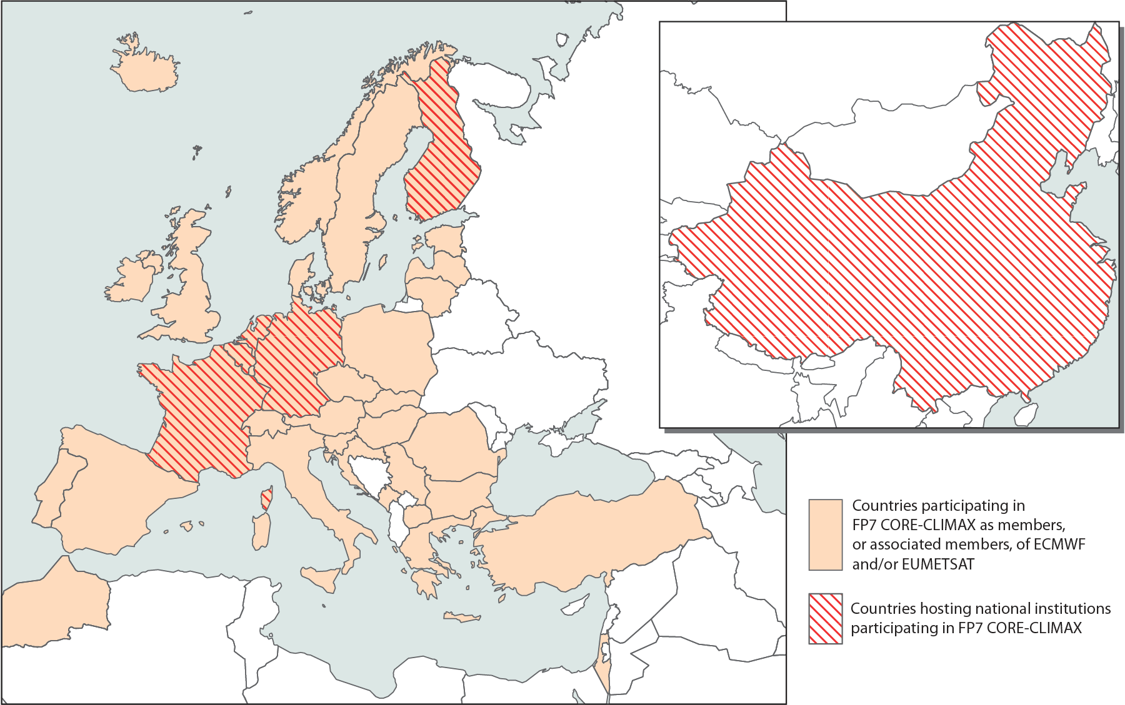








CORE-CLIMAX
COordinating Earth observation data validation for RE-analysis for CLIMAte ServiceS

Slide 3
Message Points
CORE-CLIMAX has proposed a structured process for assessing European capacity and capability in delivering Climate Data Records for ECVs and did a first capacity assessment;
CORE-CLIMAX has proposed a validation process aiming at qualifying the uncertainty of climate variables;
CORE-CLIMAX has created a feedback mechanism ensuring that the results of the re-analysis process get appropriately reflected into updates of the CDR;
CORE-CLIMAX has analysed usage of re-analyses and developed a mechanism for comparing and assessing quality of re-analyses.

Slide 4
Assessment of European Capacity for CDRs: Facts
Experienced great community support (EUM SAF, ESA CCI, Copernicus Services) leading to a successful workshop and assessment report;
Developed assessment methodology was applied to 40 data records including satellite, in situ and re-analysis (6 CCI projects participated);
Provided consistent description of all data records involved ;
Self assessment was performed with high honesty;
Review process of assessment report led to self-regulatory update of assigned maturity;
Results per data record clearly illustrate individual status and improvement potential;
Assessment provides collective and detailed information across all GCOS ECV domains, covering almost all major European CDR producers.

Slide 5
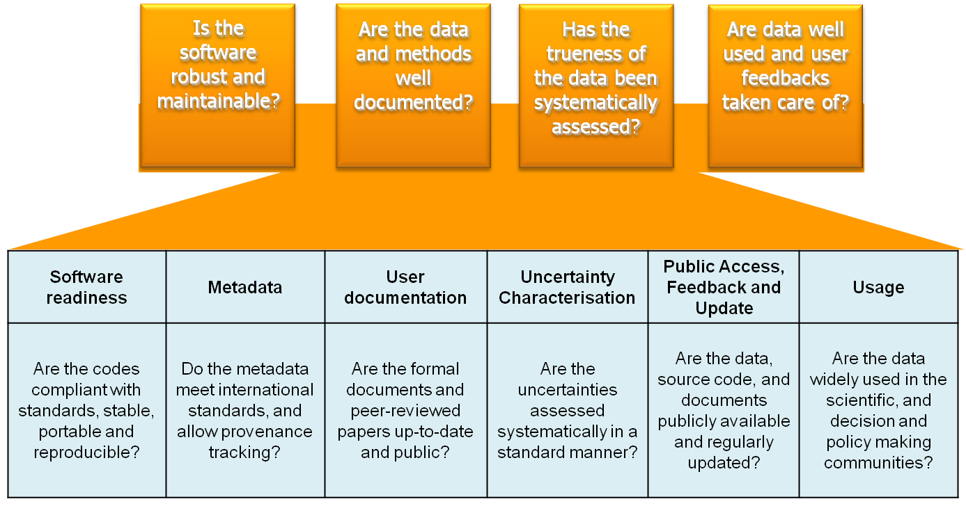
Maturity Matrix Concept
Maturity
1
2
3
4
5
6
Notes:
SMM provides assessment of whether the data set can be sustainable in terms of engineering, science, archive, and usage aspects.

Slide 6
Name | GHG-CCI; XCO₂ and XCH₄
Origin | ESA GHG-CCI; buchwitz@uni-bremen.de
Spatial Characteristics | Global, 30 x 60 km², global (land only for CO₂)
Temporal Characteristics | 2002 – 2012 (SCIAMACHY); 2009 – present (GOSAT); Instantaneous
Software Readiness | Metadata | User Documentation | Uncertainty Characterisation | Public access, feedback, and update | Usage
Coding Standards | Standards | Formal description of scientific methodology | Standards | Public Access/Archive | Research
Software Documentation | Collection level | Formal validation report | Validation | Version | Decision support system
Numerical Reproducibility and portability | File level | Formal product user guide | Uncertainty quantification | User feedback mechanism
Security |  | Formal description of operations concept | Automated quality monitoring | Updates to record
Legend
1 | 2 | 3 | 4 | 5 | 6

Slide 7
Name | ESA Aerosol_cci datasets
Origin | ESA Aerosol_cci; thomas.holzer-popp@dlr.de
Spatial Characteristics | Global, different resolution (0.1 to 10 degrees)
Temporal Characteristics | ~weekly-monthly sampling (between 1995 and 2012)
Software Readiness | Metadata | User Documentation | Uncertainty Characterisation | Public access, feedback, and update | Usage
Coding Standards | Standards | Formal description of scientific methodology | Standards | Public Access/Archive | Research
Software Documentation | Collection level | Formal validation report | Validation | Version | Decision support system
Numerical Reproducibility and portability | File level | Formal product user guide | Uncertainty quantification | User feedback mechanism
Security |  | Formal description of operations concept | Automated quality monitoring | Updates to record
Legend
1 | 2 | 3 | 4 | 5 | 6

Slide 8
Name | ESA SST CCI Analysis long-term product V 1.0
Origin | ESA-CCI; c.j.merchant@reading.ac.uk
Spatial Characteristics | Global; 0.05° lat-lon grid resolution
Temporal Characteristics | ~20 years; Daily
Software Readiness | Metadata | User Documentation | Uncertainty Characterisation | Public access, feedback, and update | Usage
Coding Standards | Standards | Formal description of scientific methodology | Standards | Public Access/Archive | Research
Software Documentation | Collection level | Formal validation report | Validation | Version | Decision support system
Numerical Reproducibility and portability | File level | Formal product user guide | Uncertainty quantification | User feedback mechanism
Security |  | Formal description of operations concept | Automated quality monitoring | Updates to record
Legend
1 | 2 | 3 | 4 | 5 | 6

Slide 9
Name | CM SAF CLARA A1 cloud properties
Origin | CM SAF; contact.cmsaf@dwd.de
Spatial Characteristics | Global, 0.25 x 0.25 grid
Temporal Characteristics | daily and monthly mean, 1982 – 2009
Software Readiness | Metadata | User Documentation | Uncertainty Characterisation | Public access, feedback, and update | Usage
Coding Standards | Standards | Formal description of scientific methodology | Standards | Public Access/Archive | Research
Software Documentation | Collection level | Formal validation report | Validation | Version | Decision support system
Numerical Reproducibility and portability | File level | Formal product user guide | Uncertainty quantification | User feedback mechanism
Security |  | Formal description of operations concept | Automated quality monitoring | Updates to record
Legend
1 | 2 | 3 | 4 | 5 | 6

Slide 10
Major Results
FCDR: high variance in all scores, the more operational the higher scores are for software readiness, meta data, documentation and public access;
Operational TCDR get high scores for Meta Data, User Documentation, Public Access and Usage. Medium scores are sometimes observed for Software Readiness and Uncertainty Characterisation;
Scientific TCDR get high scores for User Documentation, Uncertainty Characterisation, and Usage. Lower scores for Software Readiness and Public Access;
Getting consistently high scores for TCDR in all categories is a matter of time;
The maturity of in situ data largely depends on the selection of a set of stations or time period;
There was uncertainty on the applicability of Software Readiness category for in situ data. Data providers were not aware that cost for software maintenance can be substantial, e.g., when not-portable and/or not-documented.
Notes:
If old and thus especially valuable data records would be excluded, this would immediately raise the maturity noticeably. In general, a more comprehensive data set will have a lower maturity compared to a selected subset, which might lead to misinterpretation;
In "semi-operational" systems to generate data sets where people come and go, operating systems come and go, programming languages come and go, but the data set or the need to produce a CDR of a particular ECV remains for decades, and it is a lot more expensive when those systems are not portable and not well documented and so not easy to pass on to someone else to maintain/upgrade than when they are. It makes the difference between making incremental changes and having to start all over again.

Slide 11

Fitness for Purpose?
Motivation for Application Performance Metric (APM)
SMM provides assessment of whether the data set can be sustainable in terms of engineering, science, archive, and usage aspects
There is no guarantee that a data set with high System Maturity is suitable for all applications!
How do we assess the performance of a data set for a particular application?
Notes:
For example, data set X with over all System Maturity FIVE/SIX that provides DAILY mean humidity values is NOT suitable for assessing DIURNAL cycle of humidity in climate models

Slide 12


Support User’s to Select Data
Are the observations of adequate quality ?
How does the quality vary in time ?
Is there sufficient level of detail ?
What methods were used to create the product?
Is there sufficient coverage ?
What original observations were used in the product?
Coverage | Sampling | Uncertainty | Stability
Are the record length and spatial coverage meeting the application’s requirements? | Do the spatial and temporal sampling meet the applications requirements? | Do the random and systematic uncertainties meet the requirements? | Do the temporal and spatial stability meet the requirements?
Notes:
User requirements collection exercises show a large variability in the stated requirements of users with nominally similar applications;
But a core set of typical questions may always be isolated:

Slide 13
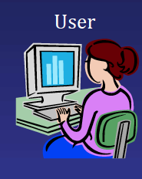

General Concept of APM
Application Specific User Requirements
CDRs matching the URs best
Database of CDR
Technical Specification +
Uncertainty Summary Information
Notes:
Search through (query) a database to pick the right data for the application
Technical specifications of ECVs (e.g., ECV inventory)
User requirements Table

Slide 14
Outreach – Impact on Community
Several Copernicus related projects (QA4ECV, GAIA-CLIM, EUSTACE) will utilise the maturity matrix approach to assess satellite data records and ground-based reference data sets as well as to monitor progress in product generation for global temperature data sets;
CHARMe and CORE-CLIMAX projects can insert the assessment results as commentary meta-data (but there was no time nor resources to realise it);
Copernicus C3S considers its use in the context of quality evaluation and assurance;
WMO SCOPE-CM uses it to monitor development progress;
The obs4mips activity considers the Maturity Matrix as starting point for a Model Evaluation Readiness Level Matrix to evaluate suitability of CDRs for CMIP experiments;
The Max-Planck Institute for Meteorology has started to define a similar maturity model for climate model data set stewardship;
CEOS-CGMS WG Climate has started assessment of ECV inventory content (220 data records) - CORE-CLIMAX assessment will be added for European data records.

Slide 15
Analysing Re-analysis Usage
Delivery
Climate Services
Delivery
Data User
Requires
?
Service
User
Delivery
Awareness
?
Reanalyses
Affects
?
Methods/Errors
Strengths/Limitations

Slide 16
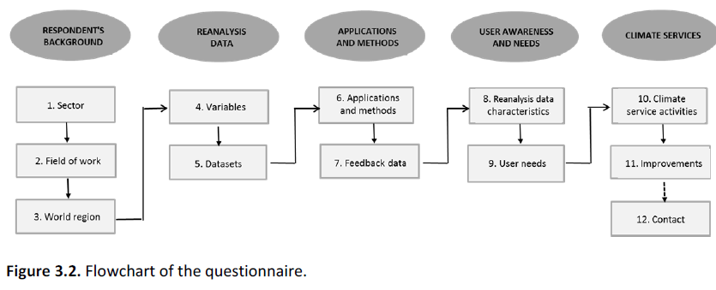
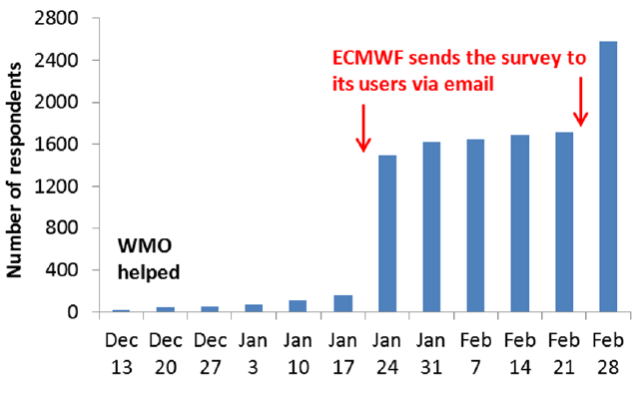
Analysis and Summary of Web-based Survey

Slide 17
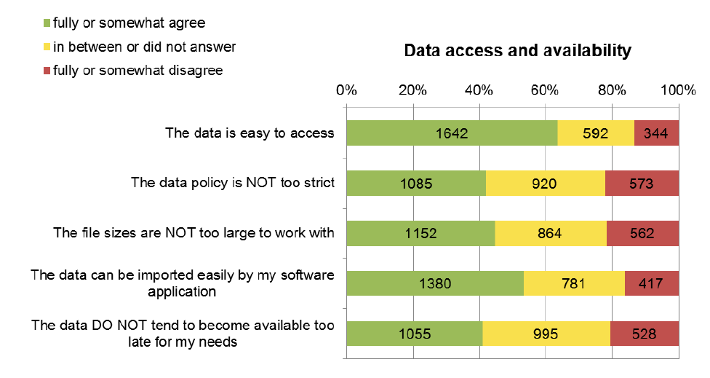
Questionaire Outcome

Slide 18
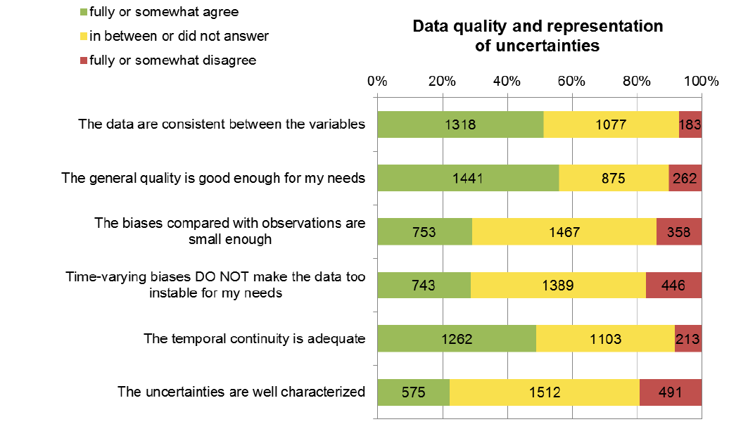
Questionaire Outcome

Slide 19
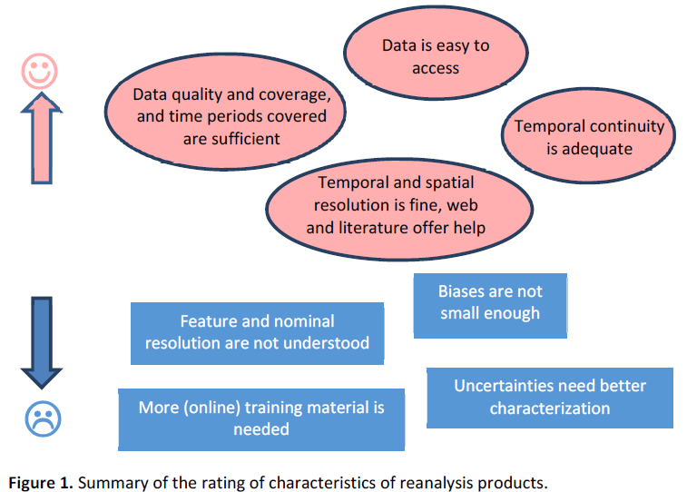
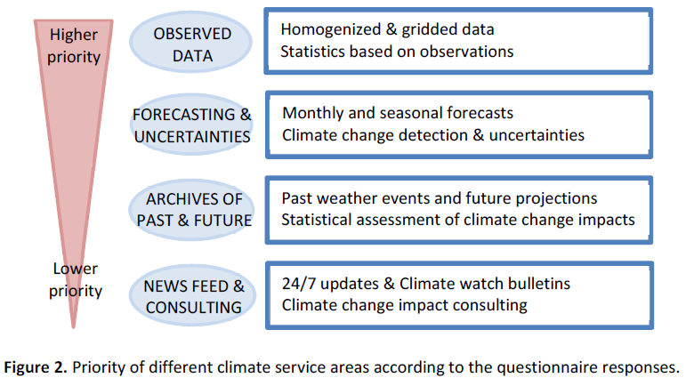
Effects of Uncertainties and Gaps in Re-analyses Important to Climate Services

Slide 20
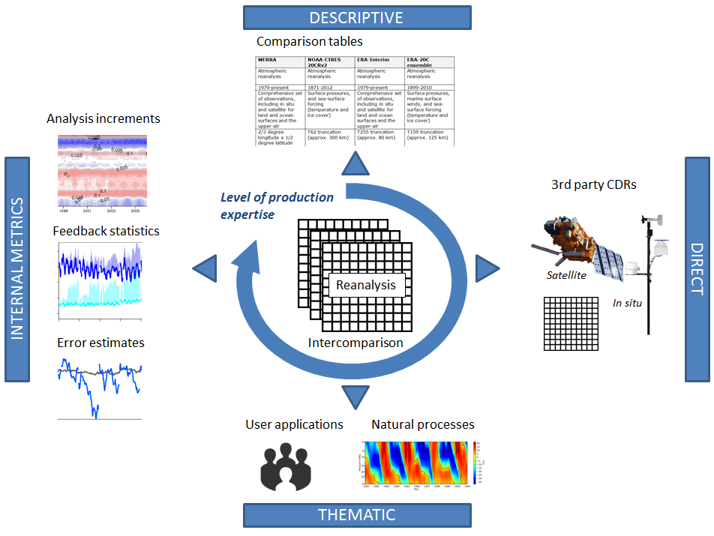
Comparisons of re-analyses
simple to conduct,
simple to interpret
difficult to conduct,
moderate to interpret
moderate to conduct,
moderate to interpret
difficult to conduct
difficult to interpret

