Slide 1




Summary Atmosphere
R. Hollmann on behalf of all Atmosperic CCI’s
Deutscher Wetterdienst

Slide 2
1. Available data set
GHG
CRDP #2 is available
Aerosols
ATSR-2 / AATSR 17 years, GOMOS 10 years stratospheric, IASI 2013, GRASP as reference data set
Ozone
Total ozone from nadir UV and TIR sensors; Ozone profiles from nadir UV and TIR sensors (Trop/Strat); Ozone profiles from limb/occultation sensors (UTLS/Strat/Meso)
CLD:
ESA Cloud CCI has generated two data sets spanning 2007-2009 exploiting for the first time synergistic capabilities of different sensors.

Slide 3
2. Applications
current and planned applications of this data, including:
- C3S, H2020 research, international initiatives, national programmes)

Slide 4
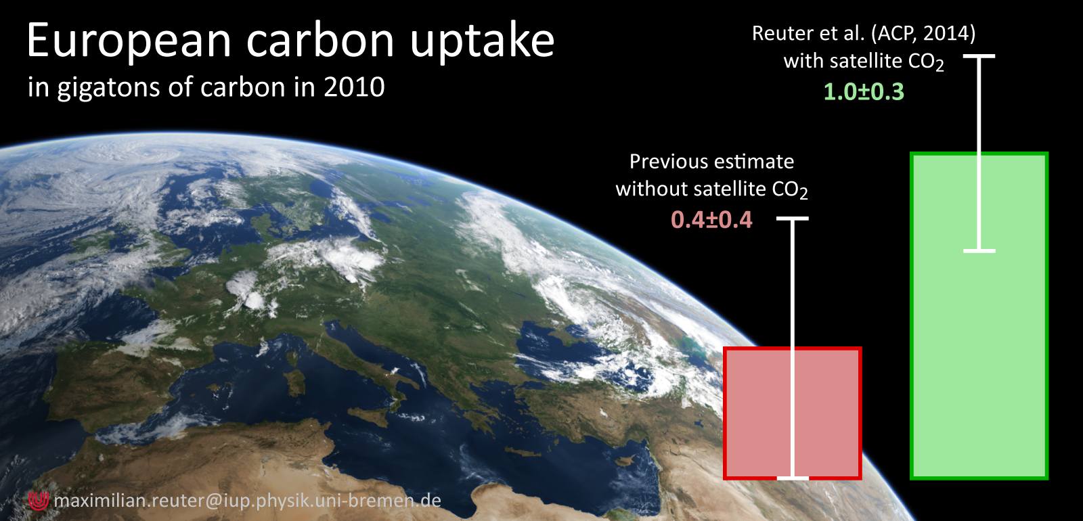
European terrestrial carbon fluxes from SCIAMACHY and GOSAT - III
Reuter et al.,
ACP, 2014
Summary for continental (TransCom) Europe:
Related ESA webstory: Is Europe an underestimated sink for carbon dioxide ?
http://www.esa.int/Our_Activities/Observing_the_Earth/Is_Europe_an_underestimated_sink_for_carbon_dioxide

Slide 5





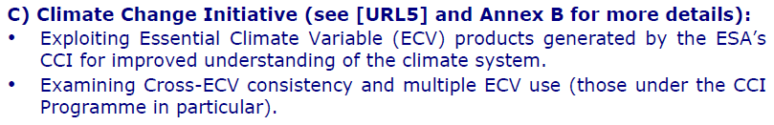
Fellowships
PostDocs selected :
Dr Robert Parker, UoL
  ELEGANCE-GHG: ExpLoring thE Global cArboN CyclE through atmospheric GreenHouse Gas variability
Dr Jens Heymann, IUP-UB
  CARBOFIRES: CARBOn dioxide emissions from FIRES
Dr. Tero Mielonen, FMI
    ITICA Does Increasing Temperature Increase Carbonaceous Aerosol Direct Radiative Effect over Boreal Forests?
  Dr. Adam Povey, UO
    ERASE aerosol and surface radiation fluxes, analyzing cloud structures up and downwind of an aerosol source as means of understanding long-term averages of aerosol cloud interaction

Slide 6
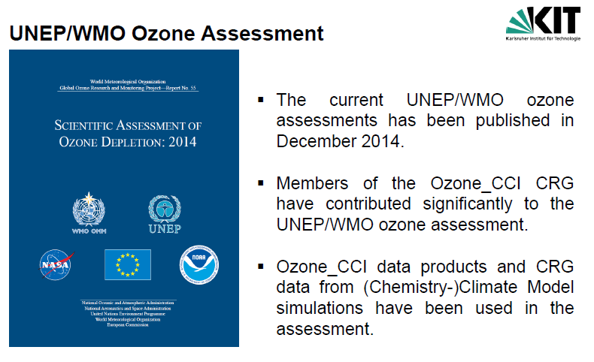
Assessments
GHG
Aerosols
GEWEX Aerosol Assessment
Ozone
WMO Ozone Assessment
CLD:
GEWEX cloud Assessment

Slide 7
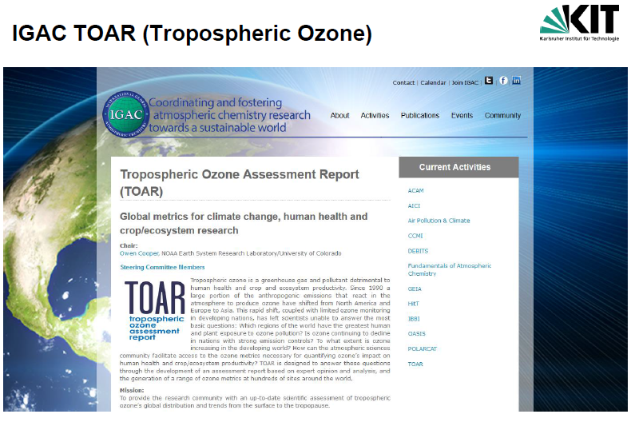
3. Plans to engage with clm res.
ESA / Frascati
8+9 October 2015
in association with
AEROCOM and CCMI
-> interaction with modelers
GHG
Aerosols
OBS4MIP
AEROSAT WS
Ozone
CLD:
OBS4MIP

Slide 8
4. Common issues
-> see presentation in SL meeting by Thomas
(consistency analysis)

