Slide 1
CCI Open Data Portal: update on progress
CMUG Integration Meeting
March 2016
Victoria Bennett and the CCI ODP Team

Slide 2
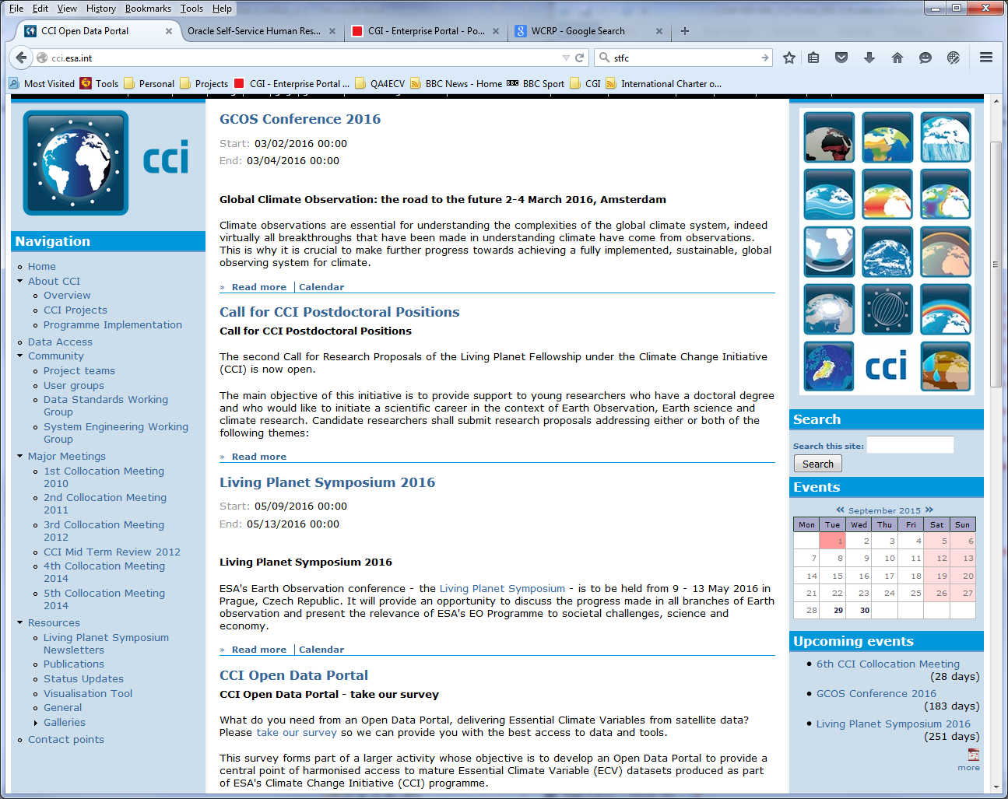
Website

Slide 3
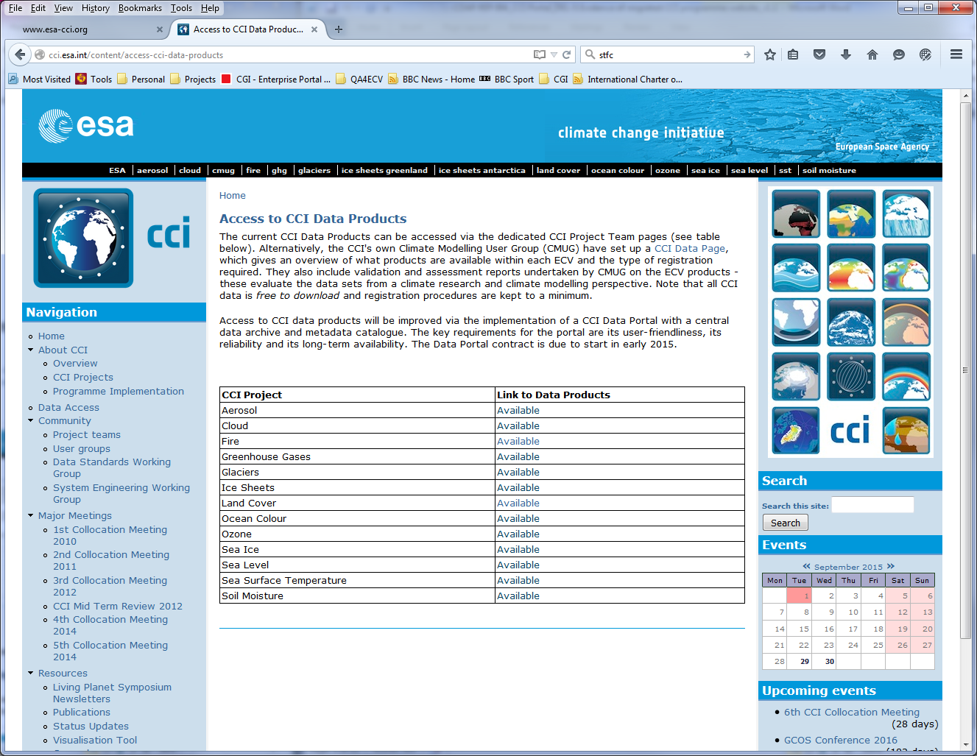

Slide 4
Archive
ECV | Volume | Notes | Version
aerosol | 0.2 TB | L2 and L3 products | various
cloud | 8.1 TB | L3C, L3S and L3U phase1_v1.0 | v1.0 (v2.0)
fire | 4.7 GB | burned_area grid and pixel | v3.1
ghg | 23.0 GB | L2 xch4, xco2 products (CRDP_2) | various
glaciers | 6.8 MB | rgi50 | V5.0
ice sheets greenland | 1.0 GB | surface_elevation_change, ice_velocity, calving_front_locations, grounding_line_locations | v1.0
land cover | 17 GB | 300m global LC Maps | 1.6.1
ocean colour | 30 TB | v1-release, geographic and sinusoidal | v1.0
ozone | 1.4 GB | L3 total_columns, limb_profiles, nadir_profiles | various
sea ice | 0.2 TB | sea_ice_concentration L4 products | v1.11
sea level | 1.5 GB | IND and L4 MSLA products | v1.1
soil moisture | 45 GB | daily_files ACTIVE, COMBINED, PASSIVE | v02.1, v02.2
sst | 3.7 TB | L4 Analysis, L3U ATSR, L2P AVHRR | v01.0, v01.1
total | 42.3 TB

Slide 5
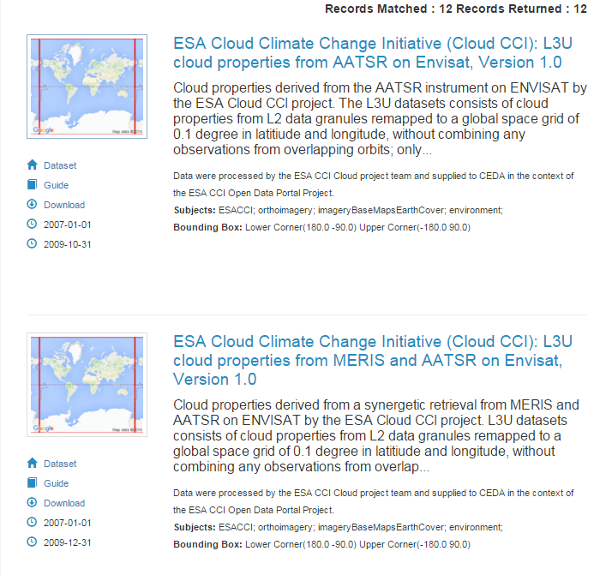
Catalogue records

Slide 6
Catalogue records
Include:
  Dataset description (title and abstract)
  Links to external documentation, papers, websites
  Authors
  Citation text
  Spatial / temporal coverage
  Keywords

Slide 7
How can you help?
Consistency – data standards
Feedback on catalogue records
Data release schedule
Follow the data standards
  Format
  Metadata attributes
  Controlled vocabularies
  Directory structure
Product version conventions
Tidy data + clear documentation = more users!

Slide 8
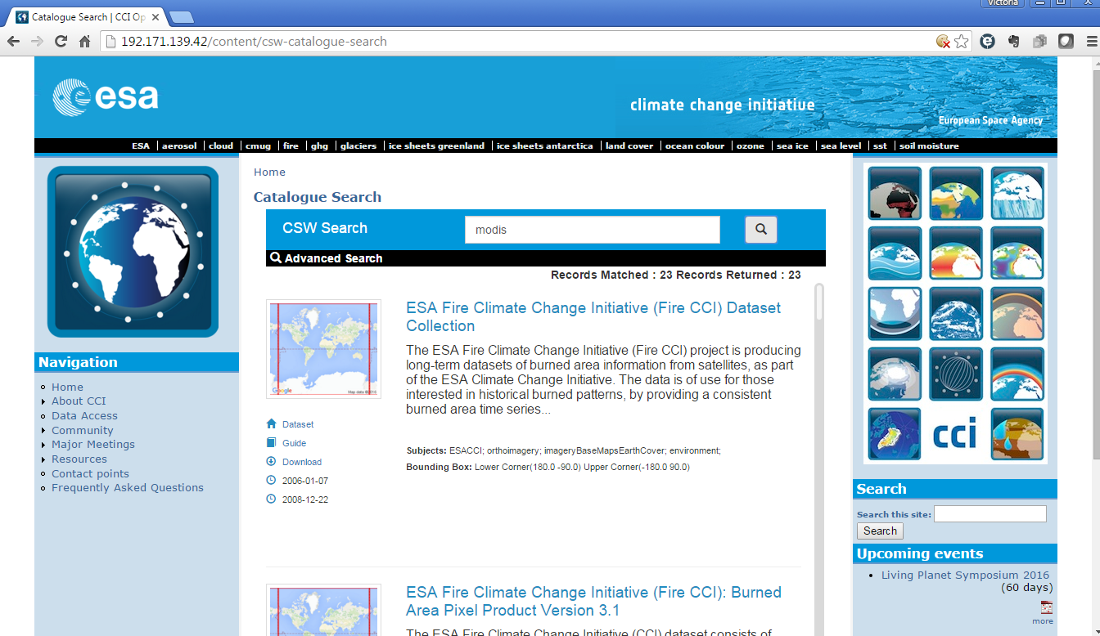
Catalogue: freetext search

Slide 9
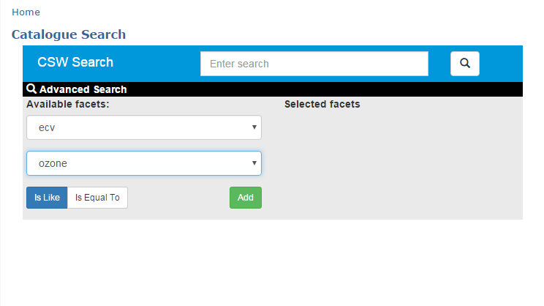
Catalogue: faceted search
Facets:
ECV
Frequency
Platform
Sensor
Processing Level
Data Type
Organisation

Slide 10
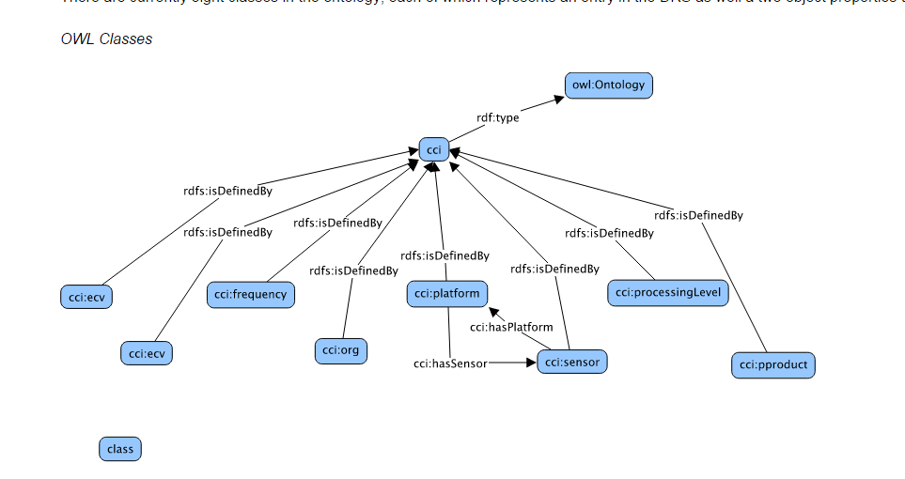
Vocabularies

Slide 11
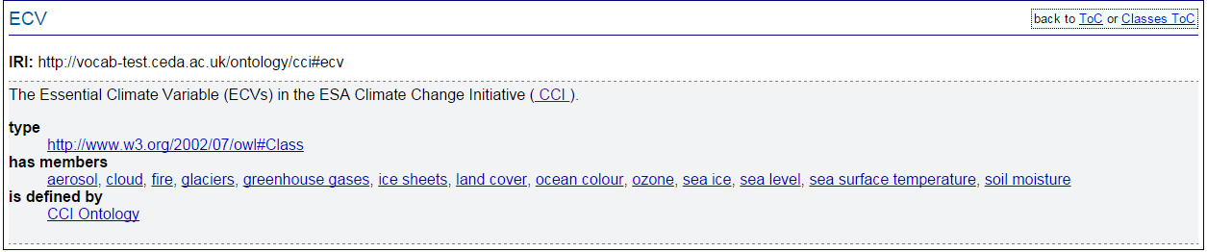
Vocabularies

Slide 12
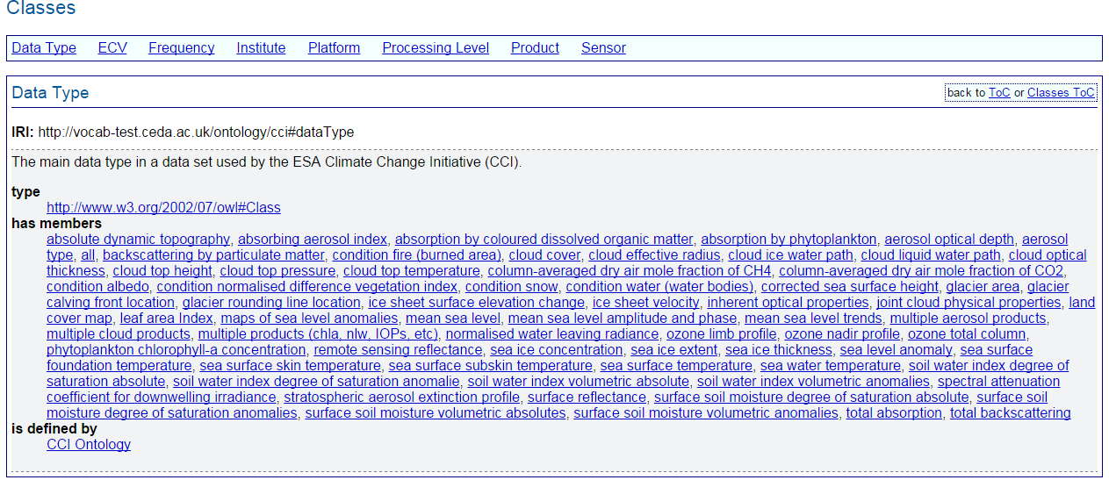
Vocabularies

Slide 13
Facets
Frequency from data in net cdf file
Institute from data in net cdf file
Platform from data in net cdf file
Sensor from data in net cdf file
CCI Project from file name
Data Type from file name
Processing Level from file name
Product from file name
Product Version from file name
NB These terms have to be extracted by machine – there are over 750,000 files in the archive, over 100 catalogue records/individual datasets

Slide 14
Platform
Not in vocab
  AATSR(ENVISAT)
    Should be ENVISAT
  AVHRR(NOAA-15,NOAA-16,NOAA-17,NOAA-18)
    Should be NOAA-15,NOAA-16,NOAA-17,NOAA-18
  ENV
    Should be ENVISAT
  MODIS(Aqua, Terra)
    Should be Aqua, Terra
  N/A
  Nimbus 7
    Should be Nimbus-7
  Orbview-2/SeaStar
    Should be Orbview-2
  merged: ERS-2, ENVISAT, EOS-AURA, METOP-A
    Should be ERS-2, ENVISAT, AURA, MetOpA

Slide 15
Sensor
Not in vocab
  AMSR-E
  ATSR-2
  AVHRR_MERGED
  GAC
  GFO
  MERGED
  MERISAATSR
  MODIS_MERGED
  N/A
  RA2
  SMR_544.6GHz
  VARIOUS
  merged: GOME, SCIAMACHY, OMI and GOME-2.

Slide 16
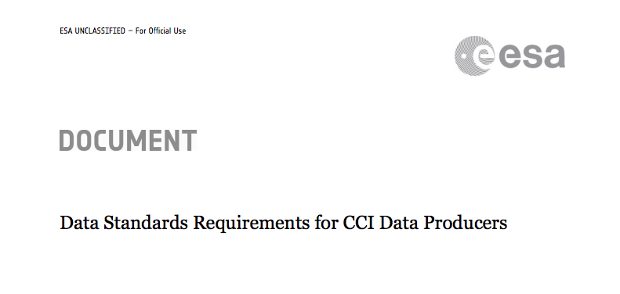
How can you help?
Follow the Data Standards
  Document available here:
    http://cci.esa.int/content/data-standards-working-group
Ask us if you’re not sure

Slide 17
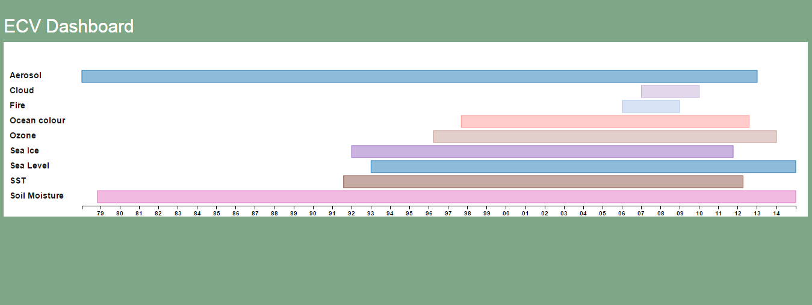
Dashboard

Slide 18
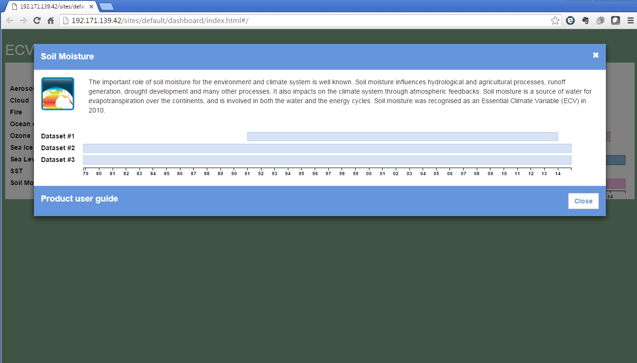
Dashboard

Slide 19
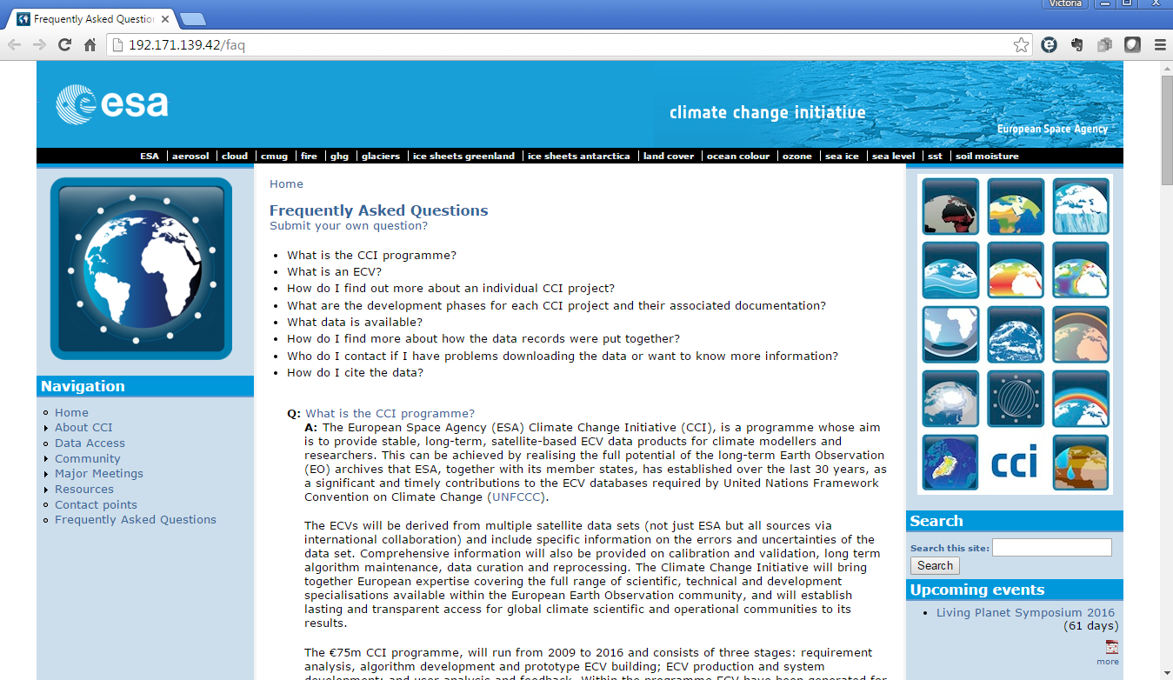
FAQs

Slide 20
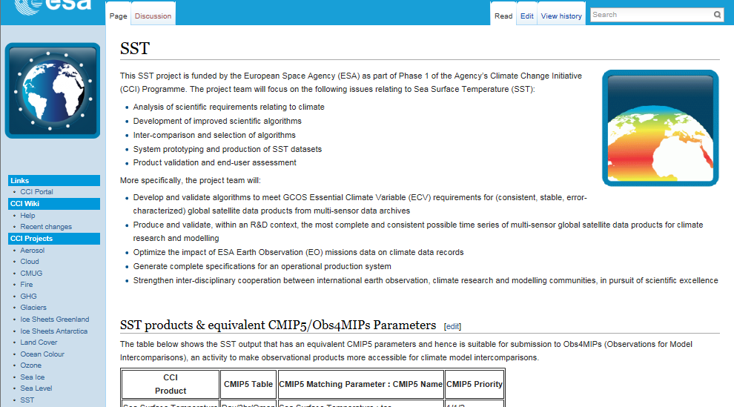
Helpdesk, Wiki
Email helpdesk for portal users
Wiki – can be edited by registered users

Slide 21
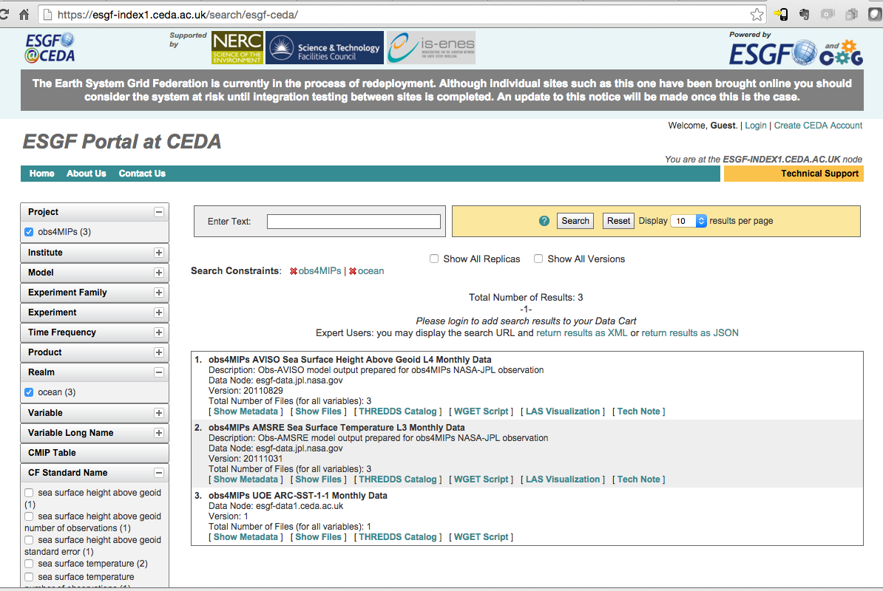
Data download methods
FTP
HTTP
OPeNDAP
WCS (server)
WMS (server and client)
ESGF

Slide 22
Usage stats: website

Slide 23
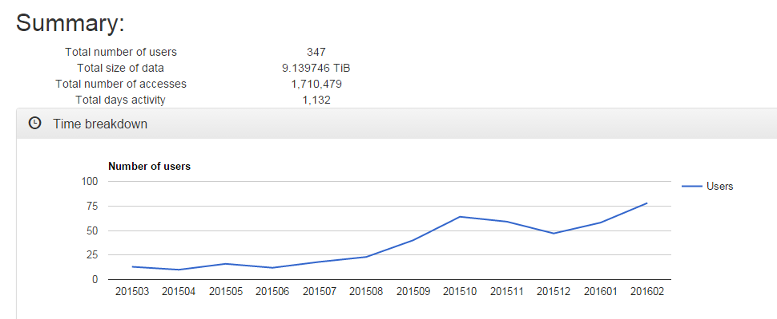
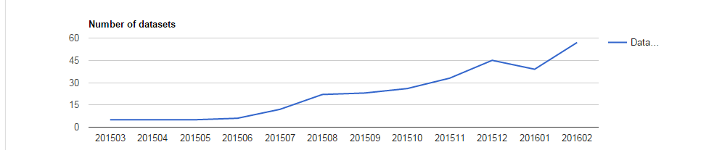
Data download stats (2015-03 to 2016-02)

Slide 24
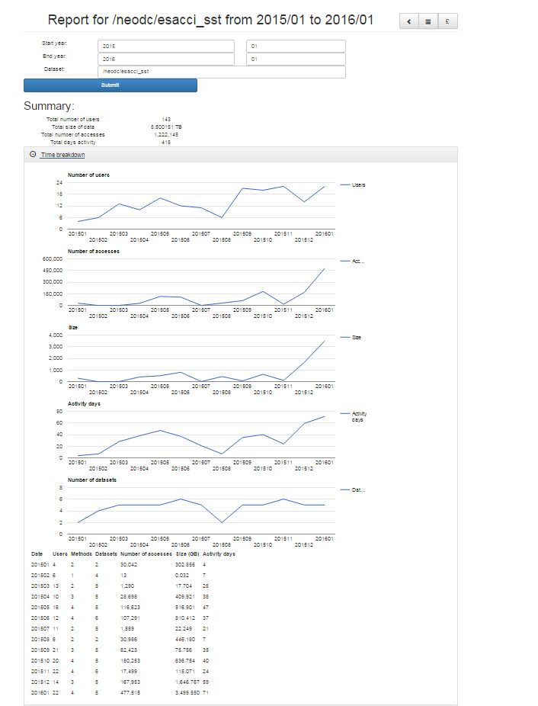
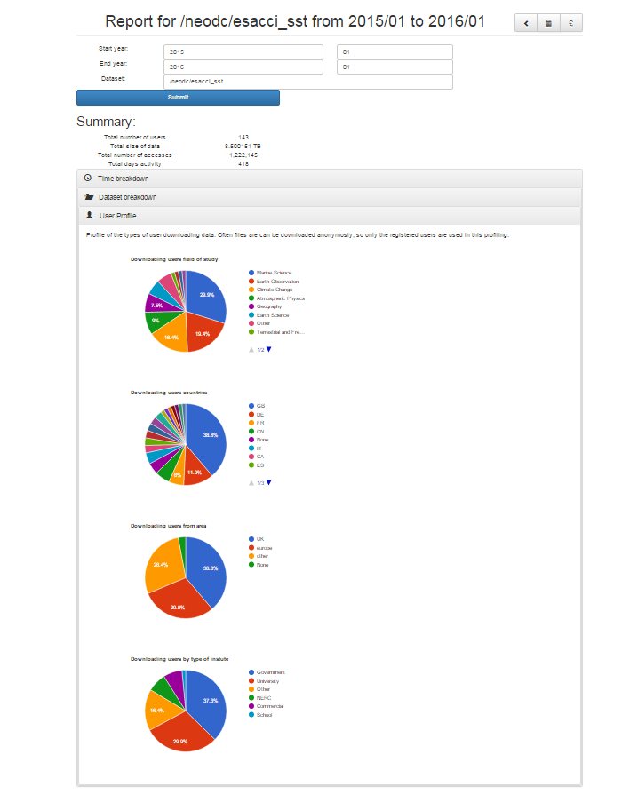

Slide 25
Feedback
Talk to us (here, Living Planet Symposium, email)
Open invitation to comment on portal via the helpdesk (from May)
Engagement activities in Y2 and Y3
Thank you

