Slide 1



Inputs to ESA CCI Sixth Integration meeting
WP3.9 Assessment of glacier, land cover and (sea level) data for hydrological modeling of the Arctic ocean drainage basin
David Gustafsson, Kristina Isberg, Jörgen Rosberg
SMHI
10 March 2016

Slide 2

Objectives
Assess the use of ESA CCI Glacier, Land cover (and Sea level) in hydrological modelling for the Arctic:
Compare CCI data with existing datasets: long term trends and seasonal variations?
Can use of CCI Glacier and Land cover improve simulated river runoff to the Arctic Ocean?
Is there a relation between changes in observed land cover and the simulated river runoff?

Slide 3
Progress since May 2015
Arctic-HYPE Pan-Arctic hydrological model updated using CCI land Cover v1.4 and CCI Glacier (RGI v4.0) – (version available in May 2015)
Additional information added after recommendation from CCI teams:
  Glacier volumes adapted to regional estimates published by Huss&Farinotti (2012)
    – still CCI glacier does not provide consistent information on the temporal development of glacier area and volume which is needed to initialize and evaluate glacier hydrological models in a climate change perspective!
Re-calibration is still on-going and comparison with previous model versions with regard to improved understanding of the arctic hydrology is still in progress.
Main improvements so far:
  Much improved representation of glacierized area and volume compared to previous model versions
  Improved representation of surface water areas – however, we believe the total surface water area is still underestimated in v1.4 (see next slides)

Slide 4
Plans until June 2016
Evaluate impact of Arctic-HYPE model updated with CCI data (land cover and glacier) with regard to longterm simulation of key water storages and fluxes in pan-arctic region
Evaluate if temporal changes in land cover in CCI data (mainly decideous needle leef forest in Siberia) is also reflected in the hydrology (biases between model and observations)
Evaluate the impact of increase amount and details in surface water area in Land cover v1.6 vs v1.4

Slide 5
January 2016 - New release of data from ESA CCI
3 new global LC maps version 1.6.1 with improved representation of lichen and mosses, deforestation patterns in Republic Democratic of Congo and water bodies;
1 new global static map of open water bodies version 4.0 at 150 m spatial resolution;
Data is available here:
http://maps.elie.ucl.ac.be/CCI/viewer/download.php
This data was downloaded 20160307
Land Cover Maps - v1.6.1
2008-2012 epoch - v1.6.1 (tif, 7z) - 2.8Go (previous used v1.3)
2003-2007 epoch - v1.6.1 (tif, 7z) - 2.8Go (previous used v1.4)
1998-2002 epoch - v1.6.1 (tif, 7z) - 1.7Go (previous used v1.4)
3-epoch series of global land cover maps at 300m spatial resolution, where each epoch covers a 5-year period (2008-2012, 2003-2007, 1998-2002).
Water Bodies - v4.0
Water Bodies v4.0 (tif) - 296Mo
Static map of open water bodies at 150 m spatial resolution resulting from a compilation and editions of land/water classifications: the Envisat ASAR water bodies indicator, a sub-dataset from the Global Forest Change 2000 - 2012 and the Global Inland Water product.
This product is delivered at 150 m as a stand-alone product but it forms class "Water Bodies" of the LC Maps v1.6.1 after resampling to 300 m using an average algorithm.
The product consists of 1 classification layer with legend : 1-Land, 2-Water

Slide 6
Conclusions from Progress meeting, SMHI 26-28/5 2015
CCI Land cover v1.3-1.4 (2000, 2005, 2010)
Improved snow and ice area
  (comp to Globcover)
  Increased water surface area
  (comp to Globcover)
  Interesting trends in Arctic forest vegetation
Current limitations:
  Static Surface water and Glacier information
Conclusions from v1.6 evaluation 8/3 2016
CCI Land cover v 1.6
  The CCI glaciers (RGI glaciers) are still not inserted to the Land cover with correct resolution.
  Water surface area has improved and for Arctic-HYPE domain it increases.
  Still trends (2000-2010) in Arctic forest vegetation (larch)
  Changes in several other classes both globally and in particular for Arctic-HYPE domain: lichens and mosses, needle leaved forest, different types of shrublands/sparse vegetation/bare land
Current limitations
  Still static water and glacier information
  It would be a large advantage if the waterbodies could be separated into rivers (at least for the largest rivers) and lakes and perhaps also ocean.
Conclusions from Progress meeting at SMHI 26-28/5 2015
CCI Glacier very useful for hydrological modelling:
  setup and evaluation of glacier area and volume
  Very high resolution and level of detail
  Global coverage
Current limitations:
  Time series missing in RGI dataset
    needed for initialization, calibration, evaluation of long term modelling
  Users may compile information from other data sets:
    GLIMS/WGMS/litterture/etc.
No changes –
our comments remains

Slide 7
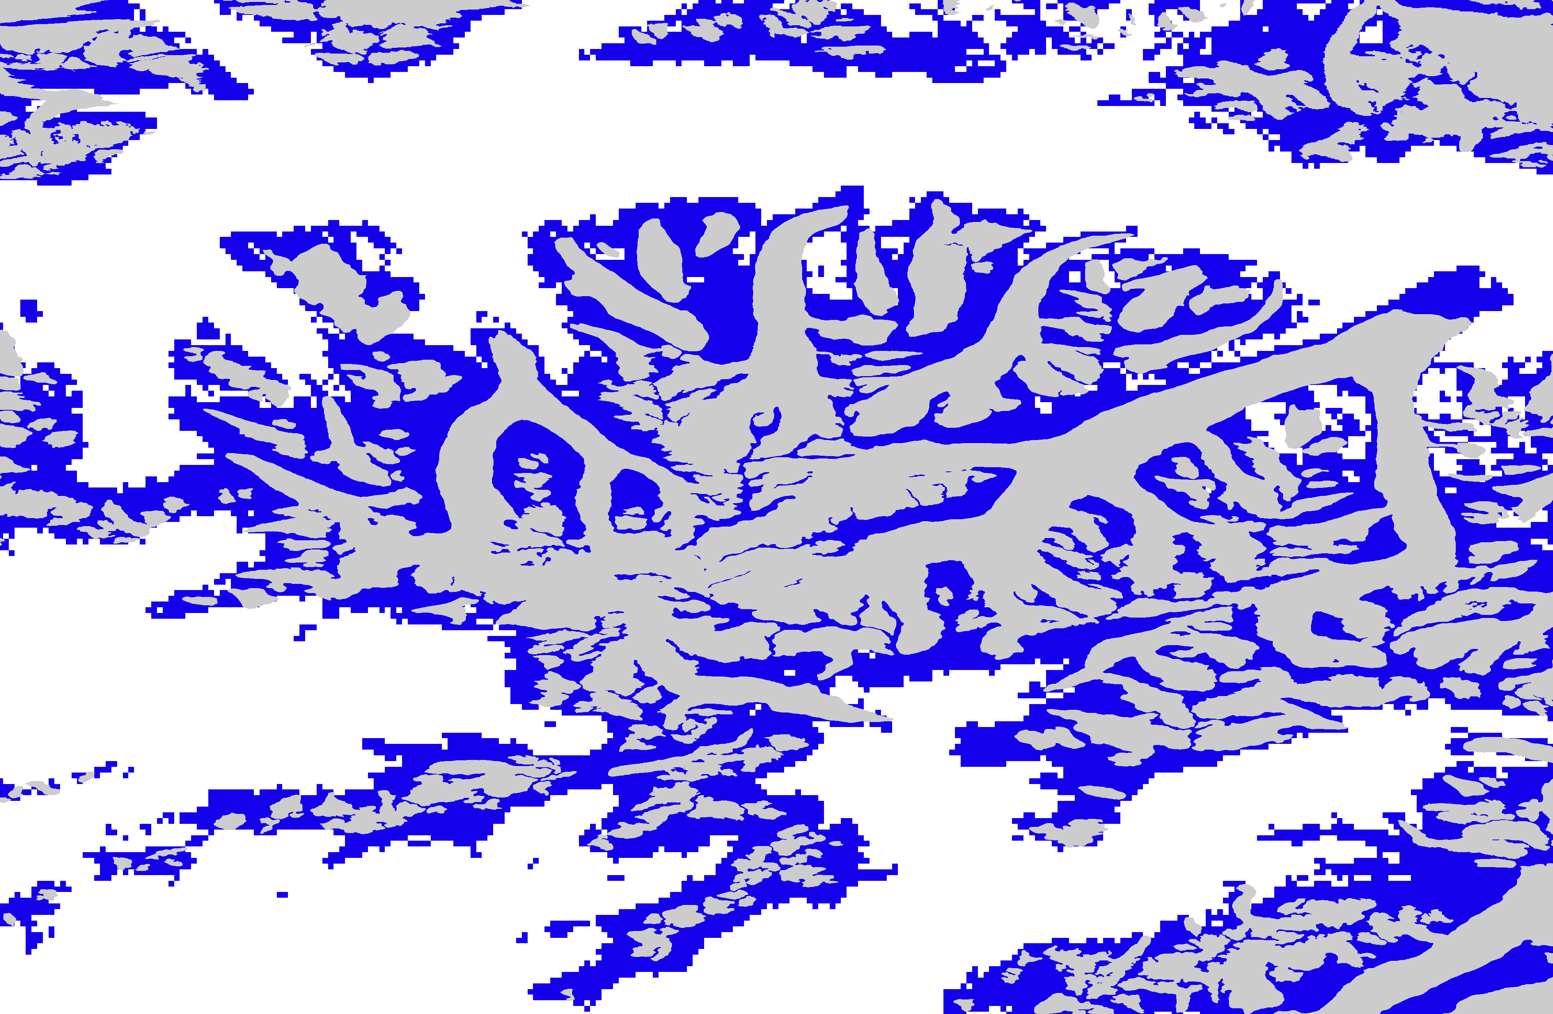
The CCI glaciers (RGI v 4.0) are still not inserted to the Land cover with correct resolution.
ESA CCI Landuse v 1.6 still gives (like v 1.4) ~30% larger area than CCI glacier (RGI v 4.0)
Part of glacier in Alaska
Glaciers in ESA CCI Landcover 2010 version1.6
Glaciers in RGI v 4.0
Results:
The RGI glaciers should be represented better.
=> The land cover class ”Permanent Snow and ice” could perhaps be separated into two classes: Glaciers and Permanent snow (or similar).

Slide 8
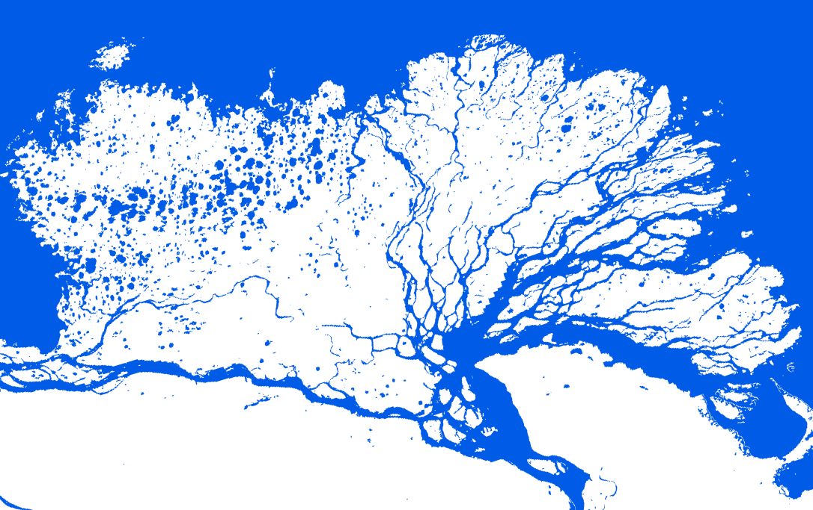
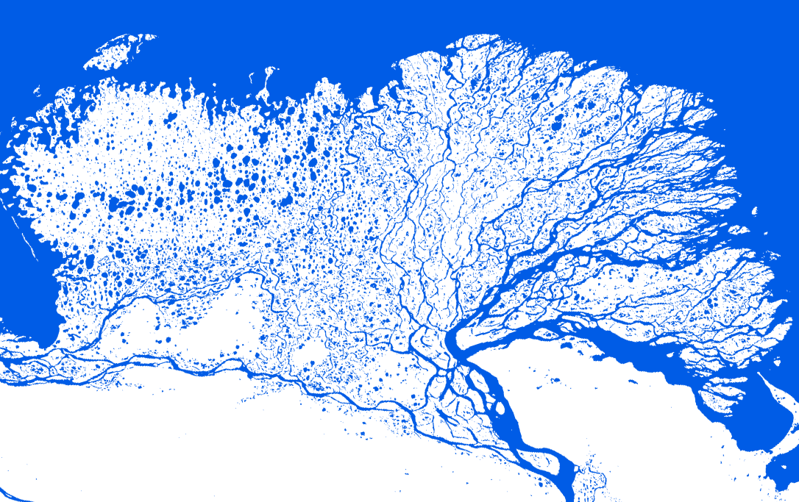
The landuse class Waterbodies has improved resolution
The waterbodies are now based on the new stand alone product for waterbodies (ESACCI-LC-L4-WB-Map-150m-P13Y-2000-v4.0.tif) which is prepared with a resolution of 150m instead of 300 m. In the ESA CCI LU v1.6 it is resampled to 300m but still show an improved picture of the waterbodies in two ways:
A. Rivers and smaller lakes which did not exist before appears => increased area
B. Very broad rivers increase their resolution => decrease in area
Results:
The total amount of waterbodies over the world remains the same.
For Arctic-HYPE domain it would be an increase from 1.10 million km2 to 1.38 million km2 .
=> decrease in several other classes
We think this is an improvement!
V 1.4
V 1.6

Slide 9
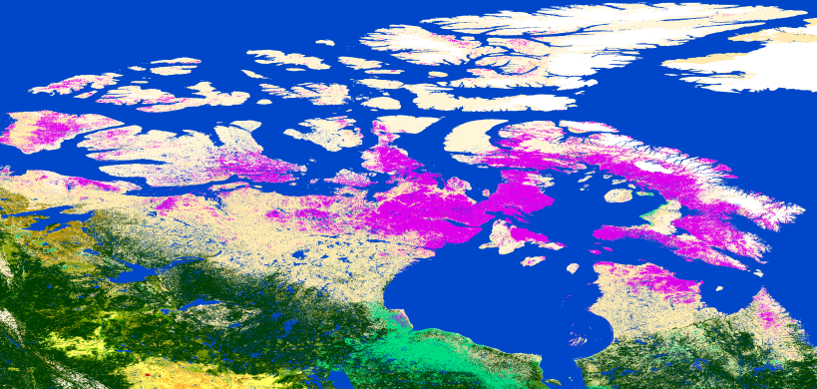
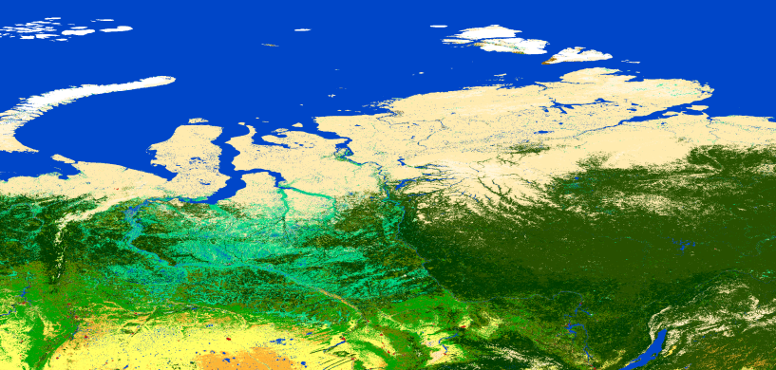
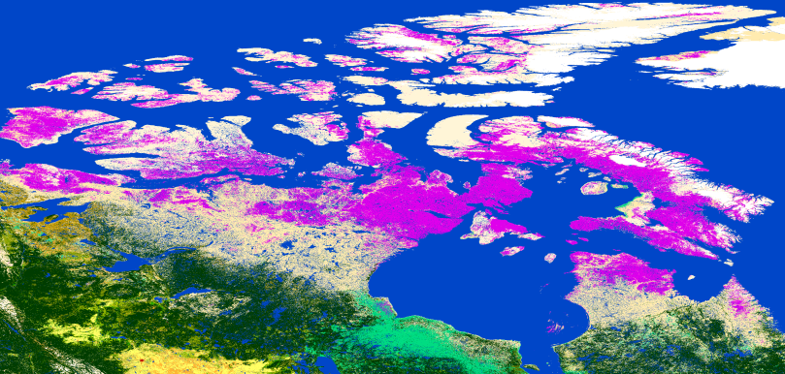
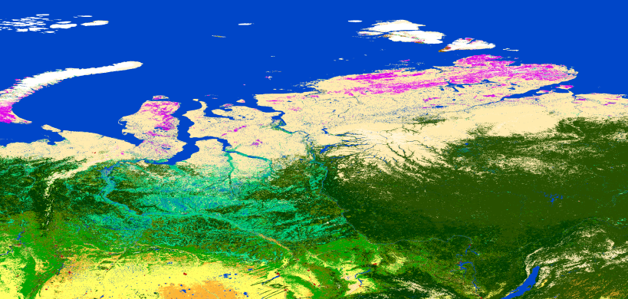
Increased amount of lichens and mosses
Northern Canada
Northern Russia
V1.4
V1.6
Results:
Lichens and mosses is a landcover class which has increased a lot for the Arctic domain with version 1.6
=> several other classes like sparse vegetation, bare areas, shrubland and also evergreen tree cover has therefore decreased.
=> We think this is an improvement and that we probably should separate land cover classes bare land and open land in the Arctic-HYPE model into three and use this information better .

Slide 10
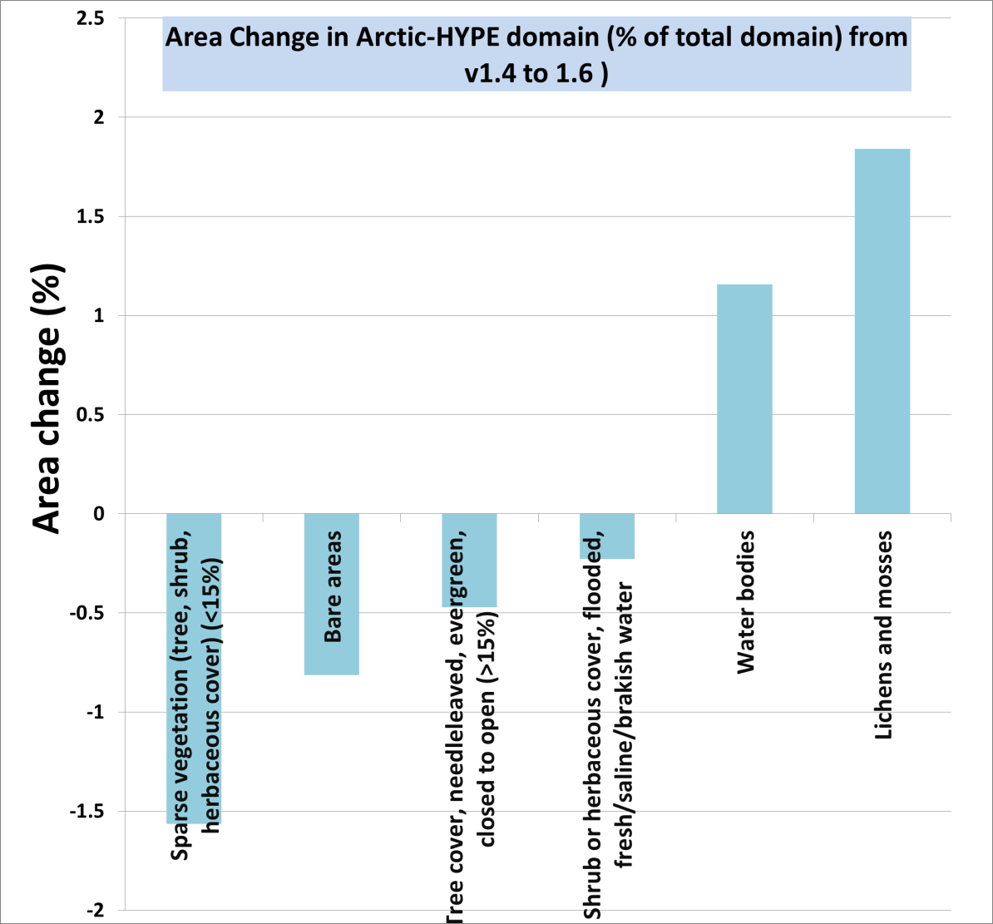
Largest changes for Arctic domain using v 1.6 instead of v 1.4
1% = 235 000 km2

