Slide 1
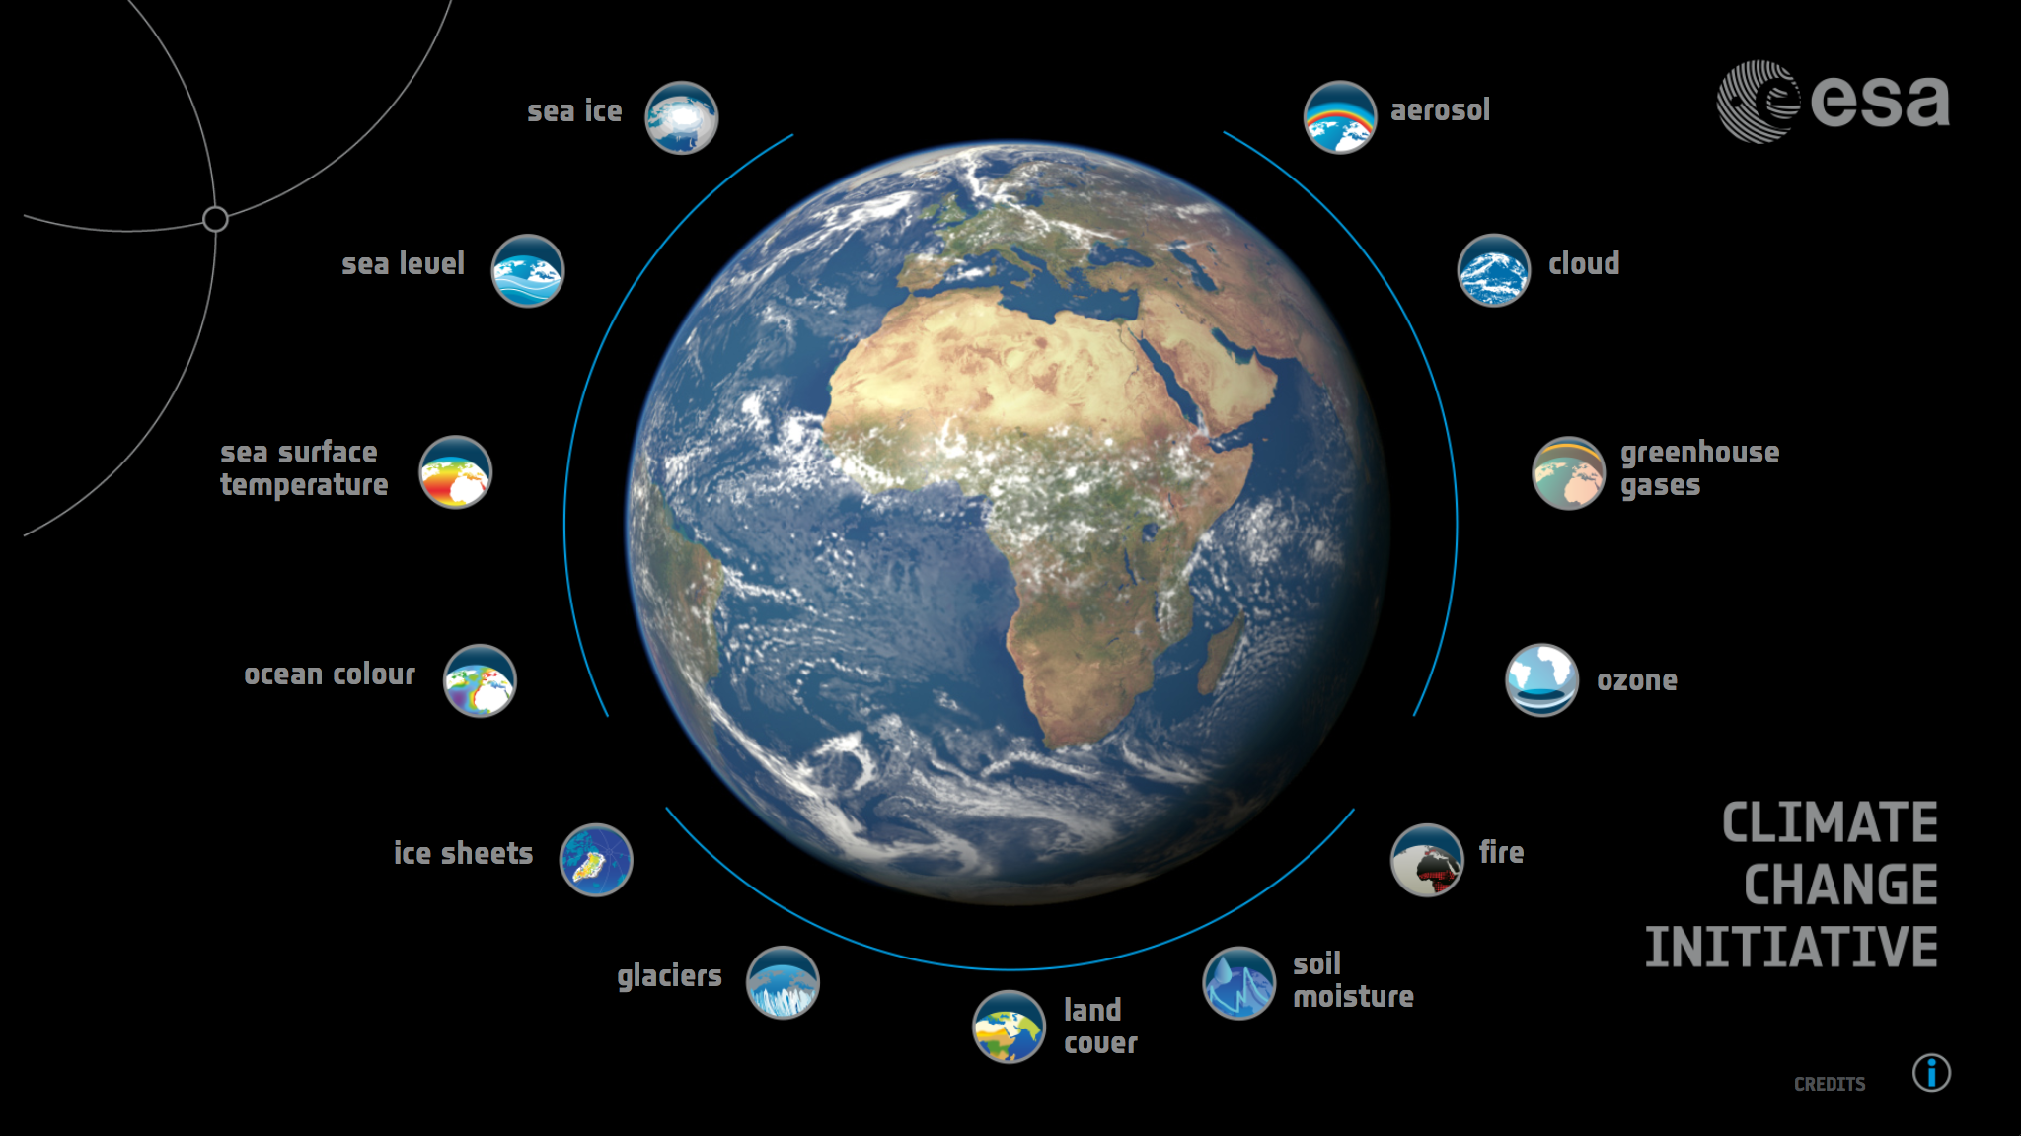
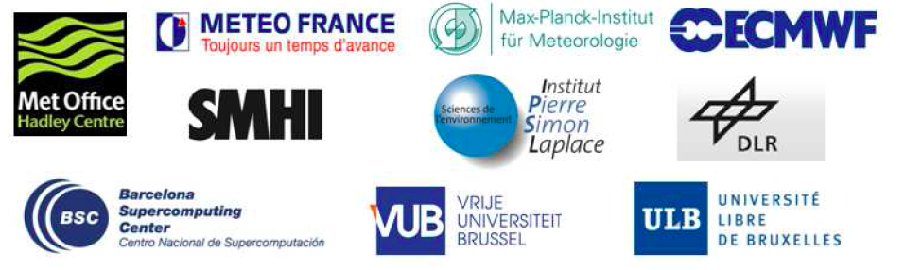
CCI-CMUG 7th Integration Meeting

Slide 2
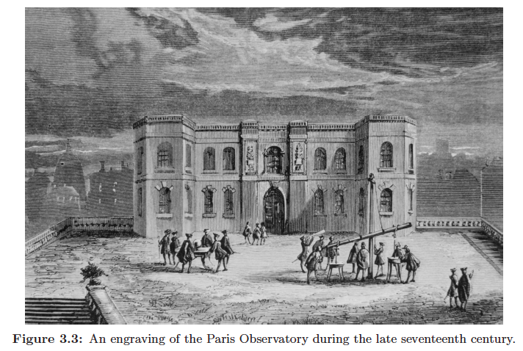
CCI-CMUG 7th Integration Meeting
Paris Observatory during late 17th century

Slide 3
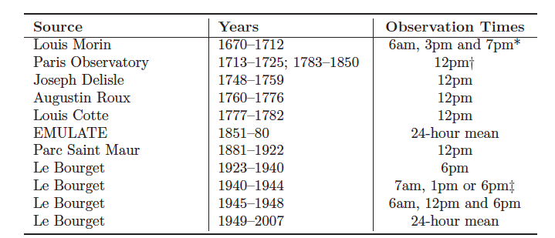
Paris surface temperature record
The observation times of the component Paris series.

Slide 4
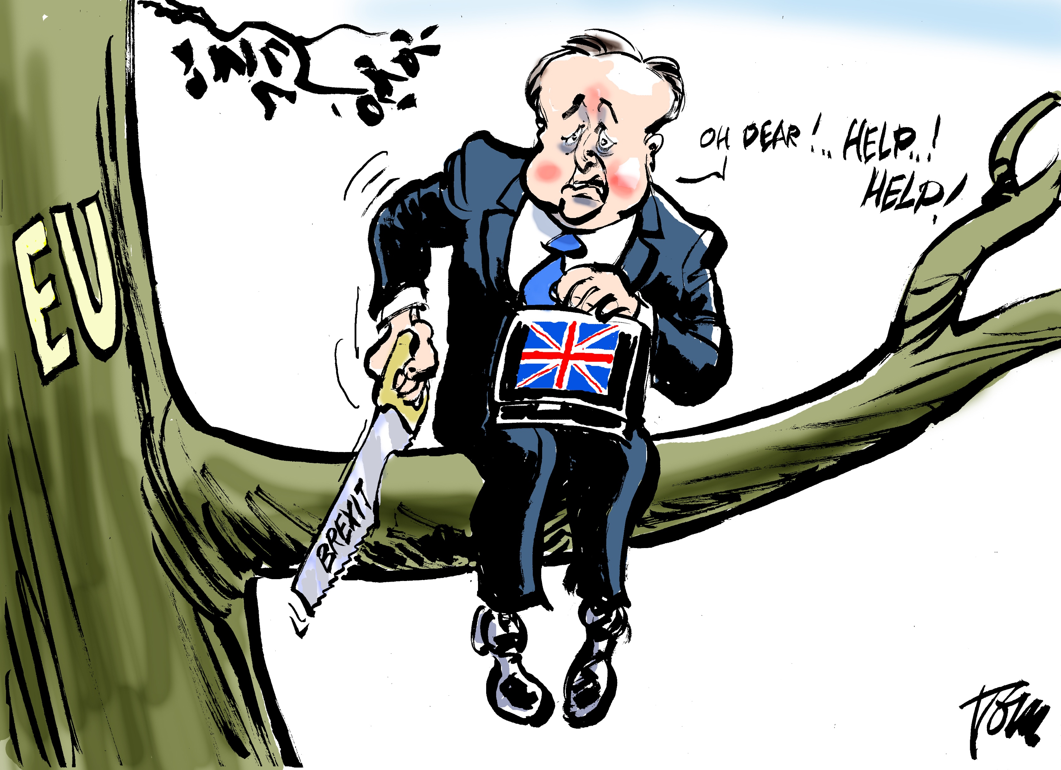
Brexit

