Slide 1
Fire / Soil Moisture
Stiig Wilkenskjeld, Gitta Lasslop
Silvia Kloster
Max-Planck-Institute for Meteorology
Hamburg

Slide 2
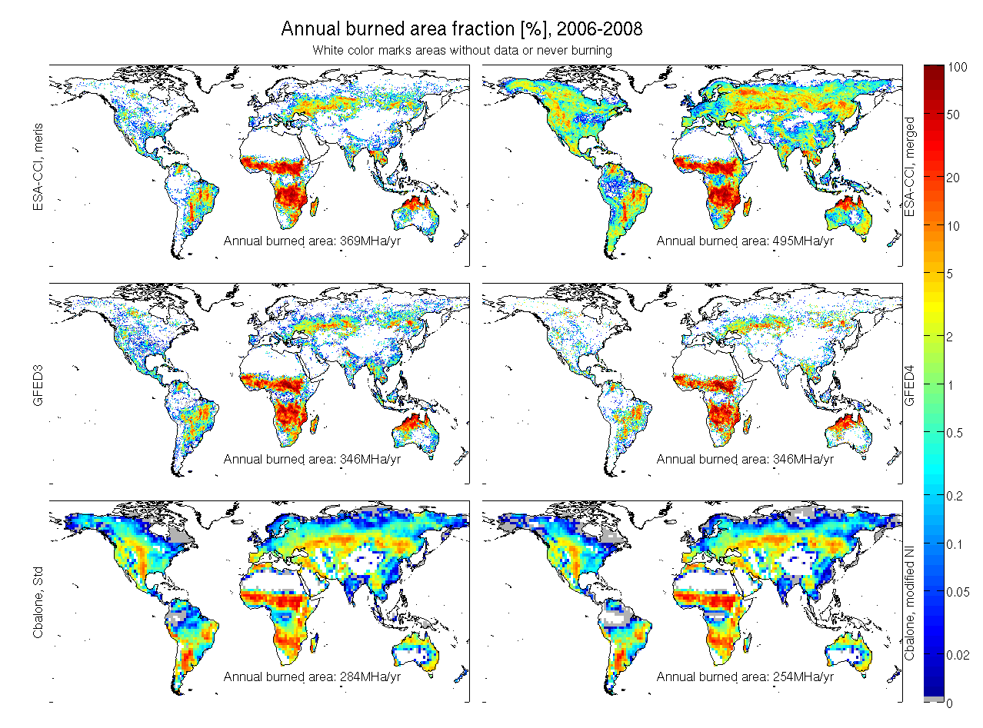
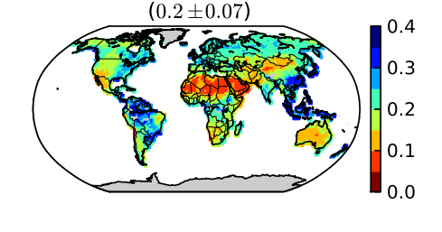
Fire – Soil Moisture
ESA CCI
CCI SM
&
GFEDv3
GFEDv4

Slide 3
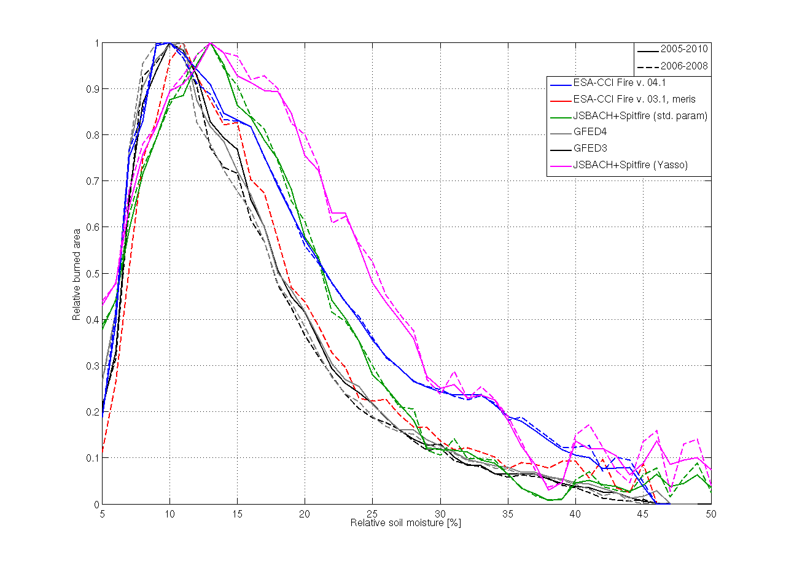
Fire – Soil Moisture
relative burned area []
Relative soil moisture [%]

Slide 4
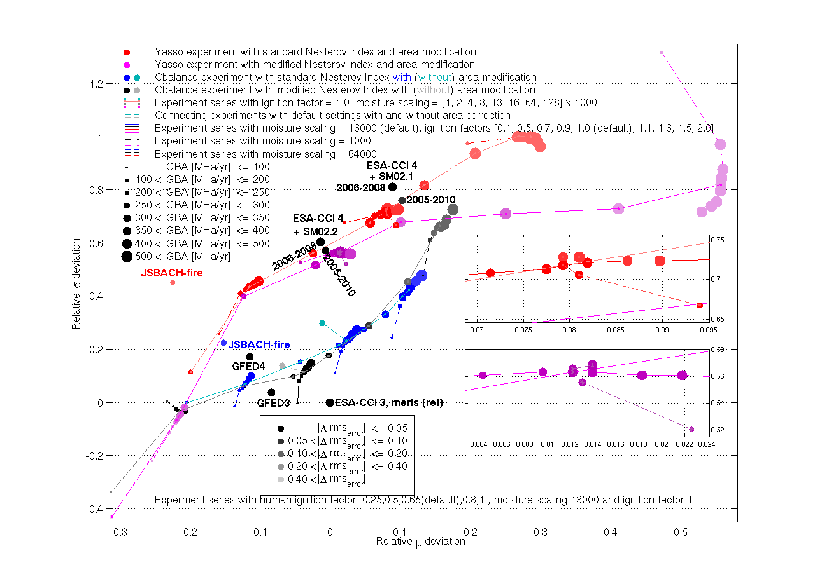
Fire – Soil Moisture
Relative width deviation []
Relative peak deviation []

Slide 5
Fire – Soil Moisture
Relative width deviation []
Relative peak deviation []
MPI-ESM / CMIP6 simulations

Slide 6
Fire – Burned area → Carbon Emissions
Burned Area
Biomass consumed
Fire Emissions

Slide 7
Fire – Burned area → Carbon Emissions
Burned Area
Biomass consumed
Fire Emissions
Fire CCI v 4.1
2005 – 2011
0.25 x 0.25
Bi-weekly

Slide 8
Fire – Burned area → Carbon Emissions
Burned Area
Biomass consumed
Fire Emissions
Fire CCI v 4.1
2005 – 2011
0.25 x 0.25
Bi-weekly
Vegetation Model
JSBACH (MPI-ESM)
what is burning (tree/grass)?
how much is burning ?
did the fire kill the tree?
what happened before 2005?

Slide 9
Fire – Burned area → Carbon Emissions
Burned Area
Biomass consumed
Fire Emissions
Fire CCI v 4.1
2005 – 2011
0.25 x 0.25
Bi-weekly
Vegetation Model
JSBACH (MPI-ESM)
what is burning (tree/grass)?
how much is burning ?
did the fire kill the tree?
what happened before 2005?

Slide 10
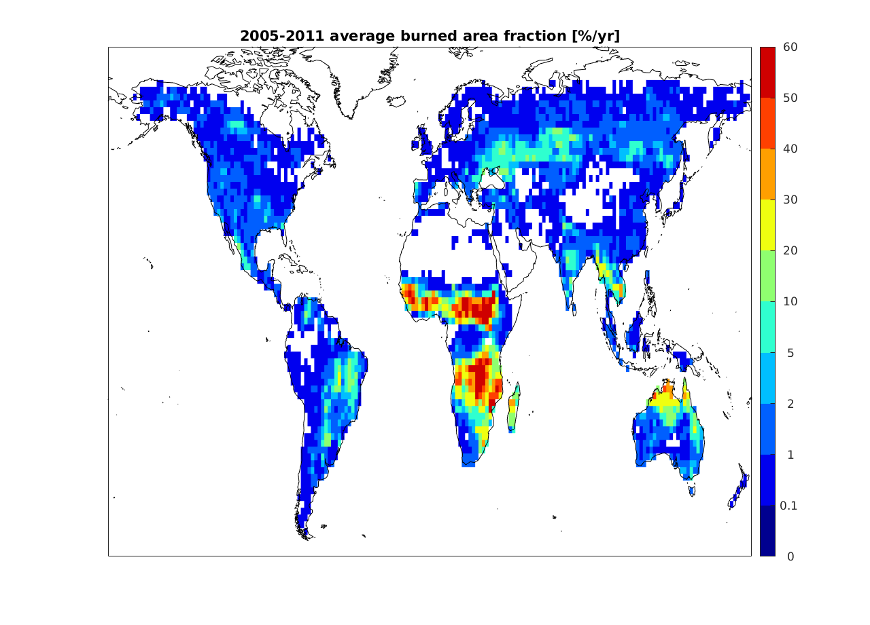
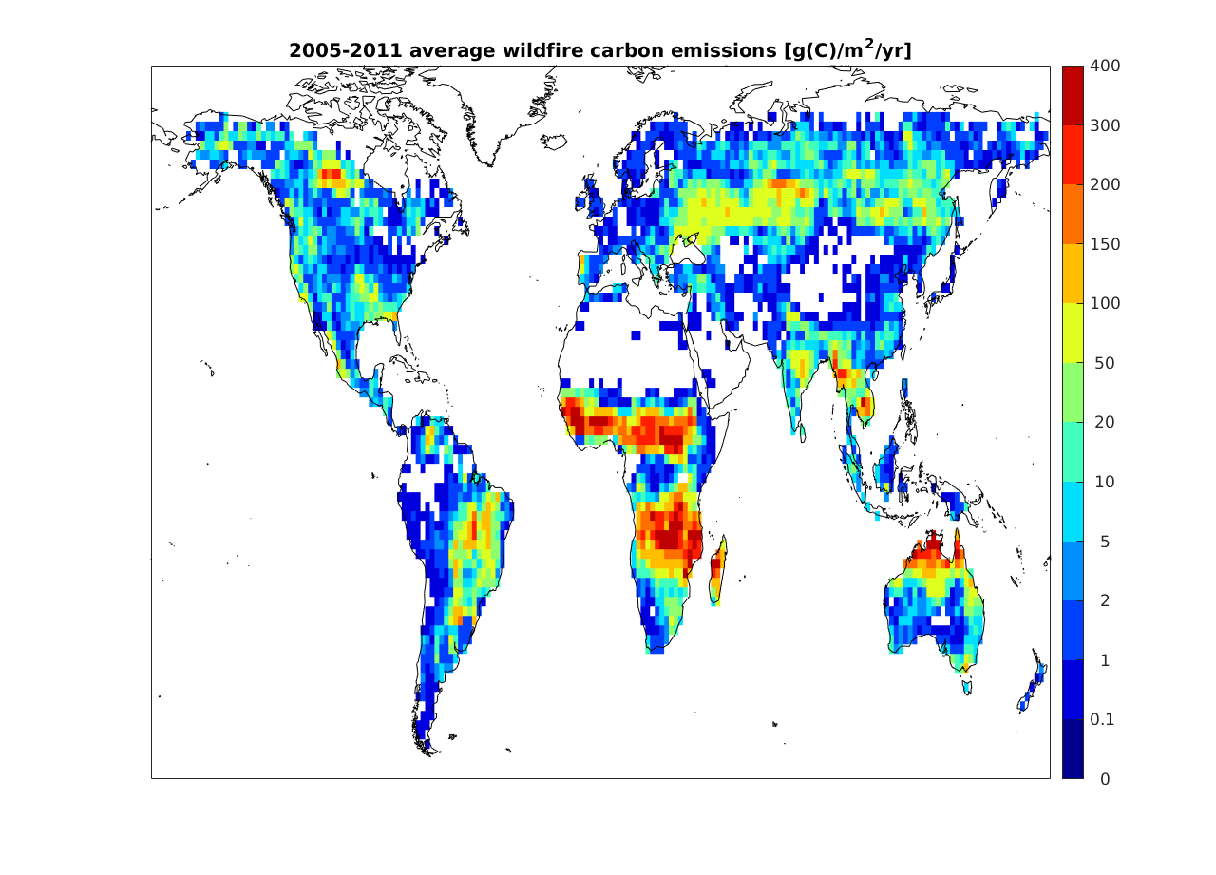
Fire – Burned area → Carbon Emissions
burned area
346 Mha
C emissions
2.19 PgC/year

Slide 11
Fire – Burned area → Carbon Emissions
burned area
346 Mha
C emissions
2.19 PgC/year
GFED4s: 402 Mha 2.18 PgC/year
(van der Werf in prep.)

Slide 12
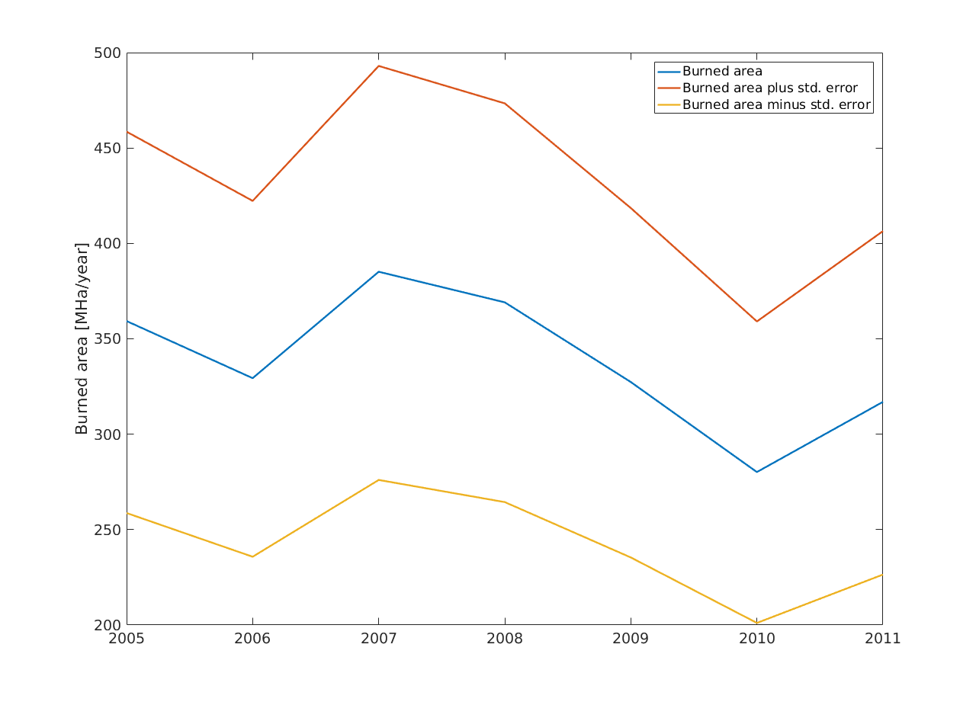
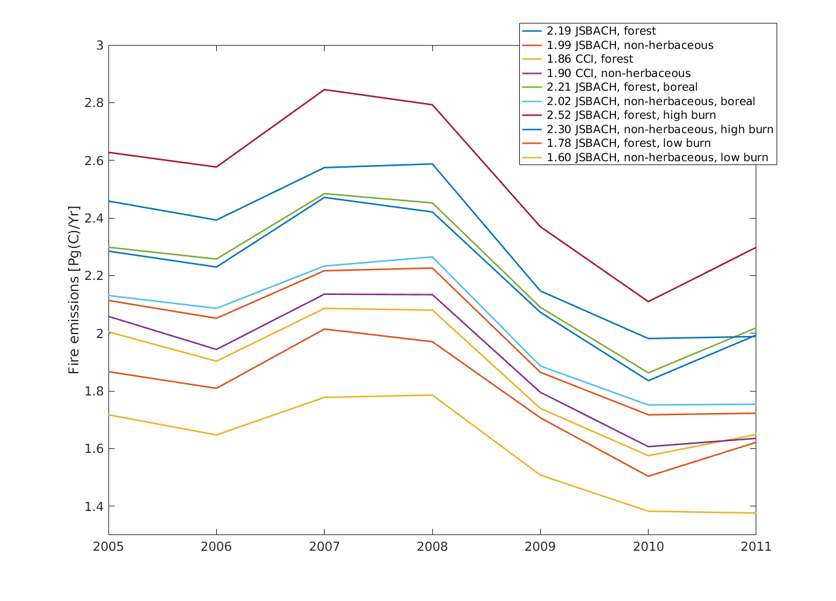
Fire – Burned area → Carbon Emissions
burned area
2005 - 2011
C emissions
2005 - 2011
2005. 2006. 2007 2008 2009. 2010 2011
2005. 2006. 2007 2008 2009. 2010 2011

Slide 13
Fire – Burned area → Carbon Emissions
Simulation | Burned Area | Land Cover | Combustion completeness | Fire Carbon Emission [PgC/year]
JSBACH | FIRE CCI | JSBACH | f(soil moisture), max=0.3 | 2.19
CCI | FIRE CCI | LC CCI | f(soil moisture), max=0.3 | 1.86
JSBACH_Boreal | FIRE CCI | JSBACH | f(soil moisture), boreal = 0.6 | 2.21

Slide 14
Fire – Burned area → Carbon Emissions
Simulation | Burned Area | Land Cover | Combustion completeness | Fire Carbon Emission [PgC/year]
JSBACH | FIRE CCI | JSBACH | f(soil moisture), max=0.3 | 2.19
JSBACH + | FIRE CCI + uncertainty | JSBACH | f(soil moisture), max=0.3 | 2.52 (+15 %)
JSBACH - | FIRE CCI - uncertainty | JSBACH | f(soil moisture), max=0.3 | 1.78 (-19%)
Burned area Min= 248 Mha / Max = 444 Mha +/- 28%

Slide 15
Summary / Outlook
ESA CCI burned area as boundary condition in JSBACH → fire emissions
  Consistency between FIRE CCI and LC CCI assures that models burn
  the correct trees
use new release of FIRE CCI (2000 – 2016)
ESA CCI burned area as boundary conditions in Vegetation Models
  Model intercomparison
  Protocol development
Transport fire emissions → compare to ESA CCI GHG

Slide 16
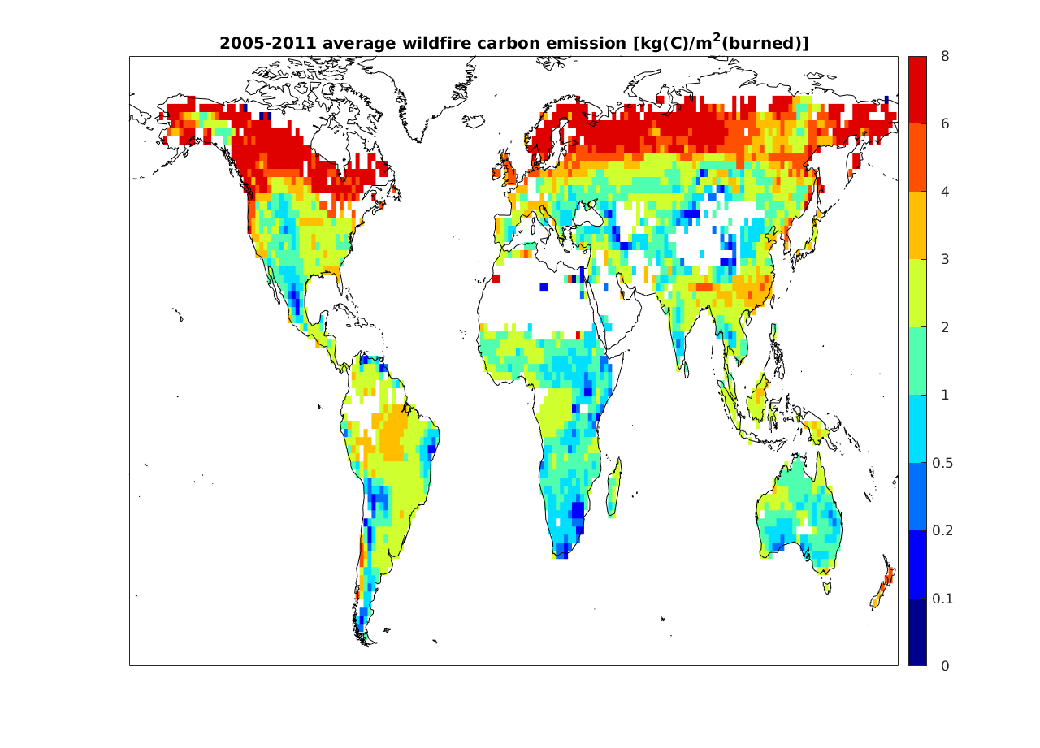

Slide 17
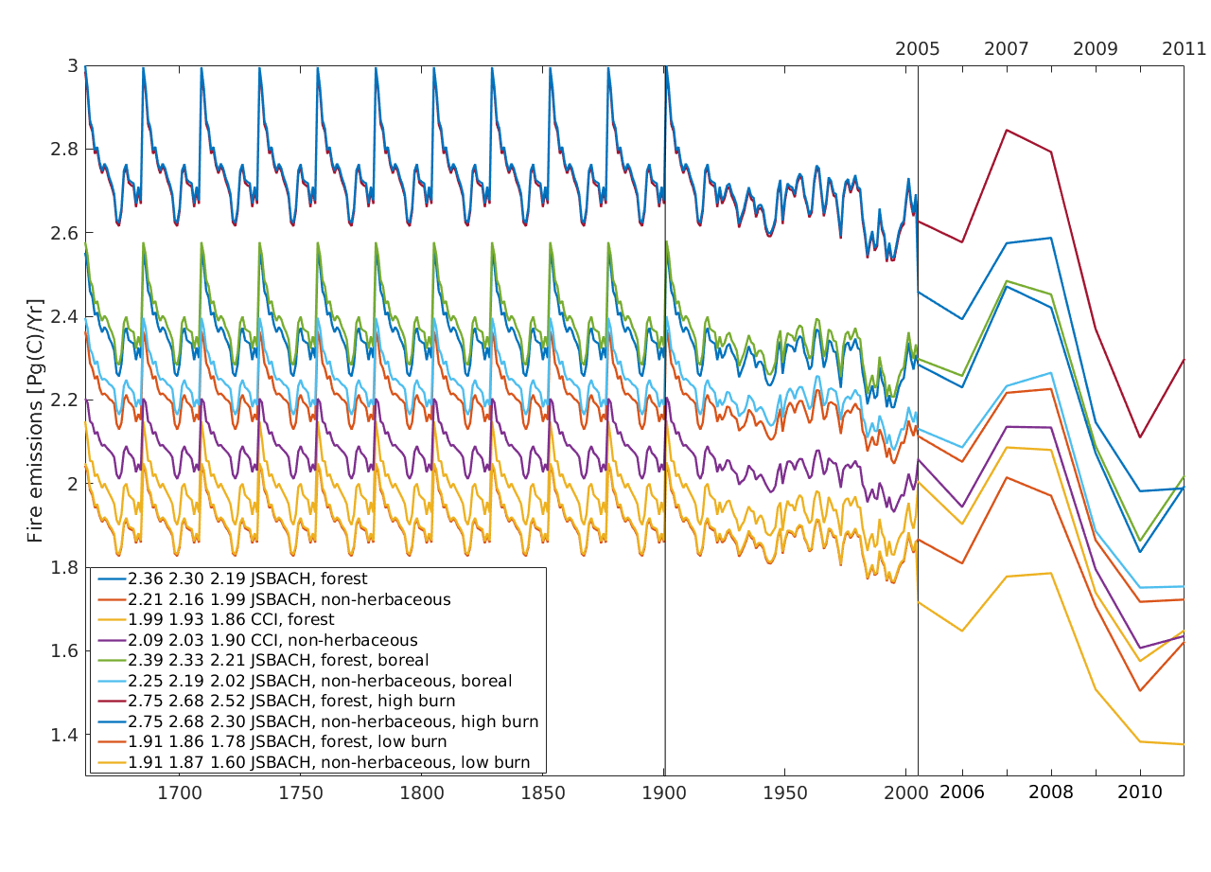

Slide 18
