Slide 1
CMUG results from the ESMValTool (WP: 5.1, O5.1, 5.2, O5.2)
Axel Lauer¹, Mattia Righi¹, Veronika Eyring¹, Alexander Löw², and Benjamin Müller²
¹Deutsches Zentrum für Luft- und Raumfahrt e.V. (DLR), Oberpfaffenhofen, Germany
² Department of Geography, University of Munich (LMU), Germany
CCI CMUG Integration 7 meeting
13 February 2017, Paris, France

Slide 2
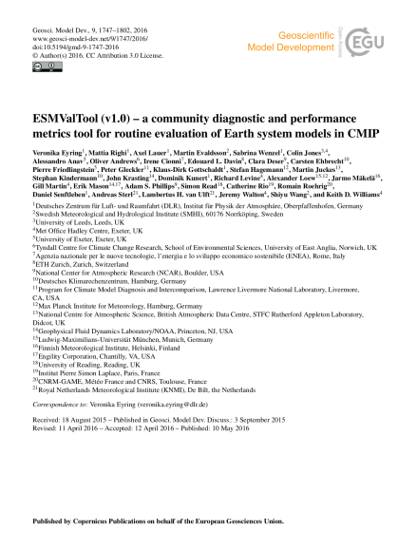

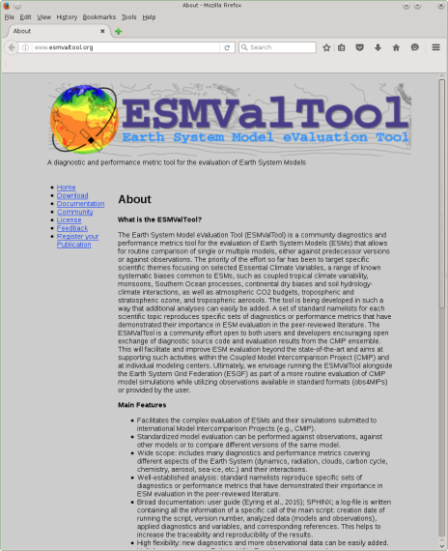
ESMValTool v1.1.0
http://www.esmvaltool.org/
ESA CCI CMUG version
Sea surface temperature
Sea ice
Soil moisture
Land cover
Aerosol
Ozone
Greenhous gases
Lauer et al. (2017), Remote Sensing of Environment (in press)

Slide 3
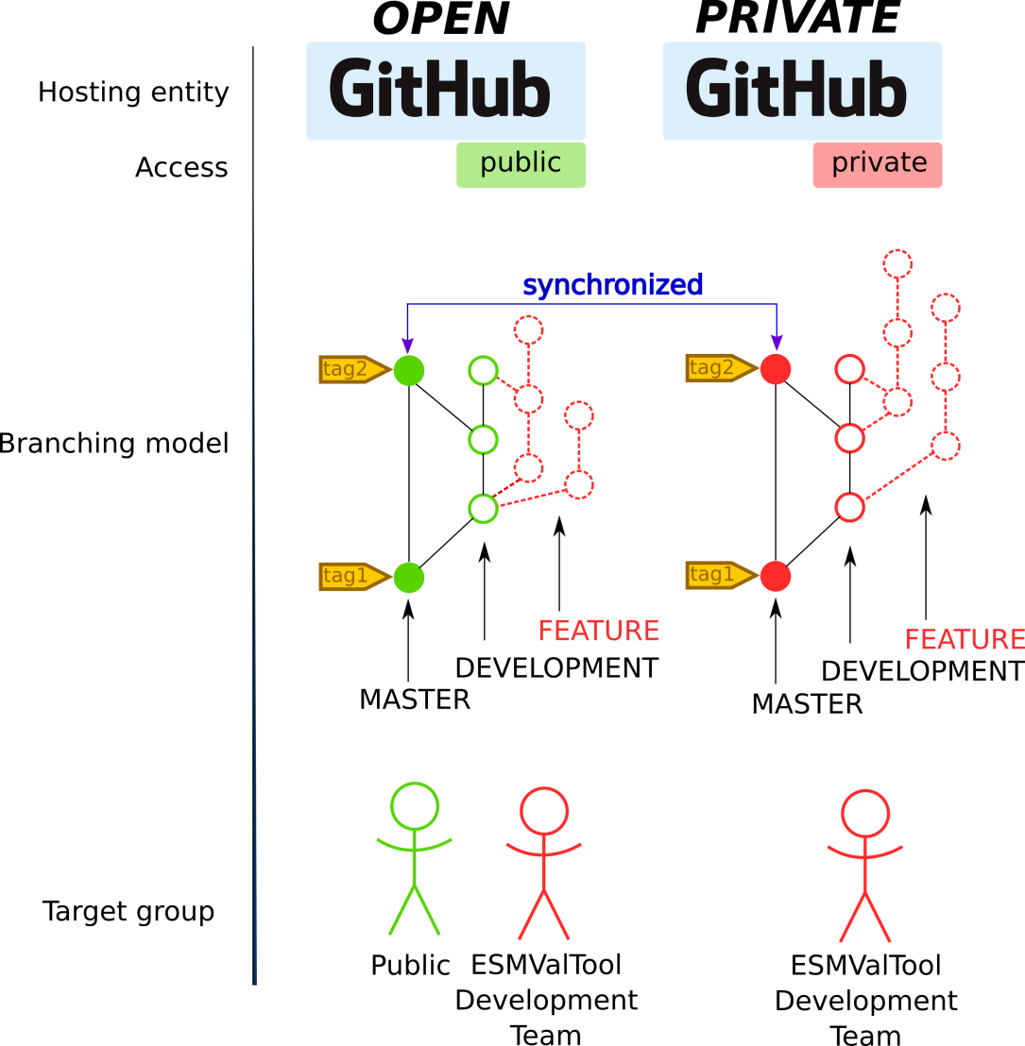
ESMValTool v1.1.0 via GitHub
https://github.com/ESMValGroup/ESMValTool
PUBLIC GitHub repository is open to the public. The ESMValTool is released as open-source software under the Apache License 2.0, version 2.0.
PRIVATE GitHub repository offers a central protected environment for ESMValTool developers who would like to keep their contributions undisclosed (e.g., unpublished scientific work, work of PhD students in progress) while at the same time benefiting from the possibilities of collaborating with other ESMValTool developers and having a backup of their work.

Slide 4
New diagnostics and metrics
Implemented and work in progress
CO₂ and CH₄ diagnostics
Emergent constraints (LTMI, southern ITCZ index, tropical mid-tropospheric asymmetry index)
Extended Taylor diagrams
Indices for extreme events
IPCC AR5 chapter 9
IPCC AR5 chapter 12
Land-atmosphere coupling
Land cover
Precipitation – soil moisture
Shifts in Austral jets
Snowfall
Soil moisture
Sea surface temperature

Slide 5
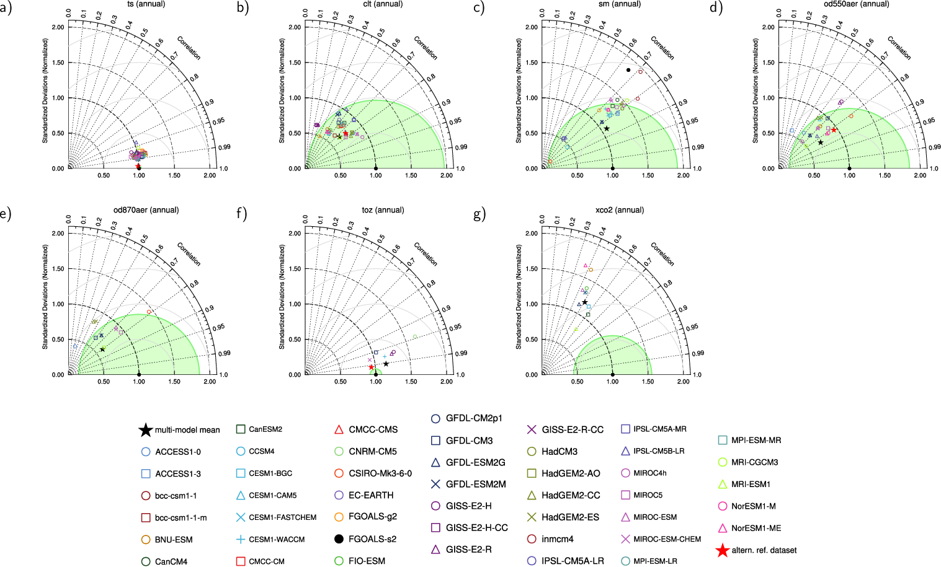
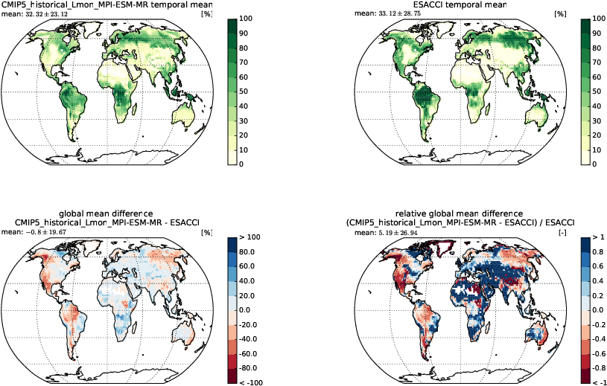
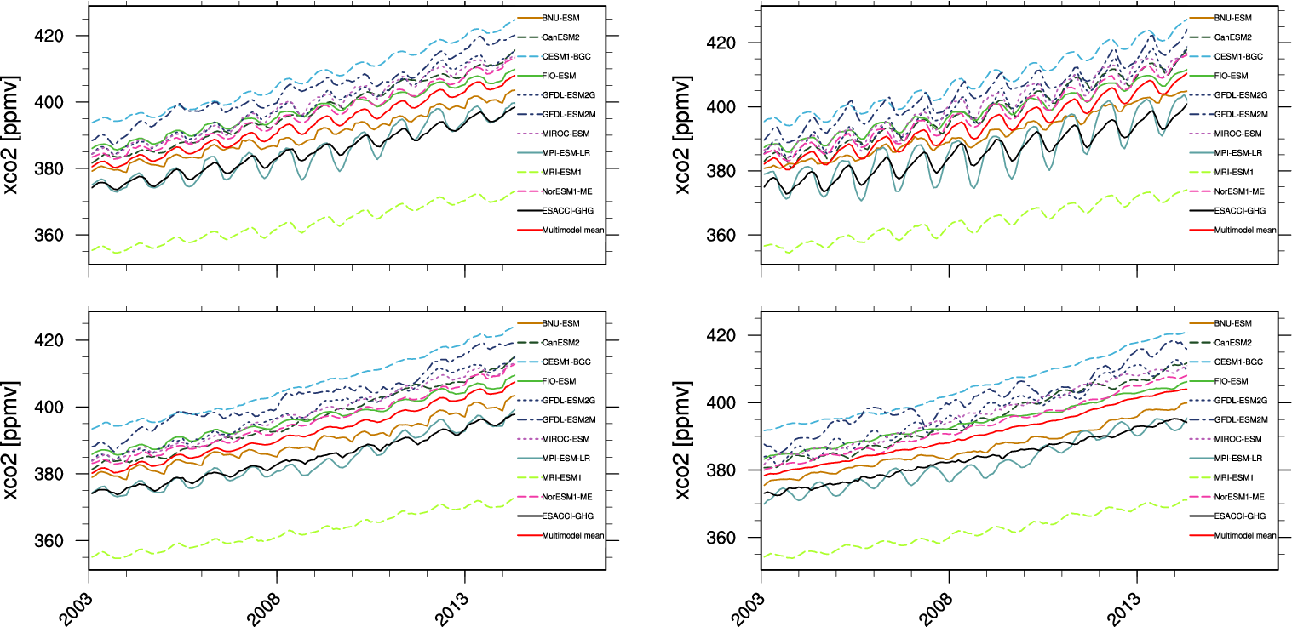
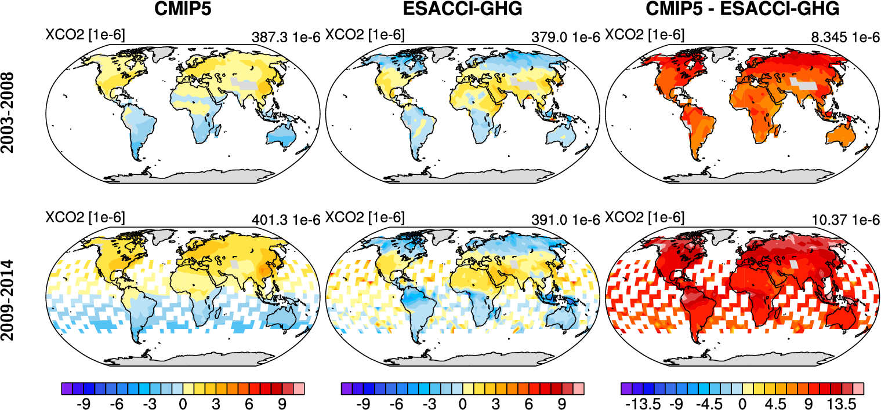
New ESA CCI diagnostics
From: Lauer et al. (2017), Remote Sensing of Environment (in press)

Slide 6
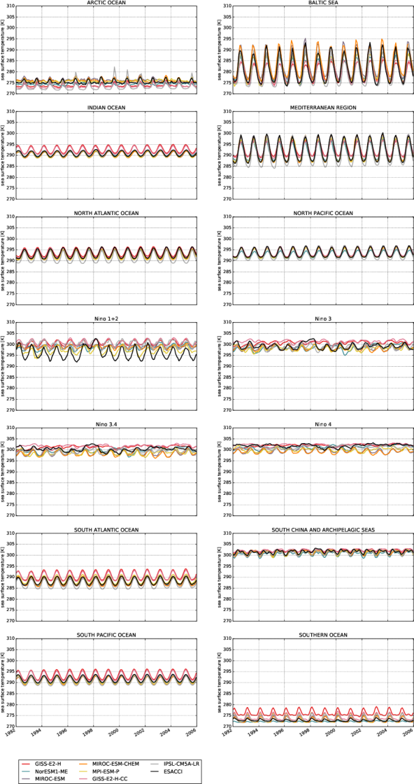
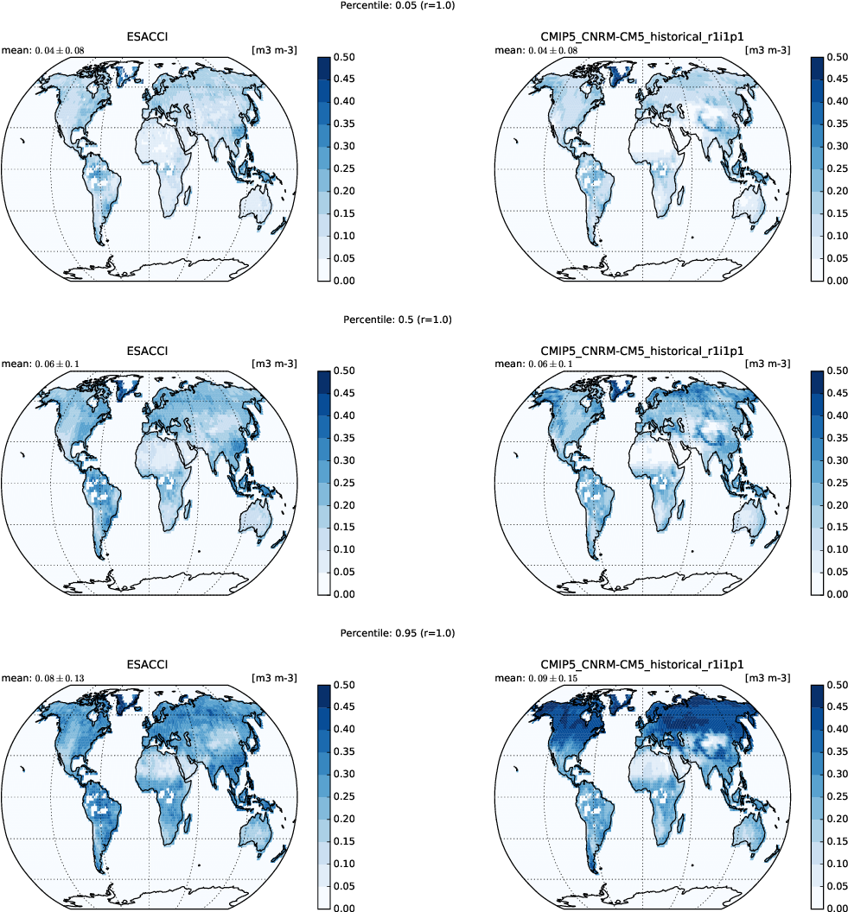
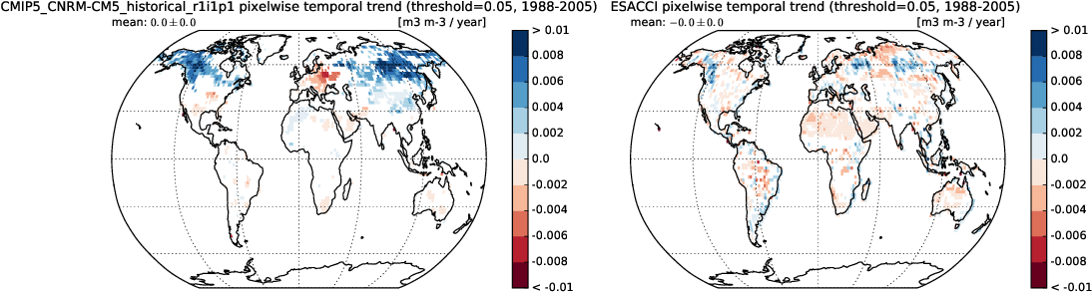
New ESA CCI diagnostics
From: Lauer et al. (2017), Remote Sensing of Environment (in press)

Slide 7
New observational datasets in v1.1.0
Aerosols/chemistry/meteorology/land/ocean/sea ice
ACCESS-2 (conccnd5, conccnd10)
Asmi11 (aerosol size)
BDBP (tro3prof)
CFSR (psl)
CLARA-A2 (clt)
CloudSat (clt)
ESA CCI AEROSOL (od550aer, abs550, od550lt1aer, od870aer)
ESA CCI CLOUD (clt, clwvi, clivi)
ESA CCI GHG (xco2, xch4)
ESA CCI LANDCOVER (grassNcropFrac, shrubNtreeFrac)
ESA CCI OZONE (tro3, tropoz, toz)
ESA CCI SEAICE (sic)
​ESA CCI SOILMOISTURE (sm)
ESA CCI SST (ts)
ESRL (surface CO₂)
HadCRUT4 (tas)
HIPPO (mmrbc)
HWSD (soil carbon content)
ISCCP (albisccp, clisccp, cltisccp, cttisccp)
JMA-TRANSCOM (CO₂ exchange)
LAI3g (leaf area index)
MTE (gross primary productivity of carbon)
NDP (vegetation carbon content)
NIWA (toz)
PATMOS-x (clt)
SSMI-MERIC (prw)
TOMS (toz)
WHOI-OAFlux (hfls, hfss)

Slide 8
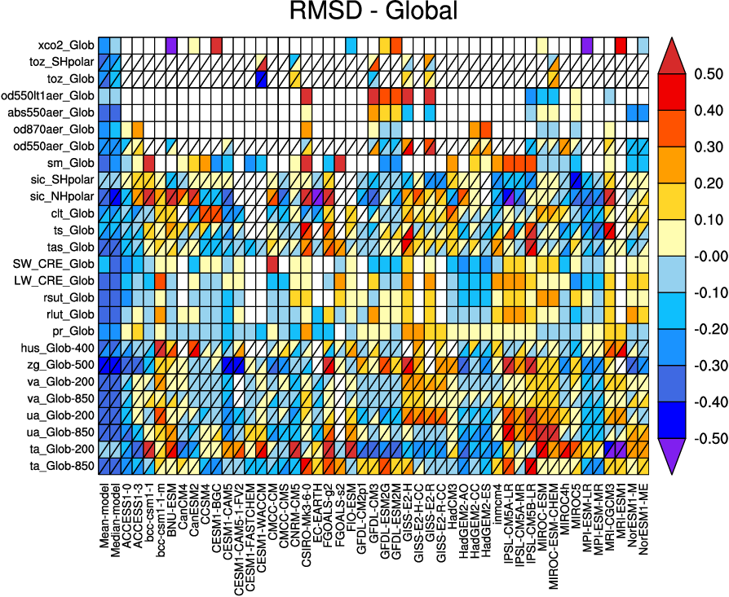
New observational datasets
ESA CCI datasets
greenhouse gases
ozone
aerosol
soil moisture
sea ice
cloud
SST
From: Lauer et al. (2017), Remote Sensing of Environment (in press)

Slide 9
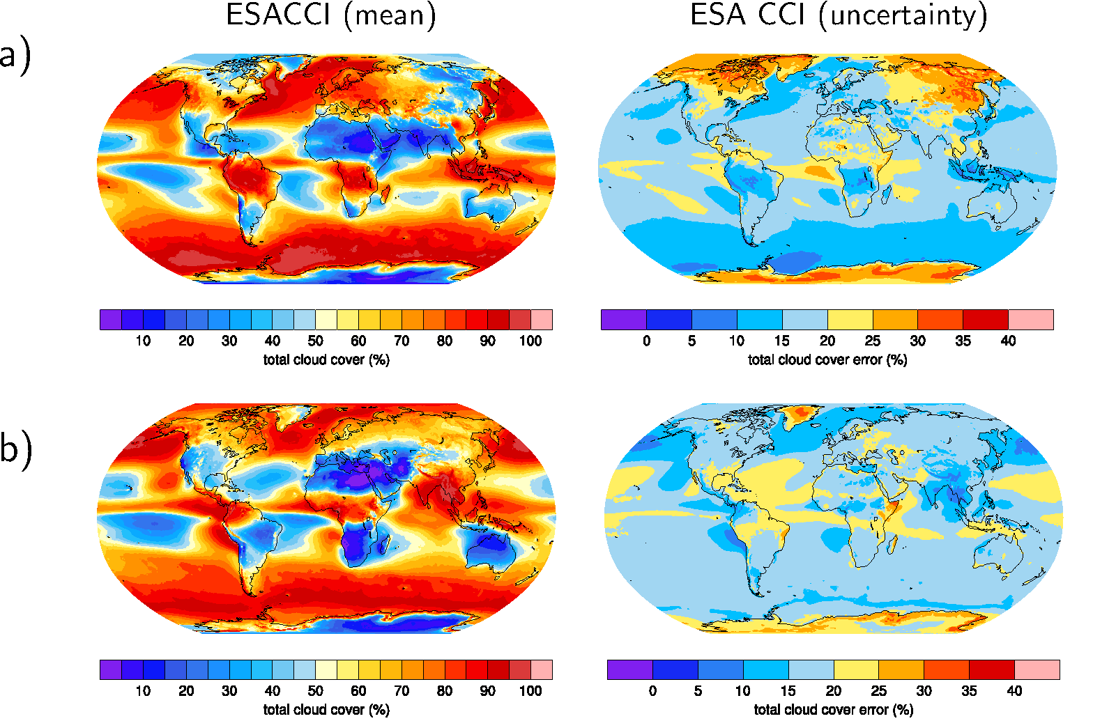
New observational datasets
Example: ESA CCI CLOUD (1982-2014)
DJF
JJA
From: Lauer et al. (2017), Remote Sensing of Environment (in press)

Slide 10

New observational datasets
Example: ESA CCI CLOUD (1982-2014)
DJF
ESA CCI CLOUD
PATMOS-x
CLARA-A2
MODIS
ERA-Interim
CMIP5 multi-model mean
Individual CMIP5 models
ESA CCI CLOUD
1-sigma uncertainty
JJA
From: Lauer et al. (2017), Remote Sensing of Environment (in press)

Slide 11
Technical improvements
Implemented in v1.1.0
paths to workdir, climodir, plotdir, model and observational data can now be set in a single (machine-specific) configuration file
reformat scripts for the observations can now be defined in a main namelist (namelist_reformat_obs.xml) and executed in the main.py framework
New variables including error estimates
Transition from svn to git
Extension of existing diagnostics (e.g. perfmetrics, aerosol, cloud, IPCC Ch. 9)
Small bugfixes and improvements
Work in progress
Preparation for ESGF coupling
Better handling of meta-data
Improved provenance
Reporting (visualization), testing, documentation
New ESMValTool backend (IRIS)
Quicklooks and monitoring

Slide 12
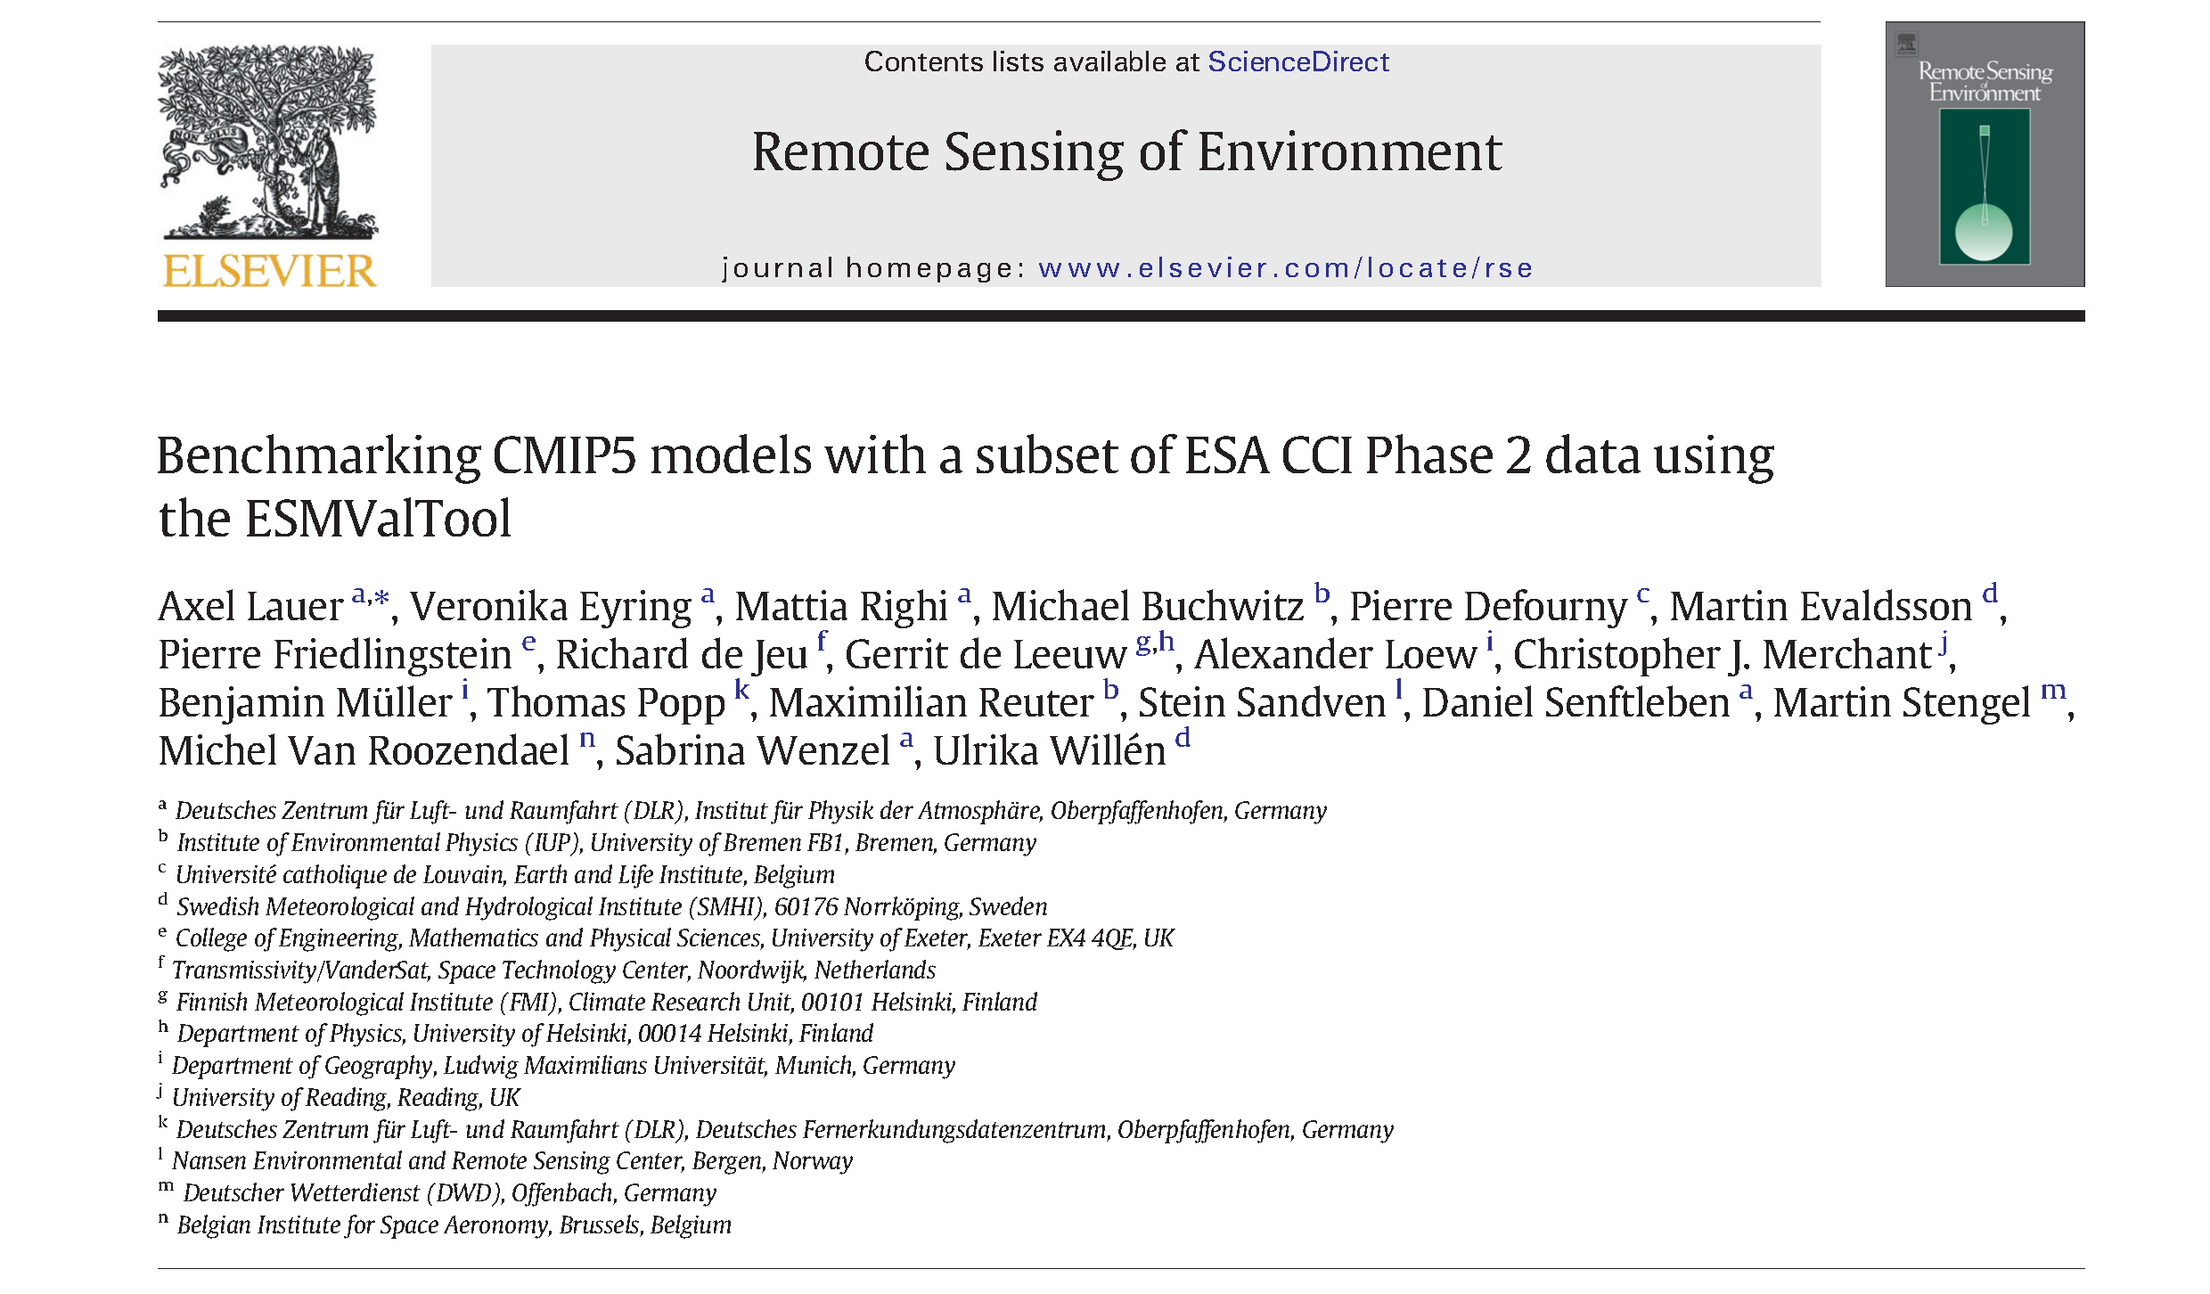
Thank you!

