Slide 1
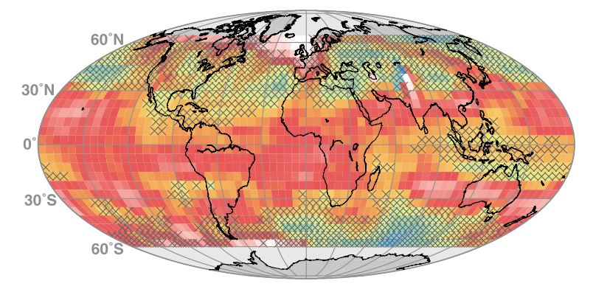















Ozone_cci results
Ozone CCI system
7th CCI CMUG meeting, Paris, France, 13-14 February 2017
M. Van Roozendael, BIRA-IASB
on behalf of the Ozone_cci consortium

Slide 2
Ozone CCI - Final data products
Product name | Product definition | Sensor input | Processing level | Product type | Temporal coverage | Spatial resolution (L3) | Provision and provenance | Format
TC_GOME | Total ozone | GOME | 2-3 | CDR | 1995-2011 | 1°x1° | BIRA/DLR | NetCDF-CF
TC_SCIA |  | SCIAMACHY | 2-3 | CDR | 2002-2012 | 1°x1° | BIRA/DLR | NetCDF-CF
TC_GOME2A |  | GOME-2A | 2-3 | ICDR | 2007- | 1°x1° | BIRA/DLR | NetCDF-CF
TC_GOME2B |  | GOME-2B | 2-3 | ICDR | 2013- | 1°x1° | BIRA/DLR | NetCDF-CF
TC_OMI |  | OMI | 2-3 | ICDR | 2004- | 1°x1° | BIRA/DLR | NetCDF-CF
TC_GTO-ECV |  | GOME, SCIA, GOME-2A/B, OMI | 3 | ICDR | 1995- | 1°x1° | BIRA/DLR | NetCDF-CF
NP_IASI | Ozone profile (nadir) | IASI | 2 | ICDR | 2008- | 20x20km² | LATMOS | NetCDF-CF
NP_GOME |  | GOME | 2-3 | CDR | 1995-2011 | 1°x1° | RAL/KNMI | NetCDF-CF
NP_SCIA |  | SCIAMACHY | 2-3 | CDR | 2002-2012 | 1°x1° | RAL/KNMI | NetCDF-CF
NP_GOME2A |  | GOME-2A | 2-3 | ICDR | 2007- | 1°x1° | RAL/KNMI | NetCDF-CF
NP_GOME2B |  | GOME-2B | 2-3 | ICDR | 2013- | 1°x1° | RAL/KNMI | NetCDF-CF
NP_OMI |  | OMI | 2-3 | ICDR | 2004- | 1°x1° | RAL/KNMI | NetCDF-CF
LMZ_MIPAS | Ozone profile (limb) | MIPAS | 2-3 | CDR | 2002-2012 | 10° lat zones | UNI-HB/FMI | NetCDF-CF
LMZ_GOMOS |  | GOMOS | 2-3 | CDR | 2002-2012 | 10° lat zones | UNI-HB/FMI | NetCDF-CF
LMZ_SCIA |  | SCIAMACHY | 2-3 | CDR | 2002-2012 | 10° lat zones | UNI-HB/FMI | NetCDF-CF
LMZ_SAGE2 |  | SAGE-2 | 2-3 | CDR | 1984-2005 | 10° lat zones | UNI-HB/FMI | NetCDF-CF
LMZ_HALOE |  | HALOE | 2-3 | CDR | 1991-2005 | 10° lat zones | UNI-HB/FMI | NetCDF-CF
LMZ_OSIRIS |  | OSIRIS | 2-3 | ICDR | 2001- | 10° lat zones | UNI-HB/FMI | NetCDF-CF
LMZ_SMR |  | SMR | 2-3 | ICDR | 2001- | 10° lat zones | UNI-HB/FMI | NetCDF-CF
LMZ_ACE |  | ACE | 2-3 | ICDR | 2004- | 10° lat zones | UNI-HB/FMI | NetCDF-CF
LMZ_MLS |  | MLS | 2-3 | ICDR | 2004- | 10° lat zones | UNI-HB/FMI | NetCDF-CF
LMZ_SABER |  | SABER | 2-3 | ICDR | 2002- | 10° lat zones | UNI-HB/FMI | NetCDF-CF
LMZ_MERGED |  | All sensors | 3 | ICDR | 1984- | 10° lat zones | FMI | NetCDF-CF
LP_MERGED |  | Selection | 3 | ICDR | 2002- | 10°x20° | FMI | NetCDF-CF
TTOC_MERGED | Tropospheric ozone column | GOME, SCIA, GOME-2A/B, OMI | 3 | ICDR | 1995- | 1.25°x2.5° | DLR | NetCDF-CF
LNTOC_SCIA |  | SCIAMACHY | 3 | CDR | 2002-2012 | 60x240 km² | UNI-HB | NetCDF-CF
LNTOC_MIPAS-SCIA |  | MIPAS, SCIA | 3 | CDR | 2002-2012 | 60x240 km² | UNI-HB | NetCDF-CF

Slide 3
Platforms and sensors
Agency | Satellite platform | Sensor | Time period
 |  |  | 96 | 97 | 98 | 99 | 00 | 01 | 02 | 03 | 04 | 05 | 06 | 07 | 08 | 09 | 10 | 11 | 12 | 13 | 14 | 15
ESA | ERS-2 | GOME
ESA | ENVISAT | SCIAMACHY
 |  | GOMOS
 |  | MIPAS
EUMETSAT | METOP-A | GOME2-A
 |  | IASI-A
 | METOP-B | GOME2-B
 |  | IASI-B
SNSB CSA | ODIN | OSIRIS
 |  | SMR
CSA | SCISAT | ACE
NASA | ERBS | SAGE-2 | 84
 | UARS | HALOE | 91
 | TIMED | SABER
 | AURA | MLS/ OMI

Slide 4
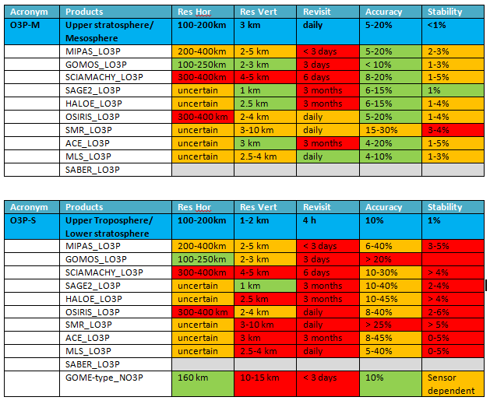
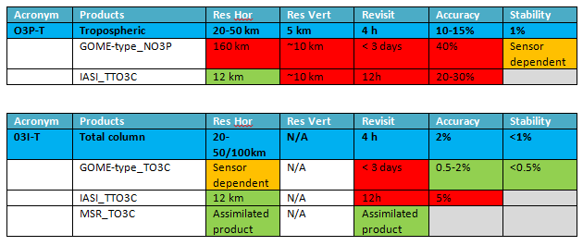
Validation against requirements
Fully documented in Ozone_cci PVIR v2.0
(July 2016)
Limb profile data sets
Nadir ozone data sets

Slide 5
Distributed production system
L2
BIRA
total ozone
RAL
BUV profiles
LATMOS
IASI Level-2 profiles
IUP-UB
HARMOZ
DLR
GTO-ECV
KNMI
Gridded and assimilated profiles
FMI
Zonal and gridded limb data
L3
Ozone CCI Data Base
In the process of being transferred to C3S
Users

Slide 6
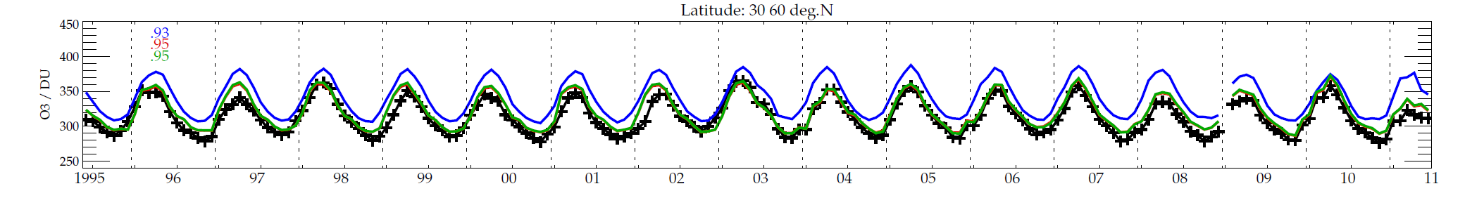
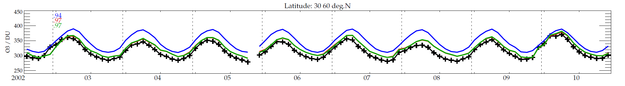
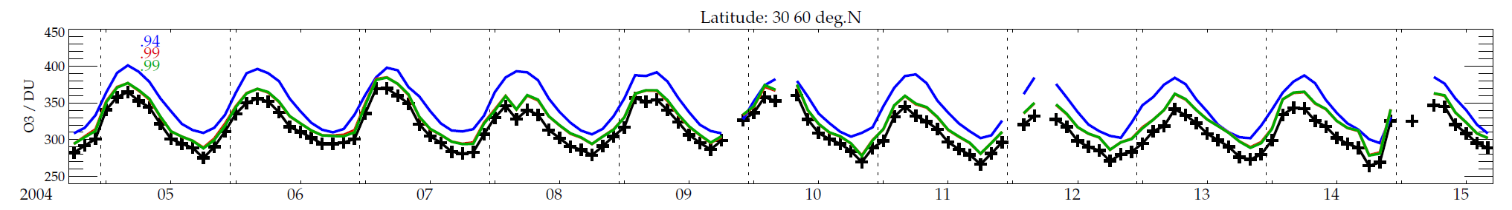
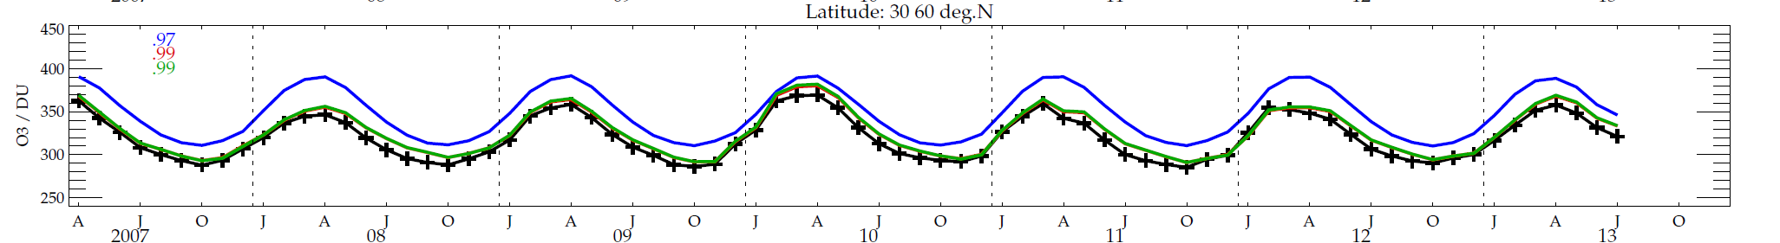

Consistent processing of multiple nadir sensors – total ozone and profiles
GOME-1 1995-2011
SCIA 2002-2010
OMI 2002-15
(1 day / mth)
Retrieval
A priori
MACC (applying AK)
GOME-2
2007-
Remote Sensing Group
Notes:
Unique opportunity of 4 consistently processed data sets with 4 year overlap to help resolve instrumental differences, which in turn will improve trend analysis.

Slide 7
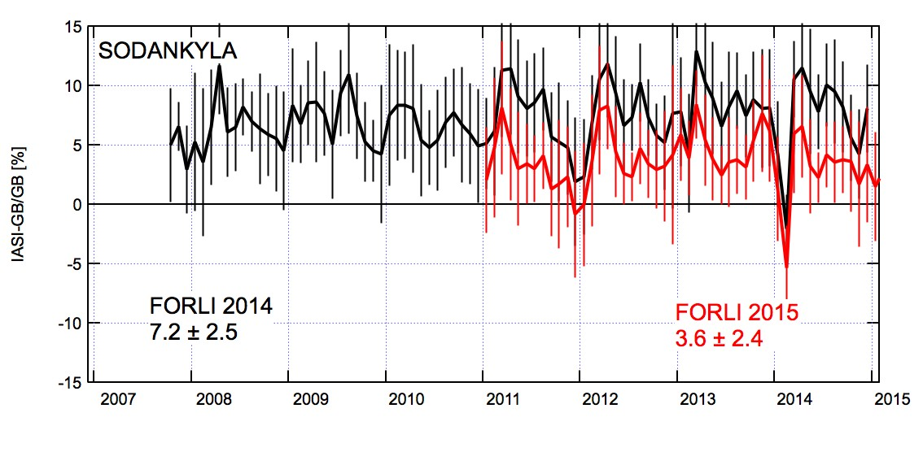

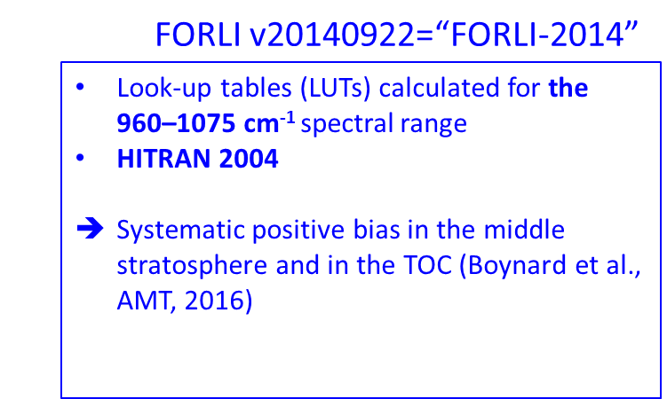

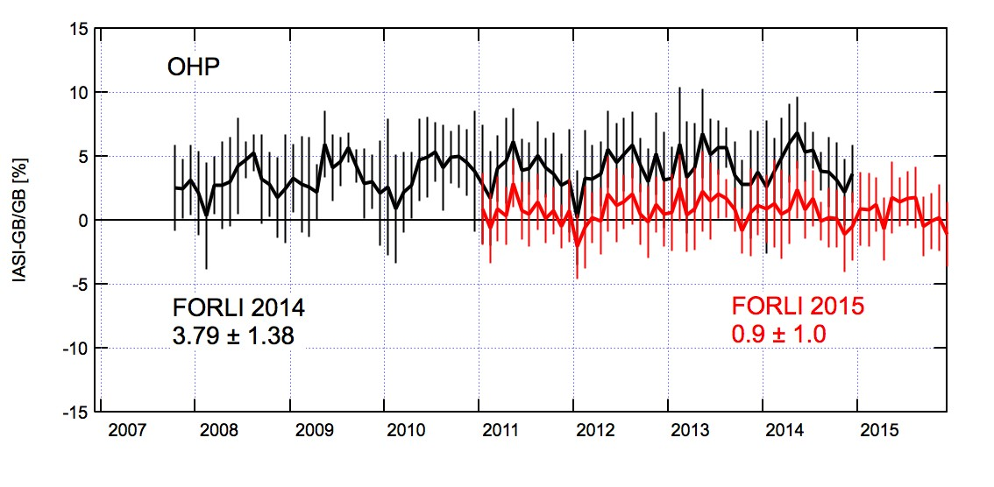
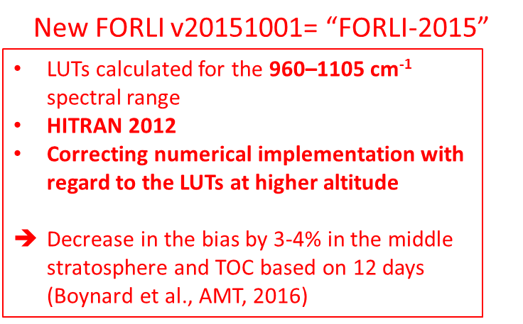
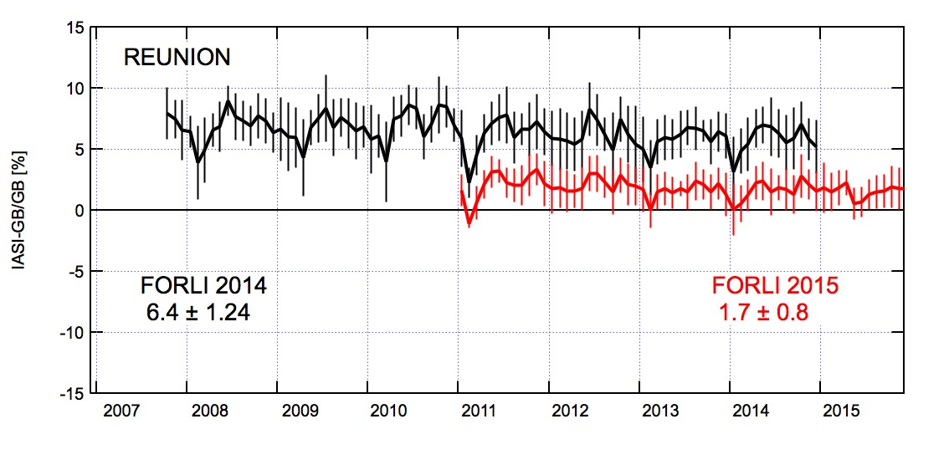
IASI FORLI 2015
Large decrease of the bias against reference data
Courtesy F. Goutail (LATMOS)

Slide 8
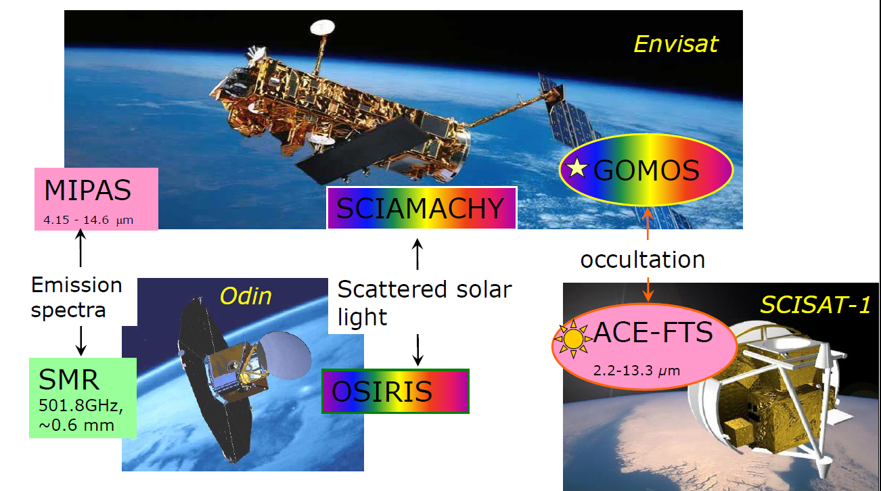
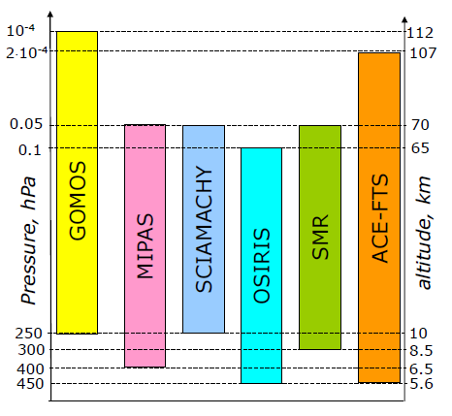
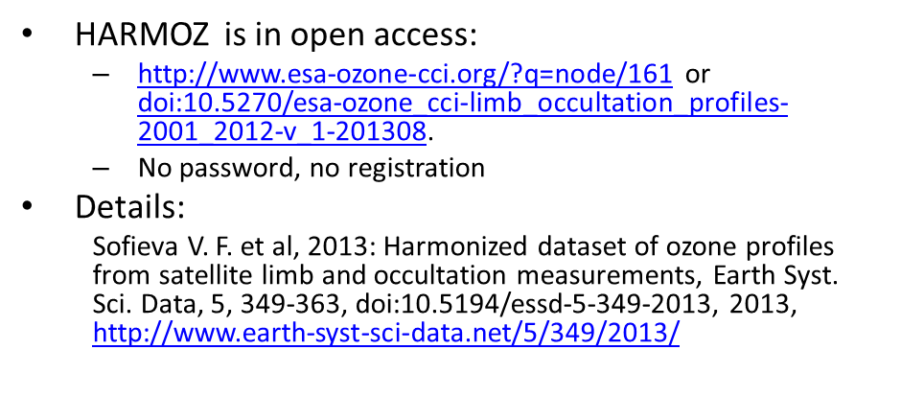
HARMonized dataset of OZone profiles (HARMOZ)
HARMOZ is the collection of ozone profiles from individual instruments, which are:
  screened for invalid data by the instrument experts
  presented on the same pressure/altitude grid
  written in the same netcdf-4 format
Bias tables are provided for each pair of instruments

Slide 9
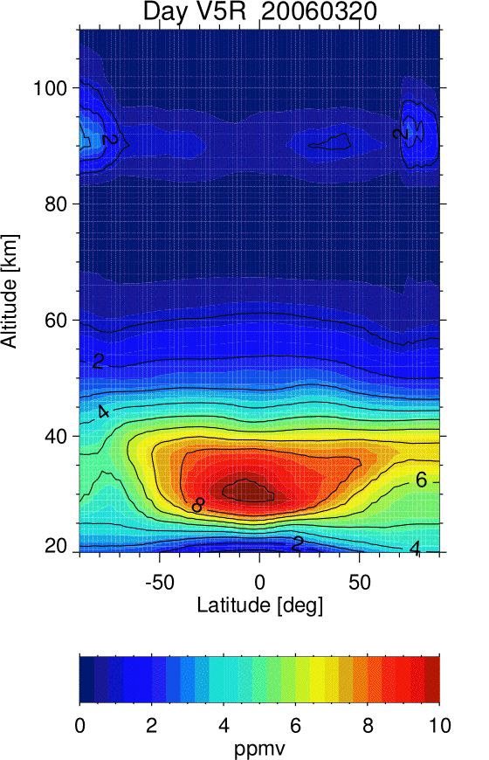
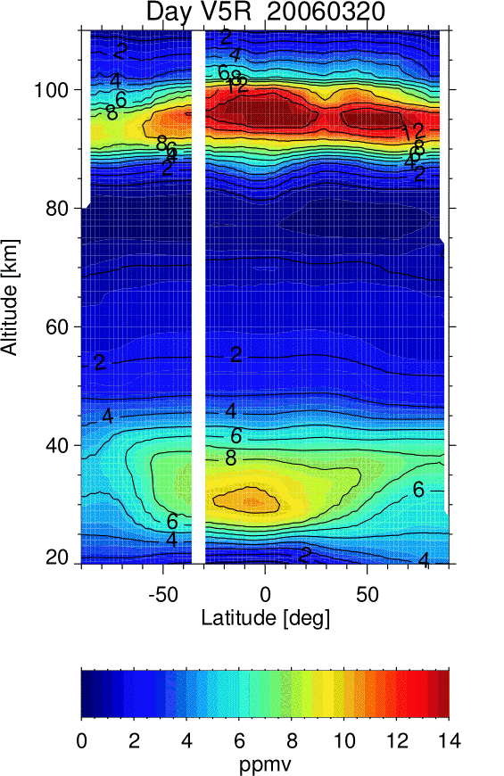

Extension to the mesosphere
MIPAS V5 in MA mode (day)
MIPAS V5 in MA mode (night)
Merging with other sensors requires proper handling of diurnal variation effects (in progress)

Slide 10
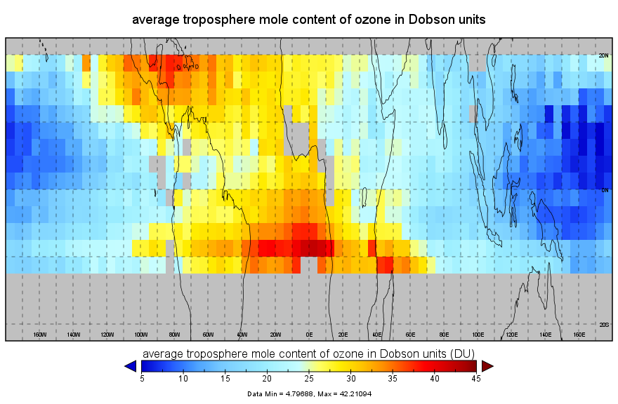
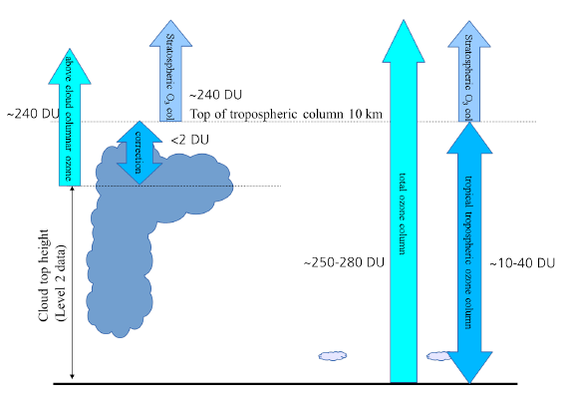
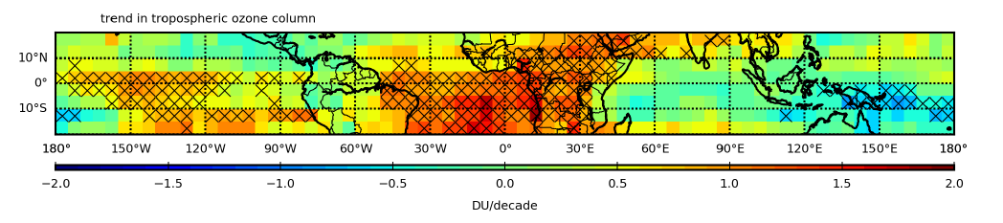
Tropical tropospheric ozone
Retrieval principle (CCD)
Heue et al., AMT, 9, 5037–5051, 2016
1995-2015 trend from combined GOME, SCIAMACHY and OMI data

Slide 11
7th CCI Collocation meeting, ESA/ESRIN, Frascati, 4-6 October 2016
What is the status of the ozone landscape at the end of 6 years of CCI?
Complete reprocessing of nadir UV sensors (1995-2015) using common algorithm selected from Round-Robin
HARMOZ limb data sets generated from 10 different ESA, ESA/TPM and NASA sensors
Extension of Phase-1 products towards mesosphere and troposphere
Extensive validation of all data sets
All data sets accessible on single entry point in NetCDF-CF format

Slide 12
Obs4MIPS
4 ozone data sets proposed in response to last April call:
Total ozone level-3 merged gridded (1°x1°) data set from GOME, SCIAMACHY, GOME-2 and OMI, 1995-2015 (DLR/BIRA)
Ozone profile level-3 gridded (1°x1°) data set from GOME, SCIAMACHY, GOME-2 and OMI, 1995-2015 (KNMI/RAL)
Ozone profile level-3 data sets from a combination of limb sensors, 2001-2015 (FMI)
  monthly mean in 10° latitude zones;
  monthly/seasonal mean 5° x10° latitude-longitude maps at several pressure levels in the UTLS and the stratosphere
Tropical tropospheric ozone level-3 data set from GOME, SCIAMACHY, GOME-2 and OMI, 1995-2015 (DLR)

Slide 13
Additional research needs
Research needed to maintain and extend the ozone data production in support of C3S
Main axis of developments:
  Improvement of data merging algorithms
  Addition of new sensors, e.g. Sentinel-5 Precursor (to be launched in July 2017), OMPS limb (only current mission with potential to extend the historical limb ozone data records)
  Fill gaps in current level-3 data sets, e.g. polar night gap (could be filled using combined UV/TIR development)
  Improvement of vertical resolution of nadir sensors through combined exploitation of UV/Vis/TIR sensors
  Further development of ozone profile reanalysis (L4) with potential to extend ozone profile CDR back in time to early eighties

