Slide 2
CMUG Integration Meeting 13-14 Feb 2017
CCI Open Data Portal Status update
CCI data archive and publishing
Obs4MIPs
User feedback
Victoria Bennett, Alison Waterfall, Kevin Halsall, Clive Farquhar

Slide 3
Archive Status
Approx. 130 CCI datasets now in Central Archive
All available via ftp, described in catalogue and visible in CCI Dashboard and Search
Approx. 70 CCI datasets published to ESGF
  Others in progress, or not suitable
  ESGF doesn’t currently publish datasets with 1000’s files – may need to restructure data
DOIs issued for SST, Ocean Colour, Fire, GHG (Obs4MIPS only), Sea Ice

Slide 4
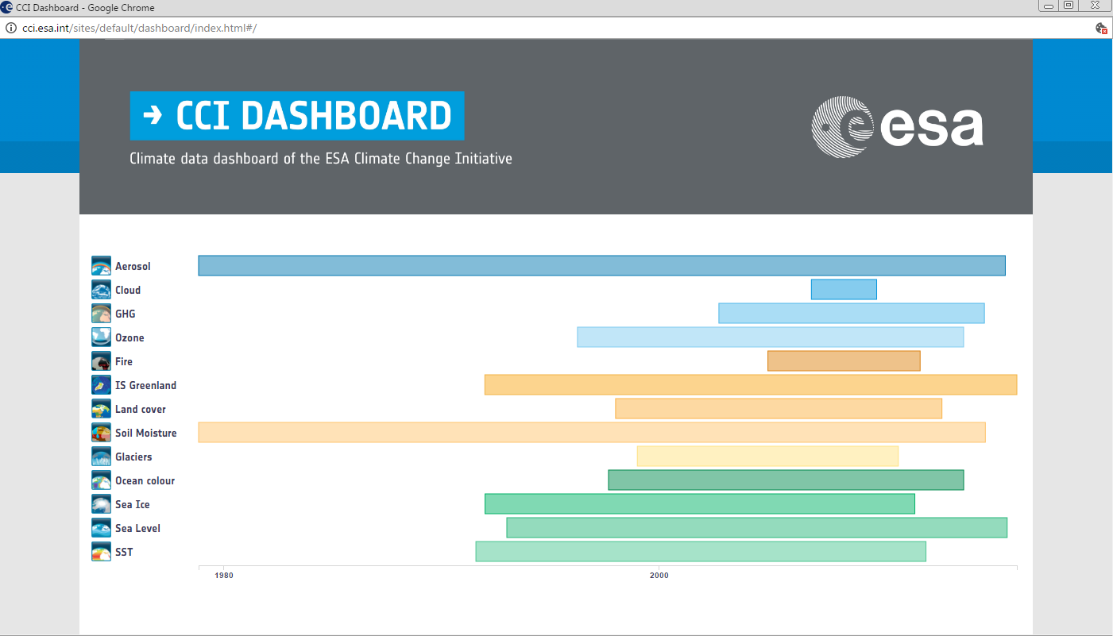

Slide 5
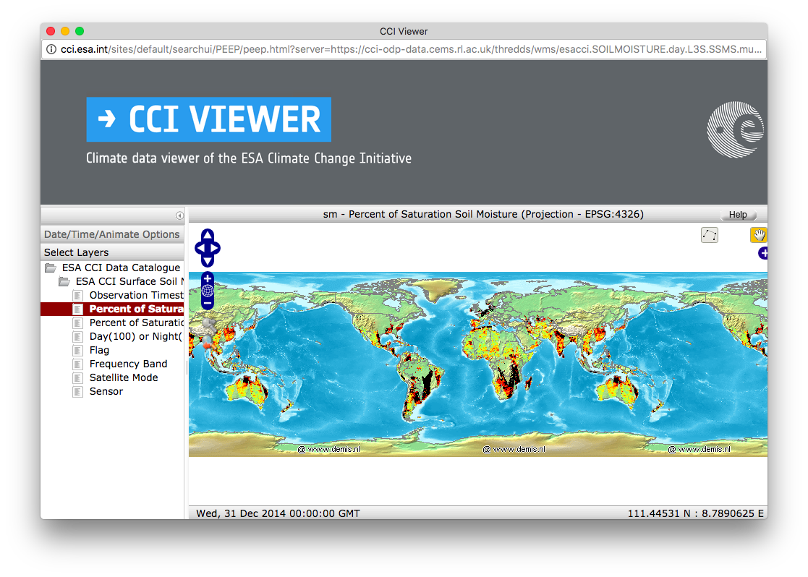
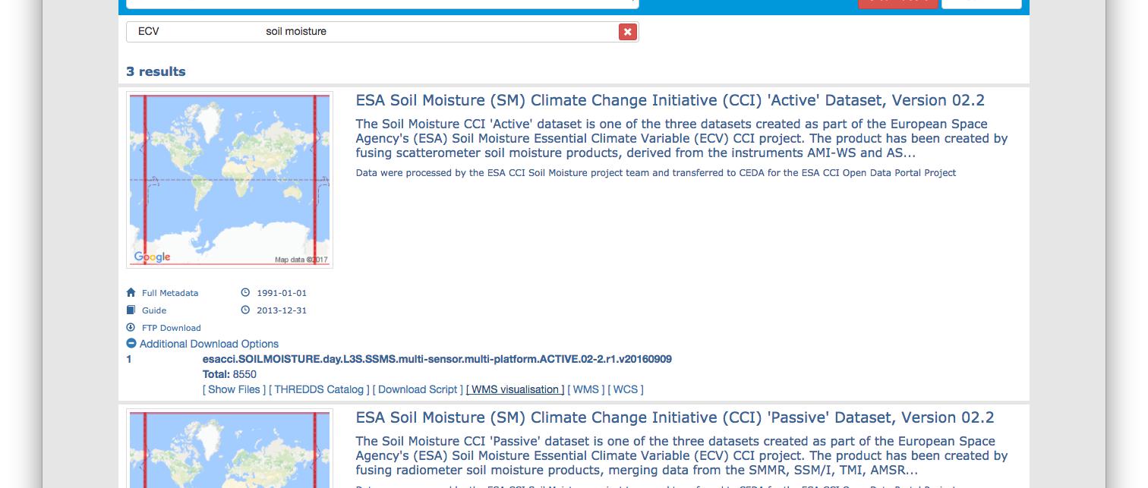

Slide 6
 | Portal datasets | Not in NetCDF | ESGF datasets | Published | To be published | Size issues
Aerosol | 17 | 1 | 25 | 1 | 24 | ~7
Cloud | 19 |  | 19 | 18 | 1
Fire | 2 | 1 | 1 | 1
GHG | 12 |  | 12 | 12
Glaciers | 1 | 1
Greenland IS | 23 | 2 | 21 |  | 21
Land cover | 2 |  | 2 | 2
Ocean colour | 10 |  | 42 | 19 | 23 | 21?
Ozone | 11 |  | 13 | 4 | 9
Sea Ice | 4 |  | 4 | 4
Sea Level | 3 |  | 5 | 3 | 2
Soil moisture | 4 | 1 | 3 | 3
SST | 3 |  | 3 | 1 | 2 | 2
Total: | 111 | 6 | 150 | 68 | 82 | 30+

Slide 7

Obs4MIPs Status

Slide 8
User Feedback Channels
Direct communication to ODP team via the Helpdesk throughout the year
  help@esa-portal-cci.org
  Urgent issues addressed upon receipt
  Non-urgent suggestions/comments fed into Annual Review Process
Online User Survey
  Short user survey released in Jan 2017 (link on ODP front page)
Annual Review Process
  All feedback analysed in advance of start of next phase (May-April)
  Analysis informs the ODP Phase 3 evolution & development activities

Slide 9
Thank you!
victoria.bennett@stfc.ac.uk

Slide 10
ECV | Parameter | DSF | TN | Data Prep. By ECV | Dataset Formatted | Export
Aerosol | AOD | Accepted | Being revised | Done | Done | Published
GHG | XCO2 | Accepted | Accepted | Done | Done | Published
 | XCH4 | Accepted | Accepted | Done | Done | Published
Ozone | VOD | In principle | Can start | Can start | Can start
 | TCO | In principle | Can start | Can start | Can start
Approved
Action needed from WDAC
Task 5 activity
Future step

Slide 11
ECV | Parameter | DSF | TN | Data Prep. By ECV | Dataset Formatted | Export
Ocean Colour | Chl-monthly | Accepted | V1 under review | OC-CCI v3.0 – Ready | Final check | Need TN first
Sea Level | ADT | Accepted | Under review
SST | SST | Accepted | Can start
Sea ice | SIC
 | SIT
Approved
Action needed from WDAC
Task 5 activity
Future step

Slide 12
ECV Project | Parameter | DSF | TN | Data Prep. By ECV | Dataset Formatted | Export
Fire | Burnt Area | Accepted | Can start | Burnt Area v4.1 – Ready | Can start
Soil Mois. | Vol. SM | Accepted | Under review | Done | Done | Final check
Ice sheets Greenland | SEC | Under review
 | GMB | Under review
Ice sheets Antarctic | SEC | Under review
 | GMB | Under review
Land cover | Not yet known

Slide 13
 | Parameters | DSF | TN | Dataset prep | Dataset formatted | Export
Cloud | Total cloud cover fraction (CFC) | Accepted | Submitted | Done
 | Cloud area fraction | Accepted | Submitted | Done
 | Cloud top phase (CPH) | Accepted | Submitted | Done
 | Cloud Optical Thickness (COT) | Rejected | Submitted | Done
 | Cloud Liquid Water Path (LWP) | Accepted | Submitted | Done
 | Cloud Top Pressure (CTP) | Accepted | Submitted | Done
 | Cloud Ice Water Path (IWP) | Accepted | Submitted | Done
Glaciers | Not Submitting

