Slide 2
CATE - Status & Evolution
Climate Analysis Tooling Environment
Unified access to CCI ECVs and other climate data into a common data model
Cross-ECV investigations
Analysis and visualisation
Supporting 7 different user groups

Slide 3
Basic Concepts (1)
Common data model
Dataset
remote
open
transform, plot, write
Data Store
Operation
*
*
Data Store Registry
Operation Registry
local
Extension point
Extension point

Slide 4
Basic Concepts (2)
Remote data stores
Workspace
Workflow
Workspace resources (Python in-memory objects, e.g. Datasets)
Workflow steps
a = open_dataset(...)
a
b
b = open_dataset(...)
c
d
e
c = coregistration(a, b, ...)
Local data store
d = read_file(‘D.tif’)
D.tif
e = correlate(a, c, d, ...)
Workspace files in workspace directory
write_datasets(e, ‘E.nc’)
E.nc

Slide 5
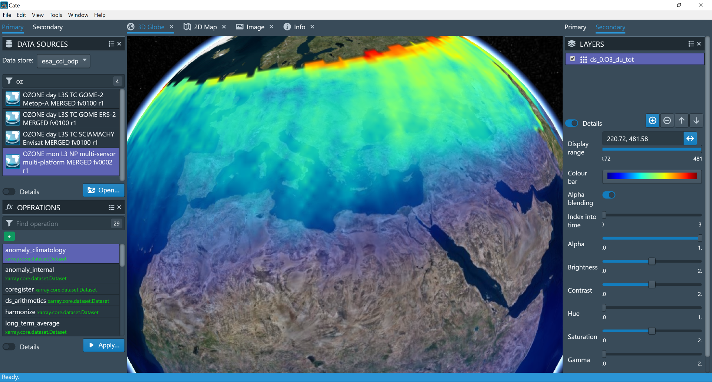

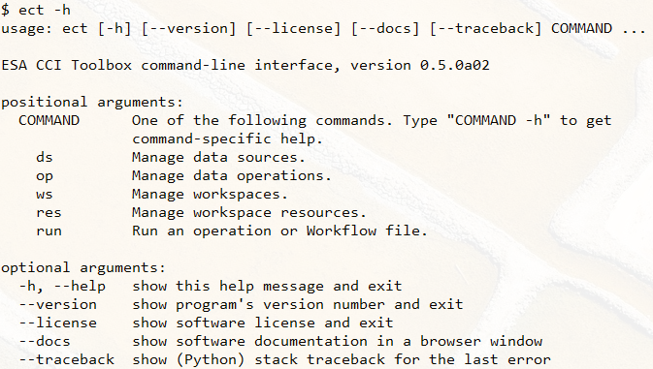
Basic Concepts (3)
Process 2
Process 3
Python Core Lib (API)
Web Service (WebAPI)
Desktop App (GUI)
{ RESTful }
Plugin 1
Plugin 2
ESA Open Data Portal and other data services
Python Core Lib (API)
Command-Line App (CLI)
Plugin extension points:
Data sources
Operations
Workflows
Plugin 1
Plugin 2
Process 1

Slide 6
CATE Desktop

Slide 7

Climate Change Data Future
Much, much more data
  New revisions of current ECVs (CCI and others)
  New ECVs (CCI+, C3S, H2020, and other)
New Sensors, growing archives
  Sentinel A and B, C and D, Sentinel 5P, Sentinel 6
  Earth Explorers, Other space agency missions
Managing change (data perspective)
  Reprocessed archives
  Traceability
Detecting change (science perspective)
  Cross ECV analysis
  Data harmonisation and consistency requirements
  Analysis methodology
Communicating the results
  Synthesis
  Visualisation beyond current experience
IT Technological developments

Slide 8
Potential Evolution in CCI+
CATE-1
Desktop application
Easy and powerful
Cloud ready
CATE-2 & 3
Desktop application
Easy and powerful
Cloud tested
CATE-SP
Service Platform
Supporting full
range of devices
Continuously growing
and updating

Slide 9



Application Scenarios
CATE APP
CATE APP
Internet Browser
Scenario #1 (current)
Scenario #2
Scenario #3
CATE APP
Server
Cate Core (Python)
Cate Core WPS
Cate Core WPS
CCI Data
CCI Data
CCI Data

