Slide 1
Use of CCI data in reanalysis
R. Dragani¹, H. Hersbach¹,
S. Hirahara² and A. Simmons¹
¹ECMWF
²JMA

Slide 2
Content
Introduction on ERA5
A successful story: how the CMUG O₃ assessment (WP3.2) fed into the ERA5 production
The reasons behind a “less-successful” study: the (reanalysis) user perspective

Slide 3
ERA5
ERA5 is a global, atmospheric reanalysis covering the satellite era that will replace ERA-Interim.
It is produced by ECMWF on behalf of the EU and as part of the Copernicus Climate Change Service (C3S).
The ERA5 temporal coverage will extend over:
  the satellite era (i.e. period from 1979 onwards) with a prompt operational extension forward in time
  Likely extension backwards in time (1950-1978)

Slide 4
ERA5: the ERA-Interim replacement
What is new in ERA5?
 | ERA-Interim | ERA5
Period | 1979 - present | Initially 1979 – present, later addition 1950-1978
Start of production | August 2006 | 2016
Assimilation system | 2006, 4D-Var | 2016 ECMWF model cycle, 4D-Var
Model input (radiation and surface) | As in operations, (inconsistent sea surface temperature) | Appropriate for climate, e.g., evolution greenhouse gases, volcanic eruptions, sea surface temperature and sea ice
Spatial resolution | 79 km globally 60 levels to 10 Pa | 31 km globally 137 levels to 1 Pa
Uncertainty estimate |  | Based on a 10-member 4D-Var ensemble at 62 km
Land Component | 79km | 9km
Output frequency | 6-hourly Analysis fields | Hourly (three-hourly for the ensemble), Extended list of parameters ~ 5 Peta Byte
Extra Observations | Mostly ERA-40, GTS | Various reprocessed CDRs, latest instruments
Variational Bias correction | Satellite radiances | Also ozone, aircraft, surface pressure

Slide 5
ERA5 Public Release Plan
Recently a two-months test data set was made available
  Full resolution, 31km, hourly and 62km-ensemble 3-hourly
  Jan-Feb 2016
  https://climate.copernicus.eu/climate-reanalysis
Q2 2017: public release of the 2010 – 2016 period
  Includes observation feedback
Q3 2017: 2017 – timely updates
  ERA5: Updates with about 2-months delay (final product)
  ERA5T: Updates with short delay (<1 week, preliminary product)
2018: Release of the 1979 – 2009 period:
  Continue ERA5 timely updates
  Integration of ERA5 back-extension to 1950
  End of ERA-Interim production (beginning of summer at the latest).

Slide 6
CCI data in ERA5
Of all CCI ECVs, only O₃ CCI products are used (assimilated) in ERA5.
The work performed within CMUG (WP3.2) was instrumental because the work was designed with the same good practice and protocols used in reanalysis/DA assessments.
For many of the European sensors measuring O₃, multiple algorithms have been developed over the years, each providing a valid candidate for the assimilation.
  The assessment was based as Round-Robin Assimilation Experiments.
O₃ CCI
CMUG
C3S

Slide 7
O3 RR experiment set-up
Five Round-Robin O₃ Assimilation experiments for five instruments (SCIAMACHY, OMI, GOME, GOME-2, MIPAS) were run
Four month assimilation experiments (1st month discarded)
Thorough assessment:
  Comparison Obs & associated uncertainties vs model equivalents (prior assimilation)
  Changes in the analysis quality due to the assimilation
  Changes in the system internal consistency (e.g. data usage)
  Consistency with other datasets
Experiment | Description
Control | L2 O3: 1 TCO3 (OMI or SCIA), SBUV 6-layer PCO3 IR/O3: HIRS [, IASI, AIRS] All other non-ozone sensitive observations
Perturbation | CTRL + CCI dataset to assess
Perturbation 2 | CTRL + Alternative option of CCI dataset to assess

Slide 8
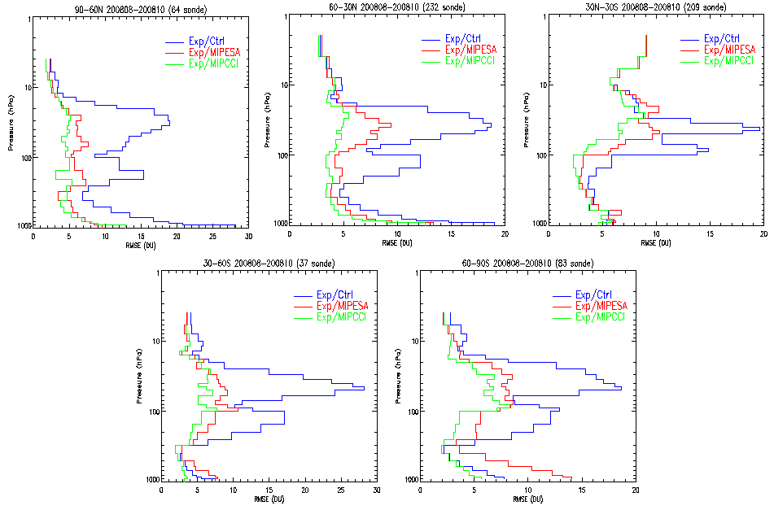
Some results: MIPAS RR
60º-90º N
30º-60º N
30º S - 30º N
64
232
209
30º-60º S
60º-90º S
Exp/Ctrl
MIP-ESA
MIP-CCI
37
83
RMS(Sonde-Analysis)

Slide 9
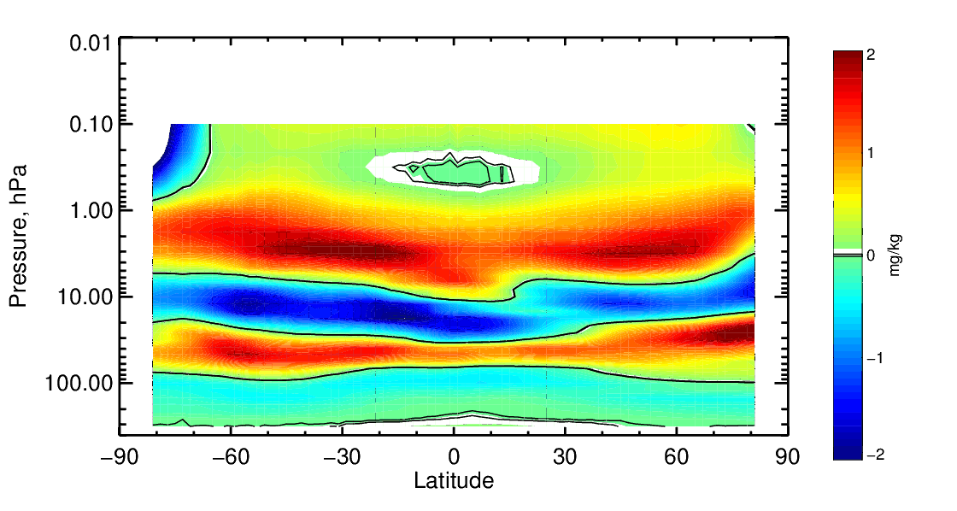
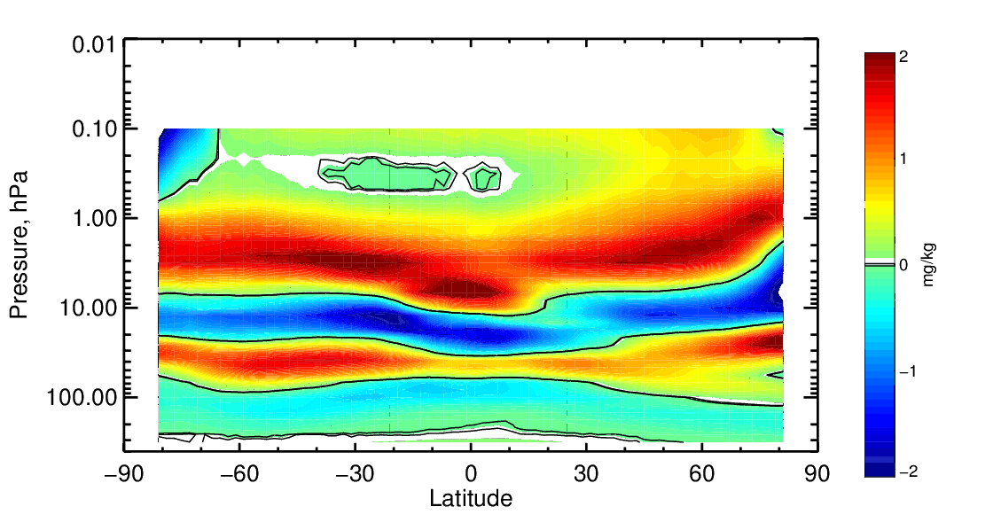
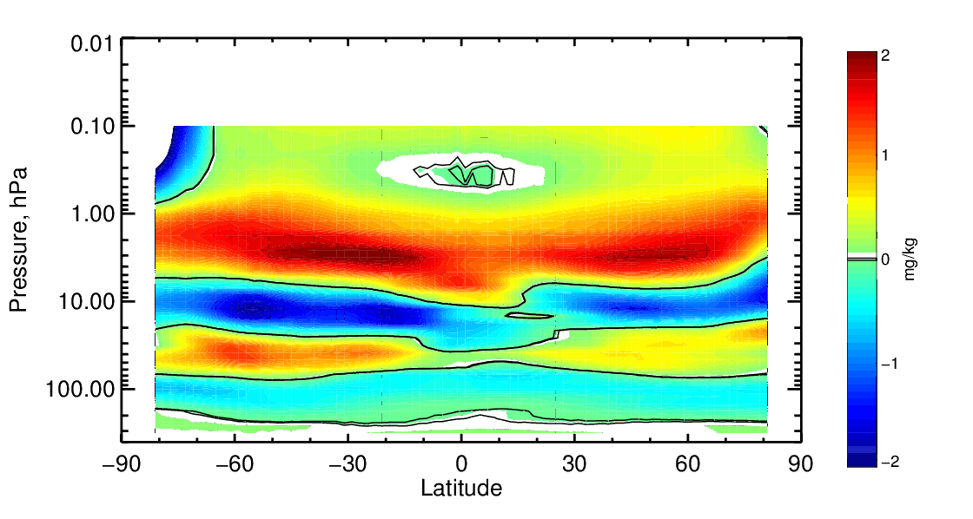
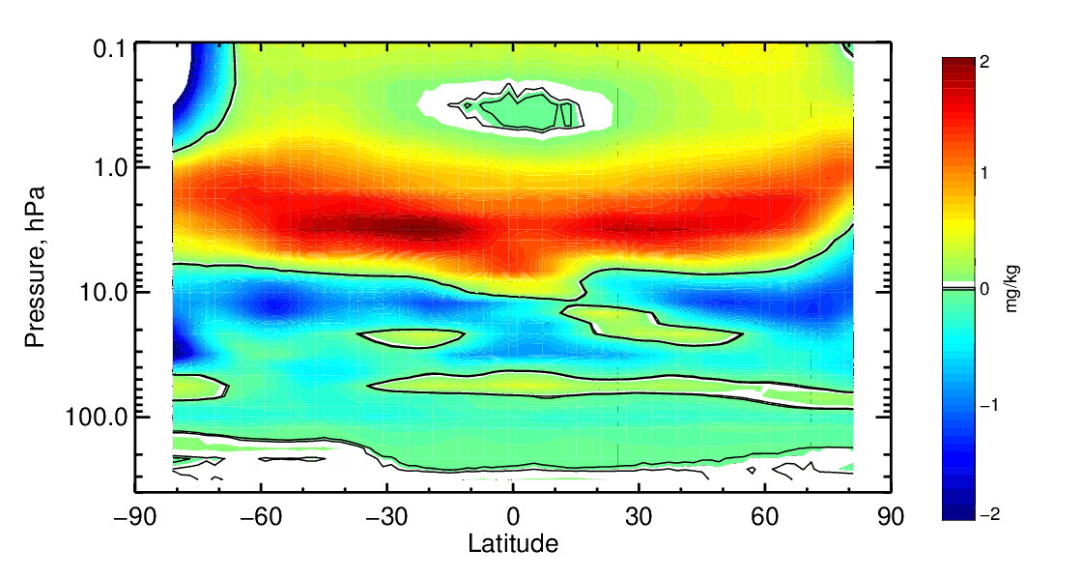
Some results: GOME-2
MLS-Ctrl
MLS-G2SAF (TCO3)
MLS-G2CCI (TCO3)
MLS-G2CCI (NPO3)

Slide 10
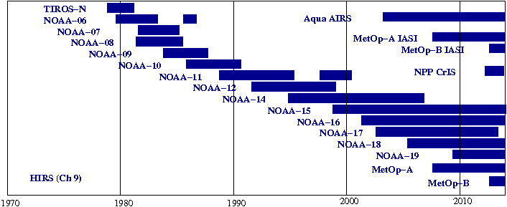
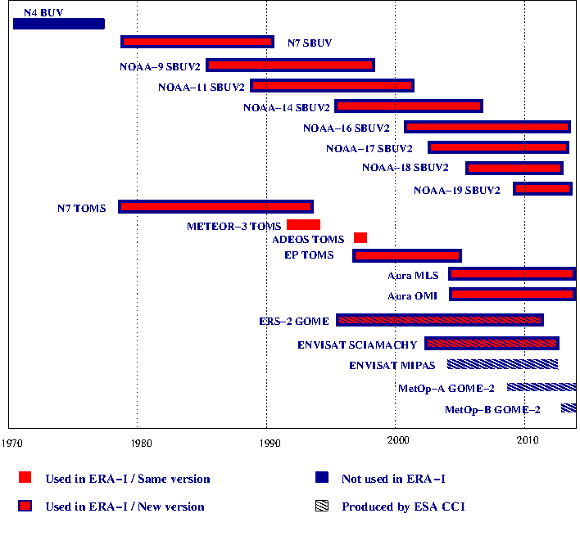
Used O₃ data:
ERA5 vs ERA-Interim
Level 1b
Used / same version
Used / new version
Never used
Available from CCI
Level 2
+ Ozone variational bias correction

Slide 11
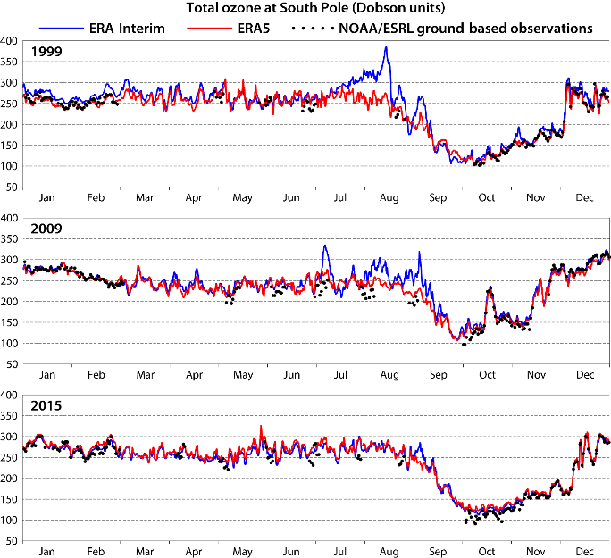
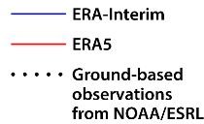
Preliminary assessment: TCO₃
South Pole
In many years, ERA-Interim builds up too-high values of ozone near the South Pole in mid to late winter

Slide 12
Preliminary assessment of ERA5 O₃ distribution
30-60N
30S-30N
129
22
30-60S
60-90S
Jan-Mar 2009
27
25

Slide 13
ERA5 O₃ distribution
30-60N
30S-30N
60
24
30-60S
60-90S
Jul-Sep 2009
22
42

Slide 14
Study on the SST

Slide 15
Study on the SST
In atmospheric reanalysis, Sea Surface Temperature (SST) is used as boundary condition.
In preparation for ERA5, an assessment of the available SST datasets was performed.
10-member
ensemble
Kennedy et al. 2016
Donlon et al., 2012
Merchant et al. 2014
Hirahara et al., 2013

Slide 16
Assessment of CCI-SST
None of the studied SST datasets provides a long enough record to meet the reanalysis requirements (1979-onwards – with the possibility of going backward).
Different combination options were investigated:
  HadISST2 > OSTIA > CCI SST > NRT OSTIA
  HadISST2 > CCI SST > NRT OSTIA
  HadISST2 > OSTIA RAN > NRT OSTIA
  HadISST2 > NRT OSTIA
Different breaking points were considered.

Slide 17
Long-term consistency
Short period of availability
Bias compared to OSTIA (NRT) and HadlSST2 ensemble (especially from 1998 onwards).
HadlSST2
ERA-Interim
COBESST2
ESA-CCI
OSTIA
Poor consistency at the
end with (NRT) OSTIA
Good consistency at the
Beginning with HadlSST2
S. Hirahara, et al (2016), ERA Technical Memorandum 26, ECMWF.

Slide 18
Summary
The ERA-Interim replacement (ERA5) is in progress
  ERA-Interim will be stopped by summer 2018 (based on current plans).
The only CCI dataset used in ERA5 is O₃ (from 4 different instruments)
  The involvement of CMUG was instrumental;
  Thanks to the many improvements (including the use of CCI O₃ data), the preliminary assessment shows that ERA5 O₃ is generally in better agreement with in-situ data than the ERA-Interim O₃ reanalyses were.
A study to possibly use the CCI SST product was also performed, but in the end not considered because:
  The time span was not long very long;
  Not enough consistency in time with the ~NRT product (OSTIA).

Slide 19
Extra slides

Slide 20
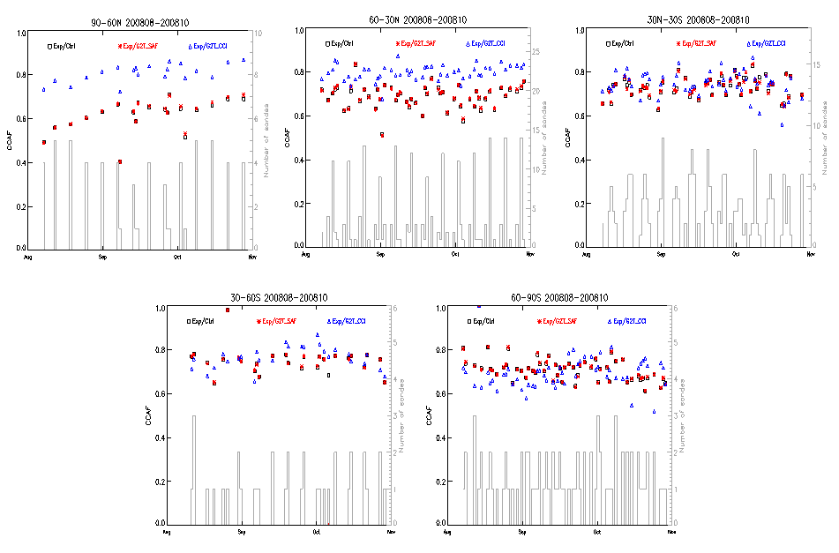
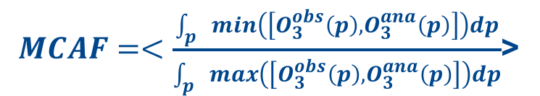

Some results: GOME2 TCO3 RR
60-90N
30-60N
30S-30N
CTRL
G2T-CCI
G2T-SAF
30-60S
60-90S
Mean Common Area Fraction
$MCAF=<\frac{\int_{p}{min\left(\left[O_{3}^{obs}\left(p\right),O_{3}^{ana}\left(p\right)\right]\right)dp}}{\int_{p}{max\left(\left[O_{3}^{obs}\left(p\right),O_{3}^{ana}\left(p\right)\right]\right)dp}}$>
$0<MCAF<1$ (Perfect match)
Aug
Sep
Oct

Slide 21
ERA5 O₃ distribution
30-60N
30S-30N
98
16
30-60S
60-90S
Apr-Jun 2009
21
26

Slide 22
ERA5 O₃ distribution
30-60N
30S-30N
56
20
30-60S
60-90S
Oct-Dec 2009
24
27

Slide 23
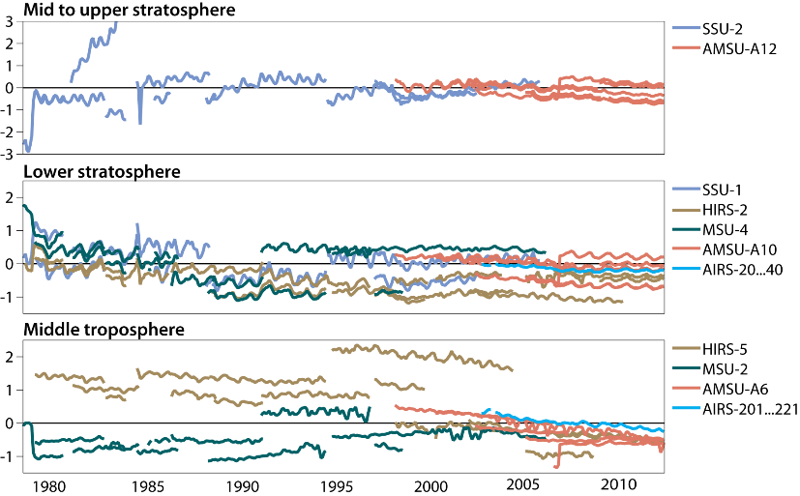
Lessons learnt from ERA-Interim
Drift due to CO₂ loss in PMR cell
Drift due to H₂O loss
Drift due to increase in unadjusted radiosonde data
Underestimation by model of Pinatubo warming
Assimilation of GPS RO data
Poor HIRS spectral response functions
TIROS-N data poor
Drift due to fixed CO₂ in RTTOV
Solar heating change due to orbital drift
Drift in data from MSU and early AMSU-A instruments due to frequency shifts of local oscillator
Dee and Uppala (2009), Kobayashi et al. (2009), Lu and Bell (2014),
Nash and Saunders (2013), Saunders et al. (2013), Simmons et al. (2014)

Slide 24
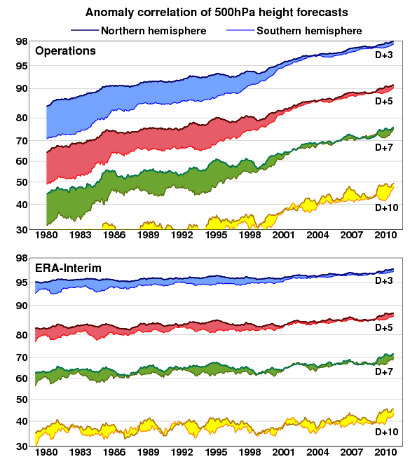
Rationale behind reanalysis:
Consistency
Consistent reconstruction of the atmosphere, waves (and ocean):
merge observations into global fields,
using the laws of physics
and appropriate bias correction scheme
maintain the same system over the entire
reanalysis period.
At lower resolution to keep affordable

Slide 25
Status and Road Map
Most of the preparations have been completed
  Building the system
  Scanning the 40-year period, and address issues in the observing system
  Monitoring tools, quality checks, checks that all data are ingested
The first two production streams are in production, 3rd+4th prepared
  2010-NRT stream to be released near the end of 2016
  1979-2009 released end 2017
  Continuation in NRT

Slide 26
ERA5: the ERA-Interim replacement
What is new in ERA5?
 | ERA-Interim | ERA5
Period | 1979 - present | 1979 - present
Start of production | August 2006 | Jan 2016, 1979-NRT end 2017
Assimilation system | 2006 technology | Current state of the art
Model input (radiation and surface) | As in operations, (inconsistent sea surface temperature) | Appropriate for climate, e.g., evolution greenhouse gases, volcanic eruptions, sea surface temperature and sea ice
Spatial resolution | 79 km globally 60 levels to 10 Pa | 32 km globally 137 levels to 1 Pa
Uncertainty estimate |  | Based on a 10-member ensemble at 64 km
Land Component | 79km | <32km, TBC
Output frequency | 6-hourly Analysis fields | Hourly (three-hourly for the ensemble), Extended list of parameters ~ 5 Peta Byte
Extra Observations | Mostly ERA-40, GTS | Various reprocessed CDRs, latest instruments
Variational Bias corrections | Satellite radiances Radiosondes: RASE | Also ozone, aircraft, surface pressure, Radiosondes: RICH + Solar-Elevation (RISE) operational bias control from 2015

Slide 27
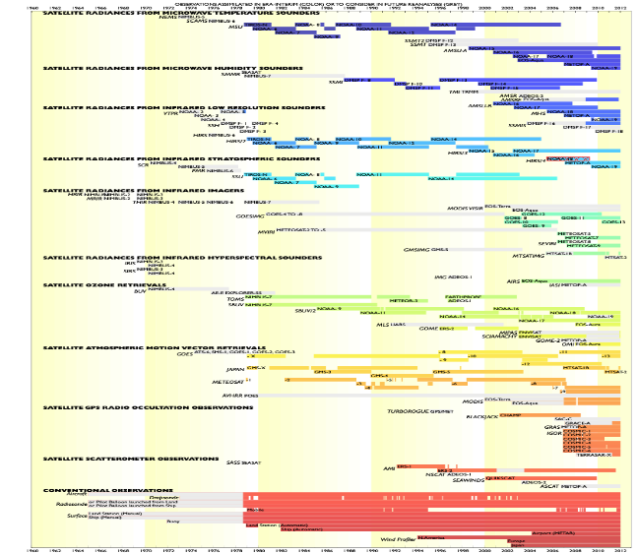
The evolving observing system
Newly reprocessed data sets
Radiances: SSM/I brightness temp from CM-SAF
METEOSAT from EUMETSAT
Atmospheric motion vector winds: METEOSAT, GMS/GOES-9/MTSAT, GOES-8 to 15, AVHRR METOP and NOAA
Scatterometers: ASCAT-A, ERS 1/2 soil moisture
Radio Occultation: METOP GRAS, COSMIC, CHAMP, GRACE, SAC-C, TERRASAR-x
Ozone: NIMBUS-7, EP TOMS, ERS-2 GOME, ENVISAT SCIAMACHY, Aura MLS, OMI
Data not used by ERA-Interim
(due to lack of infrastructure)
IASI, ASCAT, ATMS, Cris, Himawari, …
Typically the latest instruments:
ERA5 is more future proof!
Improved data usage
all-sky vs clear-sky assimilation,
latest radiative transfer function,
…

Slide 28
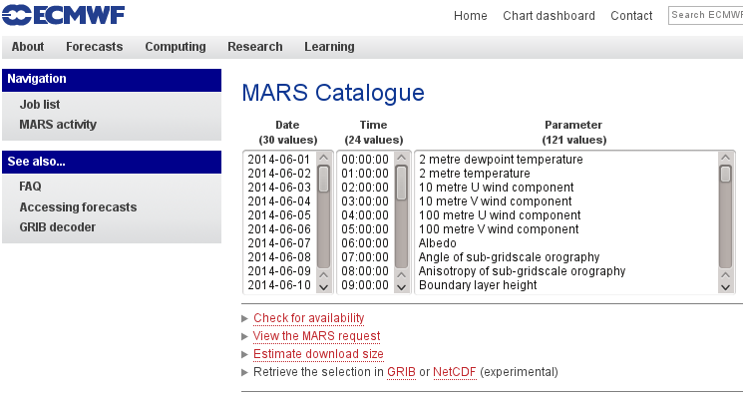
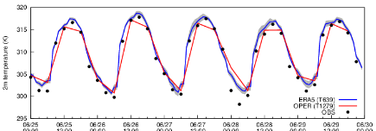
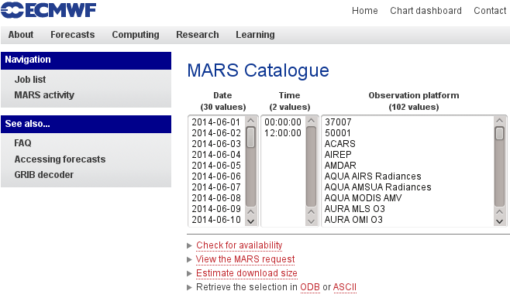
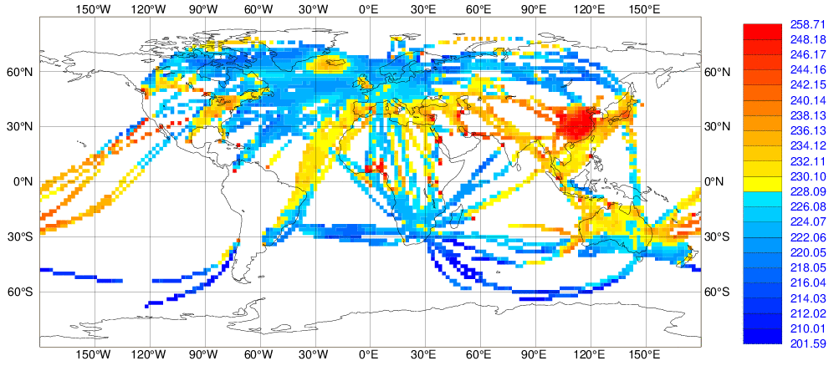
The ERA5 archive in the make
Copernicus Climate Change Service
Hourly reanalysis fields
ERA5 2-metre temperature compared to independent data
Observation feedback archive

Slide 29
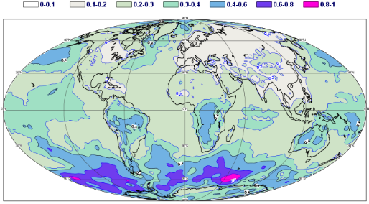
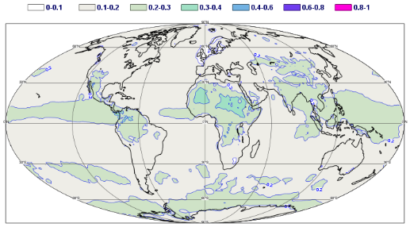
New: Uncertainty Estimate
Spread in Surface Pressure (hPa)
January 1979
July 2014

Slide 30
Status and Road Map
Most of the preparations have been completed
  Building the system
  Scanning the 40-year period, and address issues in the observing system
  Monitoring tools, quality checks, checks that all data are ingested
The first two production streams are in production, 3rd+4th prepared
  2010-NRT stream to be released near the end of 2016
  1979-2009 released end 2017
  Continuation in NRT

Slide 31
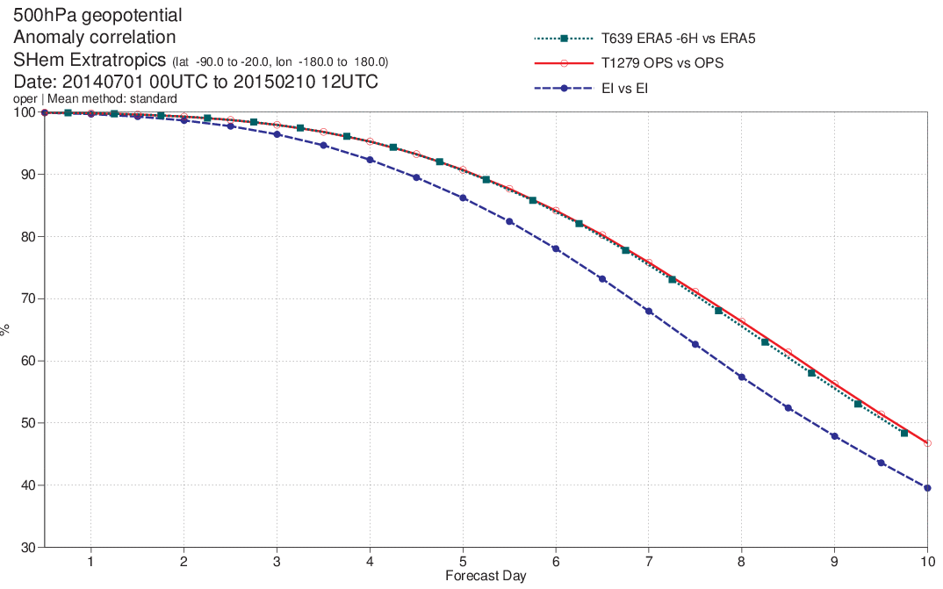
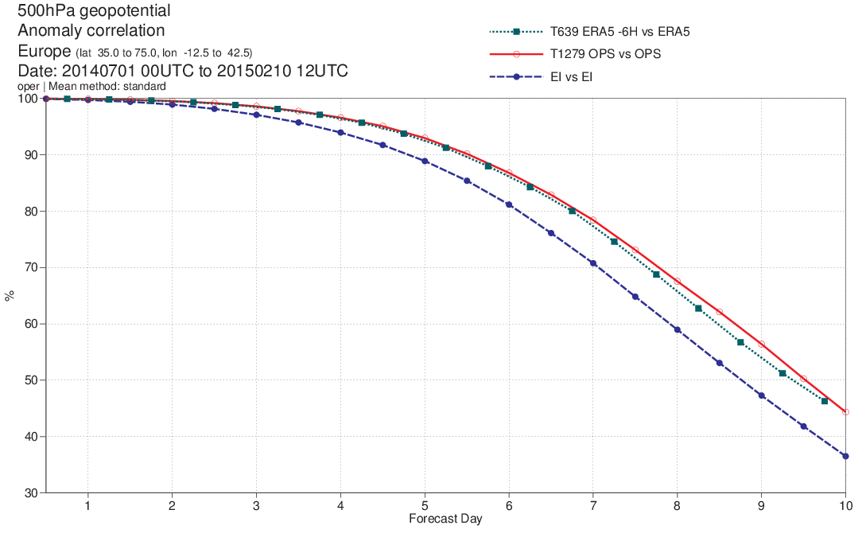
Forecast skill
Some initial verification of the 2014-NRT stream
Scores not far from ECMWF operational
Much better than for ERA-Interim
For Hurricane Arthur you miss the
operational resolution,
but better than ERA-Interim
500 hPa Geopotential, SHem
500 hPa Geopotential, Europe

Slide 32
Acknowledgements
Dick Dee, Adrian Simmons, Paul Poli,
Carole Peubey, Cornel Soci, Paul Berrisford, Iryna Rozum, Andras Horanyi,
Joaquin Sabater, Gionata Biavati, Raluca Radu, Eduardo Damasio-Da-Costa,
Shoji Hirahara, Rossana Dragani,
Patrick Laloyaux, Sami Saarinen, Dinand Schepers, Per Dahlgren,
Marco Milan, Leo Haimberger (Uni Vienna)
Elias Holm, Mats Hamrud, Massimo Bonavita, Jan Haseler, Tomas Kral,
Katie Lean, Peter Lean, Gabor Radnoti, Deborah Salmond, Heather Lawrence,
Patricia de Rosnay, Clement Albergel, Jean Bidlot, Saleh Abdalla, Giovana De Chiara,
Sean Healy, Cristina Lupu, Alan Geer, Kirsti Salonen, Niels Bormann,
Gianpaolo Balsamo, Peter Bechtold, Linus Magnusson, Sylvie Maraldel, Robin Hogan,
John Hodkinson, Axel Bonet, Mohamed Dahoui,
Ioannis Mallas, Kevin Marsh, Manuel Fuentes,
and many others ….

Slide 33
Status and Road Map
Most of the preparations have been completed
  Building the system
  Scanning the 40-year period, and address issues in the observing system
  Monitoring tools, quality checks, checks that all data are ingested
The first two production streams are in production, 3rd+4th prepared
  2010-NRT stream to be released near the end of 2016
  1979-2009 released end 2017
  Continuation in NRT

Slide 34
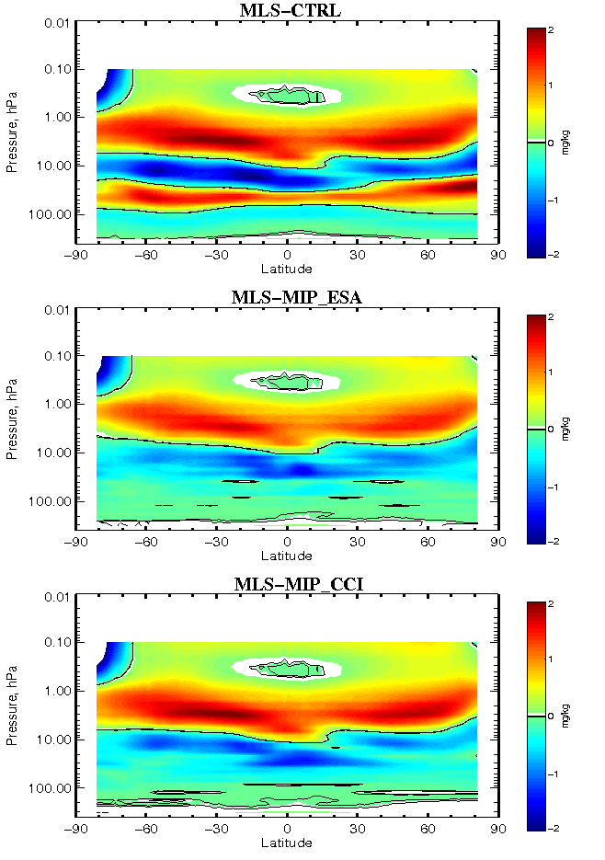
Some results: MIPAS RR
Exp/Ctrl
MIP-ESA
MIP-CCI
RMS(Sonde-Analysis)

