Slide 1
F. Cheruy and contribution from A. Ducharne and J.L. Dufresne

Slide 2
Using the CCI products to learn on the Land-surface Atmosphere coupling in the IPSL climate model
Approach : Nudged Land-surface Atmosphere simulations (SST,SIC imposed)
Constraining the evaporation at the scale of the climate model grid-box
Soil moisture and soil properties
Soil moisture, soil thermal properties and surface temperature
AMIP : soil moisture/soil thermal properties/surface temperature
AMIP : Biases related to the land-surface Atmosphere coupling

Slide 3
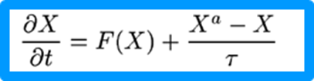
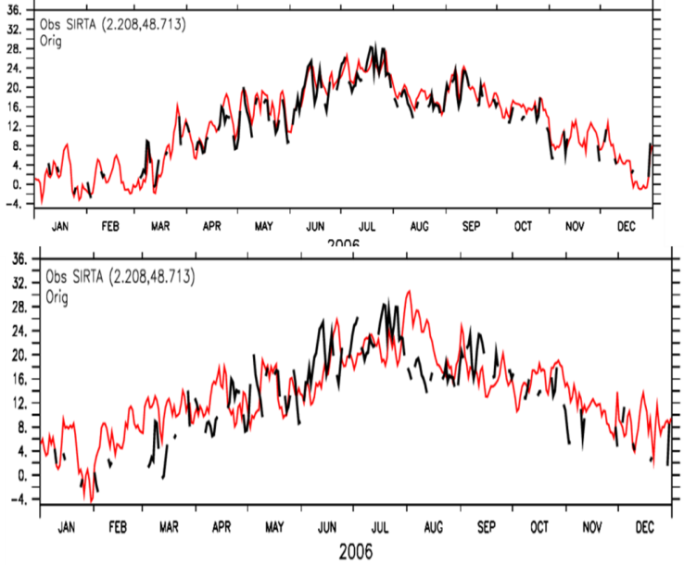
WP3.6: Constraining the evapotranspiration at the scale of climate model grid-cell
3D Land-atmosphere (LMDZOR) coupled climate model (IPSL) with nudged winds (u,v)
Atmosphere :LMDZ
Land surface: ORCHIDEE
Nudging
No nudging

Slide 4
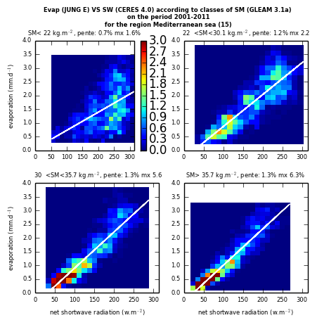
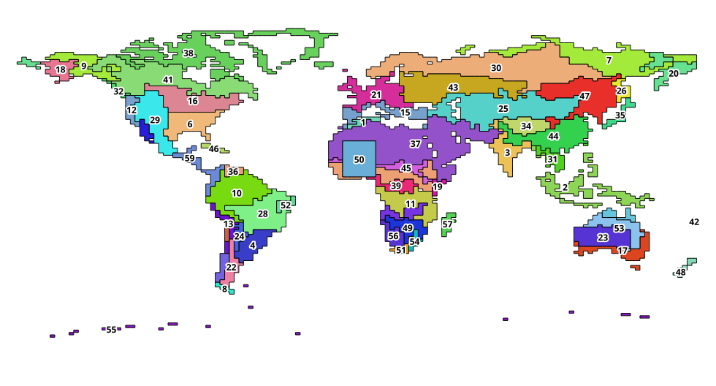
WP3.6: Constraining the evapotranspiration at the scale of climate model grid-cell
Evapotranspiration biased in climate models (e.g. Muller and Seneviratne, 2014)
contribute to disentangle possible origins, investigate ( Evaporation, SM, radiation ) relationship
Unpublished work
Mediterranean area
Notes:
the partitioning of combined SW surface radiation and evaporation data with respect to 4 soil-moisture quartiles at regional scale and on a monthly basis Example for the bi-dimentional histograms of the occurence of pairs of (Evaporation, SWnet radia-
tion) values binned into 20 intervals and for each quartiles of the Soil moisture distribution The colorscale indicates the percentage of the total
population with particular (SWnet,Evaporation) binned values.

Slide 5
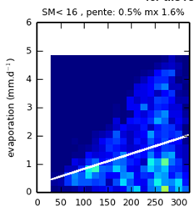
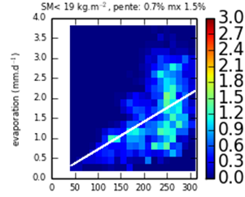
WP3.6: Constraining the evapotranspiration at the scale of climate model grid-cell
Nudged LMDZOR 2001-2011
Lowest SM quartile
Notes:
In dry regions and during the dry season radiation has hard time to trigger the evaporation. When it is triggered, it is a yes-or-no process and the evaporation rates can vary over a large range
166 of values. The highest values of the evaporation rates occur for the intermediate values

Slide 6
WP3.6: Constraining the evapotranspiration at the scale of climate model grid-cell
Nudged LMDZOR 2001-2011
How the evaporation behaves at low SSM content for a given SW_{net}
Unpublished work
Notes:
the partitioning of combined SW surface radiation and evaporation data with respect to 4 soil-moisture quartiles at regional scale and on a monthly basis Example for the Mediteranean area.
At high SW radiation, high values of the evaporation are much less frequent in the model.

Slide 7
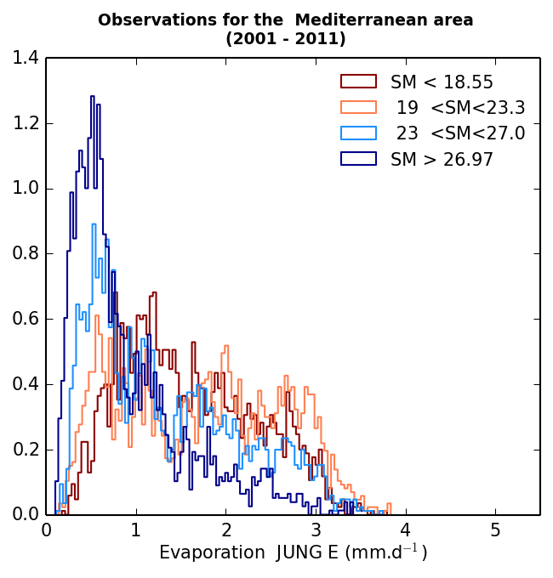
WP3.6: Constraining the evapotranspiration at the scale of climate model grid-cell
Unpublished work

Slide 8
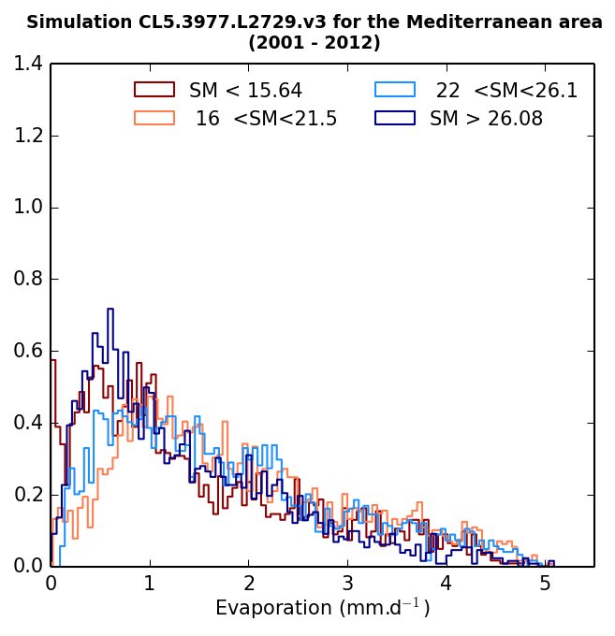
Missing clouds?
Evap. indep.
of SM
Unpublished work
Notes:
Figure 4.1 and 12 (lower 2 panels) show the histogra216 ms of the evaporation and the
217 SW radiation for each soil moisture quartile and for the reference numerical experiment

Slide 9
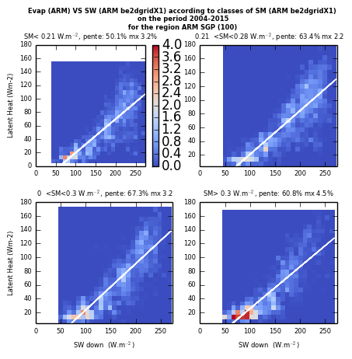
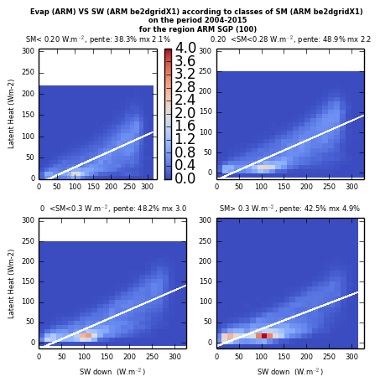
Land surface coupling
Can we use site observations ?
How the time scales impact the relationships?
SGP gridded 10 years, monthly
SGP gridded 10 years, daily
Unpublished work

Slide 10
Focus on the soil moisture

Slide 11
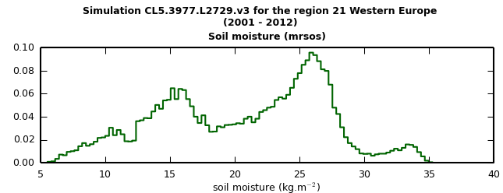
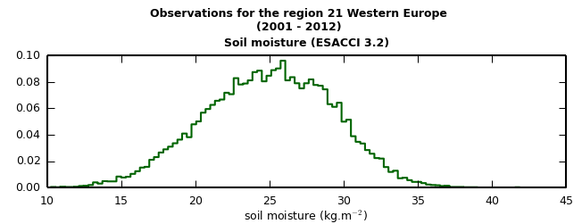
Soil moisture and soil texture

Slide 12
Soil moisture and soil texture
Silt loam
Texture dependence of the
soil parameters in ORCHIDEE
Sandy loam
Sandy clay
Sandy clay loam

Slide 13
Soil moisture and soil texture
Silt loam
Texture dependence of the
soil parameters in ORCHIDEE
Sandy loam
Sandy clay
Sandy clay loam
No such behavior in ESA-CCI
Soil moisture

Slide 14
Soil moisture and soil texture
Need to improve the representation of the variations of the pedo-transfer function with the soil grain size distributions (dependency of wilting point and field capacity with the soil grain size distribution)?
Revisit the dominant soil texture approach in ORCHIDEE ?
How the underlying hypothesis of the retrieval impacts the SM products
Is the simulated evaporation impacted?
Silt loam
Sandy loam
Sandy clay
Sandy clay loam

Slide 15
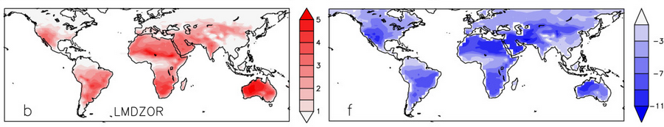
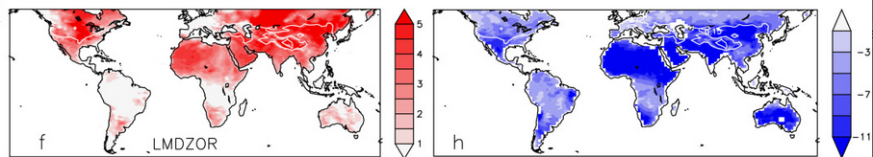
AMIP runs
Impact of thermal inertia on the mean temperature
and the DTR (soil moisture + snow properties)
june
january

Slide 16
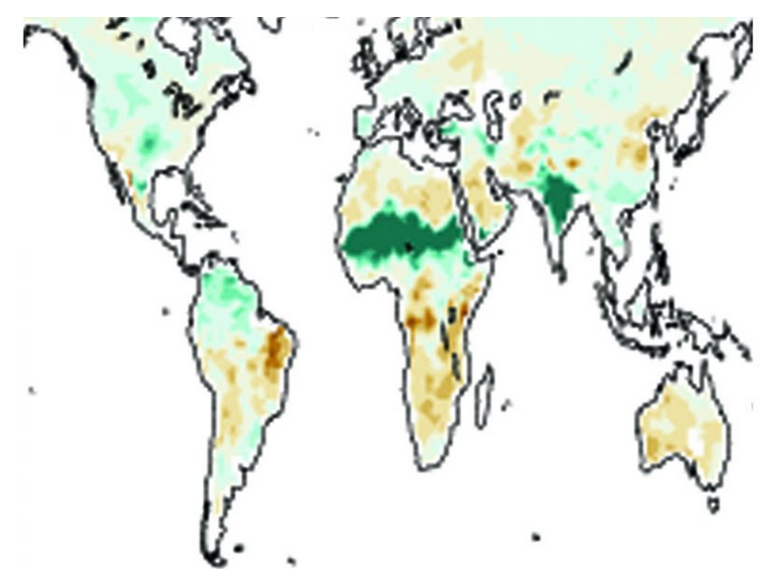
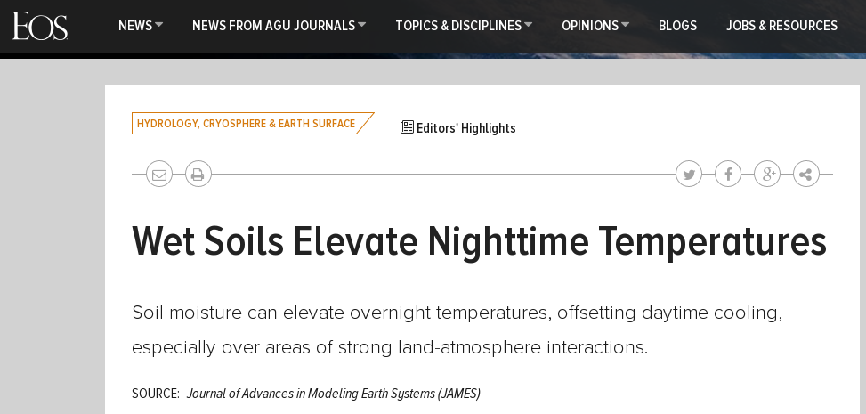
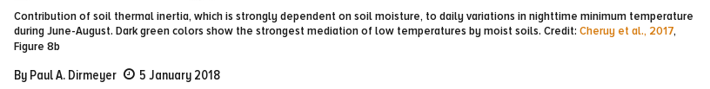

Slide 17
Soil moisture, thermal properties, surface temperature
Can this impact be detected and its can its strength be evaluated using
coincident soil moisture and land-surface temperature (diurnal).?

Slide 18
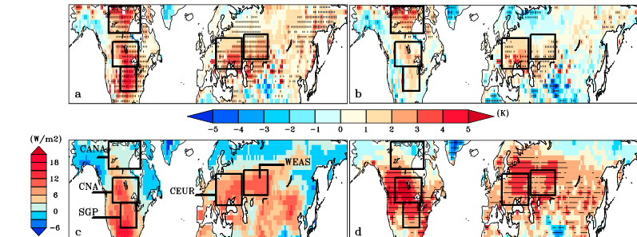
WP4.11 Assess the land-surface interaction related biases in AMIP simulations with CCI and other products
Multi model analysis of JJA T2m bias (CMIP5)
The most biased models have difficulties to sustain evaporation, in
Areas with soil-moisture limited regimes (Cheruy et al. GRL, 2014)

Slide 19
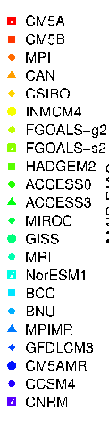
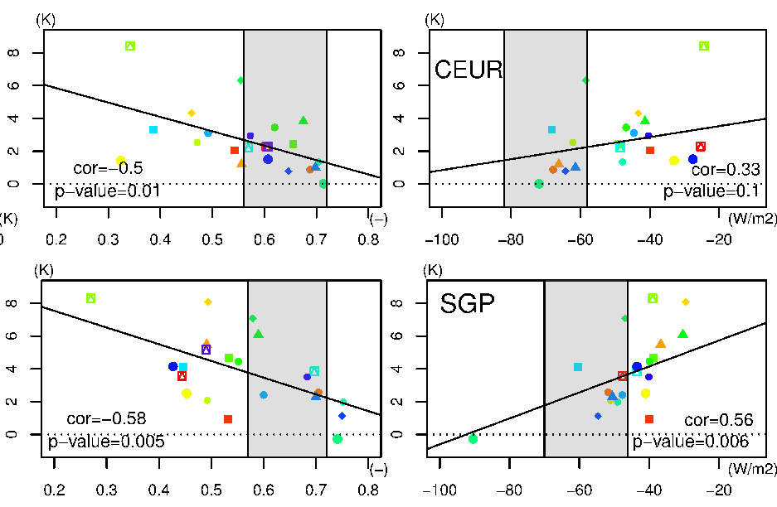
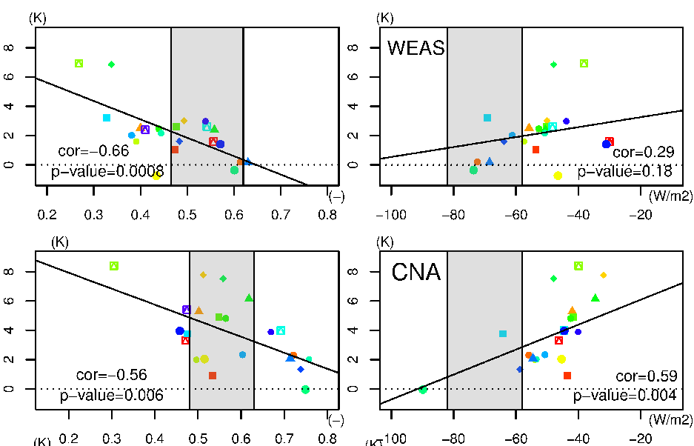
Link AMIP T2m bias, EF, CRESW for 4 regions
T2m AMIP JJA bias
Evaporative fraction
SW_sfc CRE
Evaporative fraction
SW_sfc CRE

Slide 20
Su mmary
Identified
Inconsistencies between model and obs. at low SM content
Deficit of clouds at high soil moisture content
Texture related uncertainties
Explore:
The use of site observations to help the analyze of Remote sensing
The use of LST, SM Products to analyze biases related to the LS-Atm coupling
in AMIP simulations

