Slide 1
WP3.9: Biophysical feedbacks in the global ocean
David Ford
Met Office

Slide 2
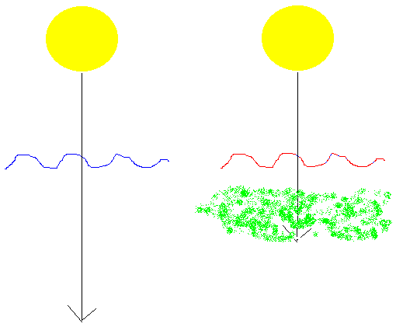
WP3.9: Biophysical feedbacks in the global ocean
Chlorophyll in the ocean affects the depth of penetration of solar radiation.
Alters SST, heat uptake, evaporation, sea ice.
Affects ENSO variability and monsoon timing.
But the process is rarely included in climate models or reanalyses.

Slide 3
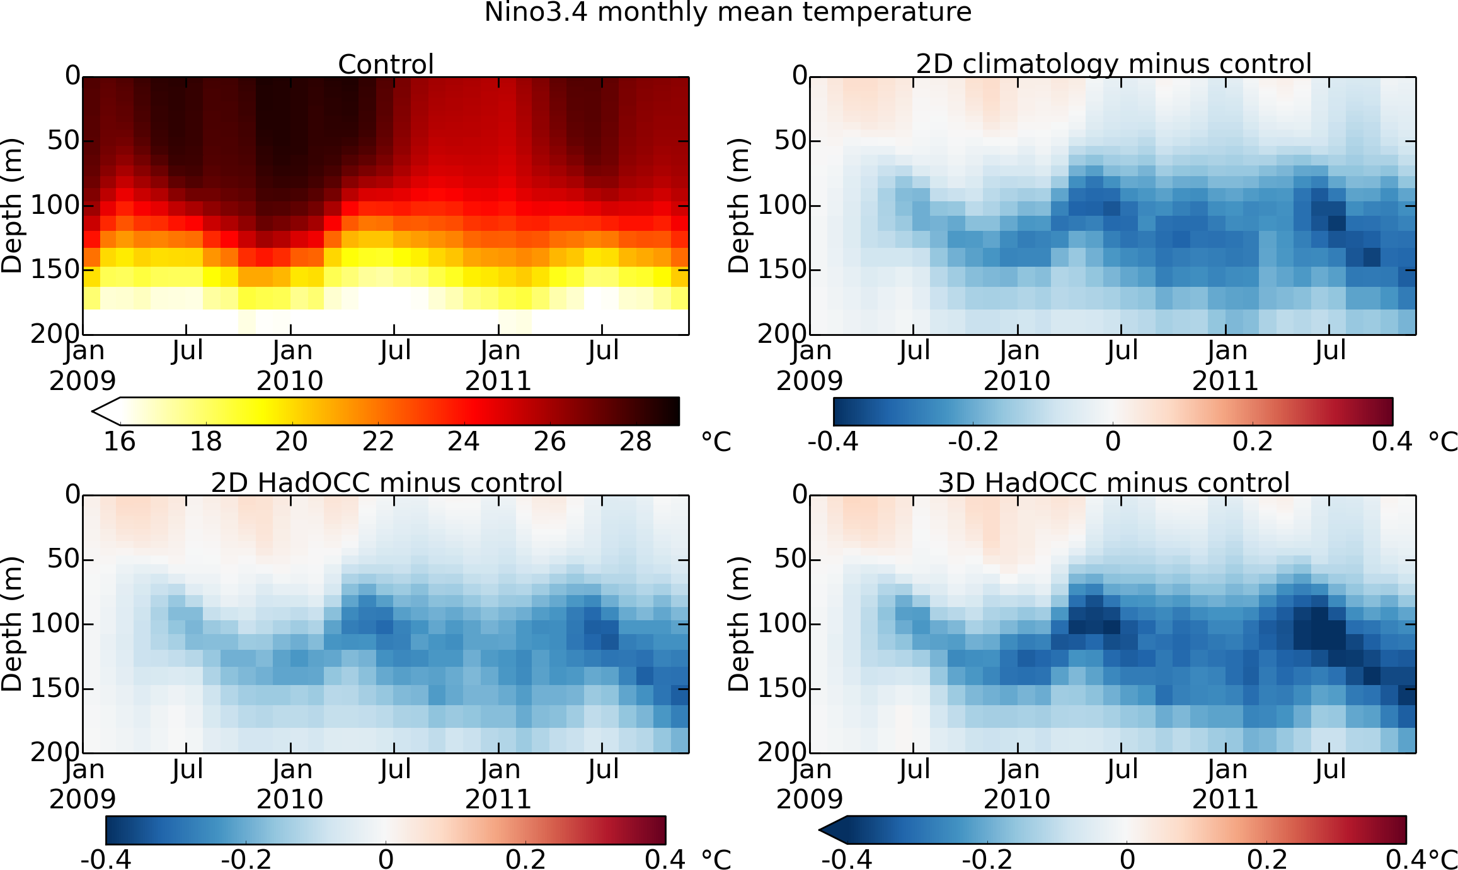
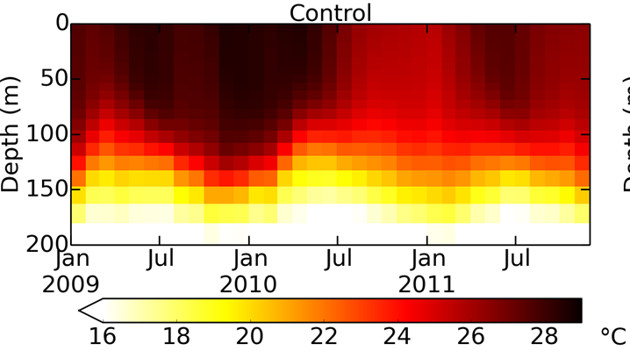
WP3.9: Biophysical feedbacks in the global ocean
Assimilate CCI ocean colour into the ocean component (NEMO-CICE-MEDUSA) of a CMIP6 Earth System model (UKESM1).
Run simulations with and without biophysical feedback, and assess consistency with CCI
SST, SI, SSH, SSSal products, and in situ data (ocean heat content, carbon fluxes).
Assess impact on climate variability, building on previous studies. Relevant to OMIP and WCRP Grand Challenges on Near-term Climate Prediction and Carbon Feedbacks.

Slide 4
WP3.9: Biophysical feedbacks in the global ocean
Air-sea CO₂ flux is a function of sea state.
In climate models, air-sea flux parametrisations just include wind speed, not sea state.
But such parameterisations have been developed. Assess the impact on ocean carbon cycle (fluxes, pH) of using such a parameterisation in NEMO-CICE-MEDUSA, forced by CCI sea state products.
Requires level 4 significant wave height data (ideally daily).

Slide 5
WP3.9: Biophysical feedbacks in the global ocean
Ocean colour uncertainties will be used in the assimilation, other ECV uncertainties can be accounted for in validation.
ECV teams will be kept in loop regarding experiments, results, and experiences of using the data.

